Slide 1
Pubmed search:
“mixed invasive ductal lobular breast cancer”
N = 200 results
Excluded:
Descriptive mDLC data was not compared to either IDC or ILC (N = 24)
No information regarding mDLC (only about IDC, ILC or different type of invasive breast cancer) (N = 36)
Study did not include any of our variables of interest (N = 16)
The term mixed did not exclusively refer to mDLC or refer to mDLC at all (N = 25)
Was a case report or included less than 10 cases of mDLC (N = 48)
Was a commentary/editorial/letter (N = 5)
Grouped mDLC into ILC or other subgroups (N = 13)
Article was limited to Inflammatory breast cancers (N = 1)
Duplicate article (same article entered as a separate result) (N = 3)
Unable to access the article (N = 2)
Data presented was not in a format that allows statistical comparison (N = 6)
Studies meeting inclusion criteria: (N = 21)
Included cohort of at least 10 cases of mDLC.
Was compared to either IDC, ILC, or both with regards to at least one of the following:
age, race, menopausal status, stage, grade, size, ER/PR, HER2, nodal stage/LN status, treatment received
Studies meeting inclusion criteria from prior literature searches that did not result using the search term above (N = 2)
Total number of cases to include in meta-analysis
N = 23
Suppl Figure S1. Flow diagram of included studies in meta-analysis. Publications included were limited to studies encompassing at least 10 patients per cohort, and directly comparing mDLC to either IDC, ILC, or both. Two additional studies meeting criteria identified on prior literature searches were included. Ultimately, 23 individual studies were included in the meta-analysis.

Slide 2
Suppl Figure S2. Graphic representation of distribution of infiltrating duct and lobular carcinoma cases identified by ICD-O-3.

Slide 3
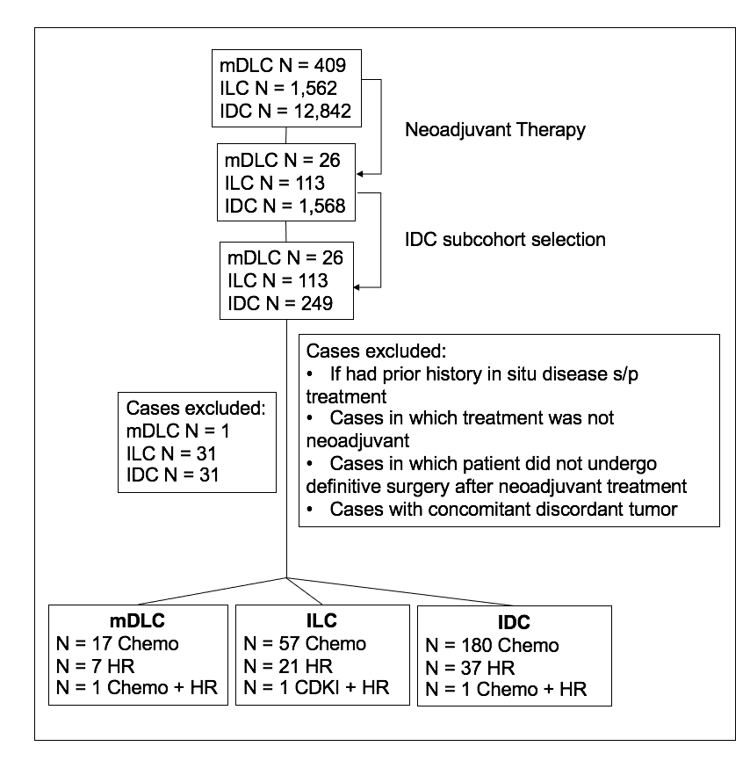
Suppl Figure S3. Consort diagram of cases treated with neoadjuvant therapy. Patients from within the origin cohort who had received neoadjuvant therapy were identified with therapy received detailed in the figure. Chemo = chemotherapy, HR = hormone therapy, CDKI = CDK inhibitor. A subcohort from the total cases of patients with IDC receiving neoadjuvant therapy was selected which was matched to cohort of patients with ILC by age, ER status, and HER2 status.

Slide 4
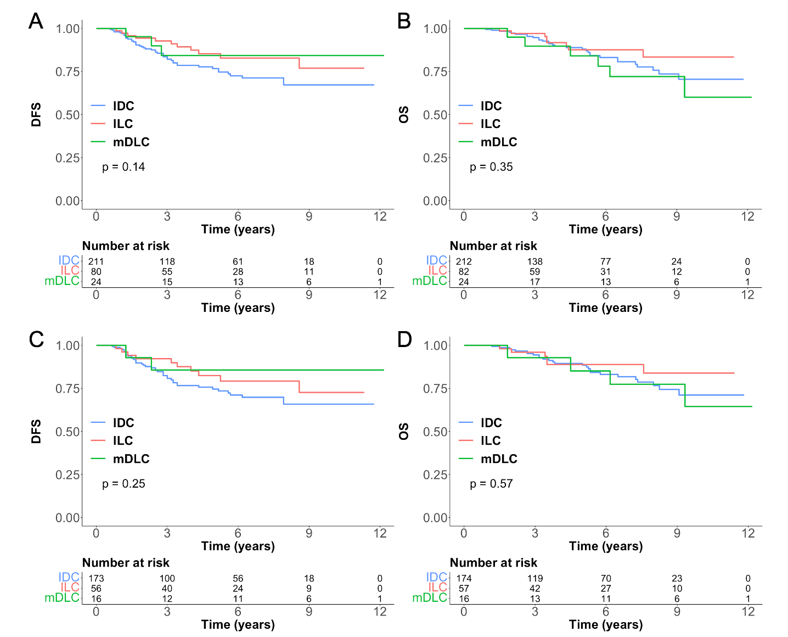
Suppl Figure S4. DFS (A) and OS (B) of all patients with IDC, ILC, and mDLC treated with neoadjuvant therapy. DFS (C) and OS (D) of patients treated with neoadjuvant chemotherapy.

Slide 5
Suppl Figure S5. Ki-67 indices (A), ER H-score (B), and PR H-score (C) of all patients with IDC, ILC, and mDLC treated with neoadjuvant therapy.
A
B
C

