Slide 1
First Author | Year | Country | Sample size | Reference
McCart Reed AE | 2018 | Australia | 82 mDLC, 256 IDC, 64 ILC | J Pathol 2018; 244: 460–468
Metzger-Filho O | 2018 | USA | 474 mDLC, 337 ILC | The Oncologist 2018;23:1–9
Williams LA | 2018 | USA | 473 mDLC, 2,856 IDC, 326 ILC | Cancer Causes Control. 2018 January ; 29(1): 25–32.
Xiao Y | 2017 | USA | 19,227 mDLC, 172,379 IDC, 17,503 ILC | Scientific Reports volume 7, Article number: 10380 (2017)
Phipps et al. | 2010 | USA | 1,601 mDLC, 14,818 IDC, 1,602 ILC | Cancer Epidemiol Biomarkers Prev. 2010 June ; 19(6): 1643–1654
Suryadevara A | 2010 | USA | 50 mDLC, 100 IDC | World Journal of Surgical Oncology 2010, 8:51
Braunstein LZ | 2015 | USA | 185 mDLC, 734 IDC, 79 ILC | Breast Cancer Res Treat (2015) 149:555–564
Wang J | 2018 | USA | 6,483 mDLC, 65,179 IDC, 9,037 ILC | Front. Genet., 17 December 2018
Zengel B | 2013 | Turkey | 47 mDLC, 508 IDC, 78 ILC | Breast Cancer (2015) 22:374–381
Fortune-Greeley AK | 2014 | USA | 2,399 mDLC, 14,357 IDC, 1,928 ILC | Breast Cancer Res Treat. 2014 January ; 143(1): 203–212.
Bharat A | 2009 | USA | 261 mDLC, 3,595 IDC, 480 ILC | The American Journal of Surgery (2009) 198, 516–519
Rakha EA | 2009 | UK | 140 mDLC, 2,170 IDC, 380 ILC | Breast Cancer Res Treat (2009) 114:243–250
Duraker N | 2020 | Turkey | 159 mDLC, 2,981 IDC, 272 ILC | Eur J Breast Health 2020; 16(1): 22-31
Colleoni M | 2012 | Italy | 338 mDLC, 5,707 IDC, 851 ILC | Annals of Oncology 23: 1428–1436, 2012
Bomeisl PE | 2015 | USA | 15 mDLC, 131 IDC, 30 ILC | Arch Pathol Lab Med. 2015;139:1546–1549
Slanger TE | 2009 | Germany | 151 mDLC, 2,224 IDC, 765 ILC | Cancer Epidemiol Biomarkers Prev 2009;18(4):1188 – 96
Falk RT | 2014 | USA | 108 mDLC, 1,443 IDC, 232 ILC | American journal of epidemiology, 2014, 180(7): 705-717.
Louwman MWJ | 2007 | The Netherlands | 7,192 mDLC, 143,816 IDC, 20,398 ILC | International Journal of cancer, 2007, 121(1): 127-135.
Newcomer LM | 2002 | USA | 28 mDLC, 1,920 IDC, 206 ILC | Cancer 2002;95:470–7.
Le Gal M | 1992 | France | 114 mDLC, 341 ILC | Radiology, 1992, 185(3): 705-708.
Sastre-Garau X | 1996 | France | 249 mDLC, 726 ILC | Cancer 1996; 77:113-20.
Arps DP | 2013 | USA | 183 mDLC, 1,499 IDC, 375 ILC | Breast Cancer Res Treat. 2013 April ; 138(3): 719–726.
Li CI | 2005 | USA | 9,636 mDLC, 102,463 IDC, 11,275 ILC | British Journal of Cancer (2005) 93, 1046 – 1052
Suppl Table S1. Characteristics and references of studies included in meta-analysis.

Slide 2
 | Number of cases
Mixed | 248
IDC + lobular features | 138
ILC + ductal features | 24
IDC + in situ disease | 52
ILC + in situ disease | 85
IDC | 15
ILC | 29
Multifocal/Multicentric disease (not mixed) | 54
Conflicting pathology on bx vs mastectomy | 23
Not original diagnosis (recurrent disease) | 10
Unconfirmed/Unclear pathology report | 125
Total | 803
Suppl Table S2. Distribution of cases designated as infiltrating duct and lobular carcinoma identified by ICD-O-3.

Slide 3
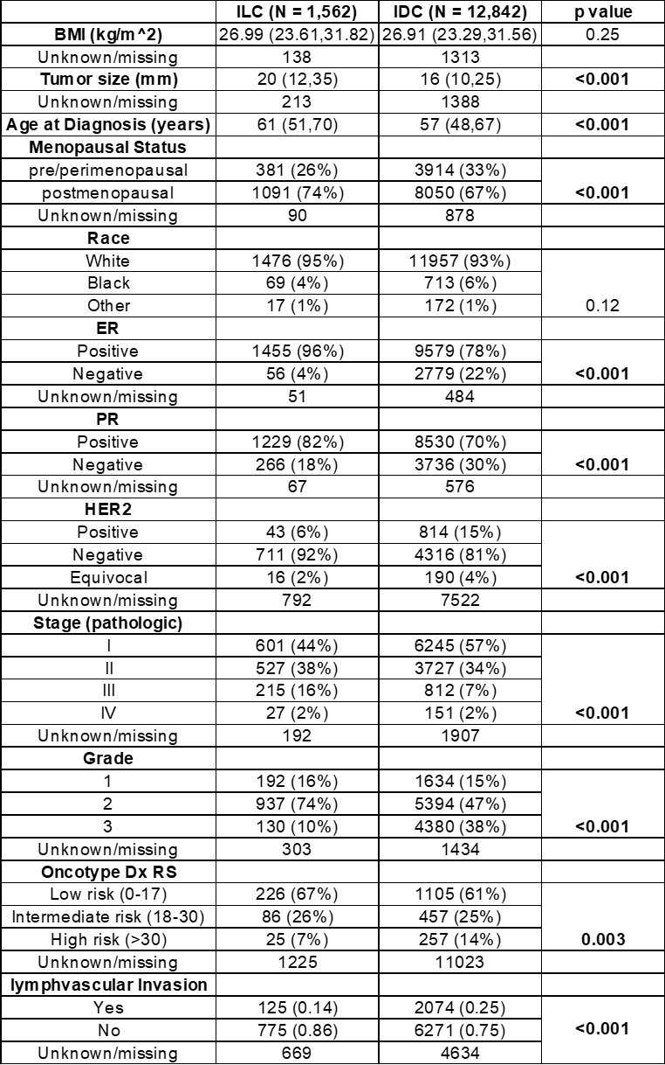
Suppl Table S3. Statistical comparison of patient demographic and tumor characteristics of ILC and IDC study populations.

Slide 4
 | mDLC (N=409) | ILC (N=1,562) | p value | IDC (N=12,842) | p value
Chemotherapy
Yes | 179 (45%) | 588 (40%) | 0.096 | 6210 (52%) | 0.007
No | 221 (55%) | 883 (60%) |  | 5801(48%)
Unknown/Missing | 9 | 91 |  | 831
Hormone Therapy
Yes | 347 (89%) | 1320 (90%) | 0.48 | 8633 (73%) | <0.001
No | 43 (11%) | 141 (10%) |  | 3228 (27%)
Unknown/Missing | 19 | 101 |  | 981
Surgery
Breast Conserving Surgery | 250 (63%) | 731 (49%) | <0.001 | 7971 (64%) | 0.52
Mastectomy | 149 (37%) | 753 (51%) |  | 4415 (36%)
Unknown/Missing | 10 | 78 |  | 456
Radiation
Yes | 100 (25%) | 361 (23%) | 0.56 | 3607 (29%) | 0.13
No | 301 (75%) | 1182 (77%) |  | 9043 (71%)
Unknown/Missing | 8 | 19 |  | 192
Suppl Table S4. Locoregional treatment and adjuvant systemic therapy.

Slide 5
 | mDLC (N=409) | ILC (N=1,562) | p value | IDC (N=12,842) | p value
Chemotherapy
Yes | 179 (45%) | 588 (40%) | 0.096 | 6210 (52%) | 0.007
No | 221 (55%) | 883 (60%) |  | 5801(48%)
Unknown/Missing | 9 | 91 |  | 831
Hormone Therapy
Yes | 347 (89%) | 1320 (90%) | 0.48 | 8633 (73%) | <0.001
No | 43 (11%) | 141 (10%) |  | 3228 (27%)
Unknown/Missing | 19 | 101 |  | 981
Surgery
Breast Conserving Surgery | 250 (63%) | 731 (49%) | <0.001 | 7971 (64%) | 0.52
Mastectomy | 149 (37%) | 753 (51%) |  | 4415 (36%)
Unknown/Missing | 10 | 78 |  | 456
Radiation
Yes | 100 (25%) | 361 (23%) | 0.56 | 3607 (29%) | 0.13
No | 301 (75%) | 1182 (77%) |  | 9043 (71%)
Unknown/Missing | 8 | 19 |  | 192
Suppl Table S5. Locoregional treatment and adjuvant systemic therapy in ER+ patients.

Slide 6
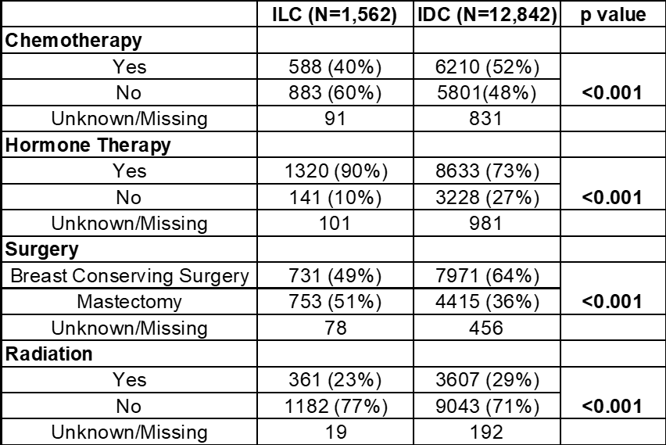
Suppl Table S6. Locoregional treatment and systemic therapy in all patients with IDC and ILC.

Slide 7
Neoadjuvant Chemotherapy
 | ILC (N=57) | IDC (N=180) | p value
Volume Reduction | 76 (26.5,90.5) | 75 (40.75,95.62) | 0.28
BCS attempted
Yes | 19 (33%) | 70 (39%) | 0.53
No | 38 (67%) | 110 (61%)
Rate of Successful BCS
Yes | 6 (32%) | 49 (70%) | 0.003
No | 13 (68%) | 21 (30%)
Neoadjuvant Endocrine Therapy
pCR
Yes | 4 (7%) | 24 (13%) | 0.25
No | 52 (93%) | 156 (87%)
Rate of Successful BCS | ILC (N=21) | IDC (N=37) | p value
Yes | 6 (60%) | 14 (67%) | 1
No | 4 (40%) | 7 (33%)
pCR
Yes | 0 (0%) | 0 (0%) | ns
No | 21 (100%) | 37 (100%)
Suppl Table S7. Response rates of patients with IDC and ILC treated with neoadjuvant therapy. Median (interquartile) is shown for volume reduction and frequency (%) is shown for other categorical variables.

Slide 8
 | mDLC (n = 46) | ILC (n = 145) | IDC (n = 1131)
Bone | 32 (70%) | 105 (72%) | 690 (60%)
Liver | 22 (48%) | 33 (23%) | 410 (36.2%)
Lung | 9 (20%) | 12 (8%) | 392 (34.6%)
CNS | 8 (17%) | 24 (17%) | 265 (23.4%)
Distant lymph nodes | 8 (17%) | 18 (12.4%) | 242 (21.3%)
Peritoneum/carcinomatosis | 5 (11%) | 32 (22%) | 34 (3%)
Pleura | 6 (13%) | 18 (12%) | 152 (13.4%)
Malignant ascites | 2 (4%) | 8 (6%) | 5 (0.4%)
Malignant pleural effusion | 0 (0%) | 2 (1%) | 7 (0.6%)
Pericardium/pericardial fluid | 1 (2%) | 1 (0.7%) | 3 (0.2%)
Skin/Subcutaneous nodules | 2 (4%) | 3 (2%) | 35 (3%)
Chest Wall | 0 (0%) | 2 (1%) | 5 (0.4%)
Small or Large Bowel | 0 (0%) | 11 (8%) | 8 (0.7%)
Stomach | 0 (0%) | 4 (2.7%) | 3 (0.2%)
Gastric Mucosa | 0 (0%) | 1 (0.7%) | 0 (0%)
Bladder | 0 (0%) | 3 (2%) | 0 (0%)
Adrenal gland | 0 (0%) | 1 (0.7%) | 5 (0.4%)
Ovaries | 1 (2%) | 6 (4%) | 5 (0.4%)
Uterus | 1 (2%) | 3 (2%) | 1 (0.08%)
Cervix | 0 (0%) | 3 (2%) | 0 (0%)
Endometrium | 0 (0%) | 2 (1%) | 0 (0%)
Fallopian tubes | 0 (0%) | 2 (1%) | 0 (0%)
Pelvic mass | 0 (0%) | 2 (1%) | 1 (0.08%)
Orbit | 1 (2%) | 1 (0.7%) | 2 (0.1%)
Bone marrow | 0 (0%) | 3 (2%) | 2 (0.1%)
Leptomeningeal carcinomatosis | 0 (0%) | 1 (0.7%) | 3 (0.2%)
Thyroid | 0 (0%) | 0 (0%) | 1 (0.08%)
Soft tissue | 0 (0%) | 0 (0%) | 2 (0.1%)
Piriformis muscle | 0 (0%) | 0 (0%) | 1 (0.08%)
Appendix | 0 (0%) | 0 (0%) | 2 (0.1%)
Gallbladder | 0 (0%) | 0 (0%) | 2 (0.1%)
Suppl Table S8. Pattern of metastatic spread in patients with mDLC, ILC, and IDC. Incidence of disease at individual sites throughout disease course is denoted.

