Slide 1
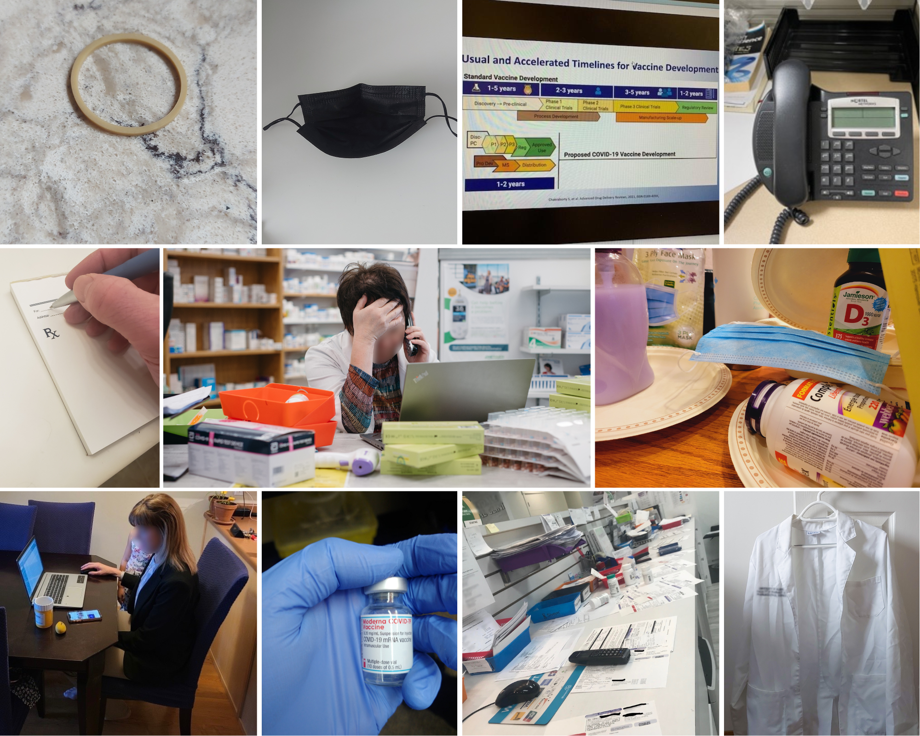
Appendix C: Photobook
A photovoice study on community pharmacists’ roles and lived experiences during the COVID-19 pandemic
Kaitlyn E. Watson, B. Pharm (Hons), PhD, GradCertAppPharmPrac, FHEA,
Theresa J. Schindel, BSP, MCE, PhD, FCSHP
Jonathan C.H. Chan
Ross T. Tsuyuki, BSc (Pharm), PharmD, MSc, FCSHP, FACC, FCAHS
Yazid N. Al Hamarneh, BSc (Pharm), PhD

Slide 2
Total number of photos provided by participants: 71
Number of photos not included in photobook due to copyright/privacy issues: 13
Total number of photos included in this photobook: 58

Slide 3
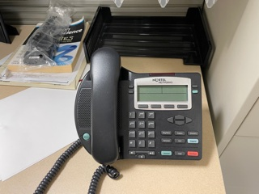
Participant 1
Photo A
“That is everything that was wrong with community pharmacy when I left, I hated it! It was ringing non-stop, and we were focused on that.”
Pictured above: Pharmacy telephone

Slide 4
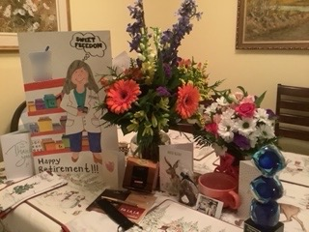
Participant 1
Photo B
“So, that is cards and thank you gifts and things from my patients when I left. So, that represents who I was as a pharmacist that I had built those relationships.”
Pictured above: Pharmacy countertop filled with various prescriptions

Slide 5
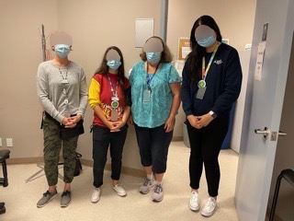
Participant 1
Photo C
“It's more of a clinical role, per se, and there's a lot of interprofessional teamwork. Those are all nurses I'm working with. It made me realize that my skills are appreciated and needed…I've appreciated [being] part of a team of [an] interprofessional team.”
Pictured above: Interprofessional healthcare team

Slide 6
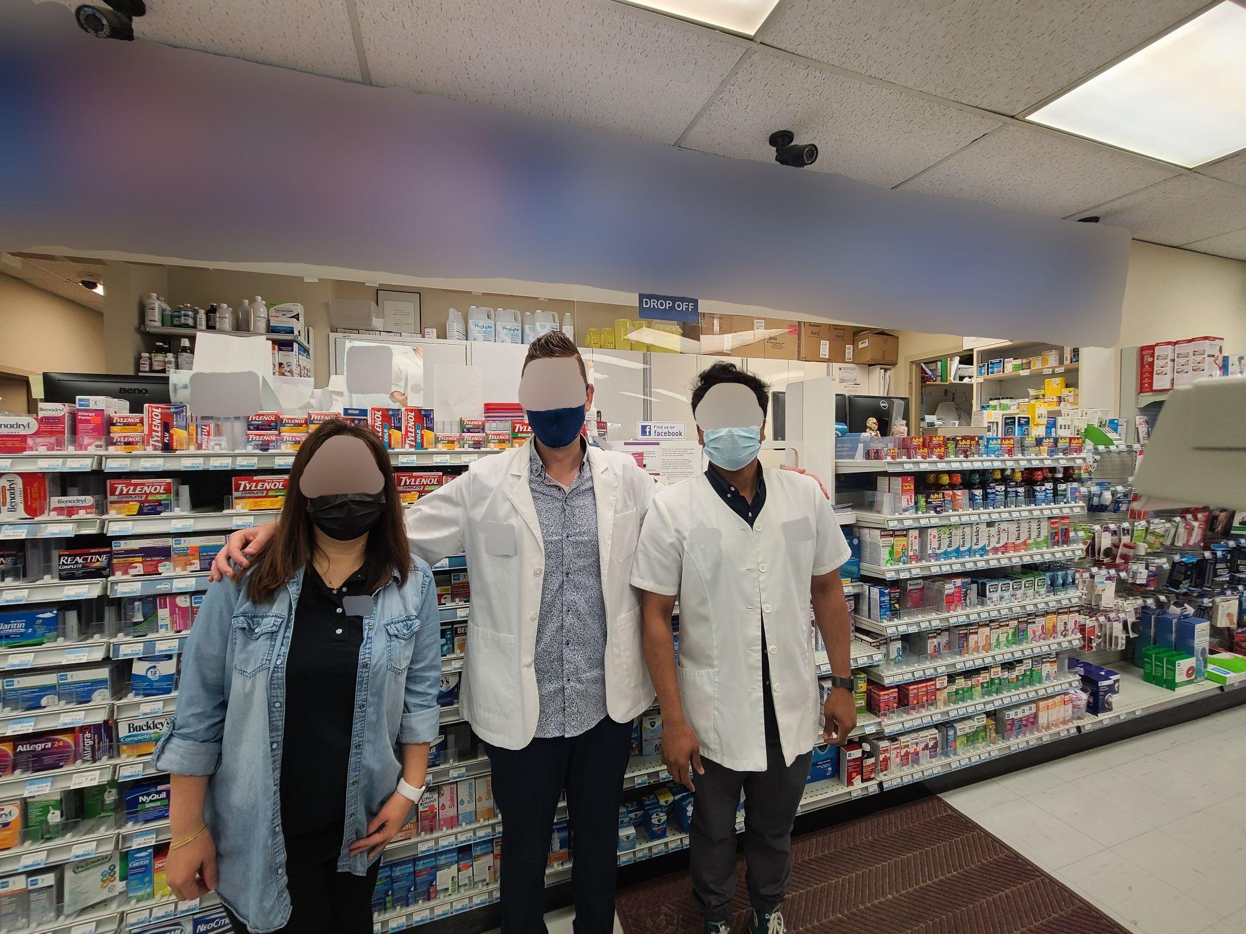
Participant 2
Photo A
“And taking that step back, we have to be on the front lines. As a matter of fact, we’ve taken on more than ever before! So, as a result of that I wanted to really outline what I see myself, as a really important job of a pharmacist, especially now during the COVID times, is actually maintaining the health and safety and the mental health and safety of our teams that we work with and our colleagues.”
Pictured above: Community pharmacy team

Slide 7
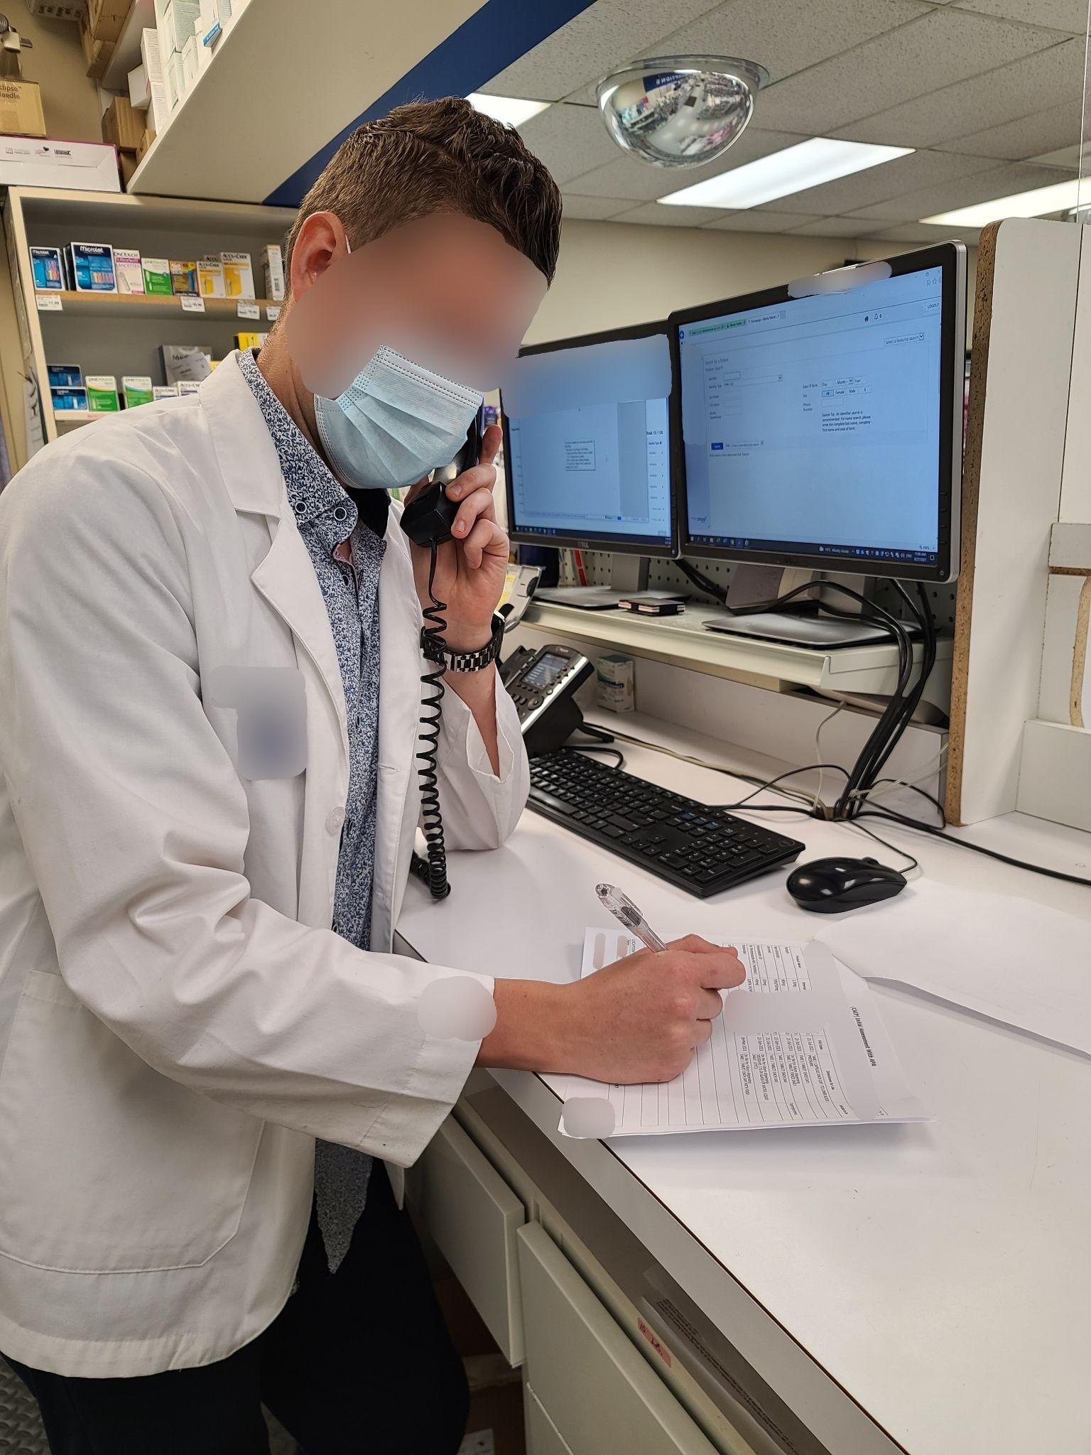
Participant 2
Photo B
“During the COVID-19 pandemic, we really had to transition to…being a lot more virtual and over the phone. And we need to get, we have to really adjust our practise”
Pictured above: Pharmacist on the phone

Slide 8
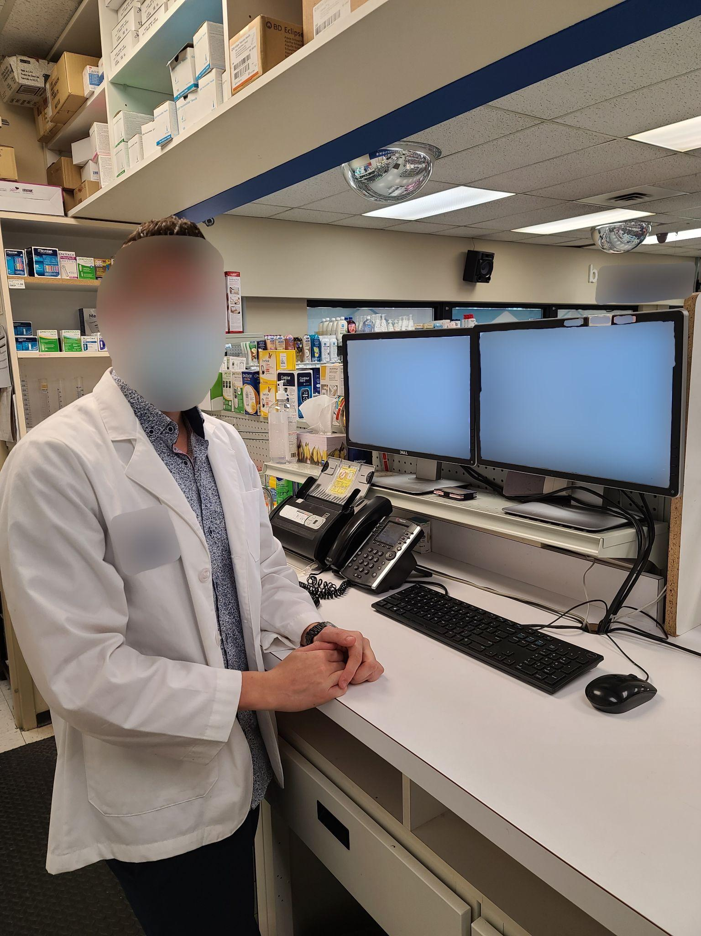
Participant 2
Photo C
“So, technology management adaptability has become a really crucial requirement for pharmacists’ job especially over the COVID-19 [pandemic]. As we had to learn new booking appointment systems, COVID supply management systems, virtual and remote counselling that many pharmacies have implemented as well. And other numerous technological advancements that we have had to implement - not necessarily because we wanted to, but because it was a necessity in order to be able to progress and help the public. Also staying up to date with all the COVID-19 protocols that are happening all the time.”
Pictured above: Pharmacist in front of workstation

Slide 9
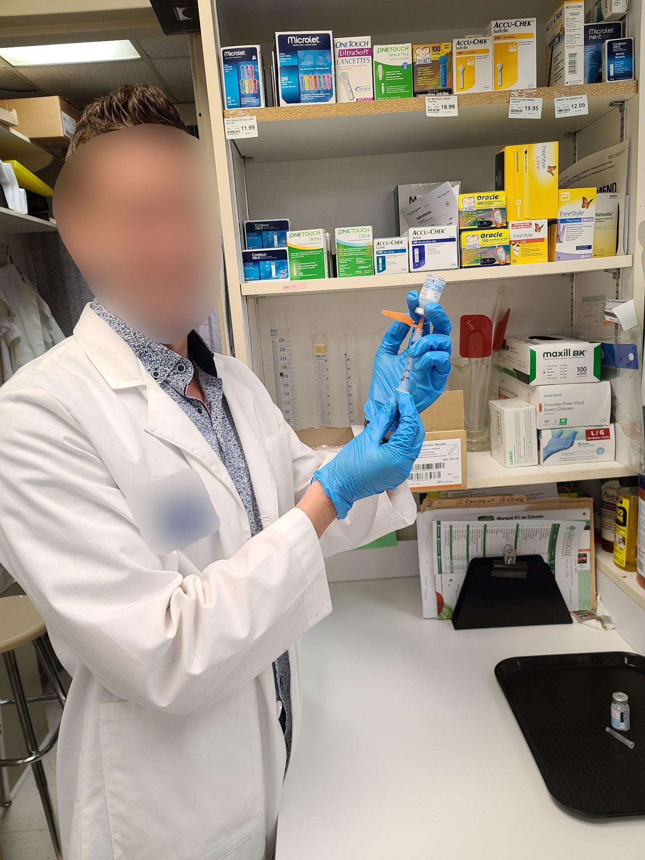
Participant 2
Photo D
“I feel like this is probably an obvious one that every pharmacist would probably outline if they were asked about their position right now. And it's really doing the COVID vaccine administration and not just the COVID vaccine administration, but any other vaccines and other injections. But the COVID vaccine has really played the cardinal role in propelling public health care and protecting the public in general. We have performed millions of injections across Canada at this point of time.”
Pictured above: Pharmacist prepares injection

Slide 10
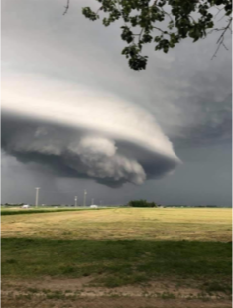
Participant 3 Photo A
“This is exactly how I would describe my days. When I go to work, it is like there's something moving and I don't know if it's going to hit today, or if it's just going to stay. Is that big cloud in the sky that I can look at and wonder. It is almost like a reminder to me to be prepared so that's how I feel everyday.”
Pictured above: Tornado in Alberta

Slide 11
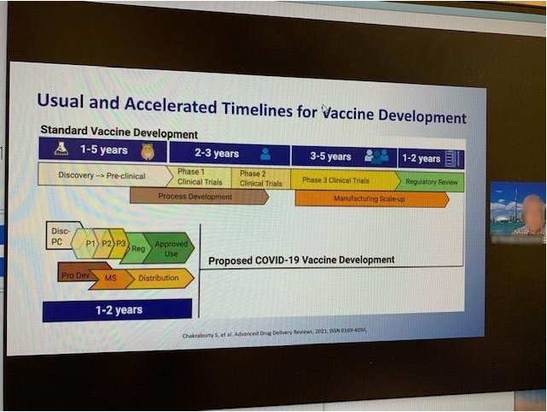
Participant 3
Photo B
“Initially I was a little hesitant about the vaccines and I knew that the only way that I would feel comfortable as if I was able to learn about it…I needed to know it because I had to tell many other people why I was comfortable with it, and I have…I think probably one of my biggest roles is education. I'm able to take something that may look very complicated and then find a way an analogy. So, my example for people for why they should get a vaccine was we live in a very cold climate. “Do you go and warm up your vehicle before you go anywhere?” And they say “yes”, and I said “so, you're starting your truck ahead of time by getting this vaccine.”
Pictured above: Pharmacist attends an online webinar on COVID-19 vaccine accelerated development

Slide 12
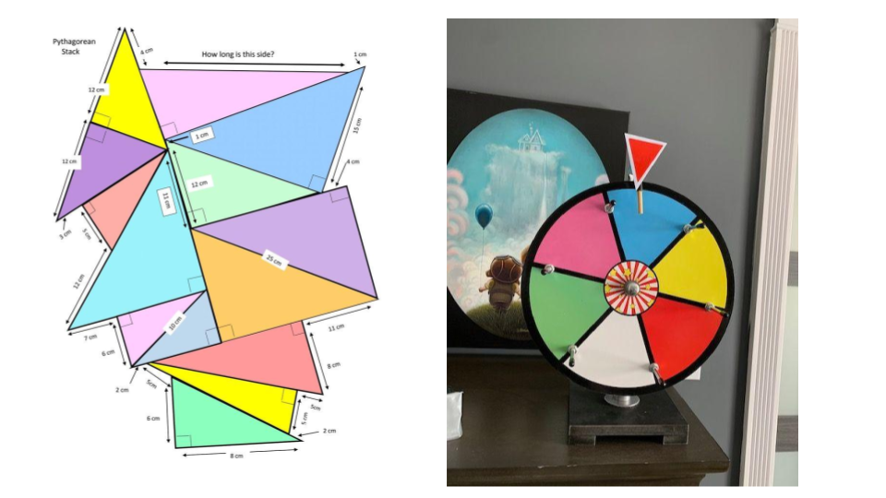
Participant 3
Photo C
“I would like to always be the person who can kind of look at things from a different angle and come up with a way of making things a little lighter and not so heavy. It's not fun to carry that weight all the time, whether it be for patients or for my team or my family even. So, I like to be the person that people can come to say ‘I have this problem I'm not really sure what to do’ and then we can come up with a solution.”
Pictured above: Geometry exercise and spin the wheel

Slide 13
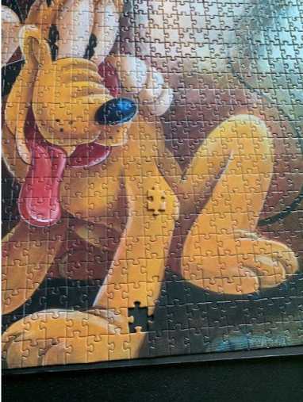
Participant 3
Photo D
“This is the ultimate frustration, so this is a big Disney puzzle and I got to the very end and I had one piece left with no errors and it wasn't the right piece…I was so frustrated because then, what do you do? So, you have all of this work done and you can't finish it and I guess with COVID-19 that's kind of how I felt is, we have [done] all this work and then nothing's ending…Sometimes you can't fix it and so sometimes you don't have all the information, and I think that that's what I deal with every day. Sometimes we just can't make things better. Of course I'll try, which is why I made the puzzle piece, but sometimes that's all we can do is try to make something fit for the patient or for ourselves and for our team. And so, as a pharmacist, I think I realized that not everything is going to be perfect.”
Pictured above: A puzzle missing the last correct piece

Slide 14
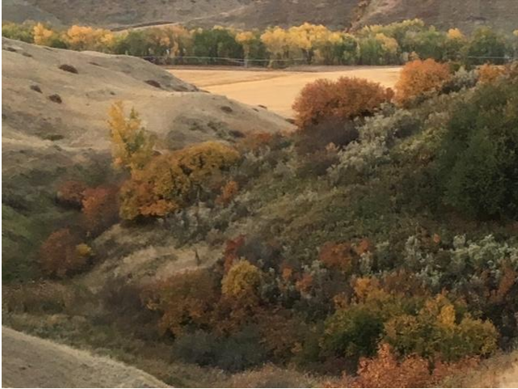
Participant 3
Photo E
“Connecting with them [patients] on an emotional level is a big deal for me. So, this kind of represents that I'm going to try and give you some peace in your mind. And this is the peace that's in my mind. I think it's an accurate representation of what I try to do for people.”
Pictured above: A fall scenery in Alberta

Slide 15
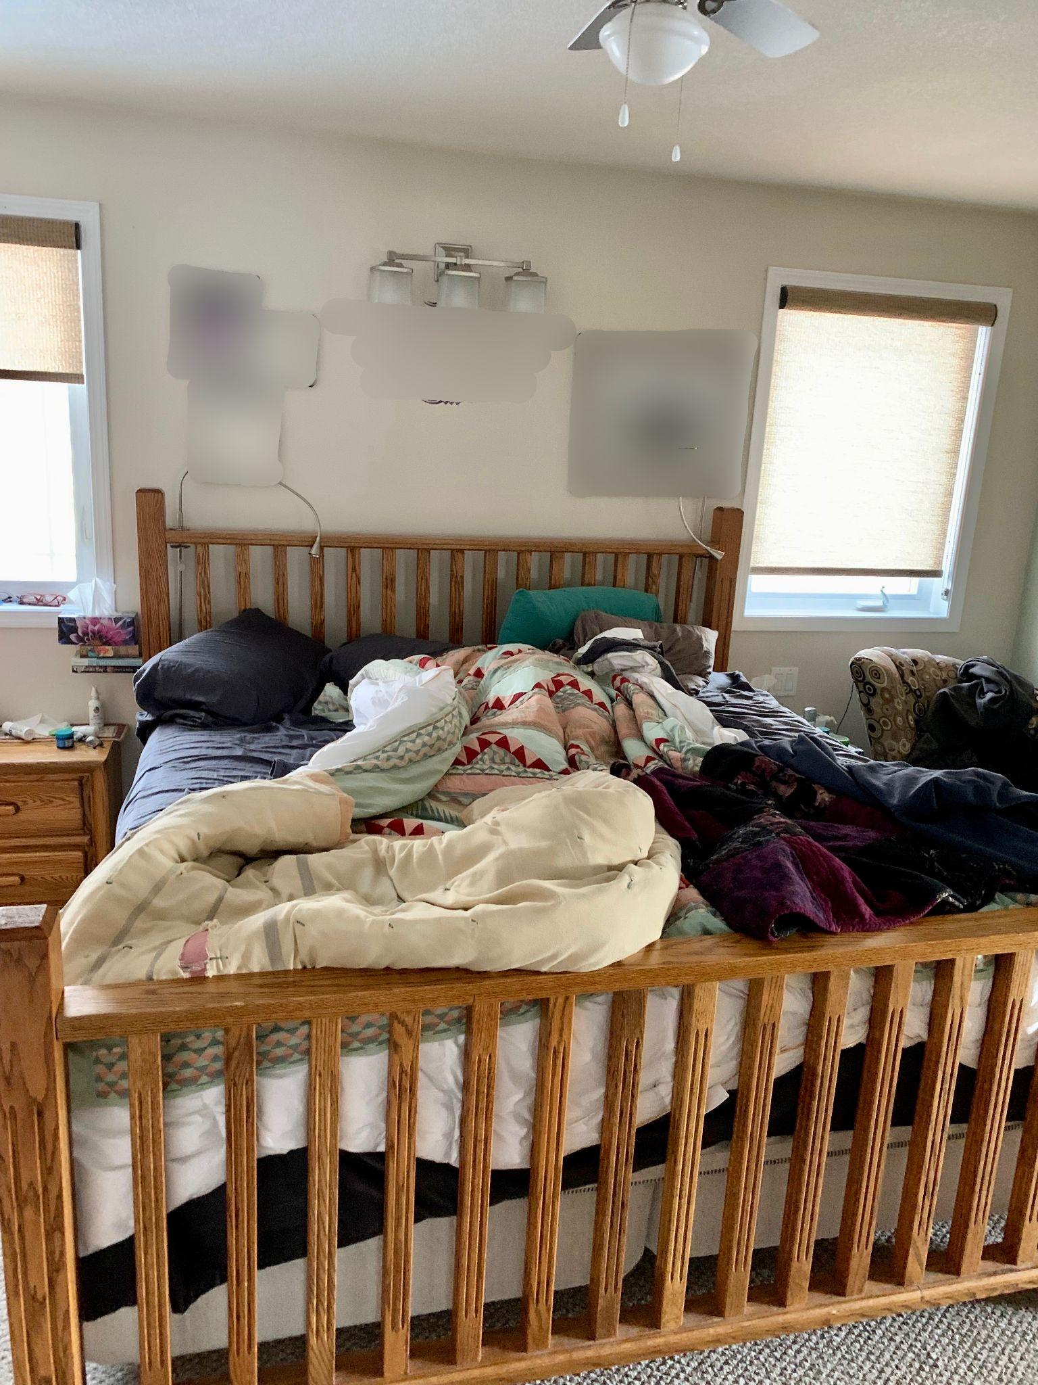
Participant 5
Photo A
“I thought this is just how I feel my life is with the way work is…I mean I’ve always worked, but never have I felt this emotionally drained and with no reserves left to cope with anything. It's even all of life, like anything outside [of work] for personal, it is just a real struggle to manage…I think I still love pharmacy. I’ve always loved pharmacy and I've been very thankful for all the years that I chose what I chose because I’m very passionate about it. I love the people aspect of it. I think going forward, I would just like to find a better balance and that's always been a struggle for me. This reflects probably the imbalance in my life, and I think I’ll have to find that balance again, to actually stay in pharmacy because that becomes the question these days.”
Pictured above: A messy bed

Slide 16
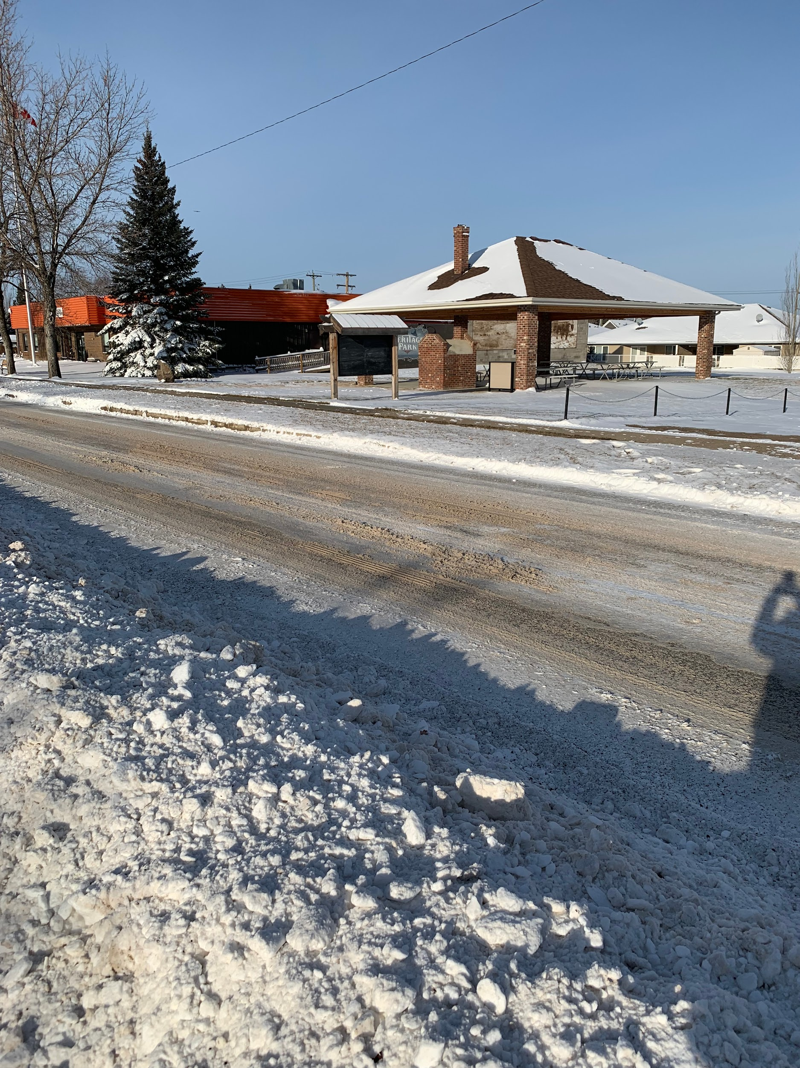
Participant 5
Photo B
“As a pharmacist, I identify extremely strongly with my role in the community, so it was kind of a reflection of you know pharmacy. My pharmacy job doesn't just stop in the pharmacy…the role we play is not just located to the building the pharmacy, right, like I said a grocery store trip now takes me 40 minutes.”
Pictured above: A community meeting place

Slide 17
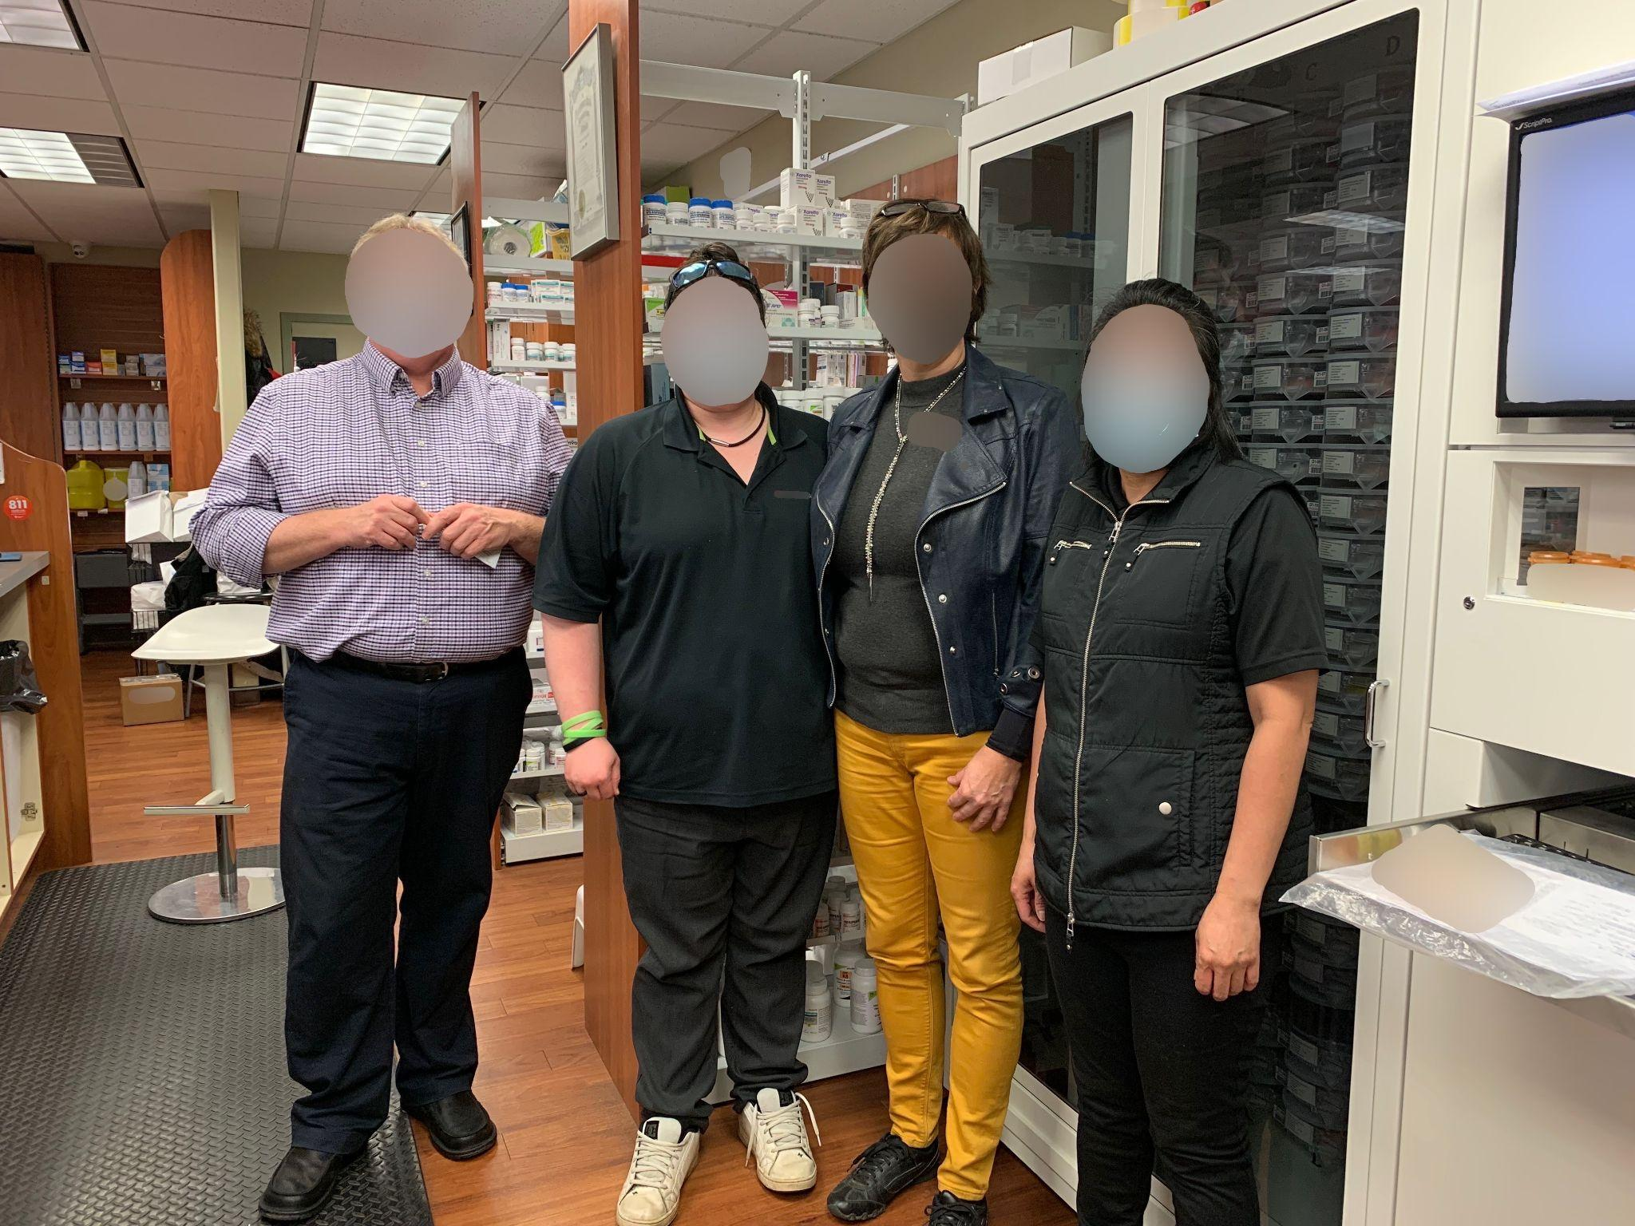
Participant 5
Photo C
“We've all been watching each other's back…So, I think there's more consideration because I think we all realize how bad things are right. So, we're trying [not] to add to that load on each other.”
Pictured above: A community pharmacy team

Slide 18
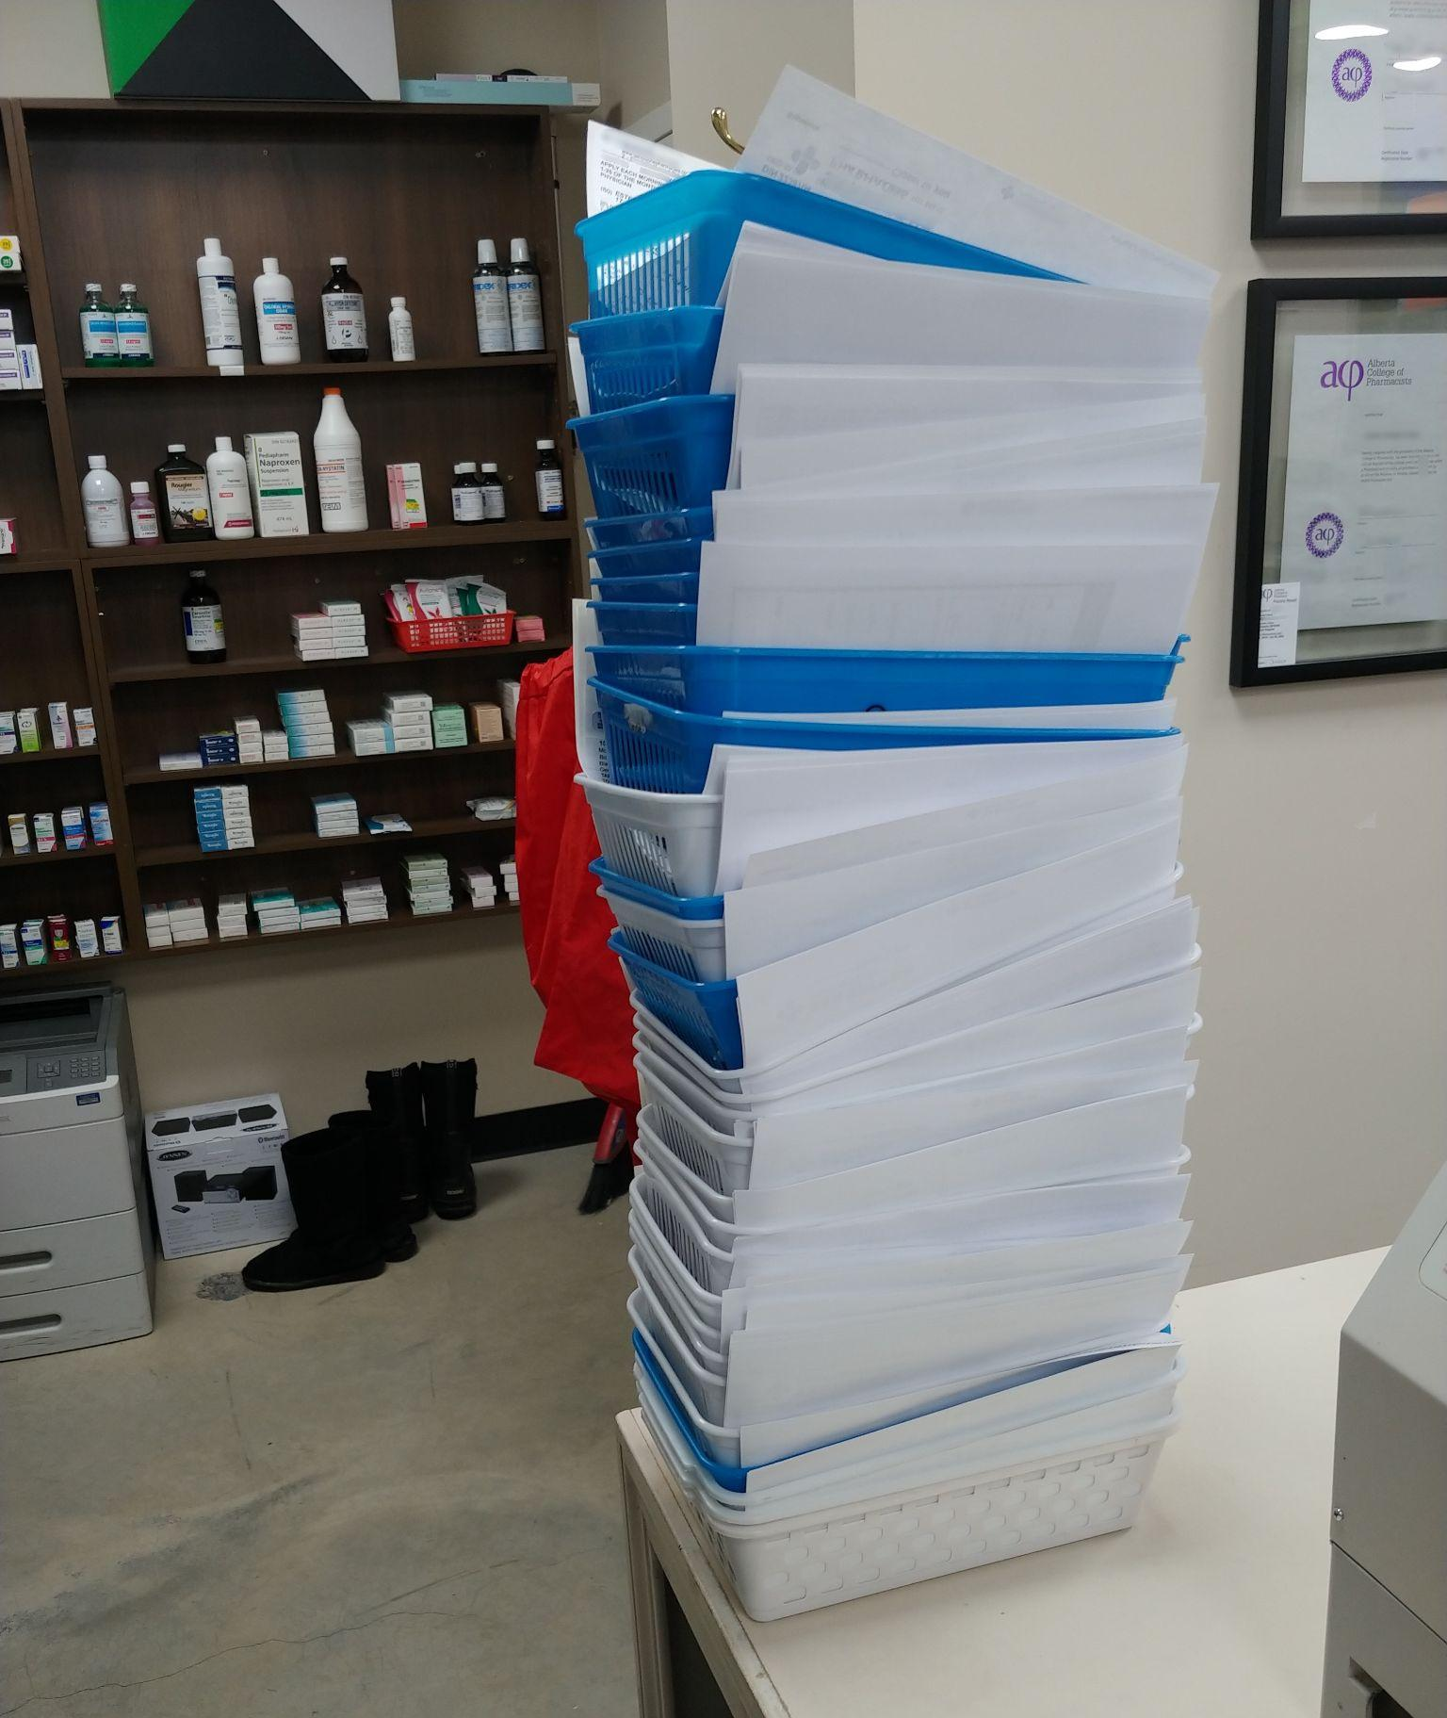
Participant 6
Photo A
“COVID is just taking the spotlight and taking me away from my traditional roles of education and sitting down with patients and being able to actually spend time with people. Which is like the best part, when actually actively helping someone through something.”
Pictured above: Piles of prescriptions to be dispensed at the end of the day

Slide 19
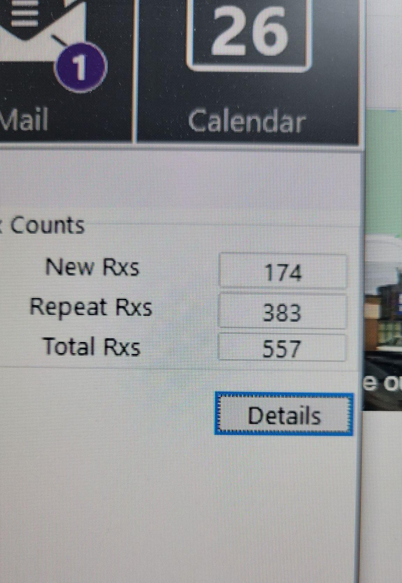
Participant 6
Photo B
“Like with fees alone that's over $5,000 that's not including markups, that's not including rebates. And they can't even pay their staff overtime, which just like makes me so mad. [laughs] We go through these conditions, so that was like one of my busier days as a pharmacist. I think, COVID-19 put it under a magnifying glass. And showed how fragile the system is — I thought it would be more ‘patient first’ for most pharmacies, but it's like ‘money first’, and like patient second.”
Pictured above: Pharmacy computer system prescription queue

Slide 20
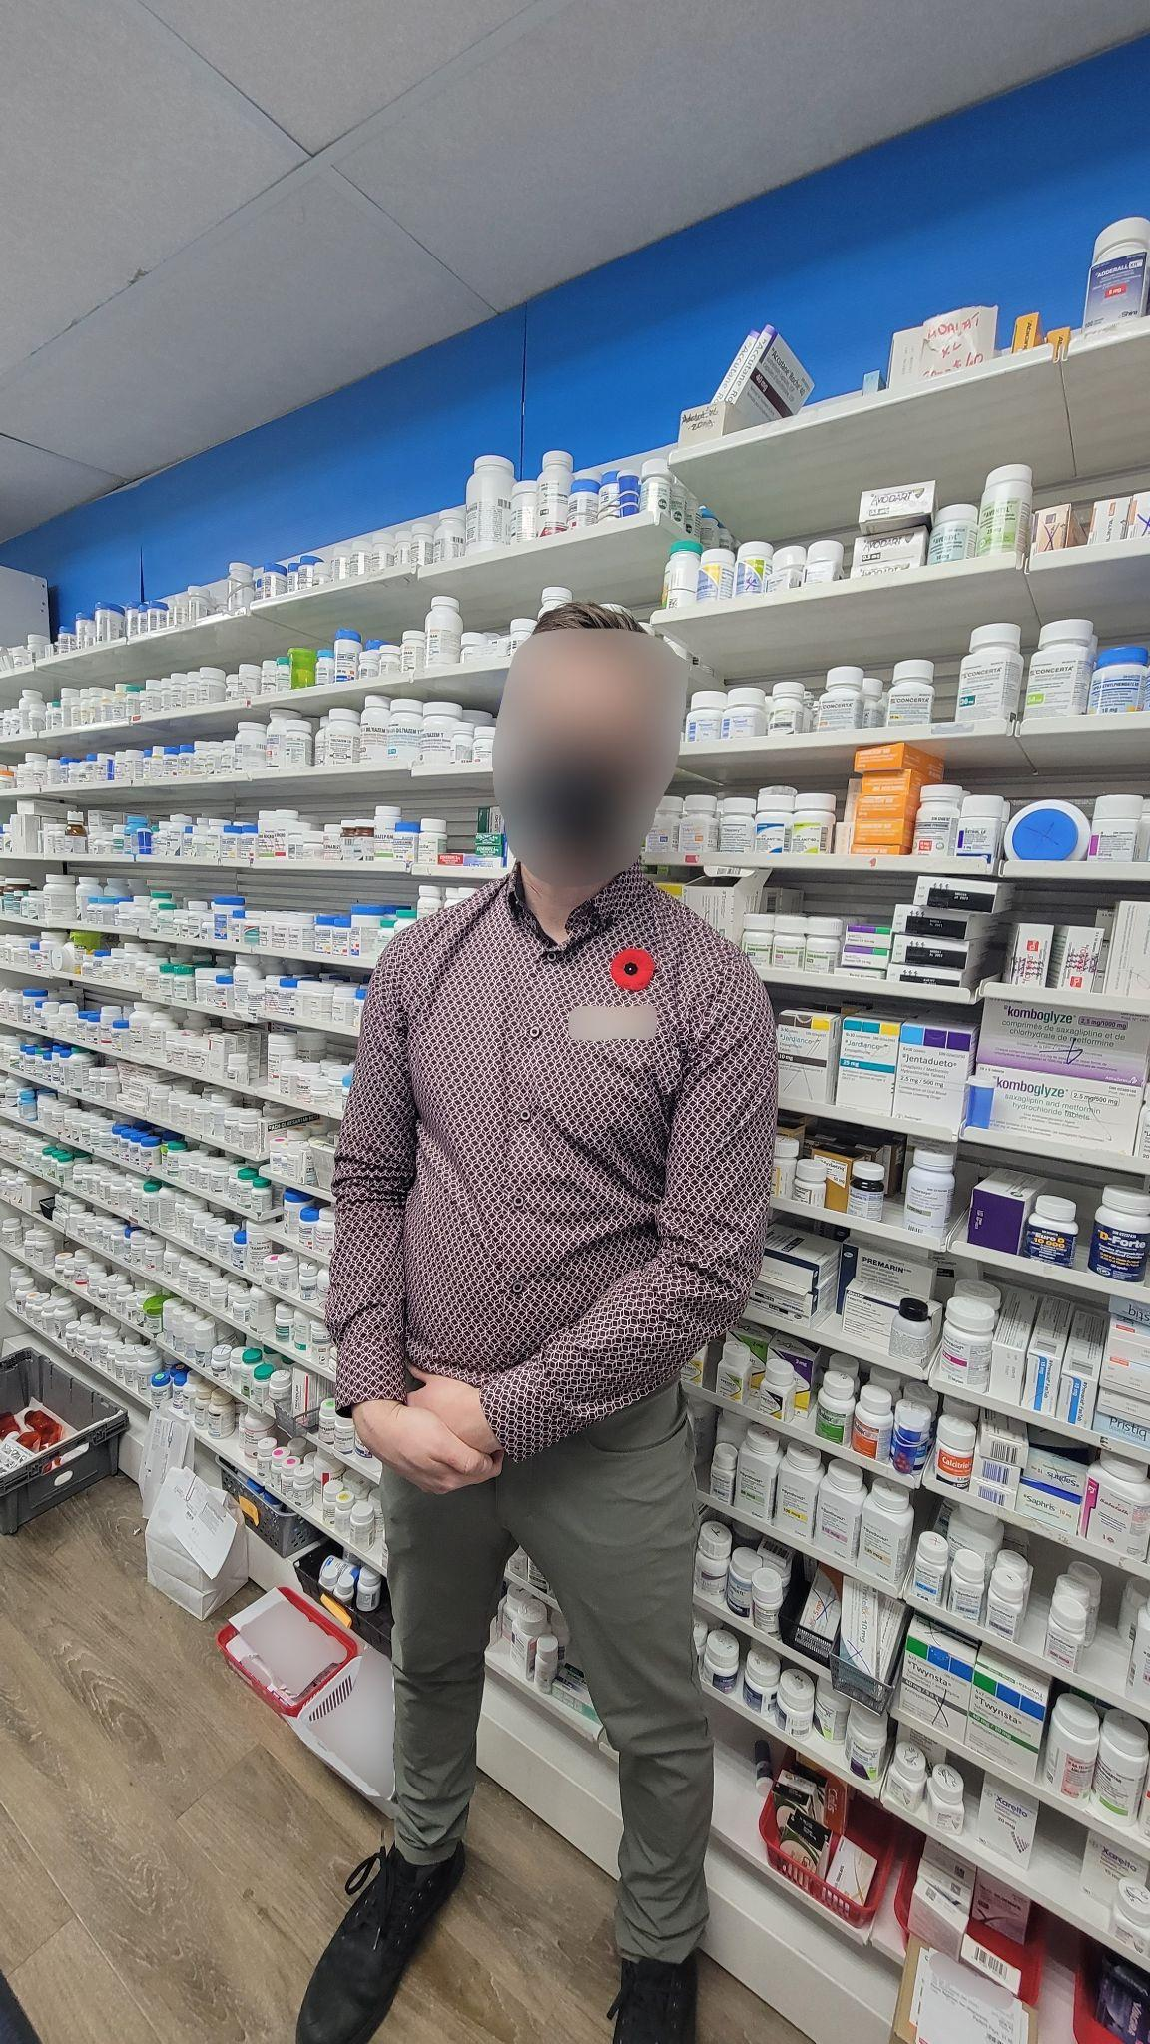
Participant 6
Photo C
“ I think, people are often surprised when they look and especially [younger] people, how many bloody drugs there are! How many things we can dispense and there's a reason we did like four plus years or so of schooling. There's a lot to know. And this is just like the tip of the iceberg.”
Pictured above: Pharmacist stands in front of a wall of medications

Slide 21
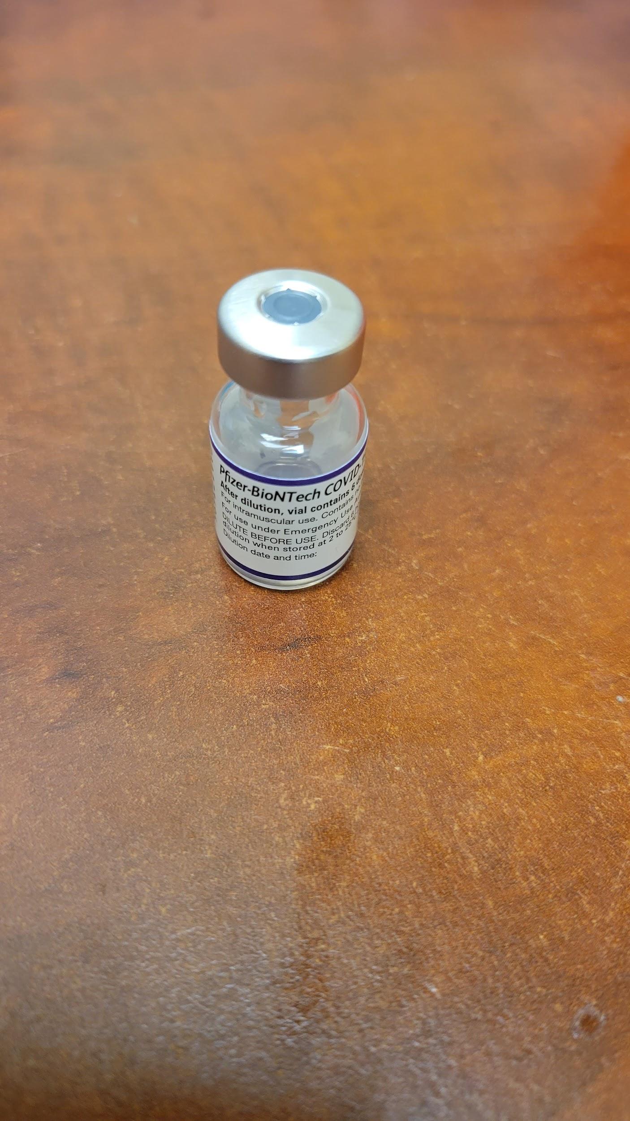
Participant 6
Photo D
“It's become such a mainstay. I mean the dilution of it, the prepping of it, the giving of it. Your day revolves around it. I remember you know I used to do the odd immunization (some B12 shot or whatever) for somebody and I think I used to do 10 or so injections a week before COVID. And now, some days I do 40 [injections], and dispense and everything and try to counsel. God forbid, I have to look something up if I’m unsure of something. Do I actually have time to properly assess a patient if there's a DRP [drug-related problem].”
Pictured above: A COVID-19 vaccine vial

Slide 22
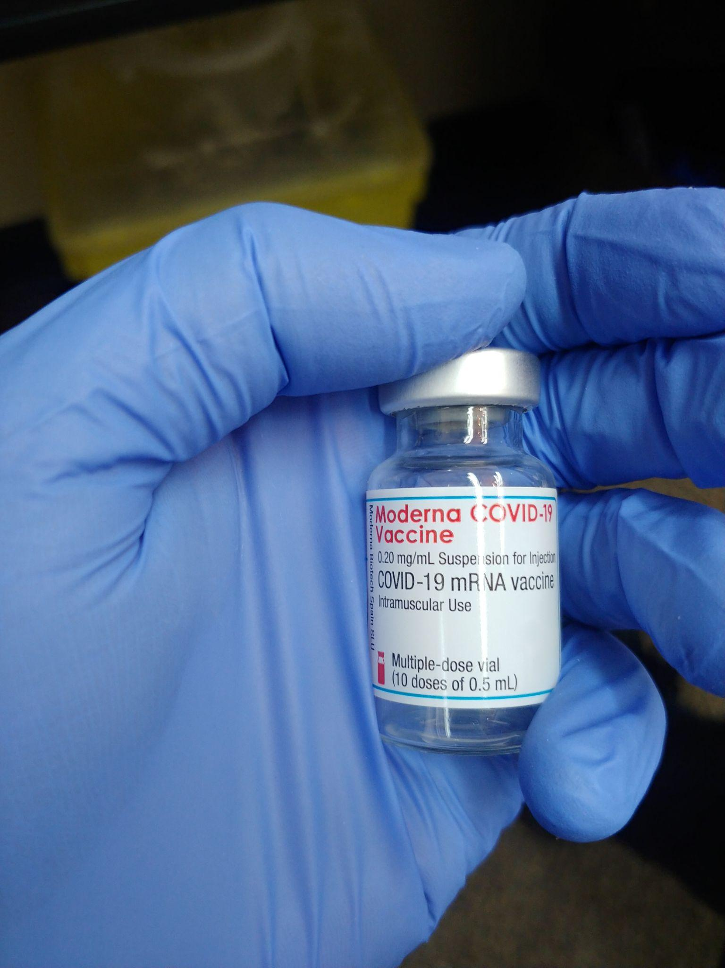
Participant 6
Photo E
“Since January of 2021, I’ve given over 4,000 injections. So, it seems daunting.”
Pictured above: Pharmacist hand holding a COVID-19 vaccine vial

Slide 23
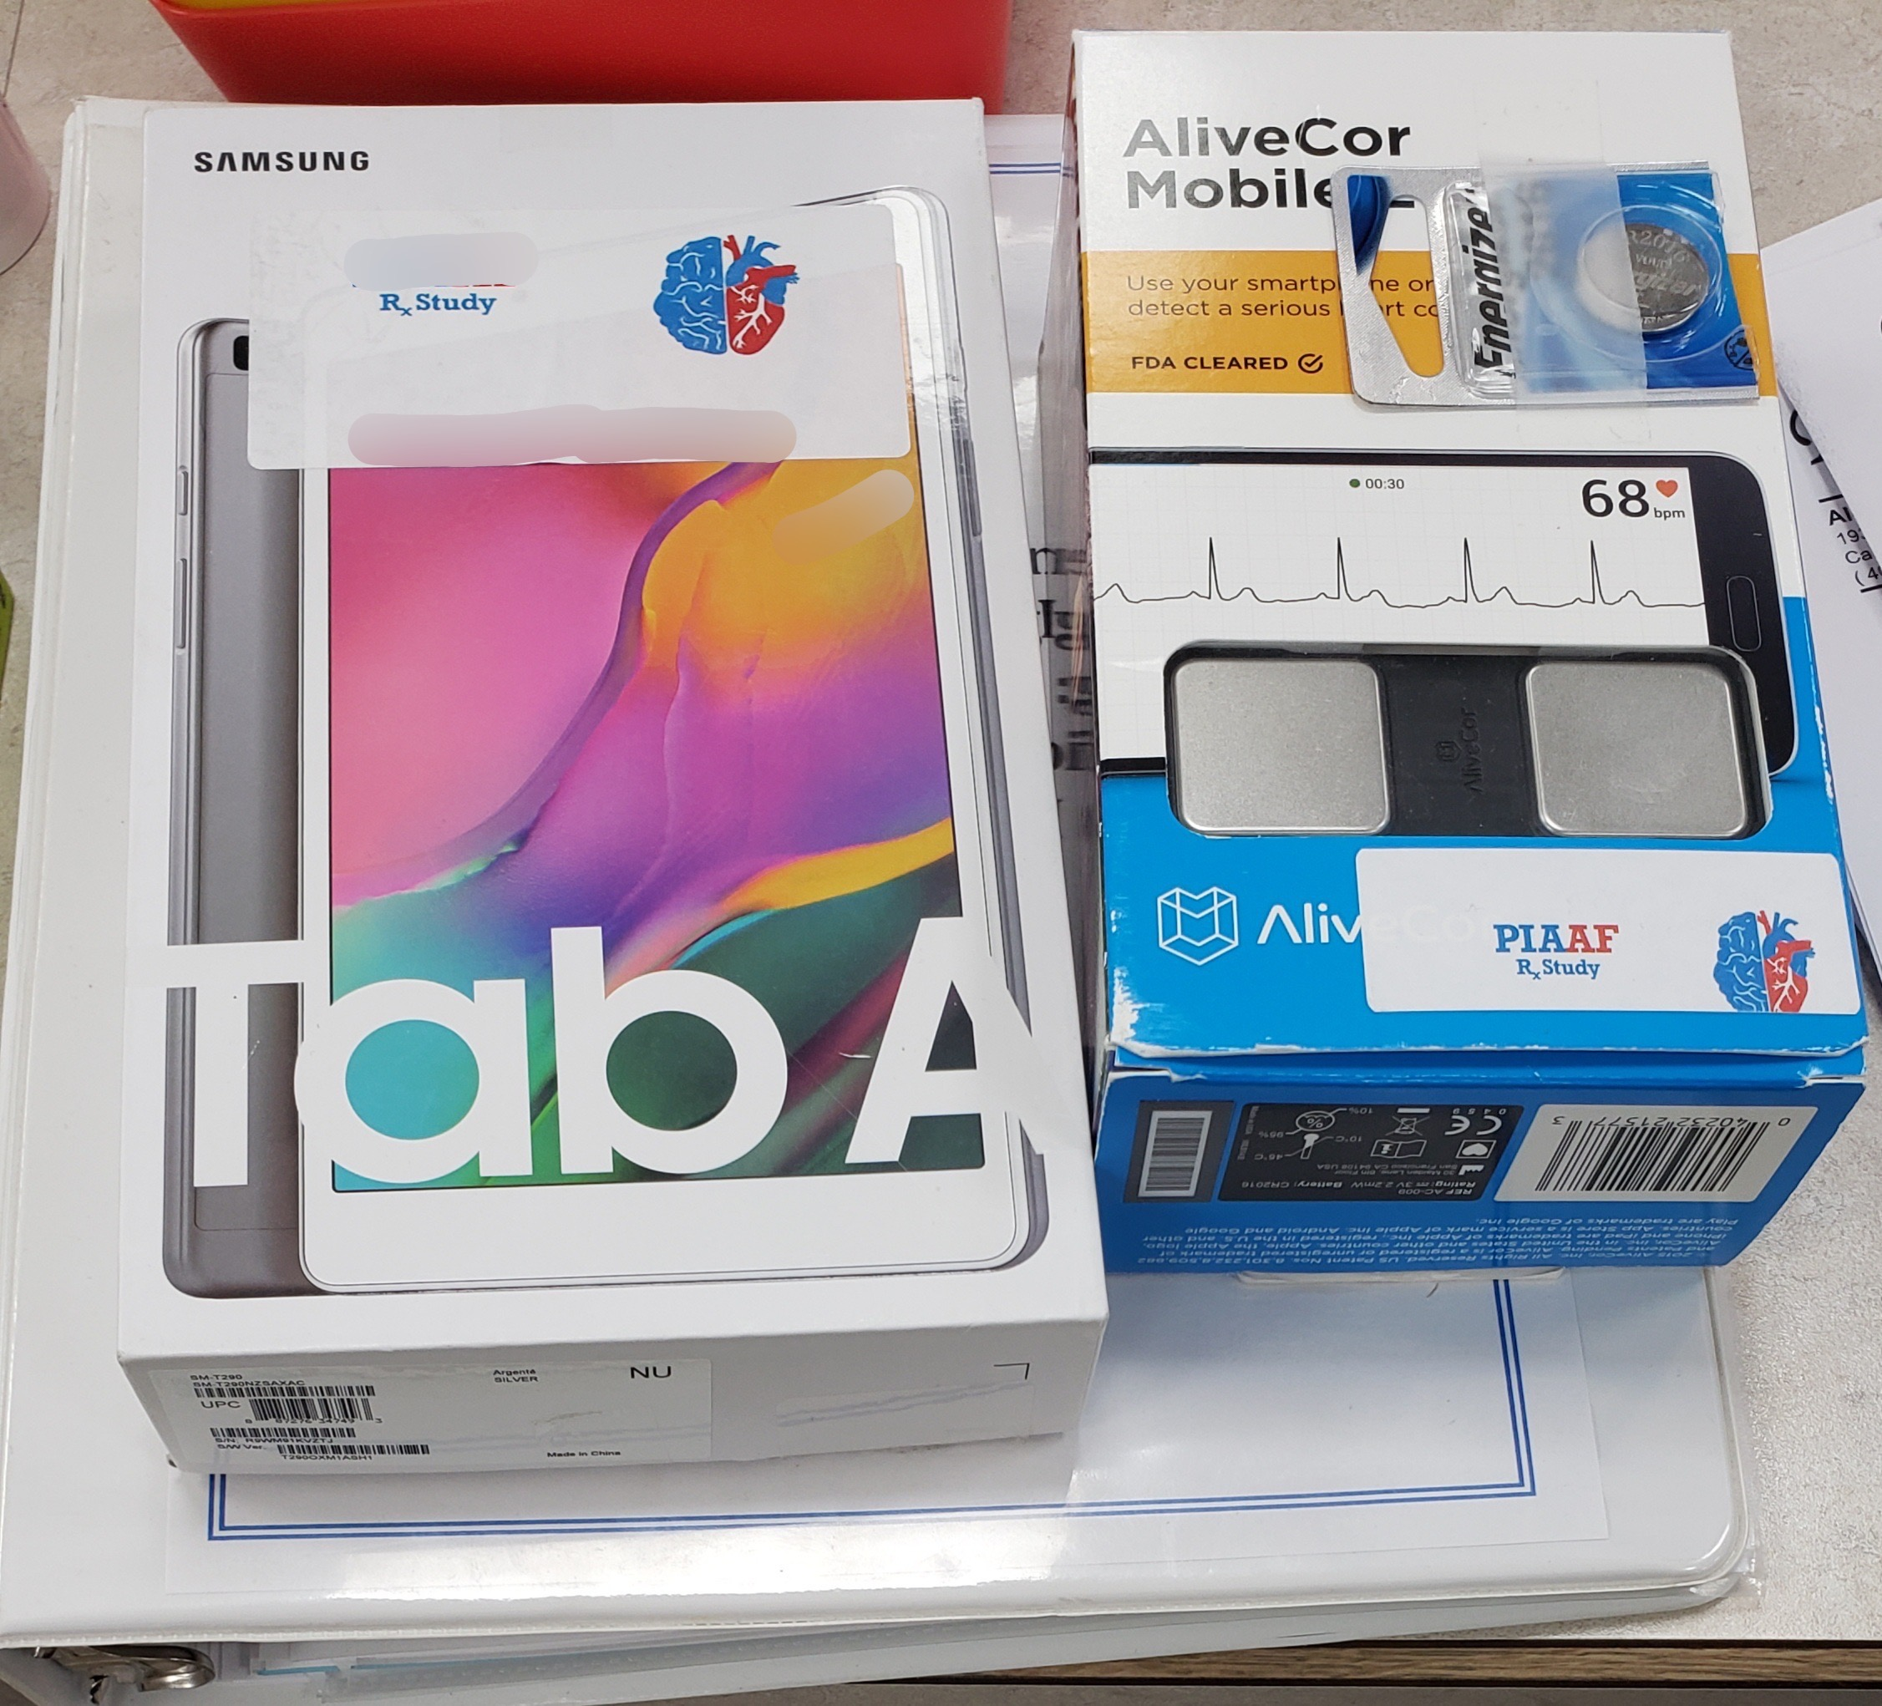
Participant 7
Photo A
“I’m actively involved outside of [community pharmacy practice], this is an example of a study that that we’re involved with…I’m proud of the fact that my team and myself are still been able to contribute outside of the regular day to day activities [during COVID-19 pandemic]…it tells others that there's a responsibility as a pharmacist, as a professional to not only support your patients that you provide direct patient care to, but also to ensure that you can support them and the profession in a way that advances care.”
Pictured above: Pharmacy research study materials

Slide 24
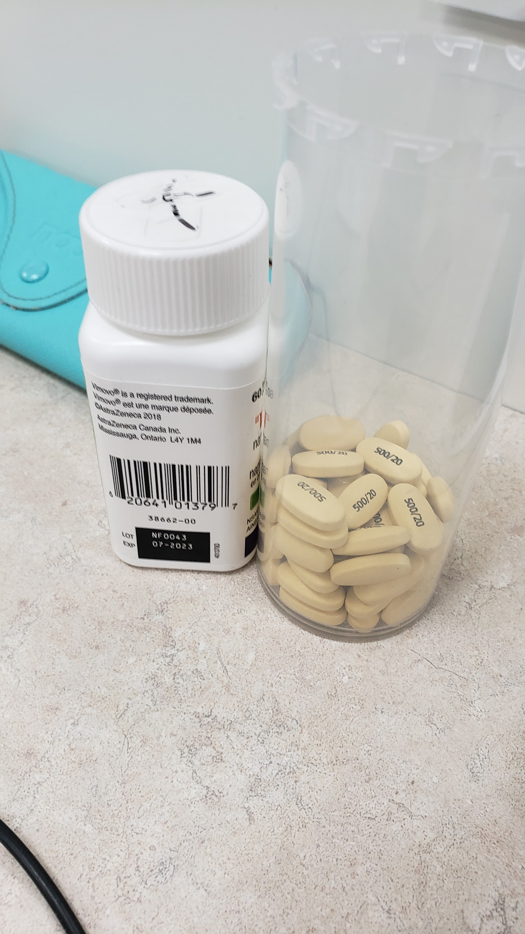
Participant 7
Photo B
“So this was put beside the station of the pharmacist, you can also see a glasses case behind there, so this is kind of an area of ‘pharmacist only’ kind of thing, and so what I think this represents is things are, are so busy...So this shows, we're engaged in multitasking. With this pharmacist probably had to go do something else with a patient that was more urgent. And so this is put aside. The responsibility was taken by the pharmacist dealing with this to ensure that the patient got a more appropriate medicine. Yet, this hadn't quite gotten put back into the vial or into the stock bottle and put back on the shelf. And this is very odd to have something like this just kind of sit there. But this clearly identifies the amount of pressure put on the pharmacist at the time.”
Pictured above: Medication bottle, pill vial, and glasses case

Slide 25
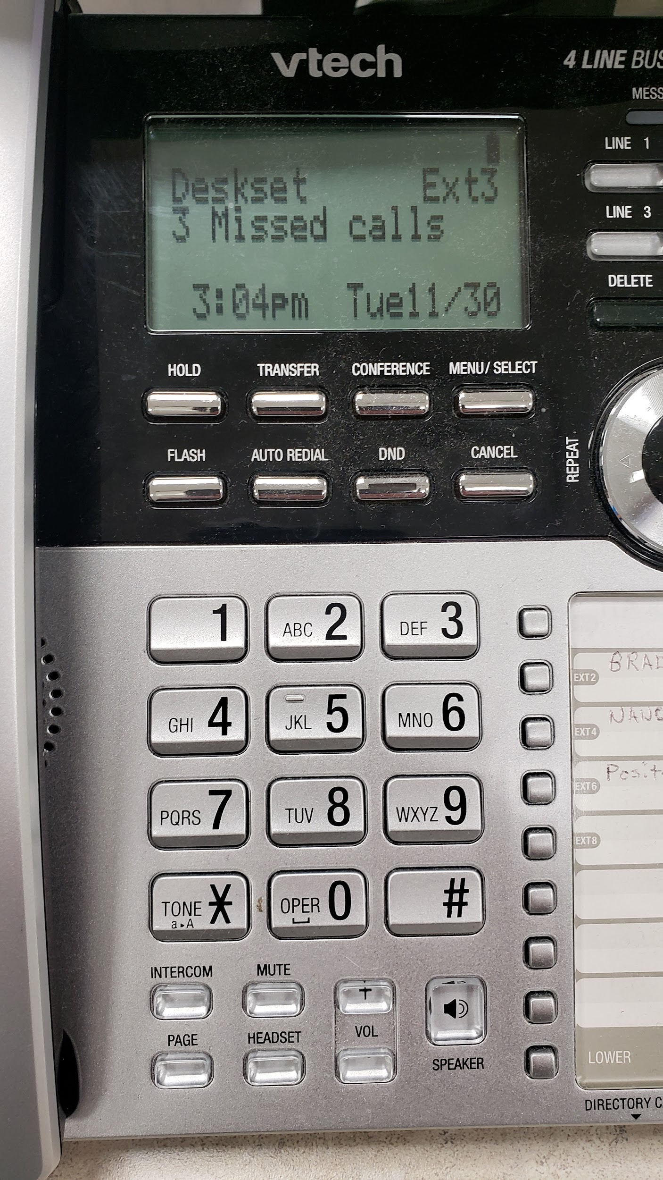
Participant 7
Photo C
“This just emphasizes the main distractor or disrupter in a community pharmacy. This shows 3 missed calls. However, there's times where that'll be 23 missed calls. And every time the government would make a change to their COVID policies or guidelines for vaccinations or who was next that was able to get their vaccinations, the phone would just go off the hook and it was difficult to answer all the questions on the phone and help the patients that were in front of us to the point where there were some days I remember where we essentially had to turn the phone off.”
Pictured above: Pharmacy phone with missed calls

Slide 26
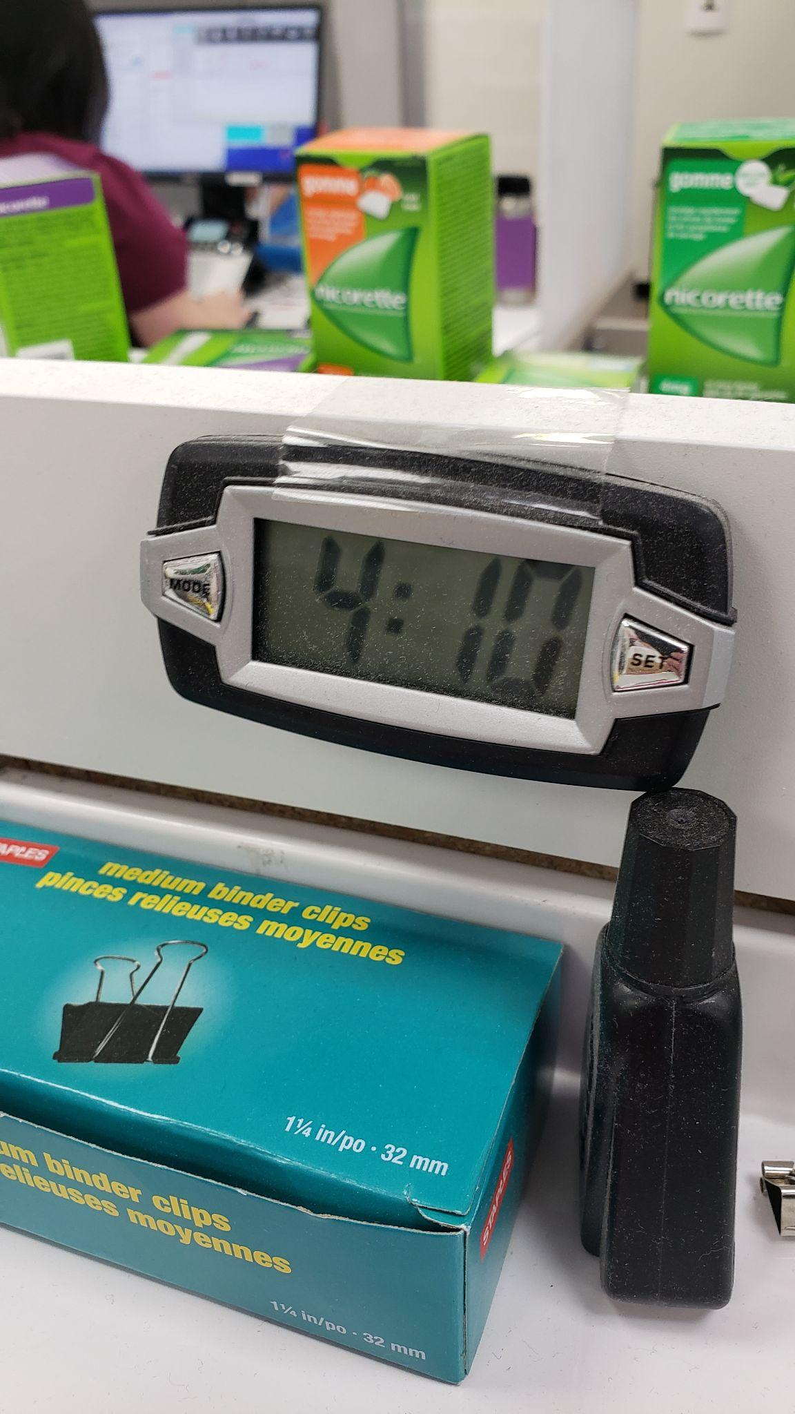
Participant 7
Photo D
“I know that it's [the clock] looked at when there's been a particularly hard day, people are thinking ‘When is this day going to be over?’. I also know that it's looked at by myself sometimes in shock. So, this was 4:10pm. And on this particular day I had to be out of the pharmacy by 3 o'clock and now I'm an hour and 10 minutes late for my next obligation and it's a reality, we all have the same amount of time in life…pre-COVID I would have already been on to my next appointment at 3 o'clock versus being there for an hour and 10 minutes over my allotted amount [of time]. I think it's just highlighting the super pressure…the pressure that has occurred over COVID on the profession of pharmacy has been significant, which then takes so much more time. Well, the only thing I could tell you is, I think that there was a time when we changed to daylight savings, the last time, and it took about a week for us to change that clock, because we didn't even have time to change the clock.”
Pictured above: A clock in a pharmacy

Slide 27
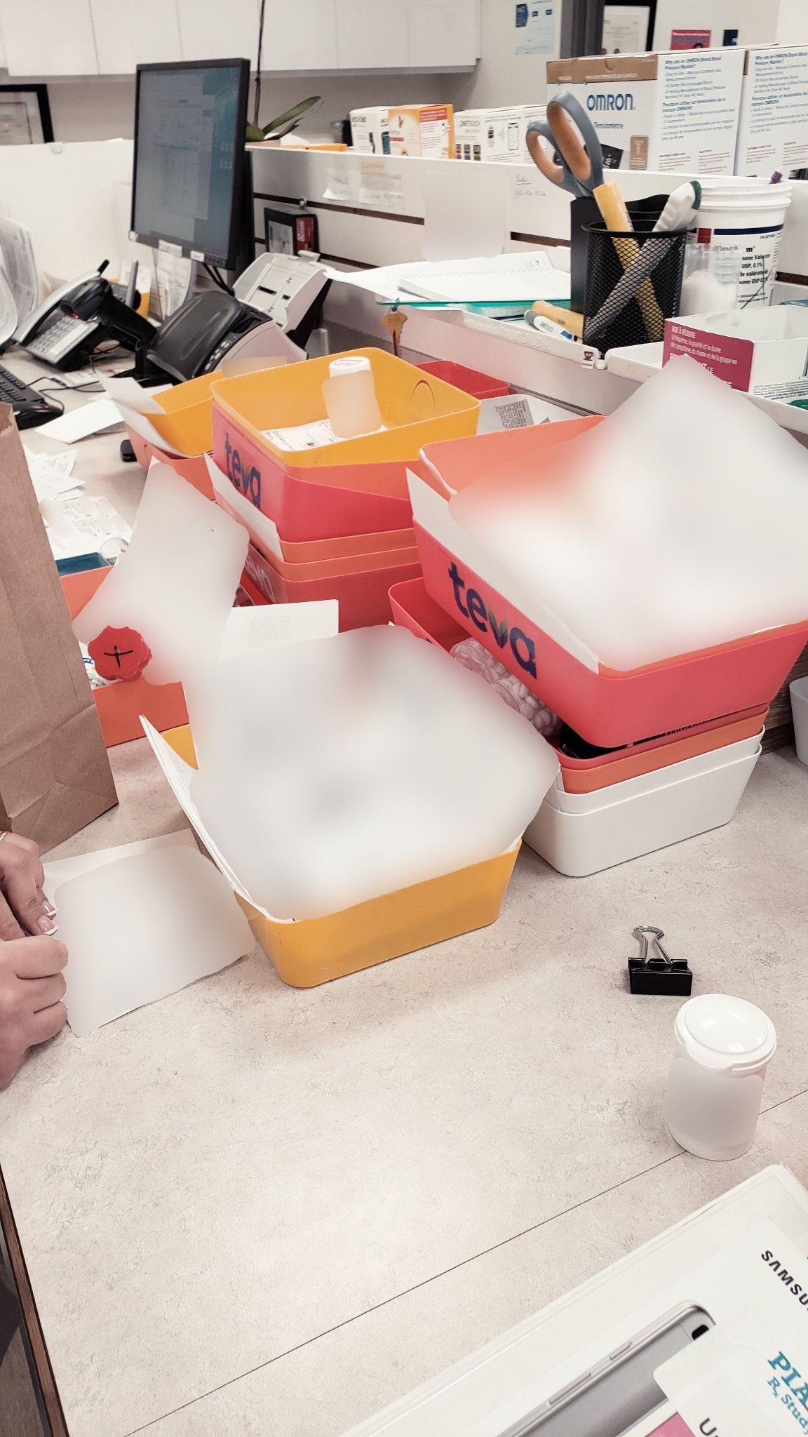
Participant 7
Photo E
“I know that during COVID because of the pressure under pharmacy there were some pharmacies that just said, ‘we're not doing this’. And we continued to try to ensure that patients got their compounded medications, but it was difficult…I’m just glad that we were set up in this particular pharmacy. Everybody was clear about what our vision is in supporting the health of the people in our community. So, when it came down to you know, ‘can we still do compounded prescriptions?’ Well, yes, we do, and maybe people have to wait a little bit longer, but overall we need to do that to ensure that people are supported the best they can to improve or to support their health.”
Pictured above: Pharmacy countertop filled with various prescriptions

Slide 28
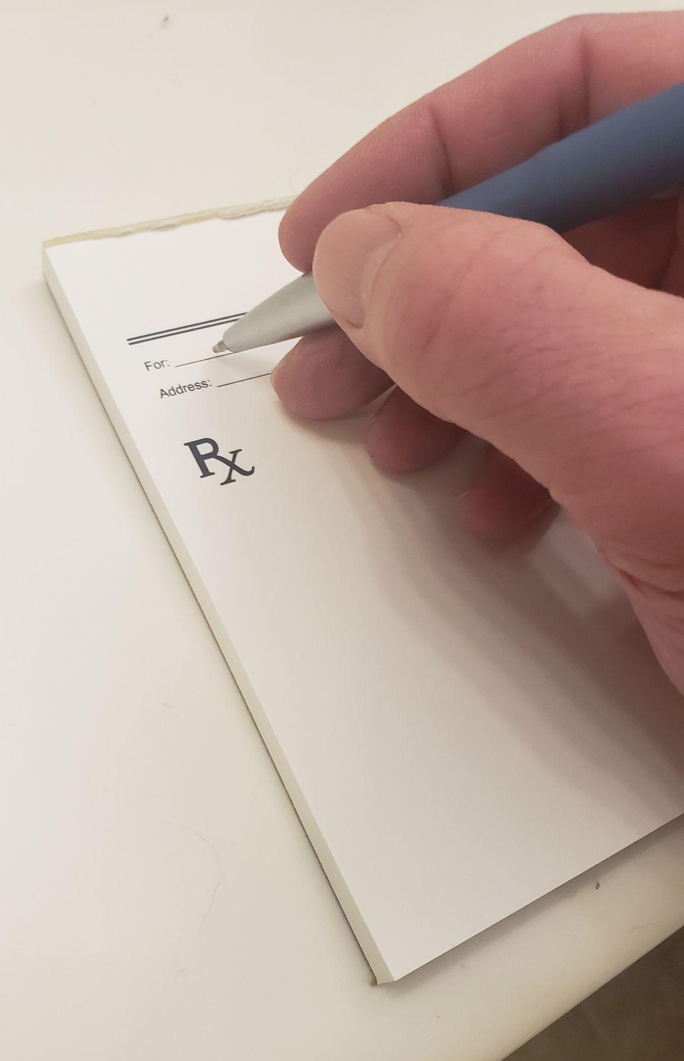
Participant 7
Photo F
“So, during the COVID-19 pandemic, personally, I wrote more prescriptions in that period of time and still do, than I ever thought that I would…The physicians too are very glad that I’m doing that right. Lots of times when I’ve sent them a note and they're like ‘thank you!’ because they understand how important it is to do these things. It can't be understated about how important and during the COVID-19 pandemic it was very clearly demonstrated.”
Pictured above: Pharmacist uses prescription pad to write prescriptions

Slide 29
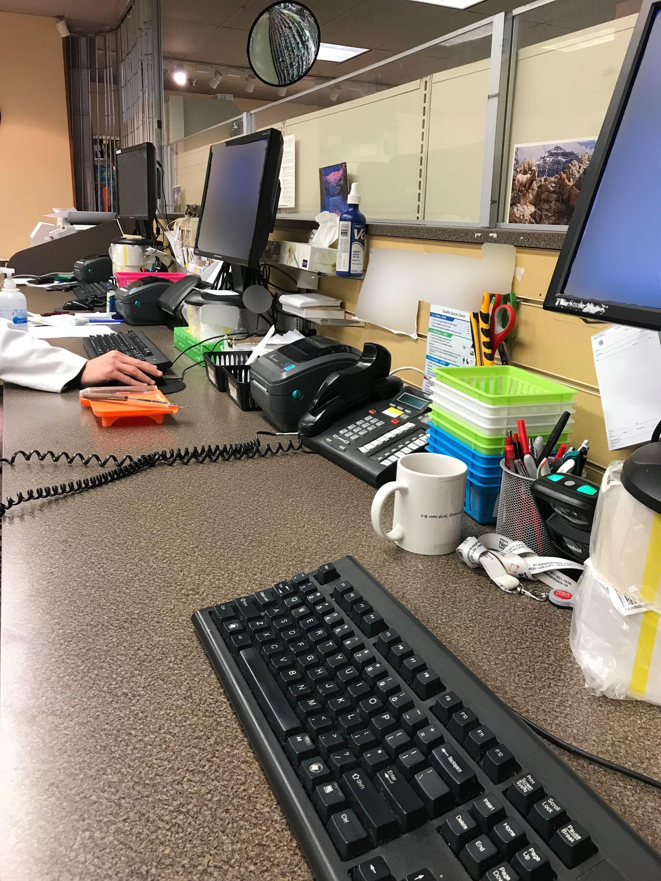
Participant 8
Photo A
“This kind of shows you the workflow. That goes through or I guess how much time how much effort that needs to be put in every day [Pre-COVID]. Before COVID there was only two computers. Now I had an additional third computer and pill counting machines. Extra help was needed, which was not there for most parts in the rural Alberta. And [it shows] much more time, effort, more stress, and more chances of making mistakes.”
“My life has revolved around this desk for the last three years.”
Pictured above: Pharmacy computer workstations

Slide 30
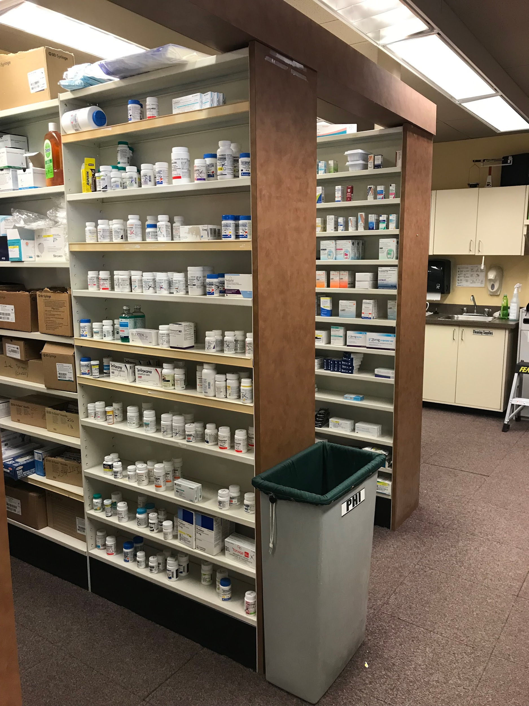
Participant 8
Photo B
“The first front rack where you see some medications and then the next one is more supplies. The front rack wasn't there with the medications before it. It is basically the added amount of the inventory in last two years. And the rack behind it to where you see all the boxes [left side of the photo] are basically supplies, with the injection needles, gloves and all other things which was not there before and which is added on there...there is also the other aspects which we can’t see in this photo. Which is the paperwork, communications with the doctors or the other health professionals, and patients are not in here. So, maybe pharmacy represents this, but the role of the pharmacist is not represented fully 100% in this photo. I guess, ‘Does it accurately represent myself in this photo?’ No.”
Pictured above: Pharmacy medication shelves

Slide 31
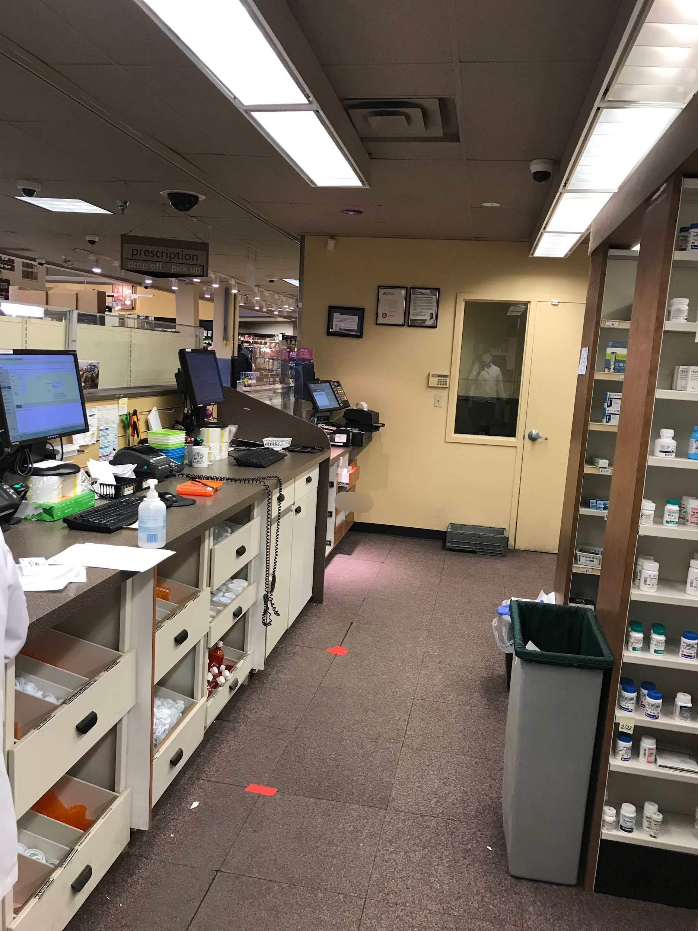
Participant 8
Photo C
“I choose this photo because it has the door. And now it looks a little bit messy as well. This is what my end of the day could look like, where I will leave with unfinished work or I would stay there till it's dark... At the same time I enjoyed doing the work here, why shouldn't I enjoy being pharmacist and what I do. I don't want to leave this place. That's why I’ve taken this picture with the door…but I want to have enough of the work time and the personal time. I just can't be there hoping that I will get out of the door.”
Pictured above: Pharmacy workstations and medication shelves

Slide 32
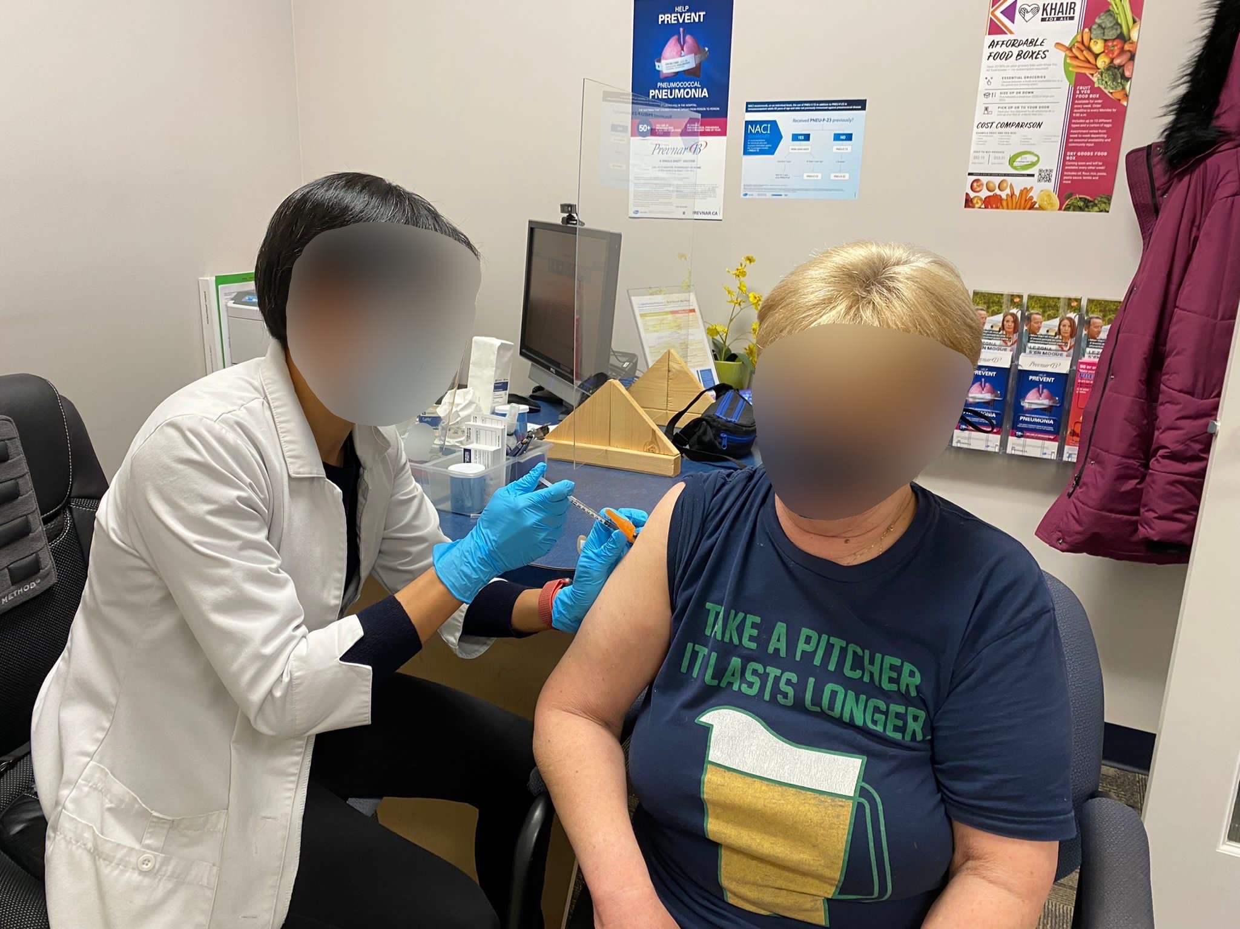
Participant 9
Photo A
“We do quite a bit of immunizations, so without [the] COVID-19 [vaccine] we do the pneumonia shots and the shingles [vaccination]. We also do travel immunization and anything routine like [Vitamin] B12 and we do a lot of mental health injections…Even before [the] COVID-19 pandemic, I really identify as an immunizer and injector. So, the COVID-19 pandemic is definitely making [it] more prominent.”
Pictured above: Pharmacist providing injection services for a patient.

Slide 33
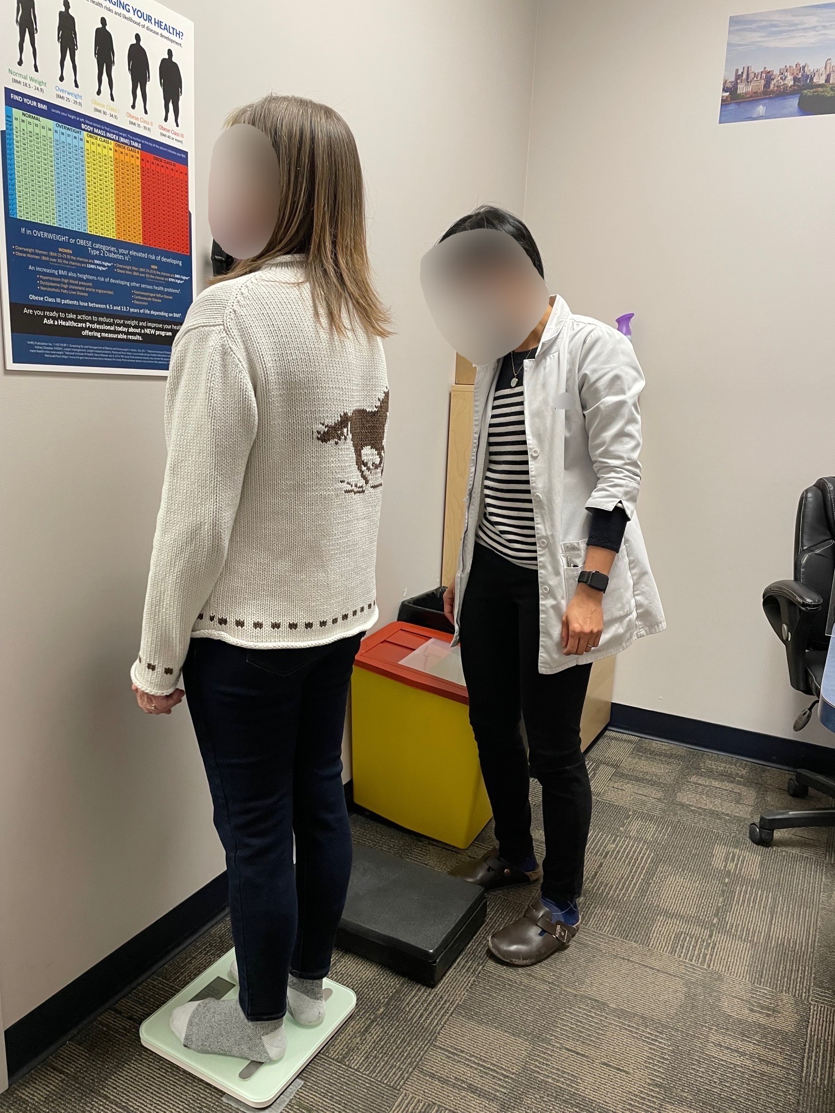
Participant 9
Photo B
“So basically we run a weight loss program called [name of program] and even during the pandemic and everything [that was going on] we still have to take care of people that wanted to improve their lifestyle…people just need it. So, we are just responding to a need. Being inside during the pandemic, you already have so much mental stress. And a lot of people feel like they overeat and are stress eating. If they want to make a change in their life, like we wouldn't deny them and if we have the program in place and we have all the protocols to defend and protect ourselves, then I don't see why not we can keep [providing the service].”
Pictured above: Pharmacist records the patient’s weight

Slide 34
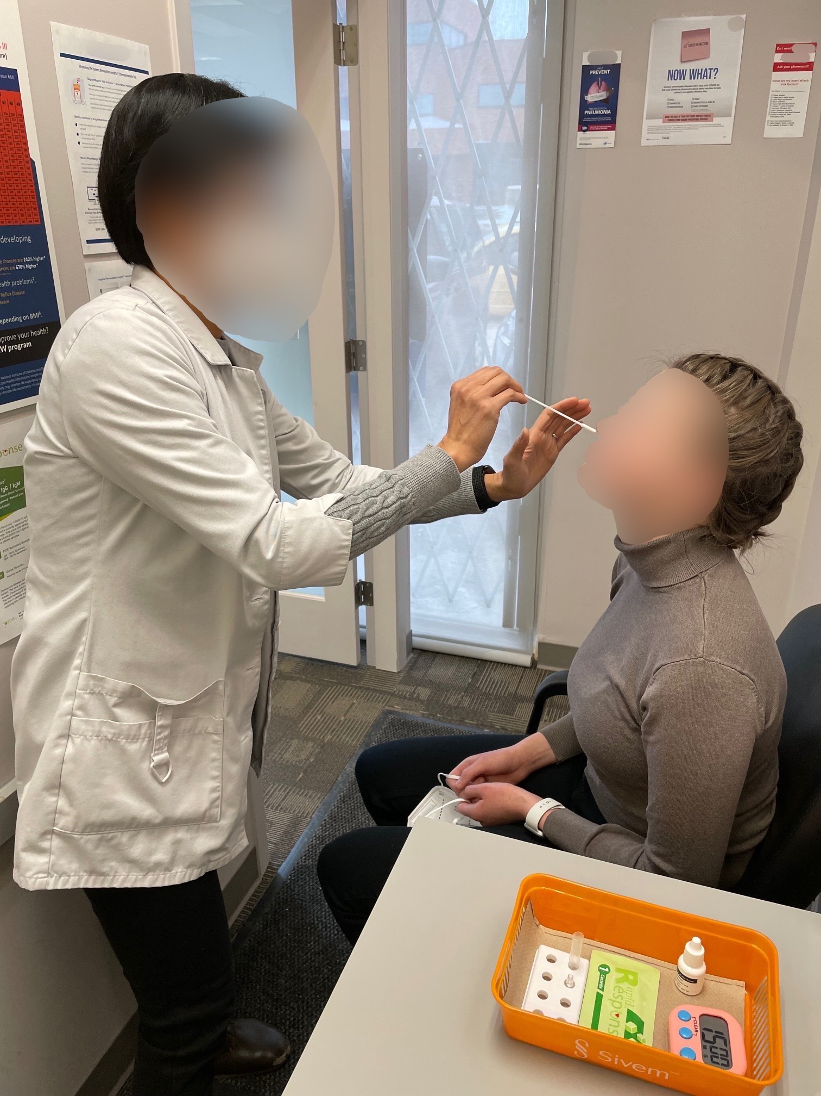
Participant 9
Photo C
“We're so adaptive and I think every pharmacist knows their role is to answer people's questions and problem solve. If we can provide the service, we will try so…I again adapted and learned how to provide another kind of healthcare service, to meet people's needs. I used my background knowledge to interpret test results and explain to clients what they have to do.”
Pictured above: Pharmacist performs a COVID-19 rapid antigen test

Slide 35
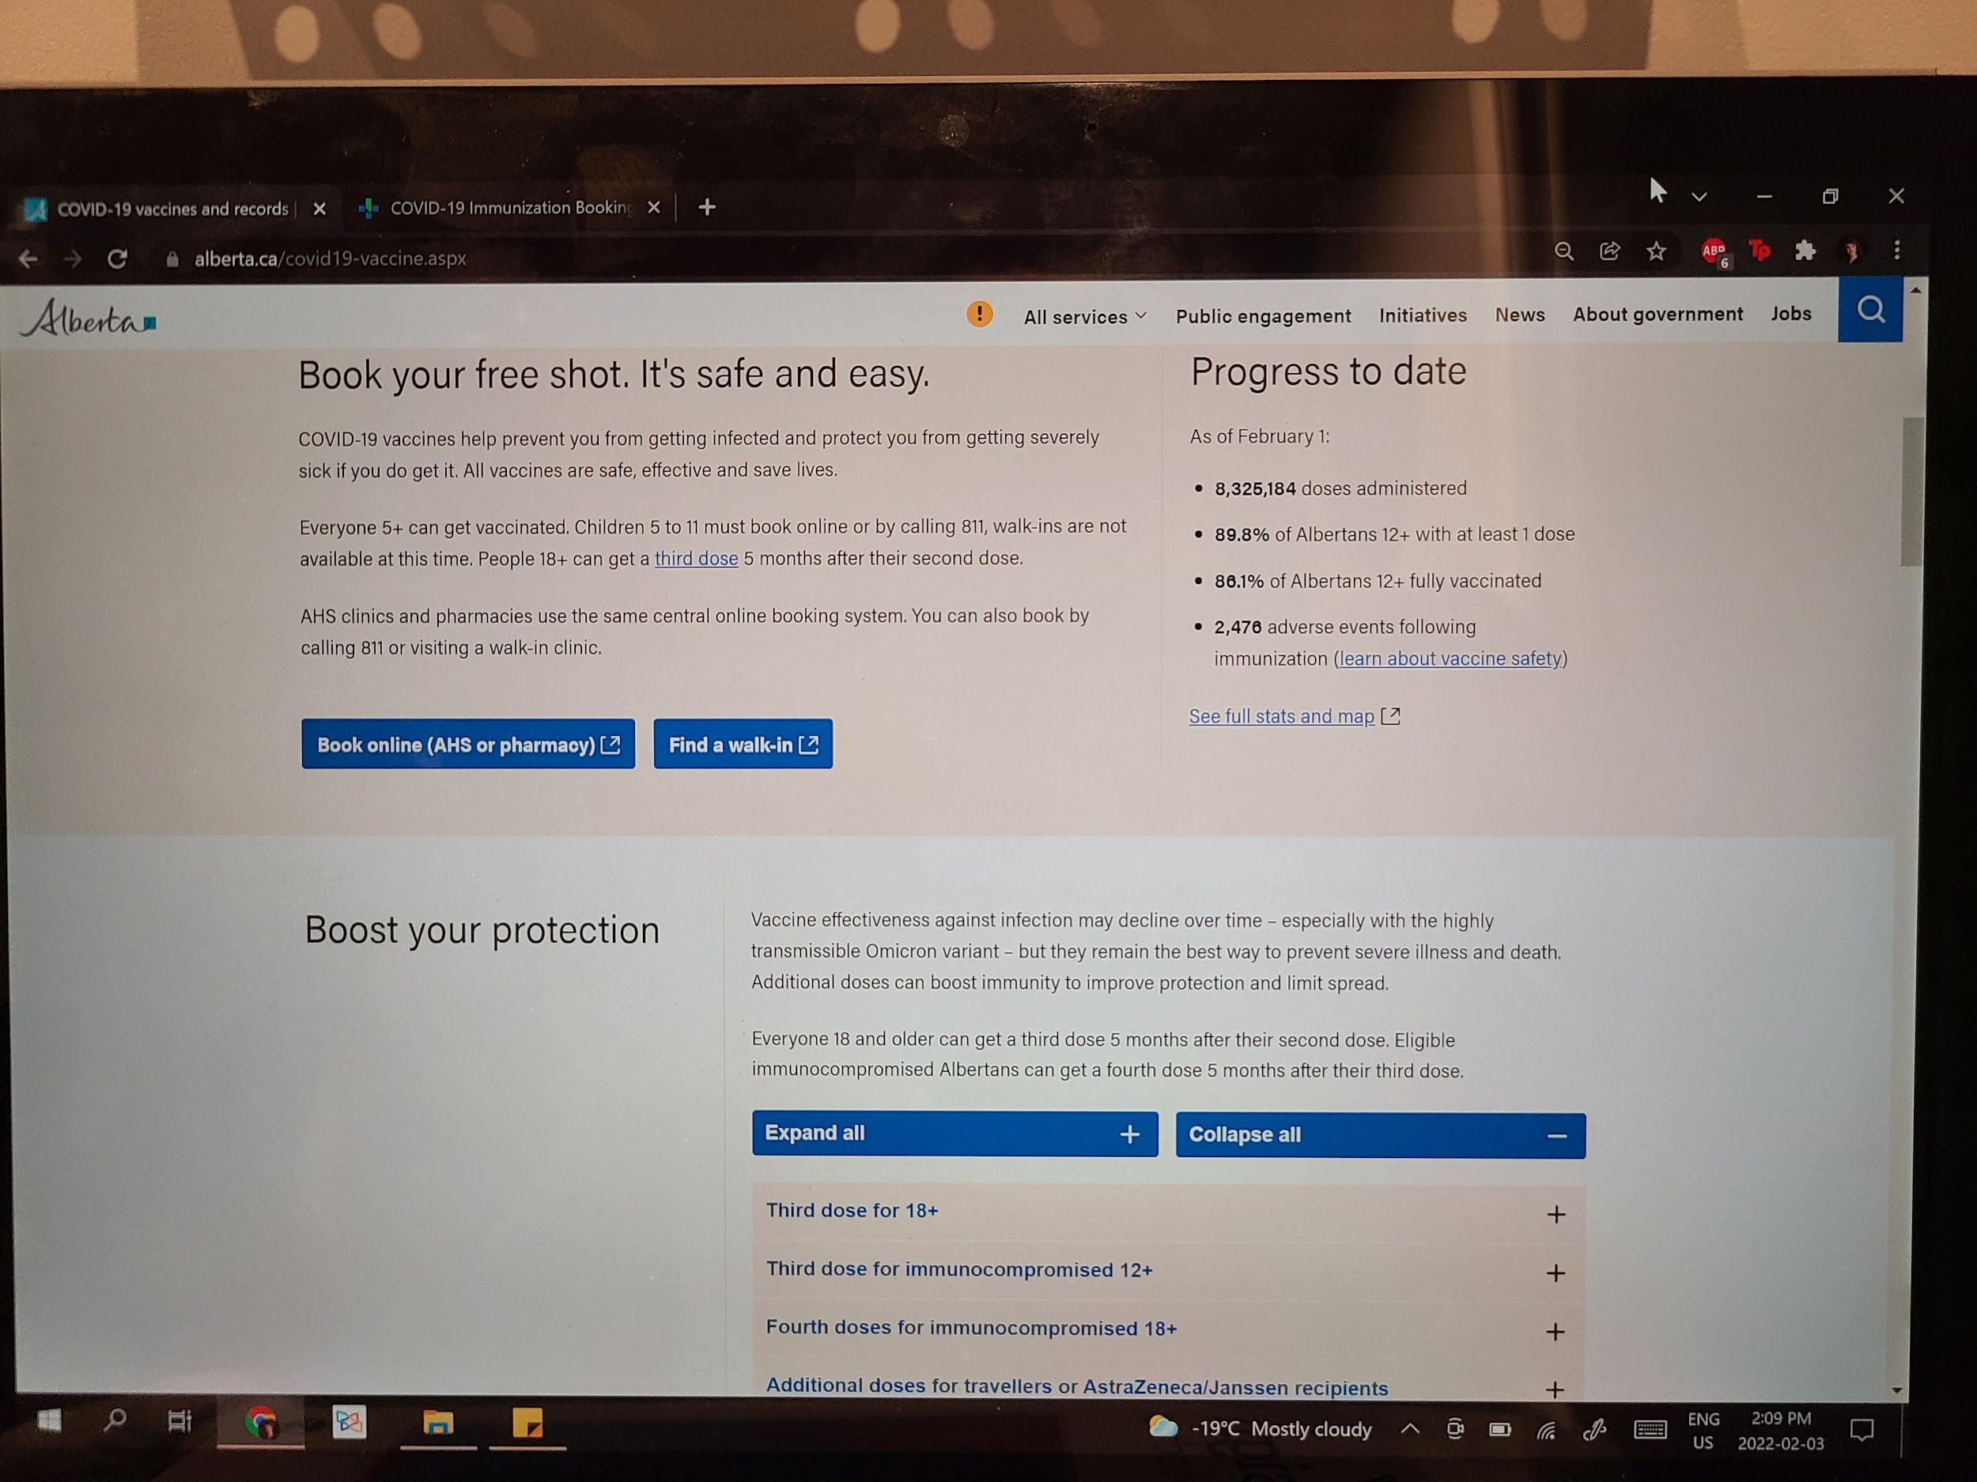
Participant 11
Photo A
“I feel like it's shifted and people almost changed how they see us. It's like, no you are expected to know this, even if you're in the middle of a shift when an [public health] announcement is made, and they [patients] know about it before you do. So, very much like the adaptability, but also sort of people's expectations for exactly how fast you're able to keep on top of news and updates and everything else.”
Pictured above: Government of Alberta’s COVID-19 vaccine website

Slide 36
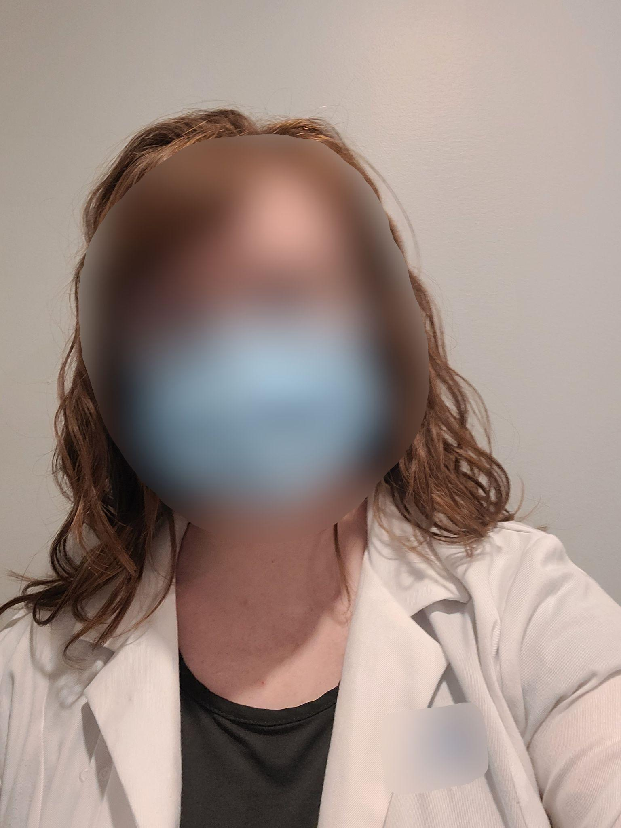
Participant 11
Photo B
“So, I feel this sort of represents the trust that I want people to be able to have in me. But also, the fact that I'm willing to put myself at your level and be like - if I expect you to do it, I expect me to do it… It feels almost hypocritical if I’m like you should do this, but I don't.”
Pictured above: A pharmacist wearing a mask and wearing a white coat

Slide 37
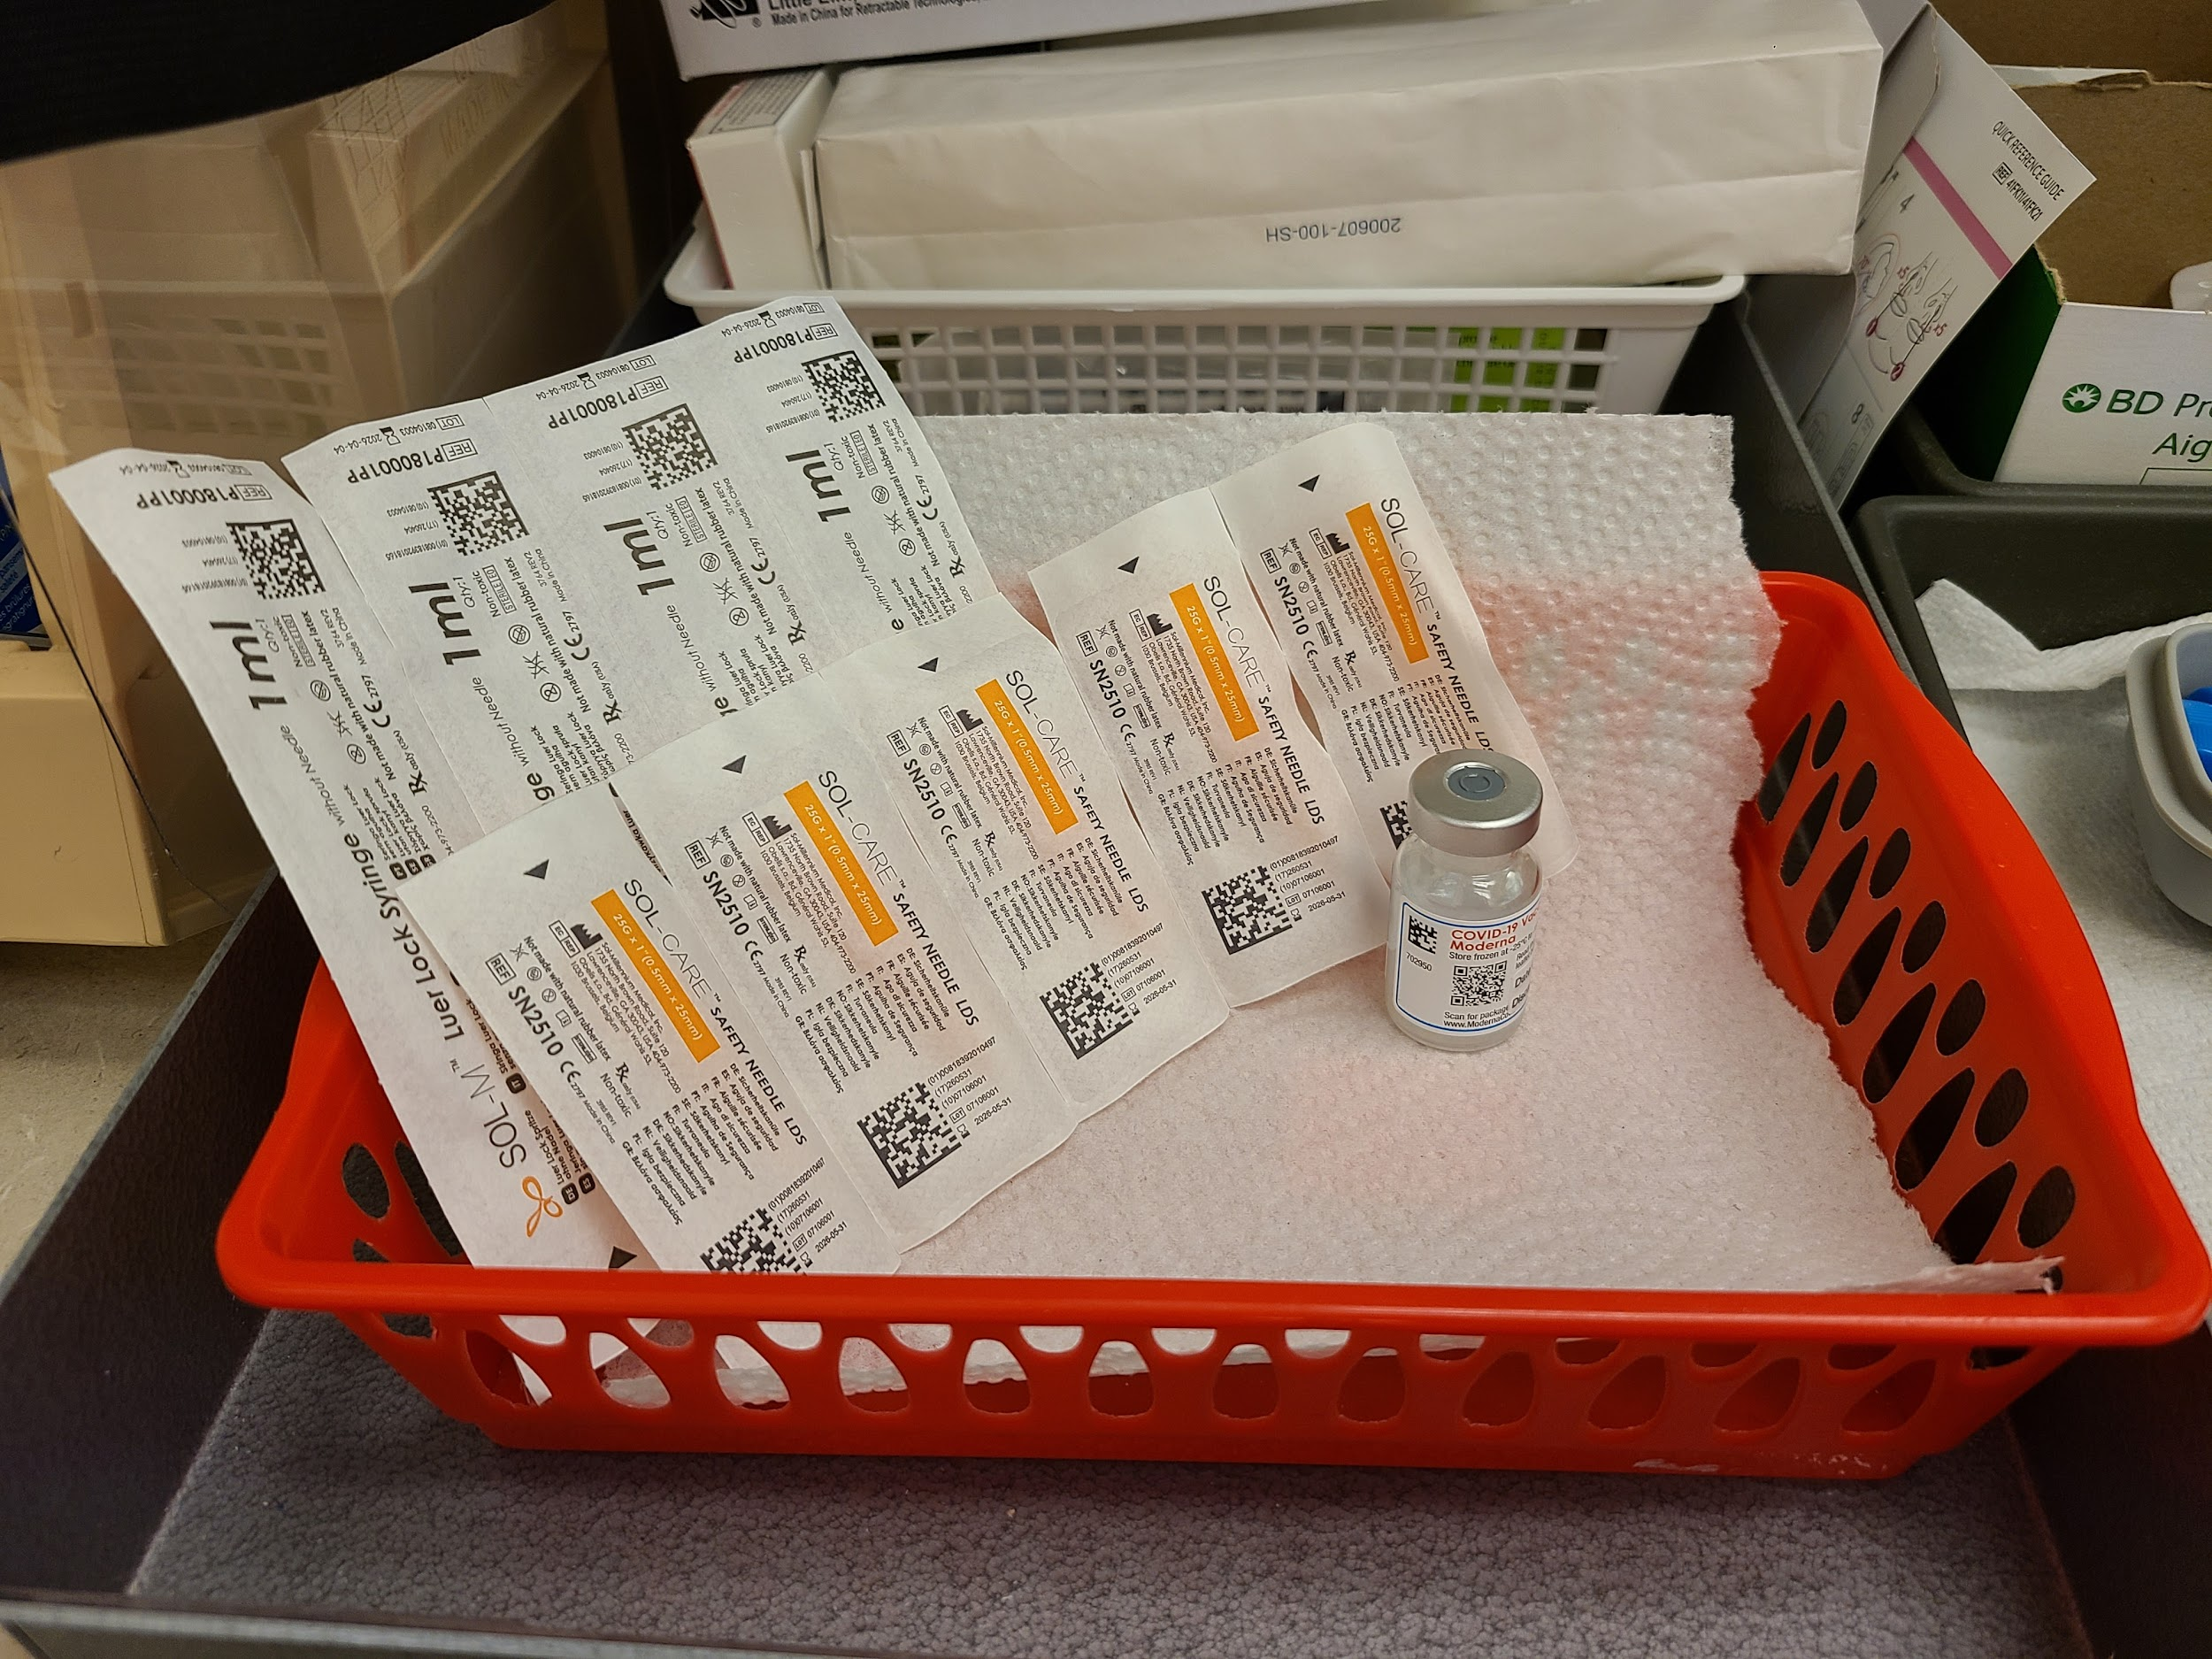
Participant 11
Photo C
“This one highlighted, how much trust people have in pharmacists, to come and ask questions and do these sorts of things…this was more of there's a lot of trust in us to provide information. Because I myself have probably given over 1,000 COVID shots last year alone. That was my entire job for three months. I got so many interesting questions, like the whole range from people who would fight with you about it vs. people who just wanted their questions answered. The fact that you were willing to spend time with them, meant a lot to them.”
Pictured above: COVID-19 vaccine vial and injection supplies

Slide 38
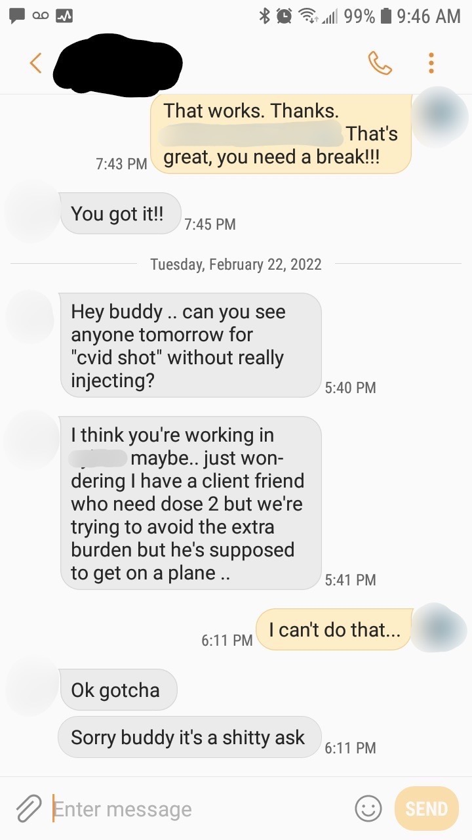
Participant 12
Photo C
“[The text message is] from a pharmacist trying to get me to give somebody a fake vaccine…but I had tons of people ask, ‘can you just like squirt it off?’ And I was like ‘no’...I was just deeply disappointed in the ethics.”
Pictured above: Pharmacist’s text message with another pharmacist

Slide 39
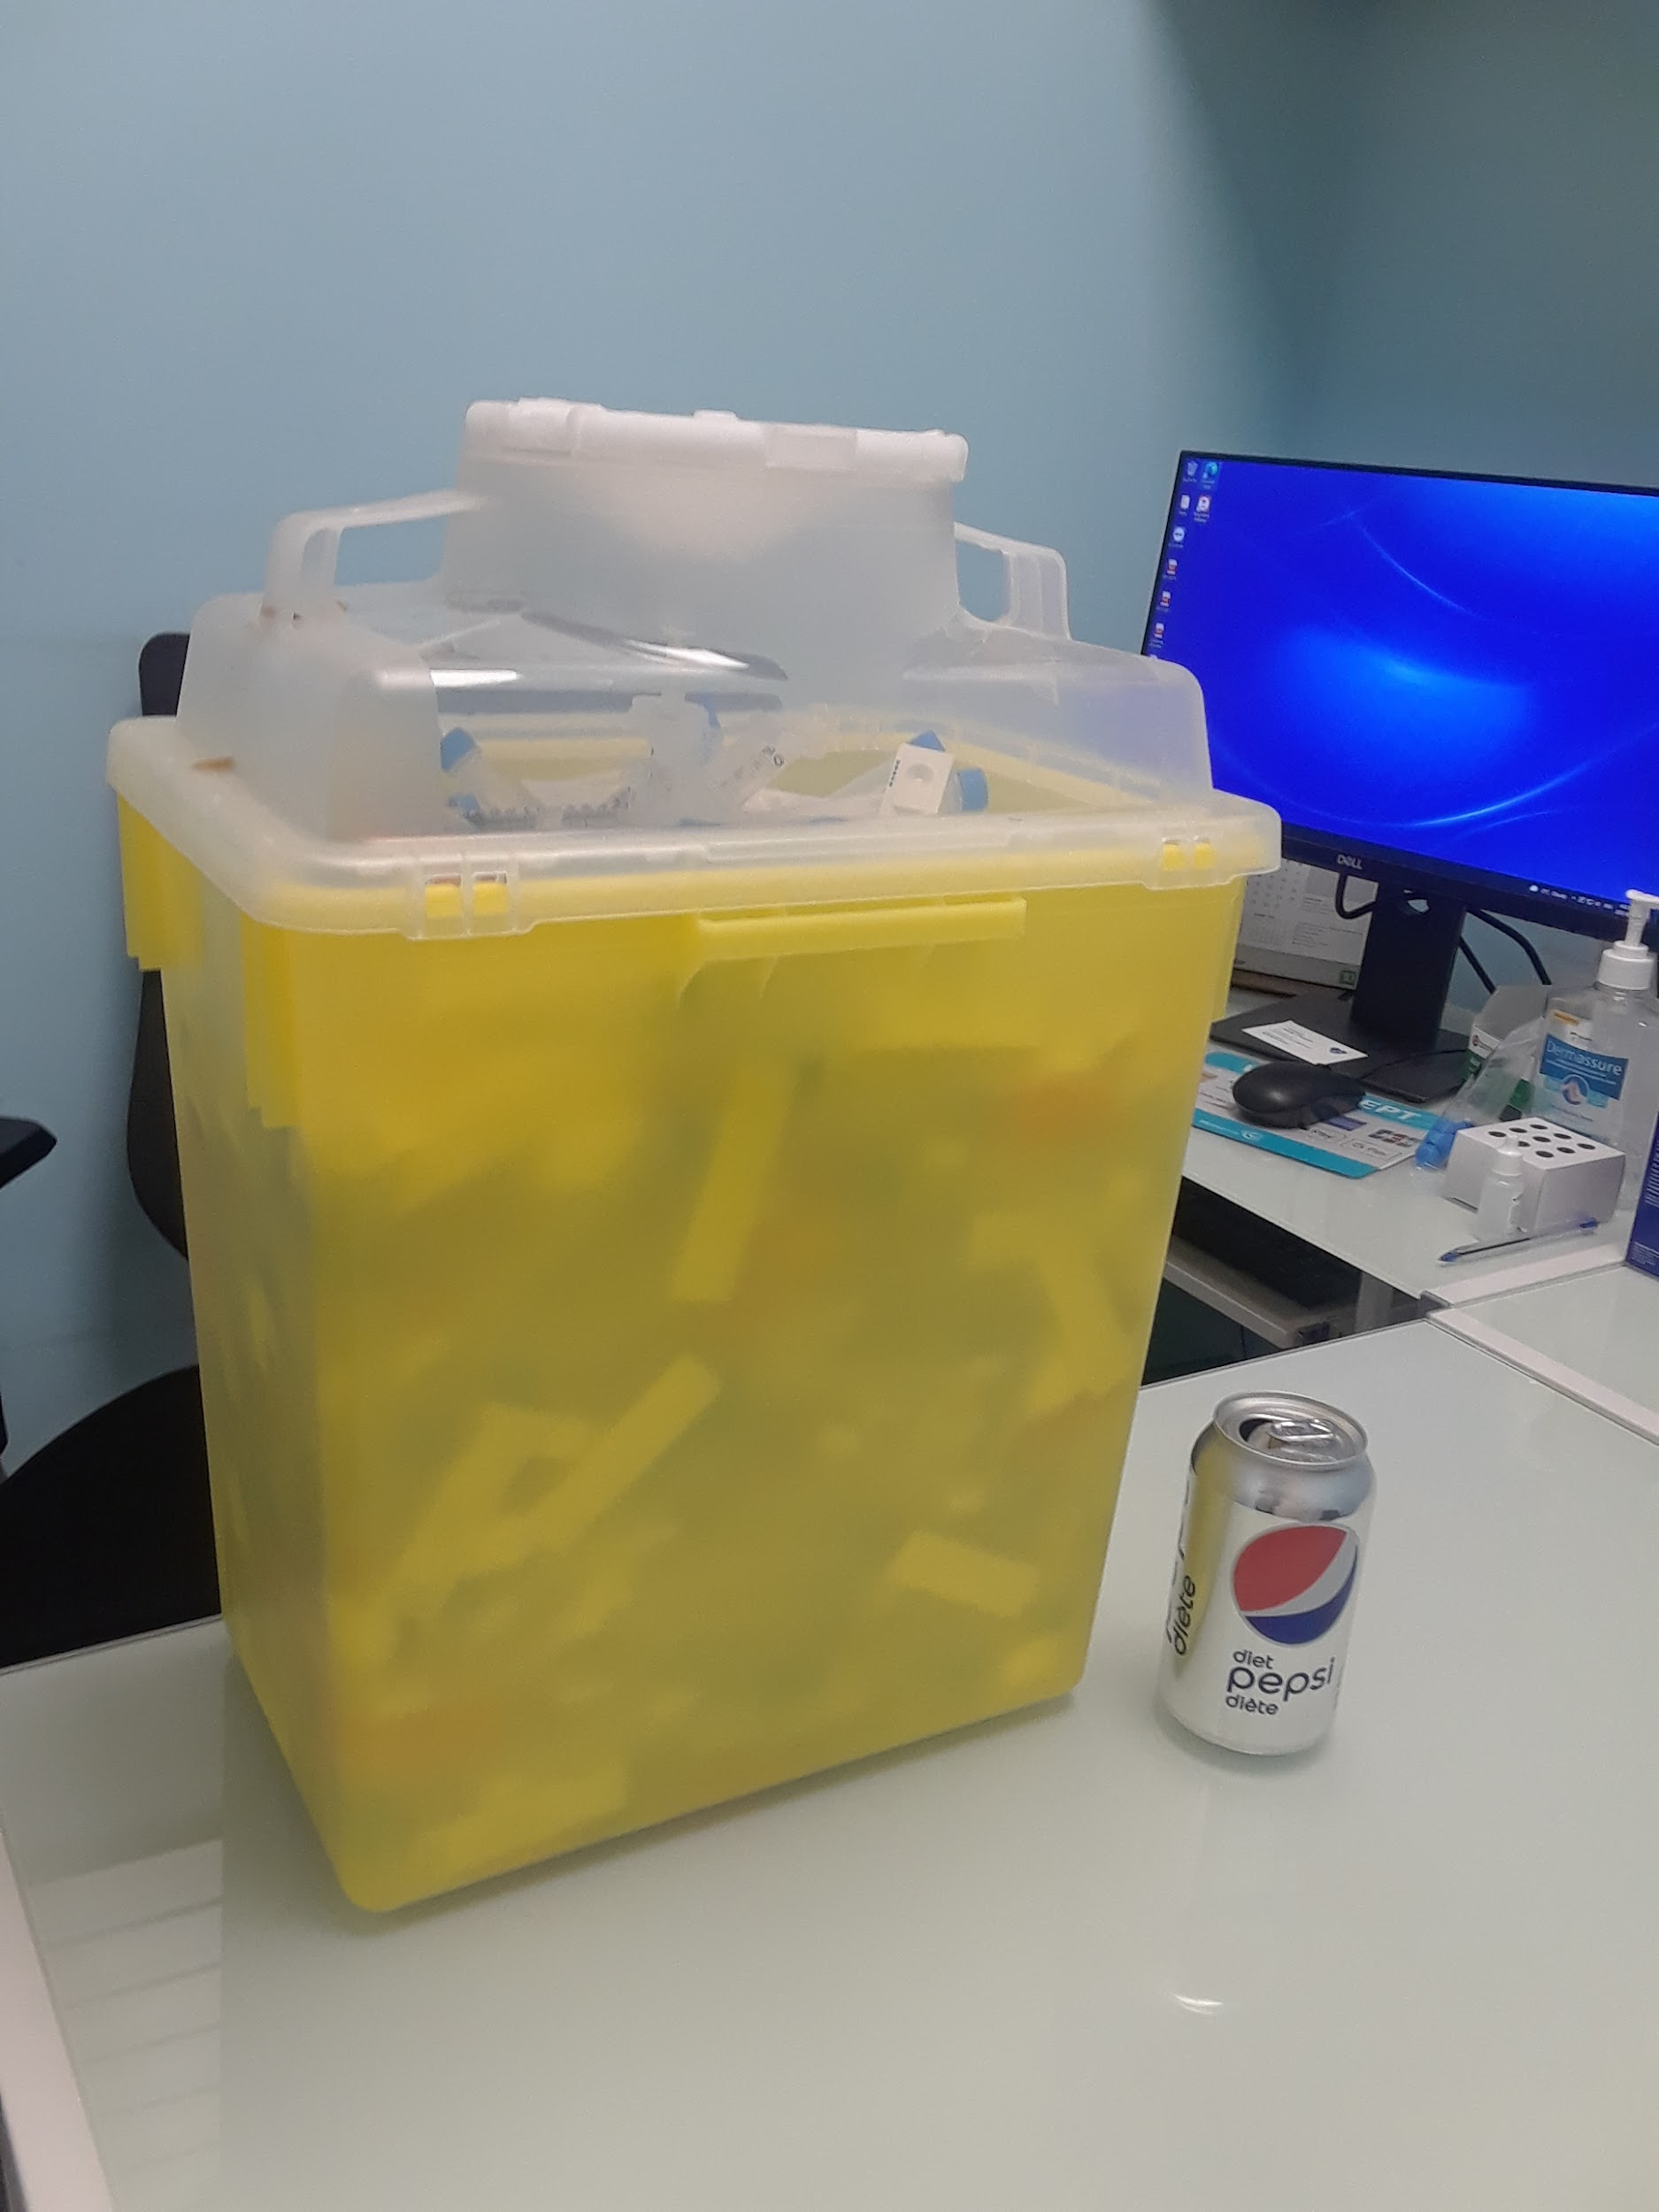
Participant 12
Photo D
“But holy crap, did we get our asses worked off over the two years! Oh man, so much work. I’m just tired, my shoes are wrecked from coming around corners. Like all the leather is ripped off the sides of them because I’d go: COVID test, injection, COVID test, injection, COVID test, injection. Stay late because people needed COVID tests, so that they can participate in human activities.We just did a tremendous amount of work, and I can honestly say that I’m quite proud of the majority of pharmacists. Who put in all that effort to help people get vaccinated and get their COVID tests and I’m happy with the effort that I put into helping society.”
Pictured above: Sharps bin and a can of Pepsi

Slide 40
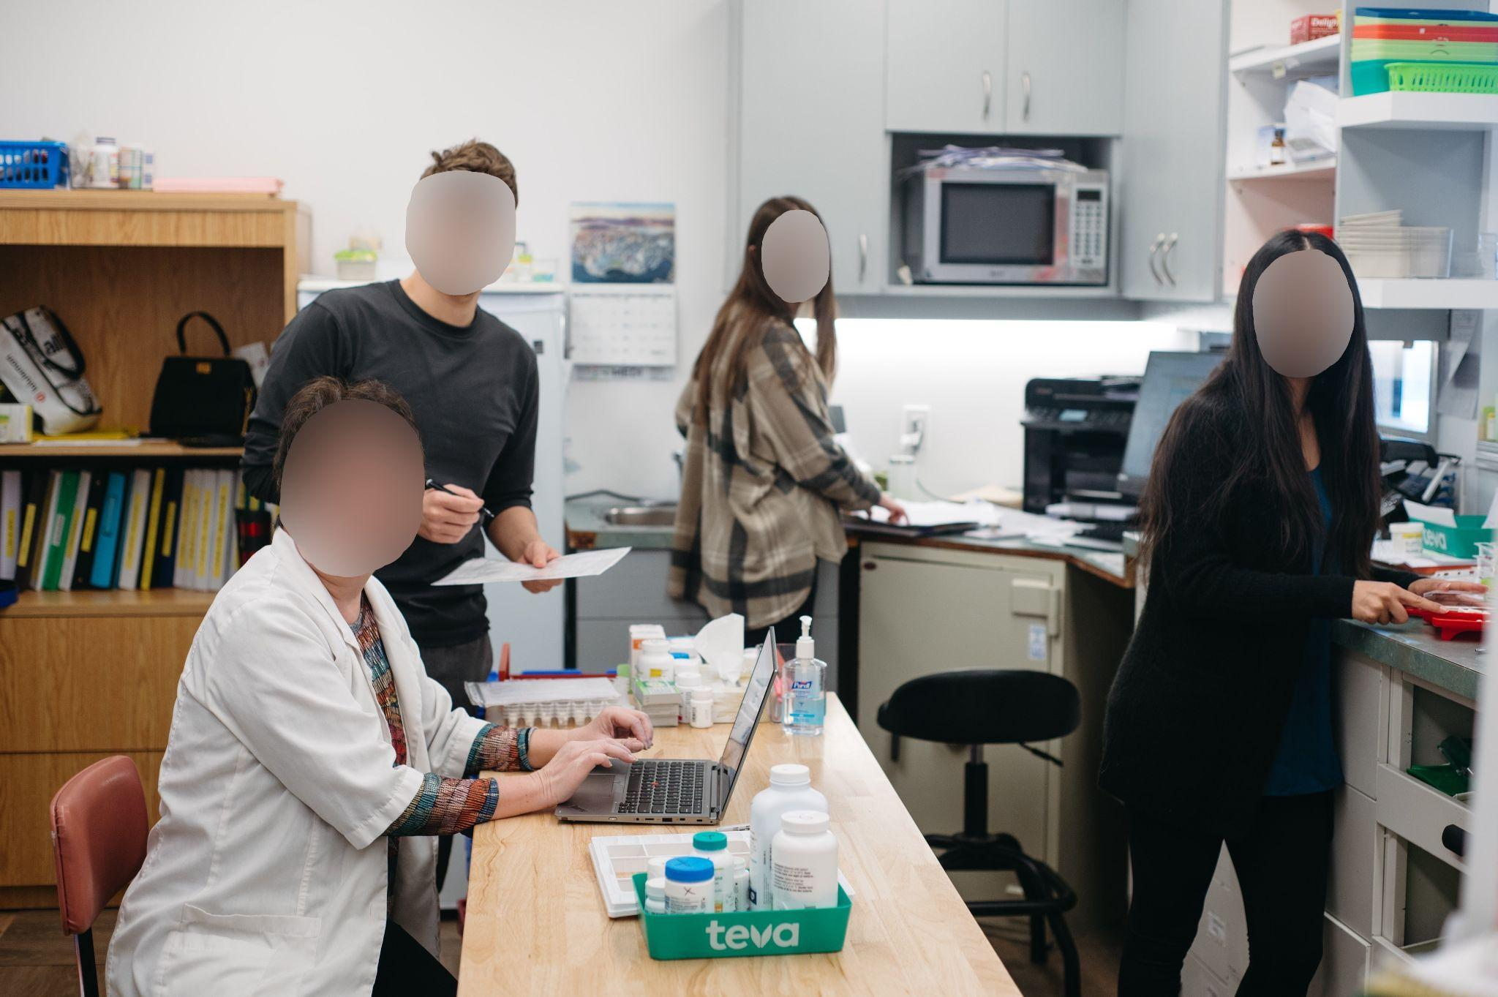
Participant 13
Photo A
“I think that we all have a role, we all work together. If that makes any sense. We're all important cogs in the wheel, no one is any better or different than the other. It's all about what we do, for our patient.”
Pictured above: Community pharmacy team

Slide 41
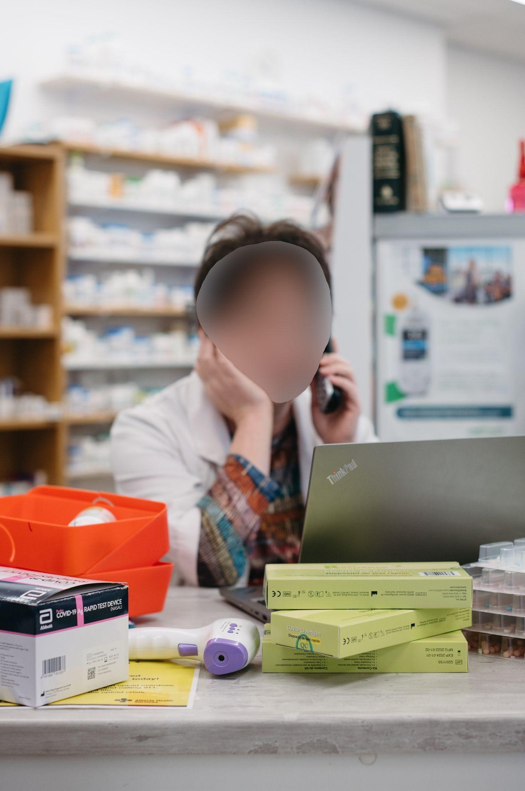
Participant 13
Photo B
“It shows just the burden that was on pharmacy over the last two years, with everything that we were doing. The computer with filling prescriptions, answering the phone, checking prescriptions, and calling people, calling for test kits, and for our safety doing the temperature checks before they came in for their asymptomatic testing. So, does this picture depict what I feel I am as a pharmacist? I think there are other pictures that would. This is just a snapshot of what we've been going through.”
Pictured above: Pharmacy counter filled with different tasks

Slide 42
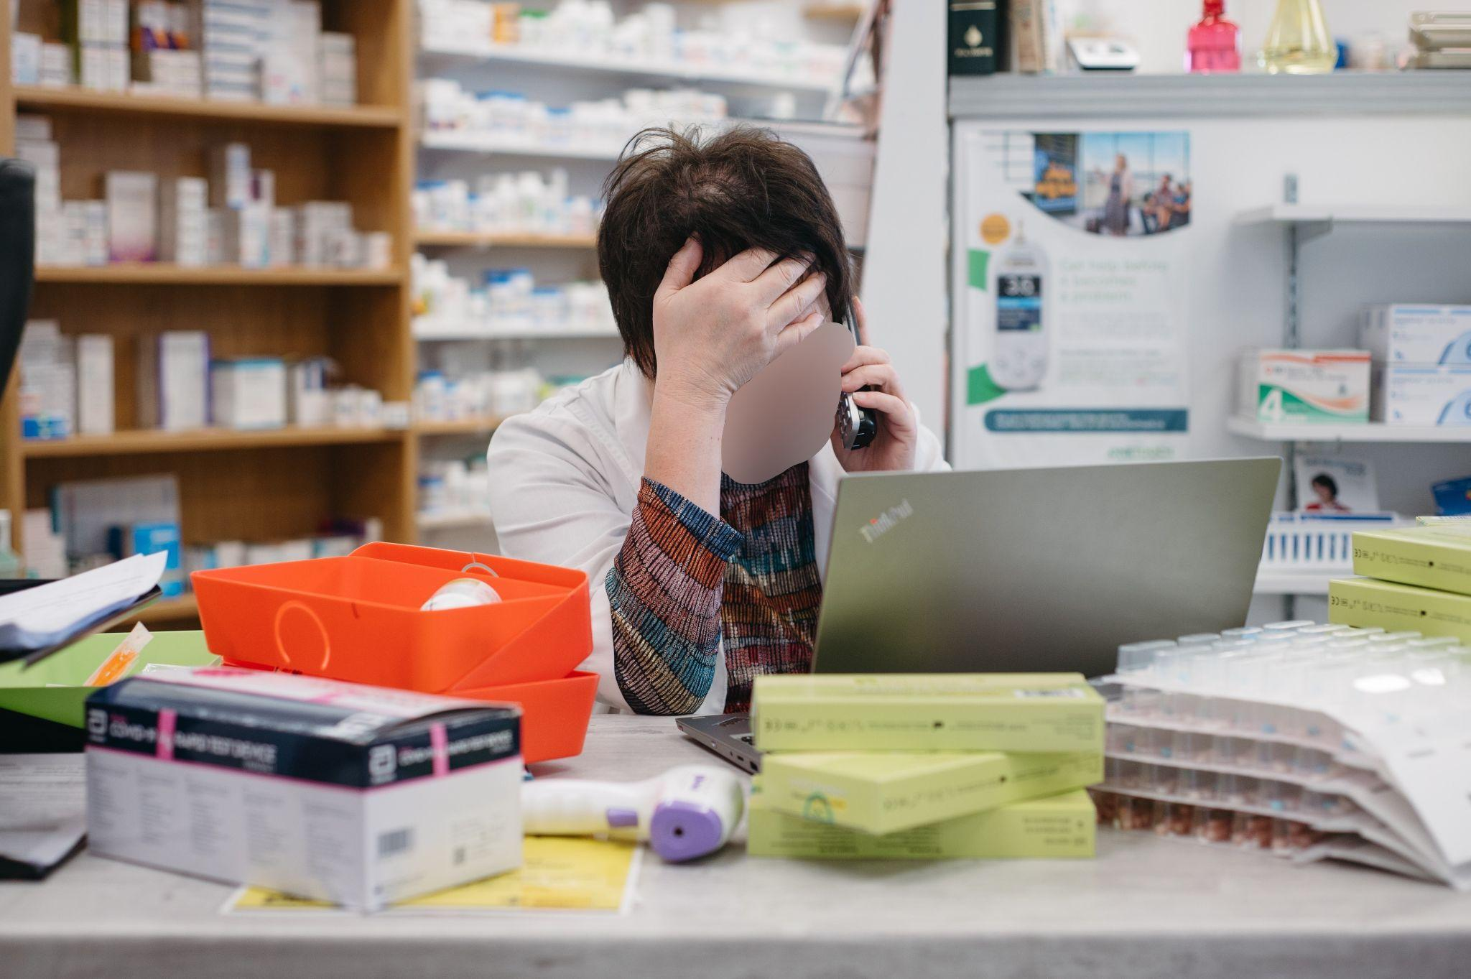
Participant 13
Photo C
“This one just depicts the overwhelming feeling every pharmacy, pharmacist has had during the last two years, at its peak. The overwhelming feeling that you can't keep up, that there's too much on our plate, or the government or the healthcare system is asking too much of us without proper support or compensation.”
Pictured above: Pharmacist overwhelmed with all responsibilities

Slide 43
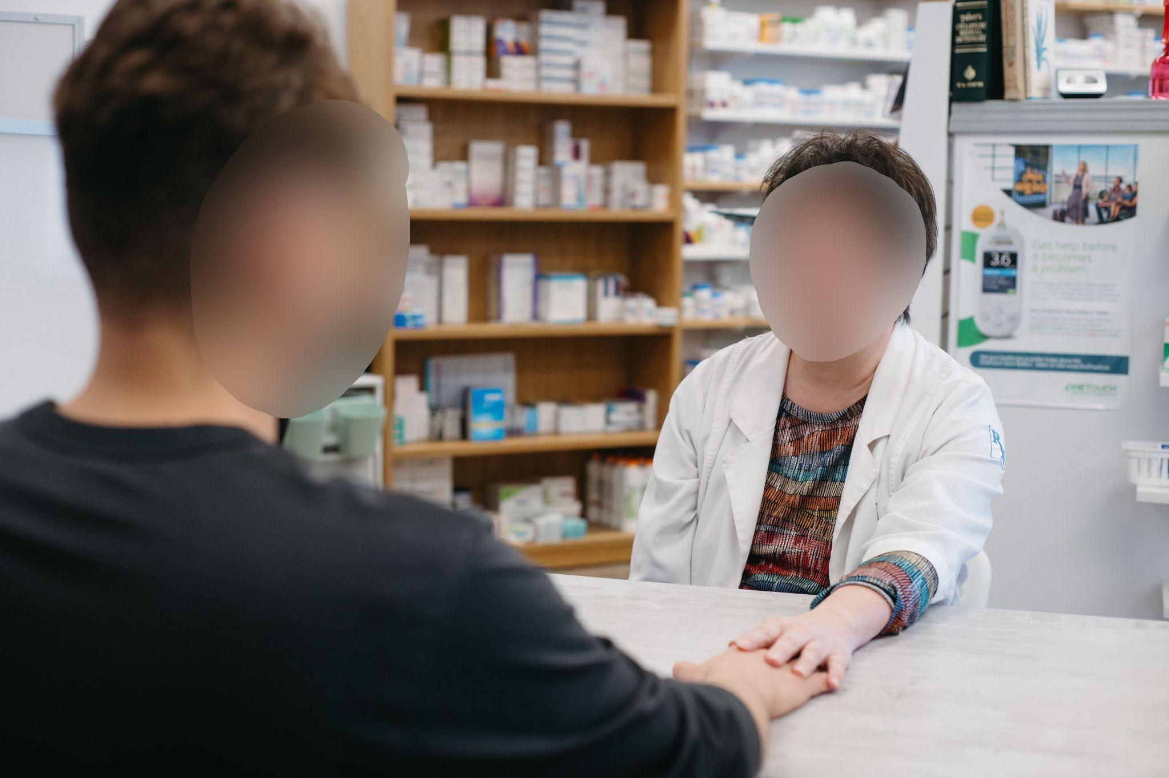
Participant 13
Photo D
“This is what I feel I am as a pharmacist, is someone caring. And I miss the contact I miss the being able to say to somebody or reach out and say ‘it's okay’ or ‘I'm here’.”
Pictured above: Pharmacist caring for a patient

Slide 44
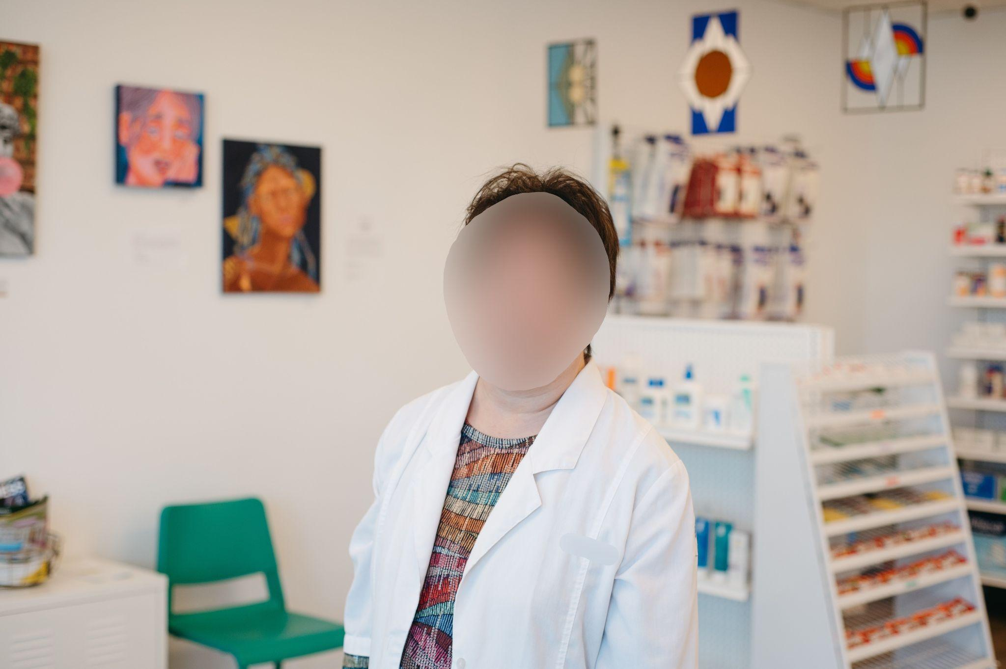
Participant 13
Photo E
“I've built a great team so that's why I don't like being up front because it's about the whole team.”
Pictured above: Pharmacist stands in a community pharmacy

Slide 45
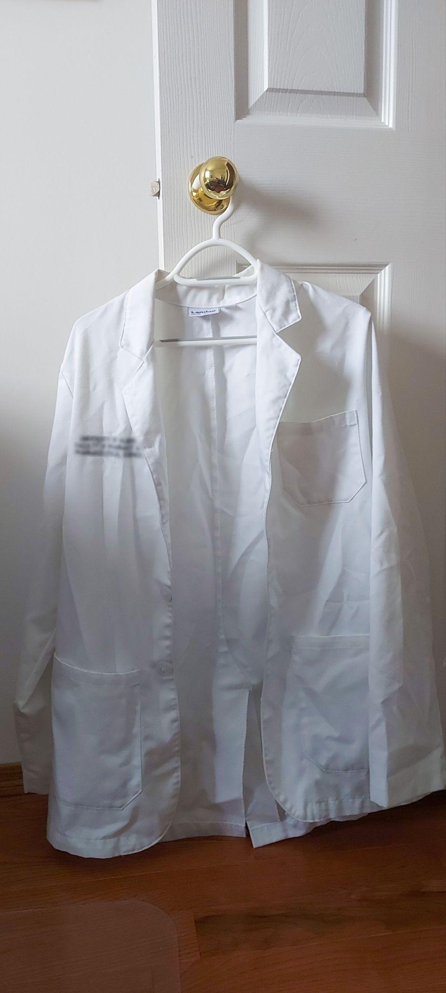
Participant 14
Photo A
“The white coat symbolizes us as a healthcare [provider], what we're able to do for our patients. But the reason I kind of left it a little bit grimy, a little bit unfolded, shows the level of work we've had to do to attain it. And even now throughout COVID, what we've had to do to try and maintain the level of care we provide for patients. And it's very time consuming. It's a lot of the extra hours and especially with the shortages, it shows how we as healthcare professionals can be quite battered from all the external stimuli.”
Pictured above: White pharmacist’s coat crumbled and disheveled

Slide 46
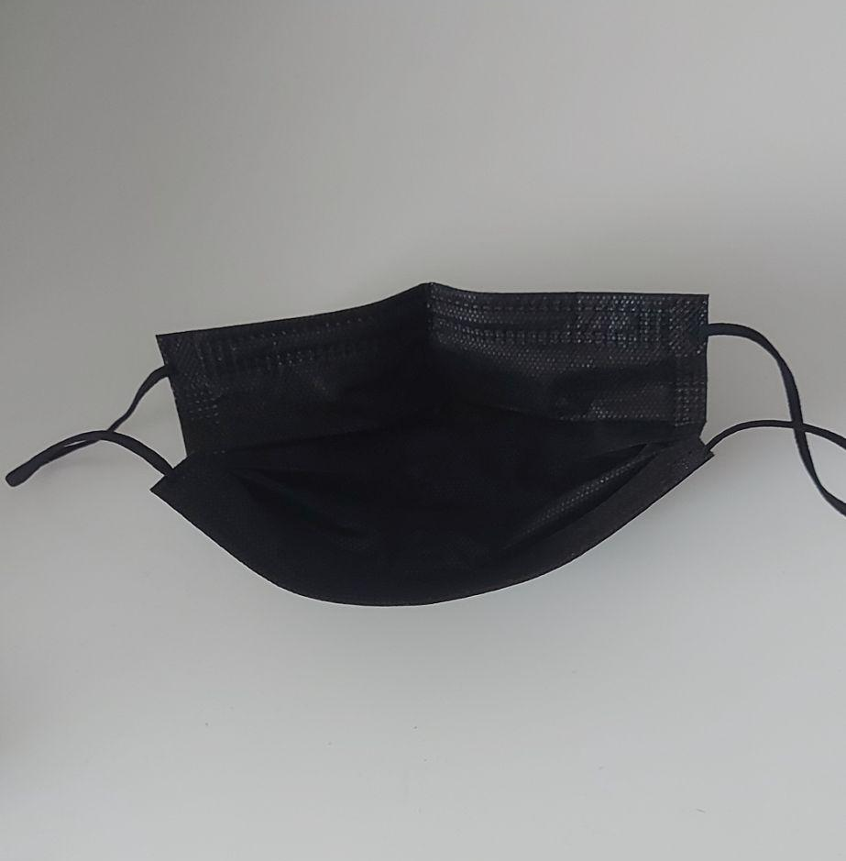
Participant 14
Photo B
“So, the reason I chose a black mask rather than the typical surgical mask. It kind of shows the level of danger and awareness that I have when I am on shift. When I am working, even though I'm doing my best to provide for my patients. That ultimately, I have to be wary of some of my own personal safety. Right. Of my family when I come home. And of course, my friends who I see and ultimately other vulnerable patients that come in and that require health services, medications and whatnot. And because I'm there and that point of contact is very important that I'm aware of my ability to potentially spread disease, especially during this COVID time. And it's just that awareness of how scary it could be. One moment you're fine. And next month, perhaps you've caught COVID. And that's one of the dangers of being a health frontline professional. And even though it may not show on individual faces of pharmacists, we are always constantly aware of the fact that there is always a possibility that we could catch a disease.”
Pictured above: A black face mask

Slide 47
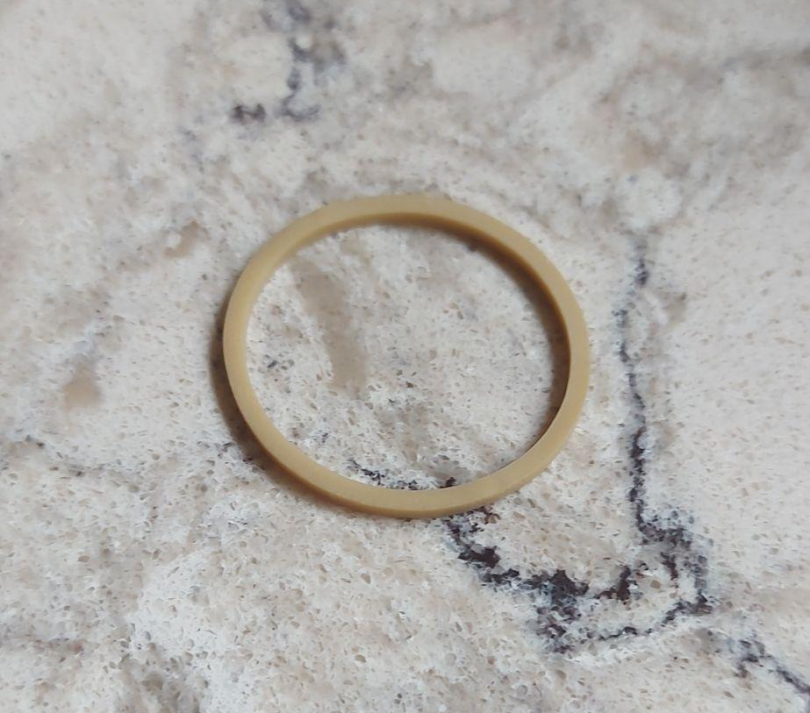
Participant 14
Photo C
“[The elastic band] represents how I feel, the way I practice, the way I feel pharmacy practice is going. And myself as a pharmacist, what does it mean to be an elastic band? An elastic band…has almost limitless potential. It could be used to bind things together. You can use it, for example, to close a bag of chips. You can perhaps even use it potentially to fix two things together that have been broken, if you like. It's quite malleable, flexible and has many roles. And its ability to be flexible, its ability to be sort of elastic really describes the nature which I feel that I am practicing and the way I feel that the pharmacy profession is currently going.”
Pictured above: An elastic band

Slide 48
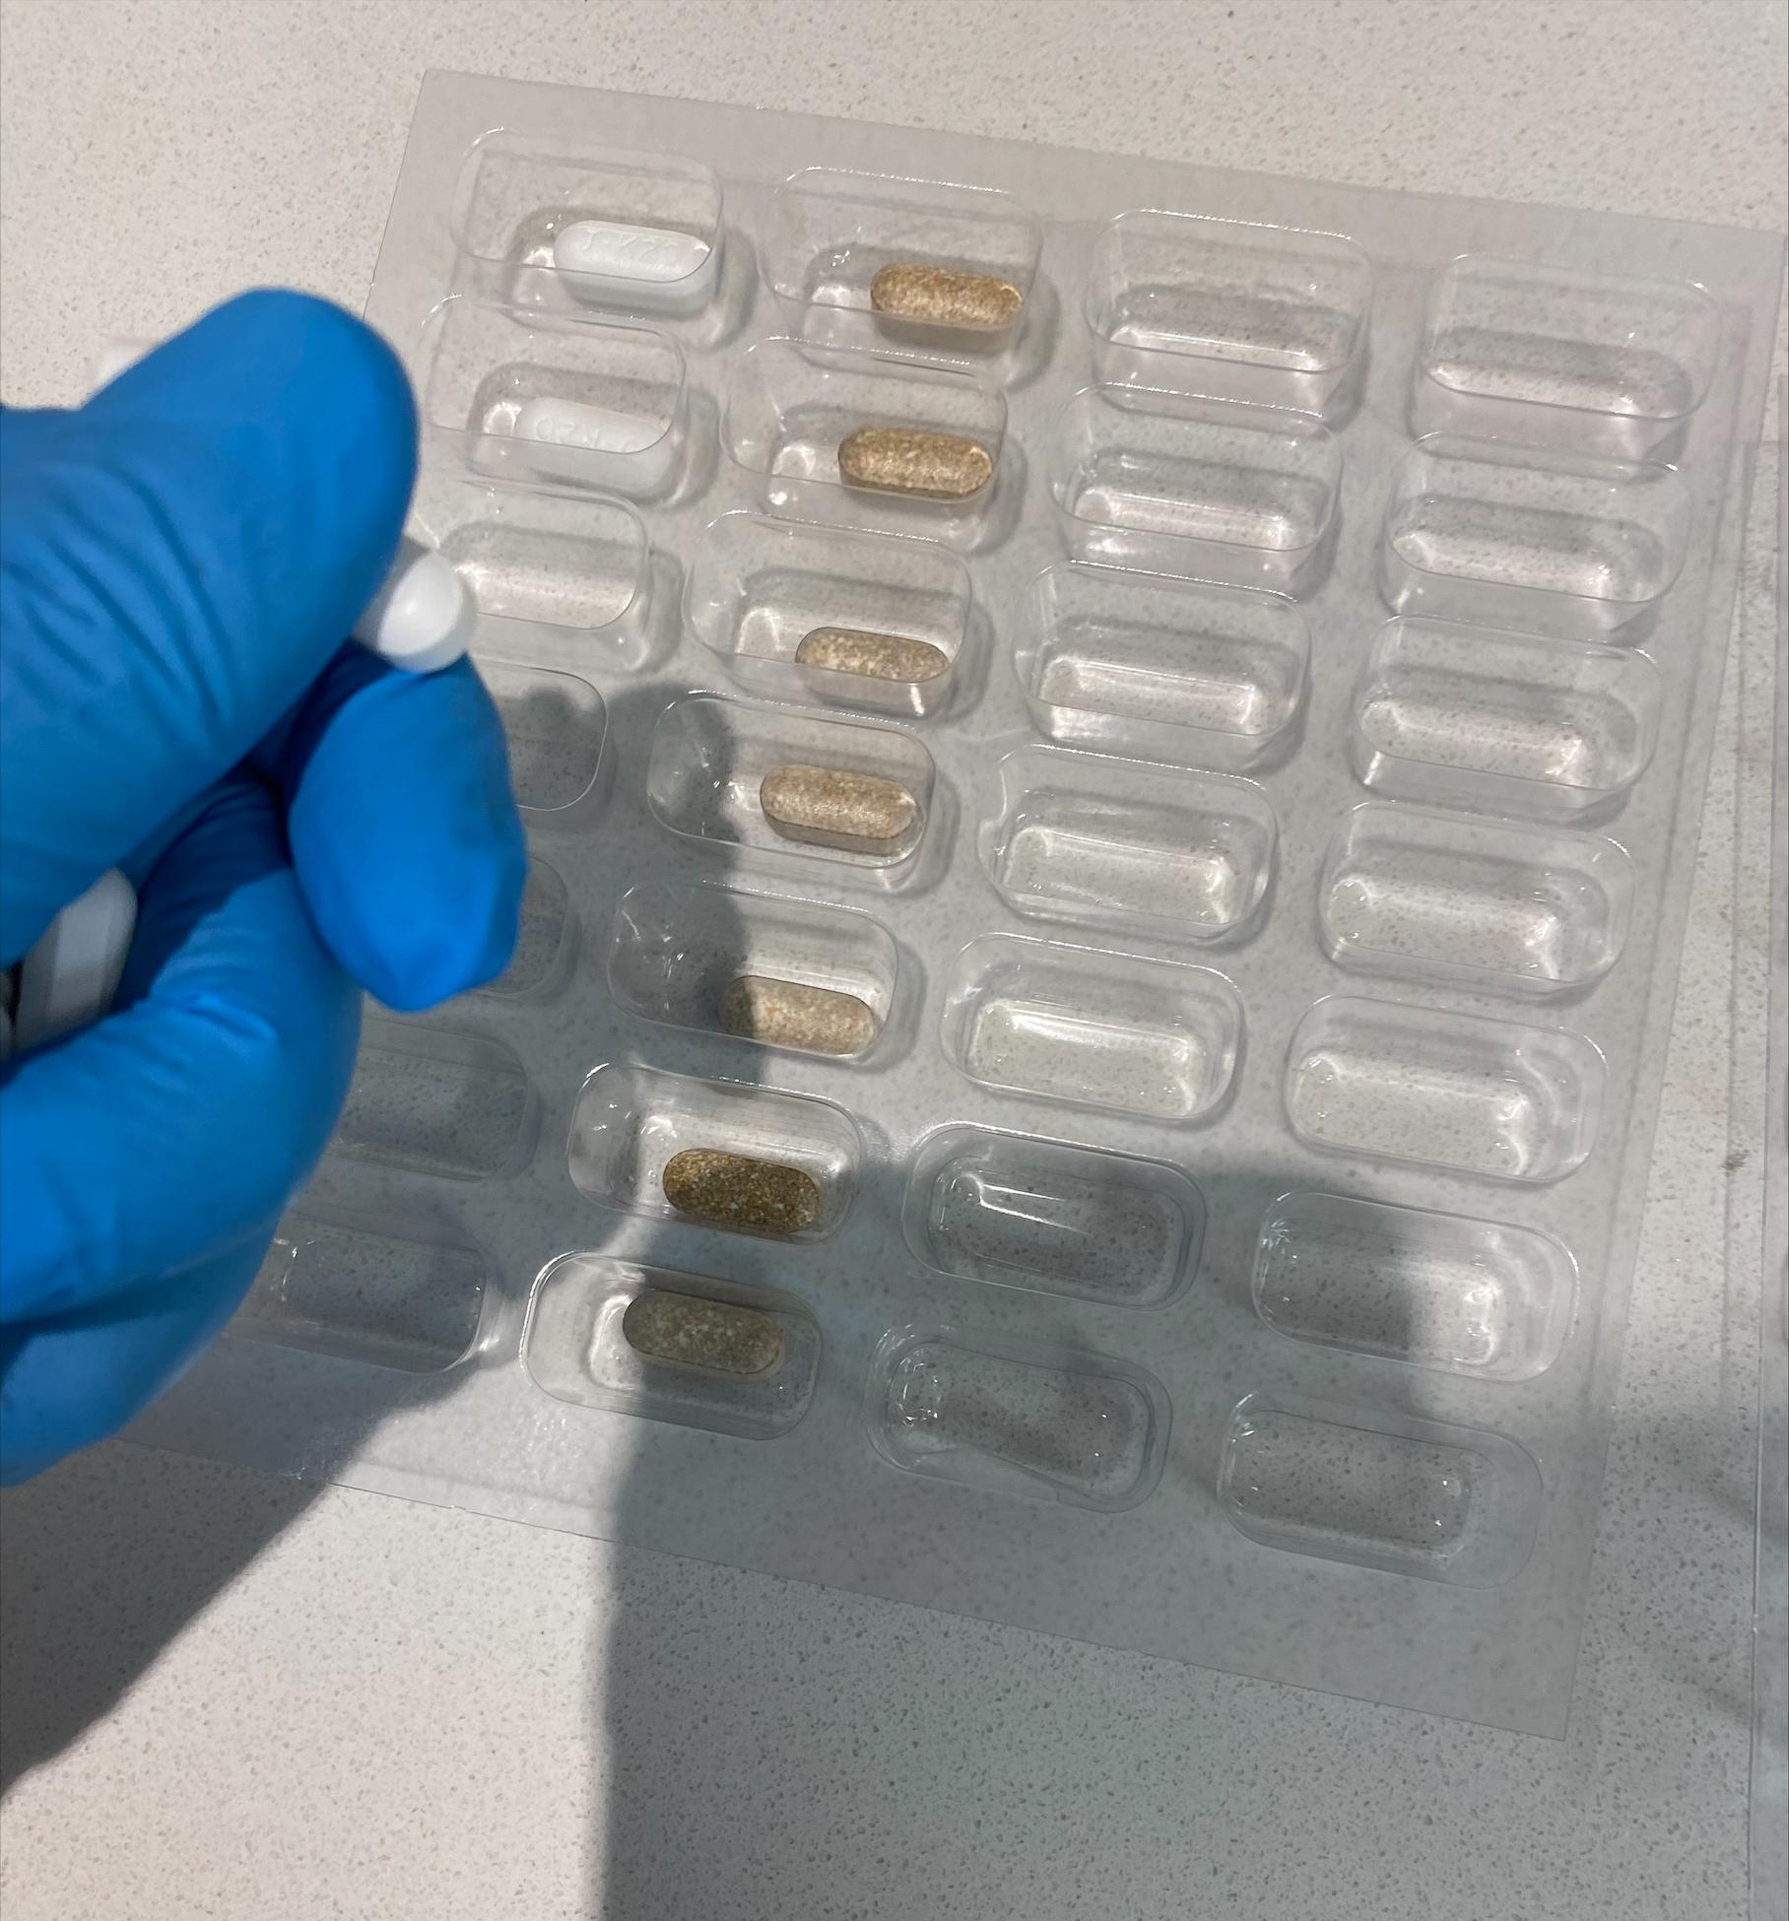
Participant 15
Photo A
“First of all, the blister packaging is one of the most important things that we do for patients with polypharmacy and with multiple conditions.I think it's a key player in the compliance of the patients and the positive outcomes to their health in general.”
Pictured above: Pharmacist holds a blister pack

Slide 49
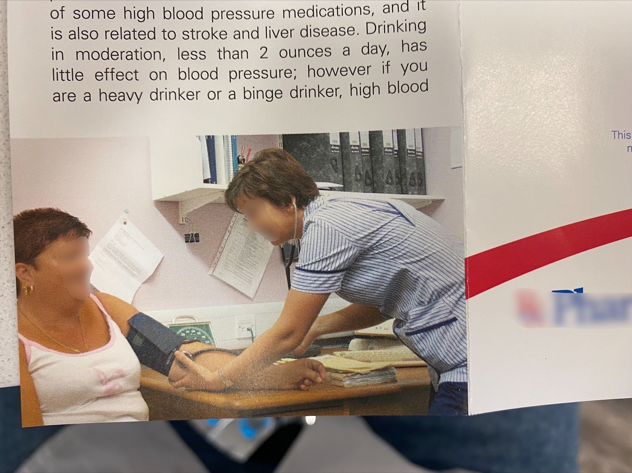
Participant 15
Photo B
“I did choose it because it does represent what pharmacists should do, putting patients first, taking patients blood pressure. When we do clinical services, when we do a care plan, stuff like that. This is probably one of the staples that we do. We measure the blood pressure. We check blood sugar [levels]. So, I did choose it because I find blood pressure and diabetes, like they are the cornerstone of the health well-being of most of my patients.”
Pictured above: Pharmacy brochure with patient care in hypertension

Slide 50
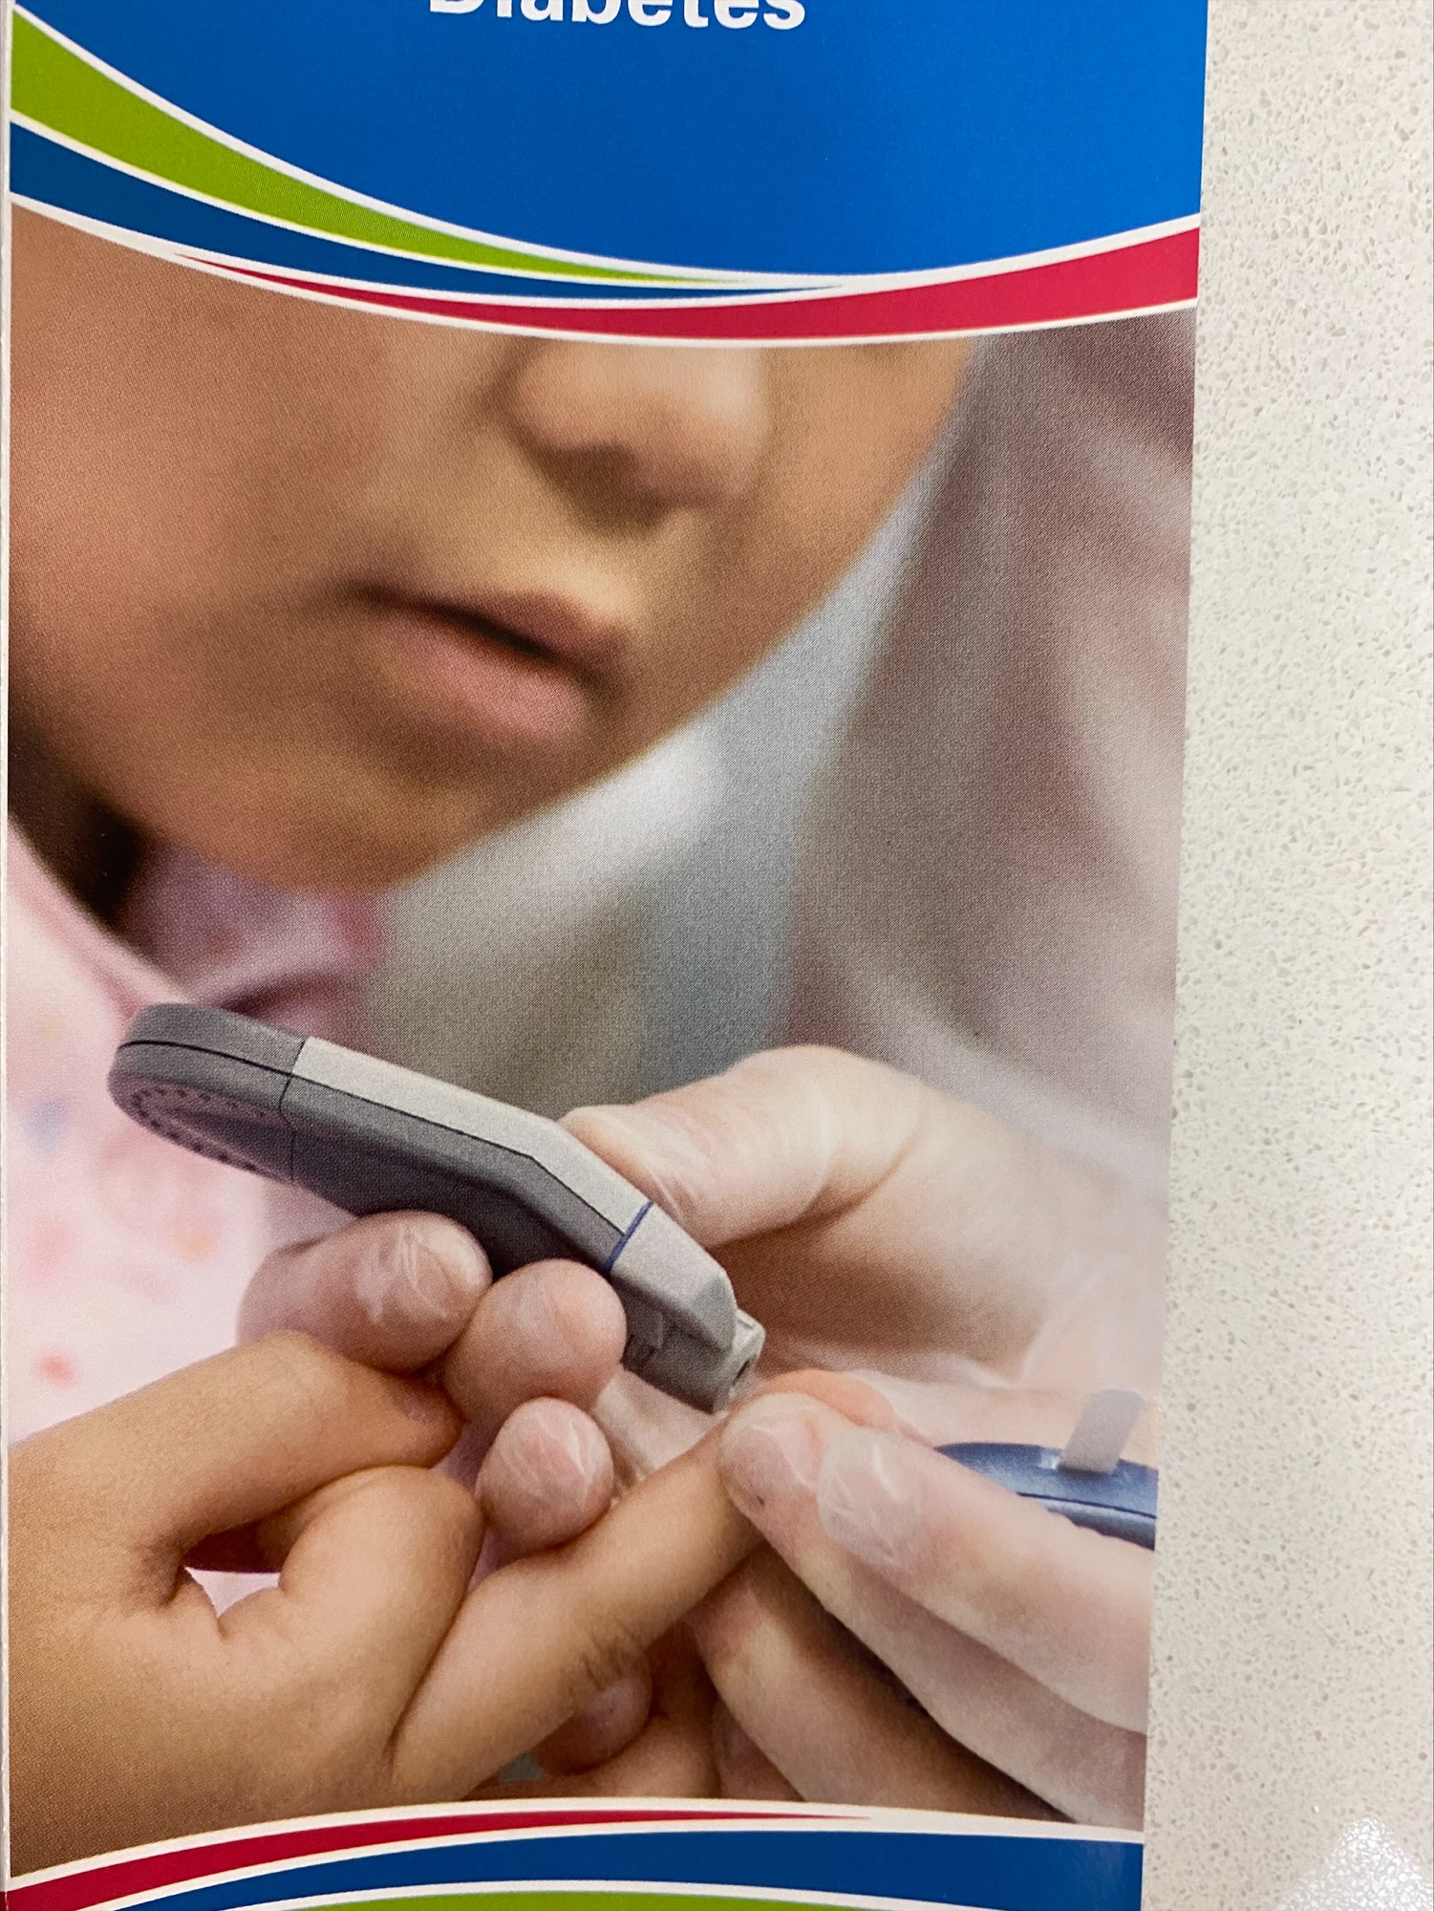
Participant 15
Photo C
“Blood glucose monitoring can be the key to unlock all these mysteries, when someone is just not feeling well for the longest time ever and they're reluctant and they didn't want to go to the lab and check. So, when you do the simple prick at the pharmacy, you just unlock the mystery and you get them to realize how important it is to take action now before it's too late. So, this is my take to that picture. It's a symbol. It's a simple prick, but it unlocks maybe a potentially very big mystery.”
Pictured above: Patient blood glucose monitoring

Slide 51
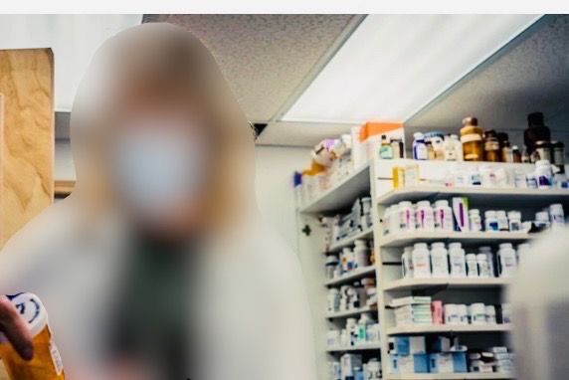
Participant 16
Photo A
“I do think it's an accurate representation of who, I am as a pharmacist, because it is definitely something that I do frequently at work and I look very focused in the photo so I'd like to think that I'm very focused pharmacist at work.”
Pictured above: Pharmacist checking prescriptions

Slide 52

Participant 16
Photo B
“I think it represents what I do as a pharmacist, because it shows me walking the walk…I was doing my job as a pharmacist keeping my patients and myself safe but also for the community. If we need everyone to get vaccinated to stay safe, then I was being a role model.”
Pictured above: Pharmacist receives COVID-19 vaccine

Slide 53

Participant 16
Photo C
“This photo was taken at my kitchen table at breakfast in the morning getting ready for work. It's a picture of me with my phone open to my Facebook App and my laptop open to the Internet. Because during COVID very early on, my mornings were consumed by opening Facebook, to see what the most recent gossip or update regarding either information on COVID itself, or the vaccines, or what the Government of Alberta was recommending for public health measures. And then my laptop was open to my resources, fact checking whatever gossip was being circulated that day. Because I knew that my day would be filled with patients coming to the pharmacy asking about what they read about COVID or what the government had recommended for changes. So, it represents what I do as a pharmacist, because it shows how dedicated I am to staying up-to-date and having the most accurate information for my patients. Not just knowing what the latest news article was about COVID, but also knowing whether what I was reading is accurate, and if it wasn't accurate how to explain why it wasn't and what is accurate. So, it's making sure that I have the best available information for my patients.”
Pictured above: Pharmacist searching for information, reading news and policy updates at breakfast prior to starting a shift

Slide 54

Participant 20
Photo A
“It's kind of abstract, but it's a line up of the COVID test kits to show how much the demand was. Remembering back to when we got the initial shipment of them even and the lineups out the door. And trying to record everyone's name and health care [number]. All the works of it. So those test kits were a lot.”
Pictured above: Rapid antigen test kits and hand sanitizer in a pharmacy

Slide 55

Participant 20
Photo B
“It was something that I had seen in a news article online and then I had re-posted it just to bring awareness. And this is also like not something that I used to do - pharmacy related social media or anything. But, it definitely hit home. I mean I can't blame the pandemic, but things got worse financially for a lot of people, and unfortunately this might have been the result of it. Yeah, not just me, but a lot of pharmacies with the same story.”
Pictured above: Social media highlighting pharmacy robberies

Slide 56

Participant 20
Photo C
“Your regular roles end up being on back burner, like your regular dispensing and your blister packaging. COVID obviously brought a bunch of extra paperwork in as well. So, this is almost towards the end of the day, when it's like - Okay, I can't even go home, because look at my countertop and that's the same for every store. But [this photo is] just kind of like a visual of behind the scenes. What's going on?”
Pictured above: Messy dispensary desks with the piles of medication management tasks to still be completed

Slide 57

Participant 20
Photo D
“People were just actually scared, I think, and they were the ones calling 811 like, ‘I have a minor scratch in my throat. What do I do?’ And then you hear on the news that the 811 call wait time is, 3.5 hours, or maybe even longer, and you can't get through. So, at that point, like as a healthcare professional and pharmacist we could have, I guess, we did ultimately. But, we can step in at that point and say like we also have the knowledge to help you or let's not overwhelm 811.”
Pictured above: Social media post promoting pharmacy services

Slide 58

Participant 21
Photo A
“It was the main way patients reached out to us…It's mostly still by phone like person to person. It's not automated. It's basically person like one question, one answer. I guess, almost like old technology. But it's helping one person at a time basically by phone. That's all you can do.”
Pictured above: Pharmacy telephone

Slide 59

Participant 21
Photo B
“I was working at a chain pharmacy, and initially at the start of the pandemic, it was mentioned that you [pharmacy staff] should not wear a mask because it will give people the impression that you are sick.”
Pictured above: Face mask on table

Slide 60

Participant 21
Photo C
“The workload just increases, like the plate is full. They want you to make it look like the plate is perfect, like there's nothing on your plate, but the plate keeps getting filled...it just keeps piling up and then, like you didn't get rid of the mess, all of the workload, the prescriptions, the questions. So, a lot of things just keep piling up.”
Pictured above: Picture of an overflowing plate

