Slide 1
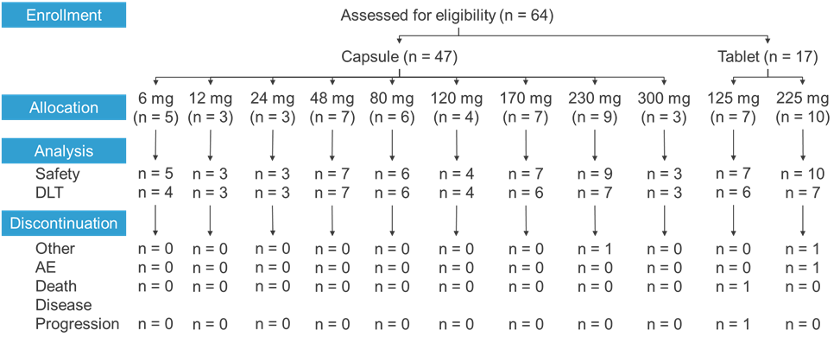
Supplemental Figure 1
Figure S1. Patient Disposition throughout the Phase 1 study with Pelabresib. PK and PD populations included the same number of participants as the Safety population. AE=adverse event; DLT=dose limiting toxicity; PK=pharmacokinetic; PD=pharmacodynamic.

