Slide 1
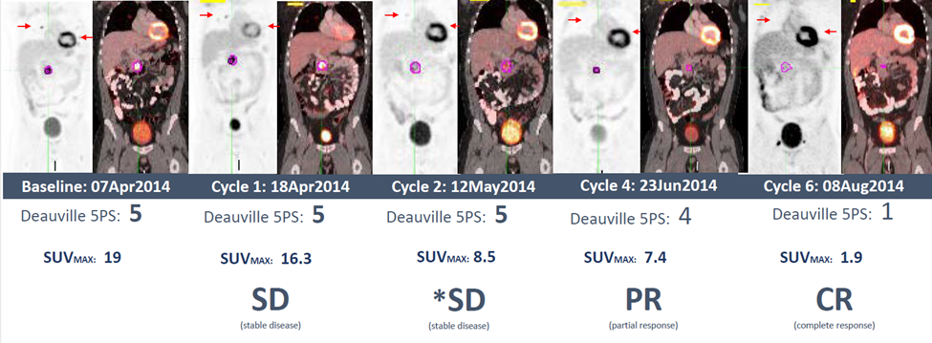
Supplemental Figure 2
Figure S2. Complete Response Achieved After Six Treatment Cycles. The significant reduction of SUV uptake at Cycle 2 is an early predictor of response as this patient achieves a CR at the Cycle 6. Non-target lesions in the lungs (indicated by arrows) show progressive decrease with a CR by Cycle 6. SD was assessed using the 2007 Revised Response Criteria for Malignant Lymphoma (Cheson, 2007). PR or PMR by EORTC and Lugano 2014 criteria, respectively. Interpretation of FDG-PET imaging data followed the 5-point Deauville criteria (Meignan, 2009). CR=complete response; EORTC=European Organisation for Research and Treatment of Cancer; FDG-PET= fluorodeoxyglucose-positron emission tomography; MAX=maximum; PMR=partial metabolic response; PR=partial response; SD=stable disease; SUV=standardized uptake value.

