Slide 1
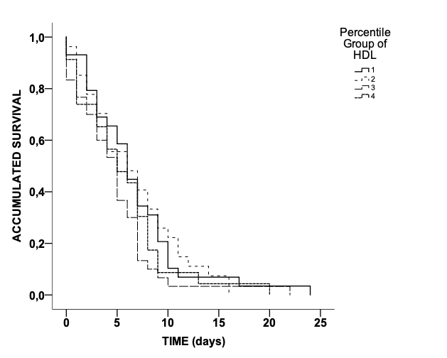
Supplementary material: Kaplan Meier survival curve regarding HDL cuartiles
P = 0.169

