Slide 1
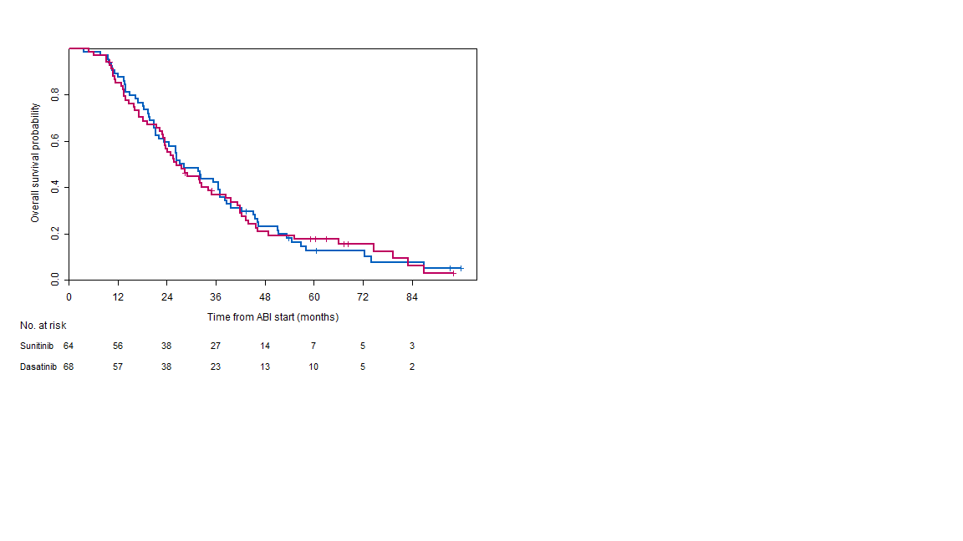
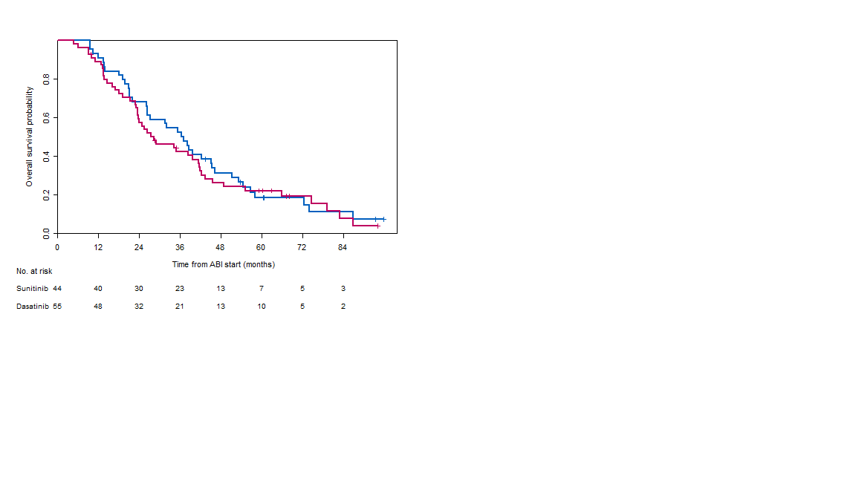
Supplementary Figure 1: Kaplan-Meier estimates for overall survival from study entry by treatment group a) in all patients randomized and b) in patients who did not receive prior chemotherapy.
a)
b)
Median Overall Survival
Sunitinib (58/64) 27.7 months (95% CI 23.3 – 37.1)
Dasatinib (59/68) 26.3 months (95% CI 23.5 – 38.4)
Median Overall Survival
Sunitinib (38/44) 36.8 months (95% CI 26.4 – 46.3)
Dasatinib (46/55) 28.5 months (95% CI 23.5 – 41.8)
HR 1.02 (95% CI 0.71 – 1.47)
HR 1.14 (95% CI 0.74 – 1.75)

