Slide 1
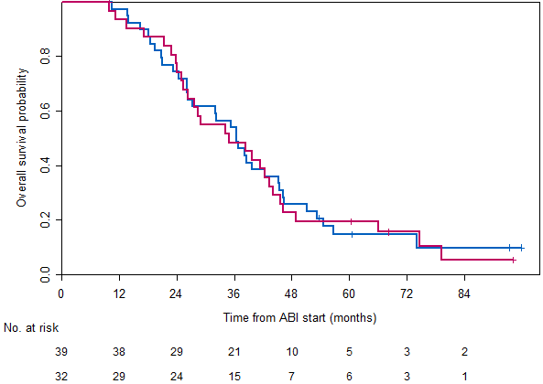
Supplementary Figure 2: Kaplan-Meier estimates for overall survival in patients who received both targeted agents in sequence (Sunitinib followed by Dasatinib vs Dasatinib followed by Sunitinib)
Median Overall Survival
Sunitinib- Dasatinib (34/39) 36.6 months (95% CI 27.2 – 45.5)
Dasatinib- Sunitinib (28/32) 35.0 months (95% CI 26.3 – 45.7)
HR 1.03 (95% CI 0.62 – 1.70)
Sunitinib- Dasatinib
Dasatinib- Sunitinib

