Slide 1
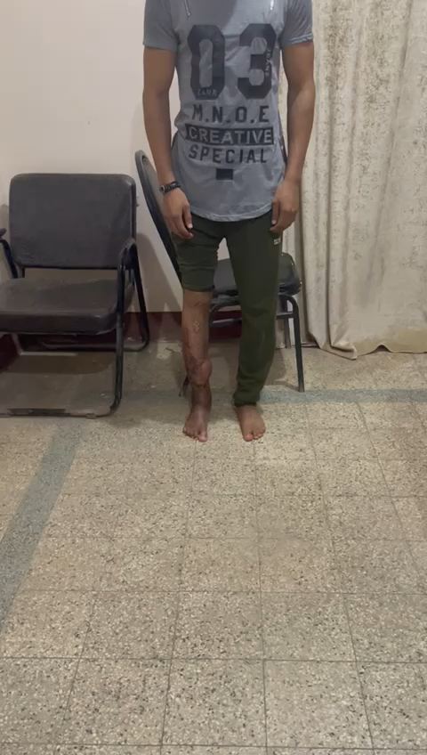
Video 1: A male patient experienced paralytic foot drop, compromised soft tissue, and knee stiffness due to a previous united, open floating knee fracture. He was dependent on two crutches and retired. After surgery, he can walk unaided with an improved gait pattern and return to work.

