Slide 1
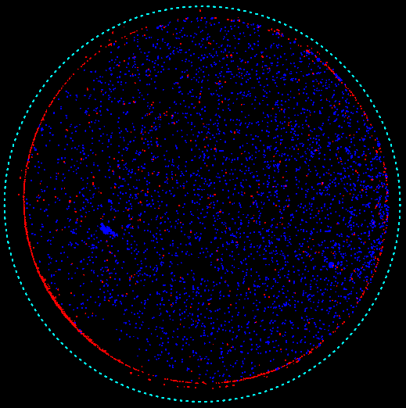
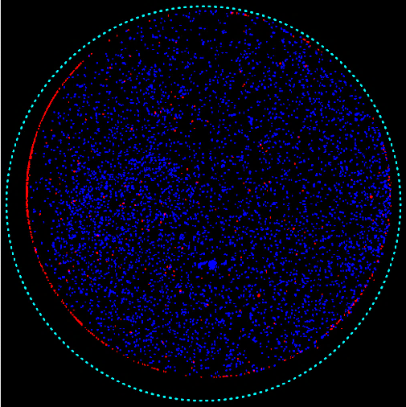
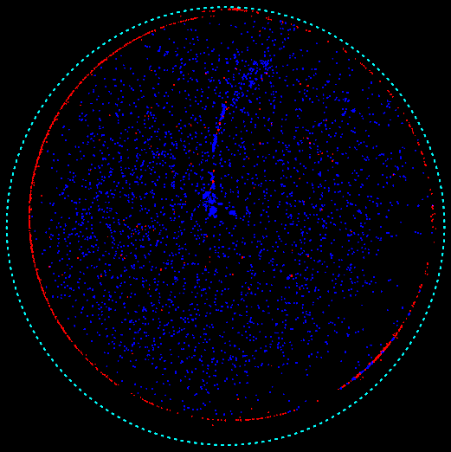
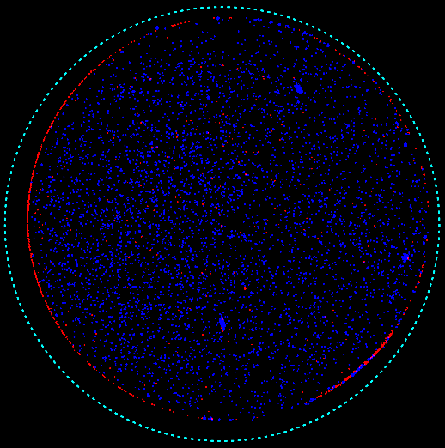
S1
A
Control Mal C 1μM Mal C 5μM Mal C 10μM
B
D
C
-- + -- + Mal C 10μM
-- -- + + Con A

Slide 2
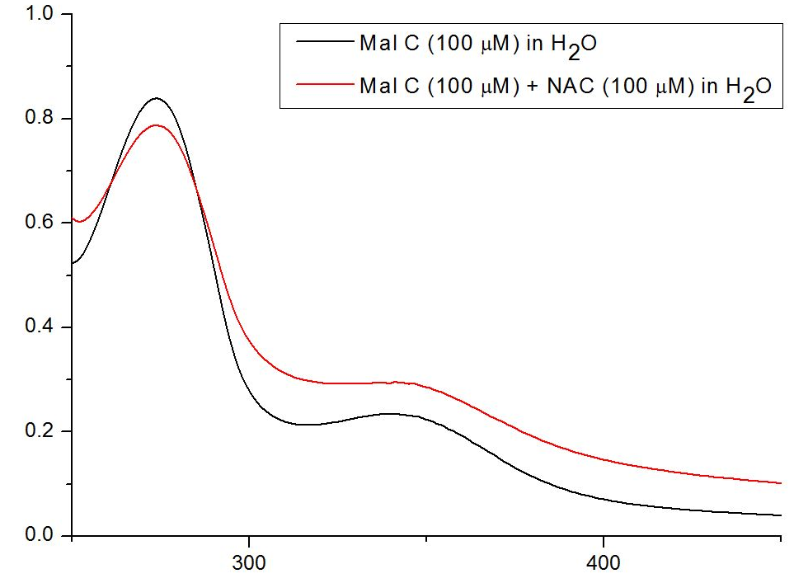
S2
Spectroscopic analysis
O.D. (AU)
Wavelength (nm)

Slide 3
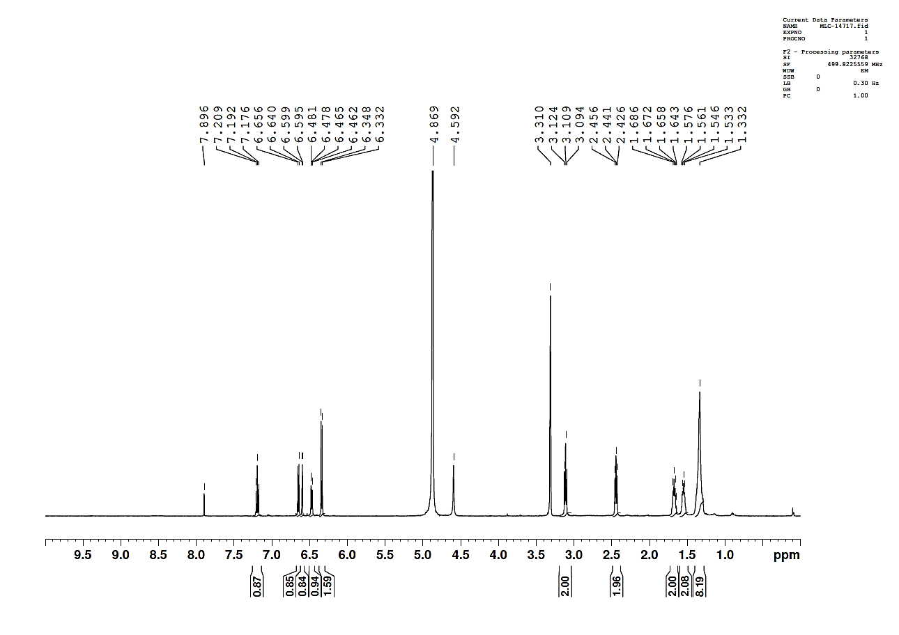
S3
¹H-NMR and ¹³C NMR spectra were recorded on Varian 500 MHz spectrometer.
¹H NMR of Mal C (CD₃OD, 500 MHz): δ 7.19 (1H, t, J = 8.0 Hz), 6.65 (1H, d, J = 8.0 Hz), 6.60 (1H, d, J = 1.5 Hz), 6.47 (1H, dd, J = 1.5 Hz and 8.0 Hz), 6.34 (2H, d, J = 8.0 Hz), 3.11 (2H, t, J = 7.5 Hz), 2.44 (2H, t, J = 7.5 Hz), 1.69-1.64 (2H, m), 1.58-1.53 (2H, m), 1.40-1.28 (8H, m).

Slide 4
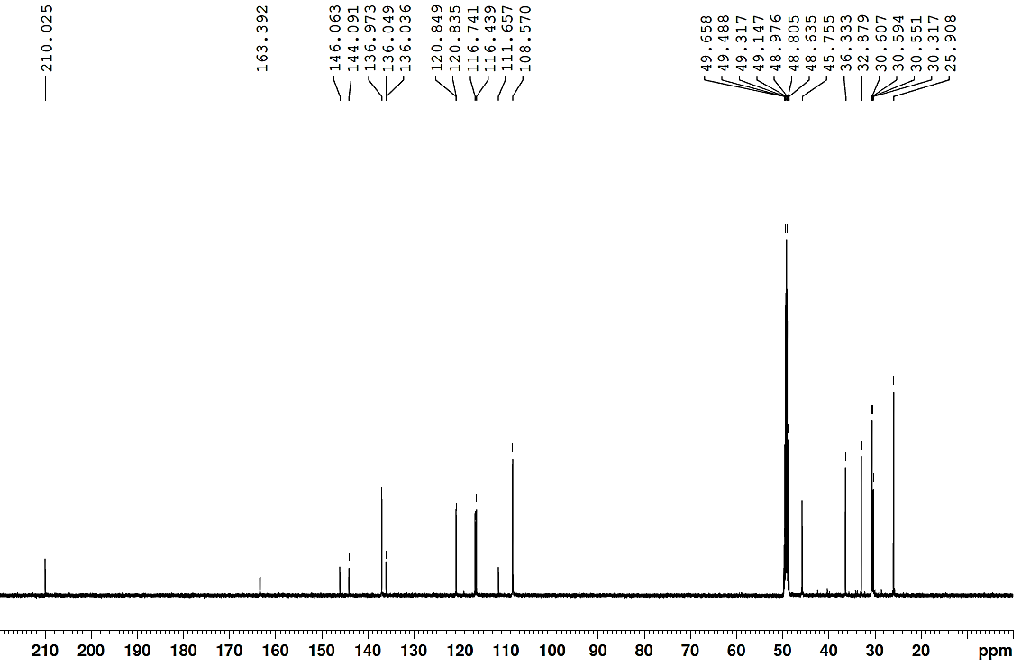
S4
¹³C NMR of Mal C (CD₃OD, 125 MHz): δ 210.0, 163.4, 146.1, 144.1, 137.0, 136.0, 136.0, 120.8, 120.8, 116.7, 116.4, 111.7, 108.6, 45.8, 36.3, 32.9, 30.6, 30.6, 30.5, 30.3, 25.9.

Slide 5
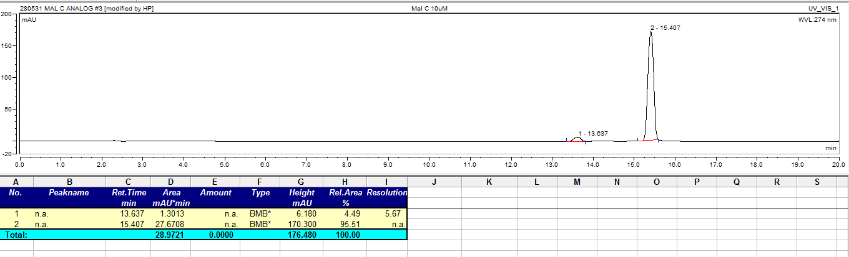
S5
HPLC was run on Dionex Ultima 3000 series HPLC system with reversed phase C18 column and UV detection at 274 nm.

