Slide 1
Supplementary Fig. S1
a
Temperature (°C)
b
Temperature (°C)
Supplementary Figure S1. Monthly rainfall and maximum (Tmax) and minimum (Tmin) mean temperature registered at weather stations located at CYCTEX (a) and Maguilla (b) during the field experiment season (2019).

Slide 2
Supplementary Fig. S2
rainfed
irrigated
Supplementary Figure S2. Principal component analysis (PCA) of three biological replicates for each condition. PC 1 and PC 2 represent the first two analysis components, explaining 70.7% and 11.3% of the total variation, respectively. Axes represent the percentage of variance that each principal component is able to account (p-adj < 0.05). Proteome Discoverer 2.4 (Thermo Fisher Scientific, Massachusetts, United States) was used to obtain this Figure.

Slide 3
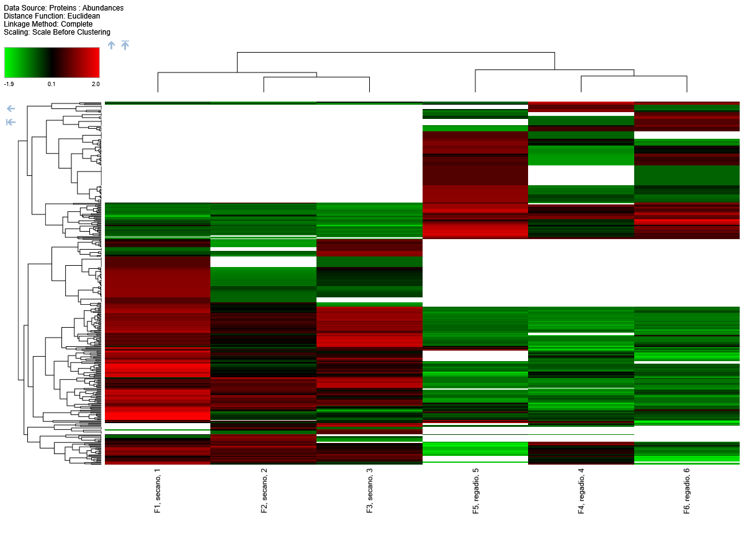
Supplementary Fig. S3
Rainfed 1
Rainfed 2
Rainfed 3
Irrigated 1
Irrigated 2
Irrigated 3
Supplementary Figure S3. Heat map of common and exclusive proteins found in each biological replicate of the seeds harvested from irrigated and rainfed conditions (p-adj < 0.05). Proteome Discoverer 2.4 (Thermo Fisher Scientific, Massachusetts, United States) was used to obtain this Figure.

Slide 4
Supplementary Fig. S4
Supplementary Figure S4. Hierarchical Biological Process GO terms of overrepresented proteins in seeds harvested from irrigated conditions.

Slide 5
Supplementary Fig. S5
Supplementary Figure S5. Hierarchical Molecular Function GO terms of overrepresented proteins in seeds harvested from irrigated conditions.

Slide 6
Supplementary Fig. S6
Supplementary Figure S6. Hierarchical Biological Process GO terms of overrepresented proteins in seeds harvested from rainfed conditions.

Slide 7
Supplementary Fig. S7
Supplementary Figure S7. Hierarchical Molecular Function GO terms of overrepresented proteins in seeds harvested from rainfed conditions.

Slide 8
Supplementary Fig. S8
Supplementary Figure S8. Hierarchical Cellular Component GO terms of overrepresented proteins in seeds harvested from rainfed conditions.

Slide 9
Supplementary Fig. S9
Supplementary Figure S9. Hierarchical Cellular Component GO terms of overrepresented proteins in seeds harvested from irrigated conditions.

