Slide 1
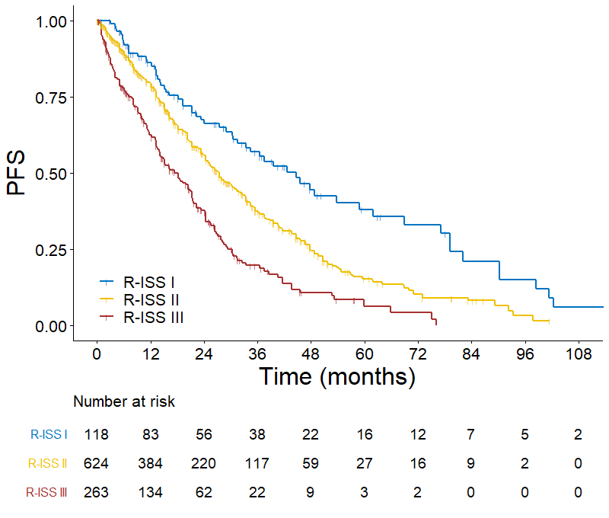
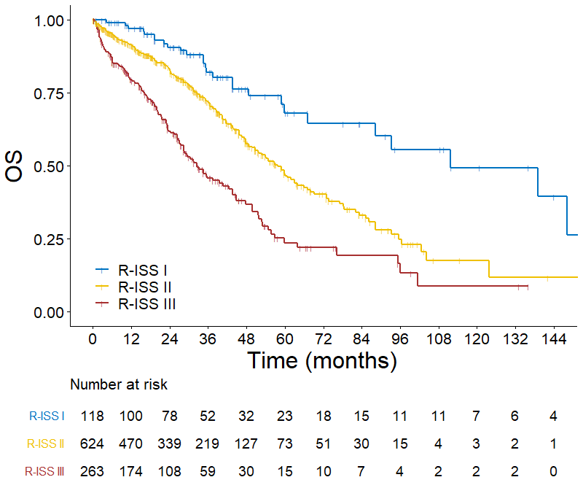
A B
I vs II: HR 1.704, 95% CI 1.289-2.254, P=0.0002
II vs III: HR=1.738, 95% CI 1.447-2.087, P<0.0001
I vs II: HR 2.216, 95% CI 1.471-3.338, P=0.0001
II vs III: HR 1.977, 95% CI 1.589-2.461, P<0.0001
18.2m
32.5m
111.6m
27.4m
44.6m
57.8m

Slide 2
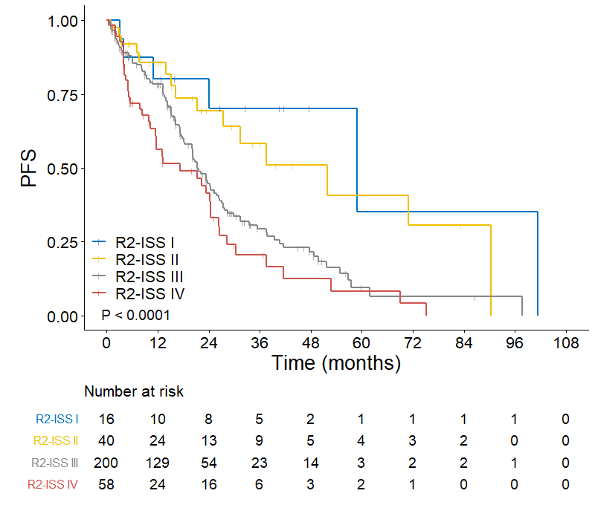
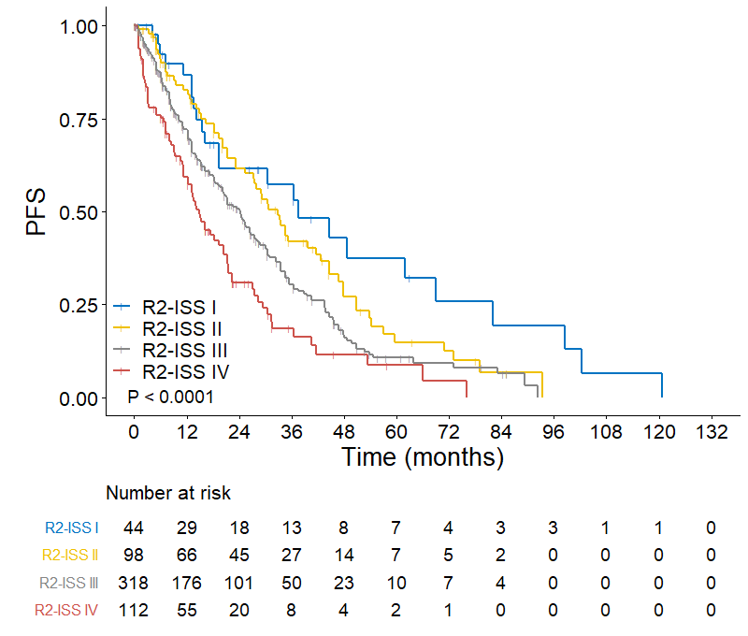
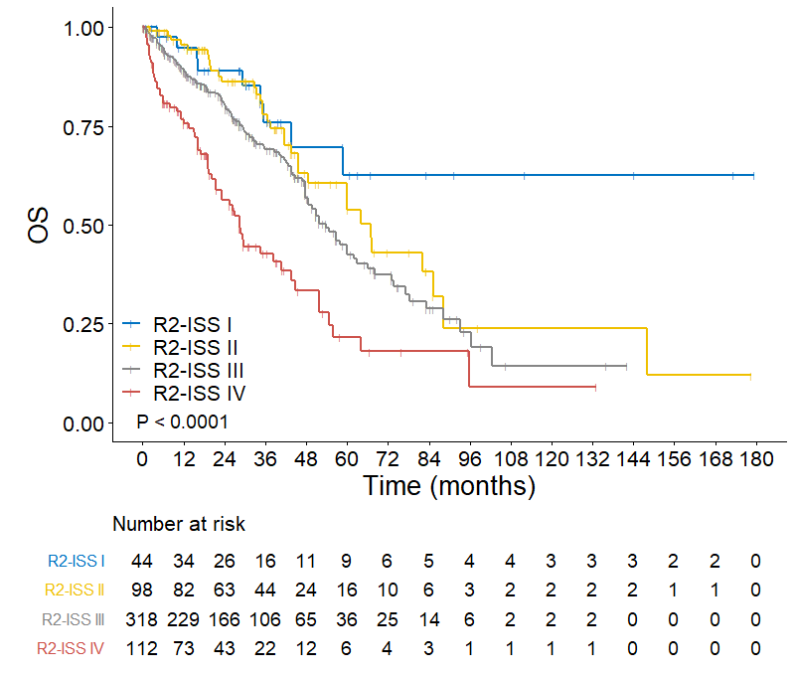
A
I vs II: HR 1.533, 95% CI 0.558-4.211, P=0.4068
II vs III: HR 1.933, 95% CI 1.133-3.297, P=0.0155
III vs IV: HR 1.381, 95% CI 0.962-1.982, P=0.0803
17.3m
51.8m
58.8m
21.3m
B C
I vs II: HR 1.453, 95% CI 0.880-2.400, P=0.1446
II vs III: HR 1.398, 95% CI 1.049-1.864, P=0.0223
III vs IV: HR 1.536, 95% CI 1.180-2.000, P=0.0014
I vs II: HR 1.652, 95% CI 0.786-3.473, P=0.1856
II vs III: HR 1.378, 95% CI 0.930-2.040, P=0.1099
III vs IV: HR 2.073, 95% CI 1.515-2.835, P<0.0001
NR
14.9m
28.4m
24.2m
53.8m
32.8m
37.5m
67.0m
Notes:
B,C: ≤65岁患者中，不接受ASCT的R2-ISS生存比较
A:>65岁患者的R2-ISS生存比较

Slide 3
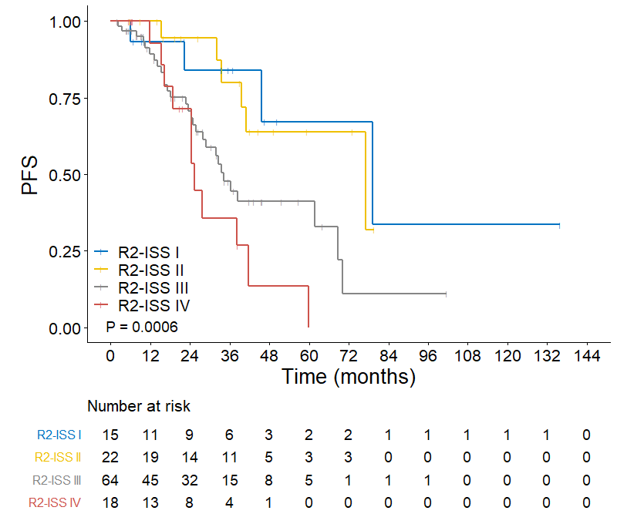
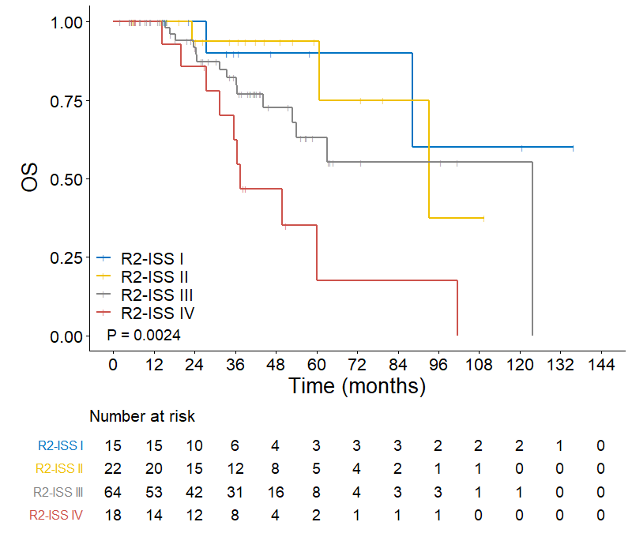
A B
I vs II: HR 1.281, 95% CI 0.209-7.862, P=0.7892
II vs III: HR 1.969, 95% CI 0.564-6.880, P=0.2884
III vs IV: HR 2.803, 95%CI 1.236-6.356, P=0.0136
I vs II: HR 1.170, 95% CI 0.323-4.239, P=0.8116
II vs III: HR 2.746, 95% CI 1.124-6.705, P=0.0266
III vs IV: HR 1.743, 95% CI 0.858-3.538, P=0.1242
NR
25.4m
77.1m
37.5m
93.3m
123.8m
34.2m
79.2m
Notes:
≤65岁患者中，接受ASCT的R2-ISS生存比较

Slide 4
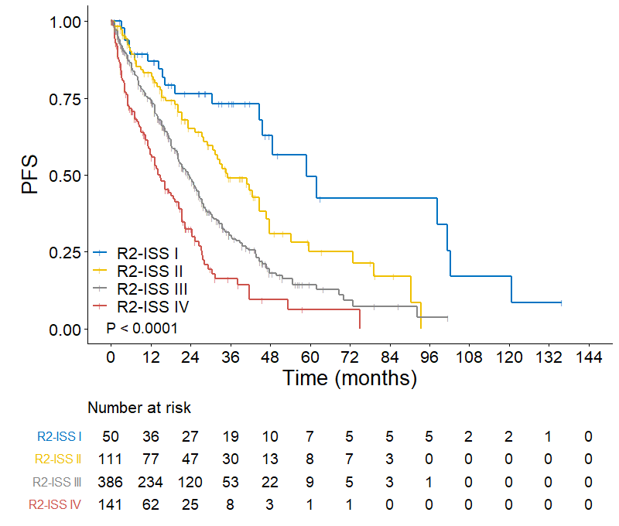
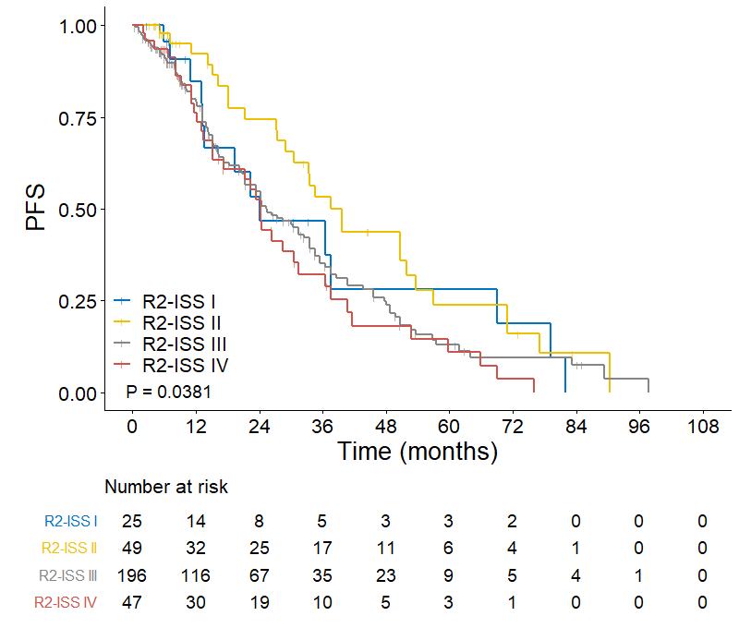
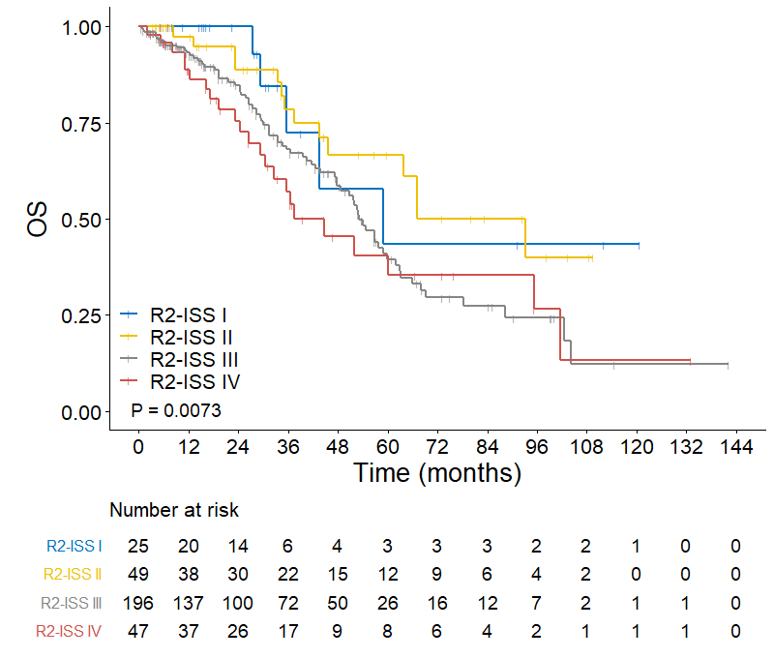
A B
I vs I: HR 2.119, 95% CI 1.205-3.726, P=0.0091
II vs III: HR 1.600, 95% CI 1.194-2.145, P=0.0017
III vs IV: HR 1.660, 95% CI 1.303-2.115, P<0.0001
I vs II: HR 0.711, 95% CI 0.370-1.366, P=0.3054
II vs III: HR 1.564, 95% CI 1.030-2.374, P=0.0360
III vs IV: HR 1.178, 95% CI 0.805-1.724, P=0.3981
14.9m
58.8m
24.0m
23.4m
25.3m
35.2m
24.3m
39.6m
C D
I vs II: HR 0.955, 95% CI 0.341-2.673, P=0.9306
II vs III: HR 1.866, 95% CI 1.051-3.313, P=0.0331
III vs IV: HR 1.201, 95% CI 0.752-1.919, P=0.4438
19%
37%
37.5m
64%
53.0m
58.9m
93.3m
78%
63%
36%
3%
Notes:
B,C: 应用IMiDs+Pis 患者的R2-ISS生存比较
A:应用IMiDs或Pis患者的R2-ISS生存比较

