Slide 1
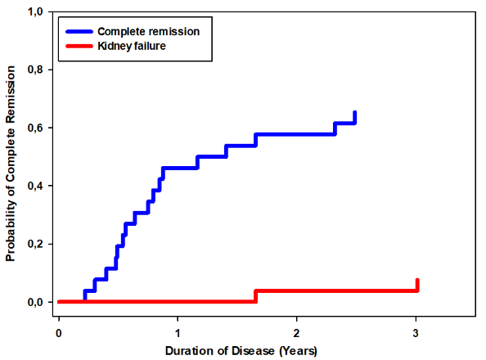
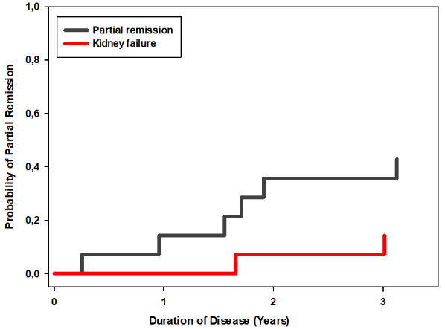
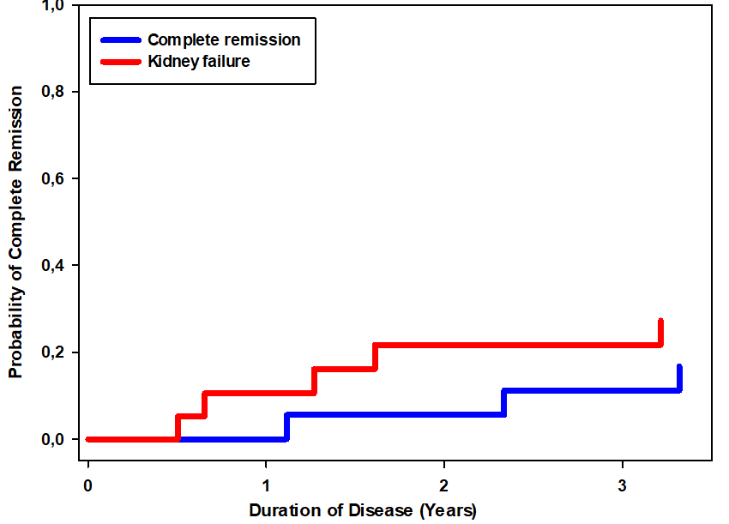
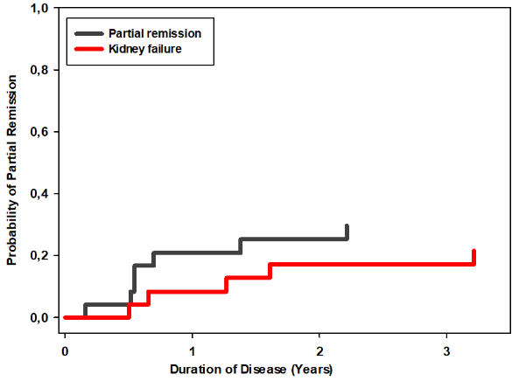
Outcomes of steroid-resistant nephrotic syndrome in children
not treated with intensified immunosuppression (IIS)
HYPOTHESIS: Can spontaneous remission occur in children with SRNS? What is the role of angiotensin blockade?
Complete remission
Partial remission
DESIGN & OUTCOMES:
95 children with SRNS
not treated with IIS
Remission vs.
kidney failure
Non-genetic SRNS
Genetic SRNS
Retrospective analysis from PodoNet Registry
Competing risks
in 67 children
CONCLUSION: Spontaneous complete remission can occur in a substantial fraction of children with non-genetic SRNS and a milder clinical phenotype.
RAAS blockade increases the likelihood of partial remission of proteinuria in all forms of SRNS.
Trautmann et al. 2022

