Slide 1
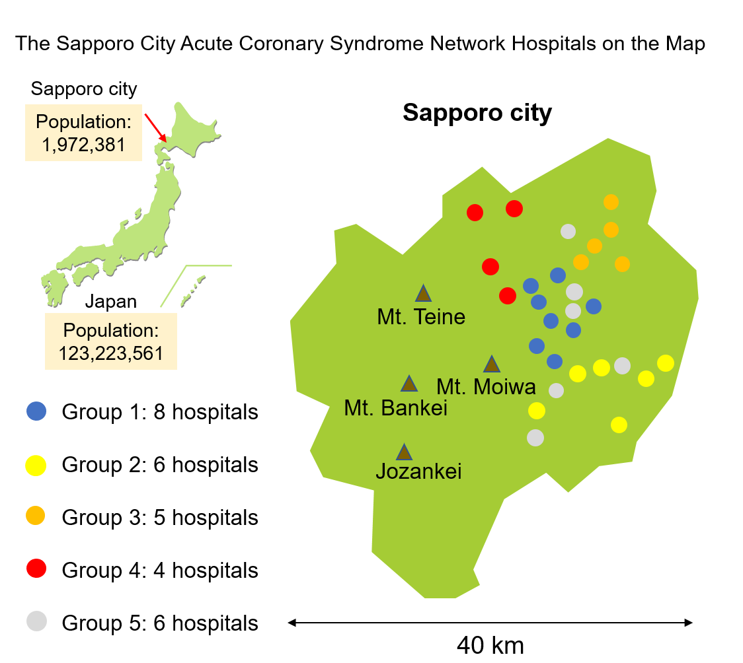
Supplementary Figure S1
Group 1, North and Central district; Group 2, South district; Group 3, East district; Group 4, West district; Group 5, North and Central district
This figure is illustrated manually using Microsoft PowerPoint 2019 MSO (version 2301, Build 16.0.16026.20196) 64 bit (https://www.microsoft.com/en-us/microsoft-365/powerpoint)

Slide 2
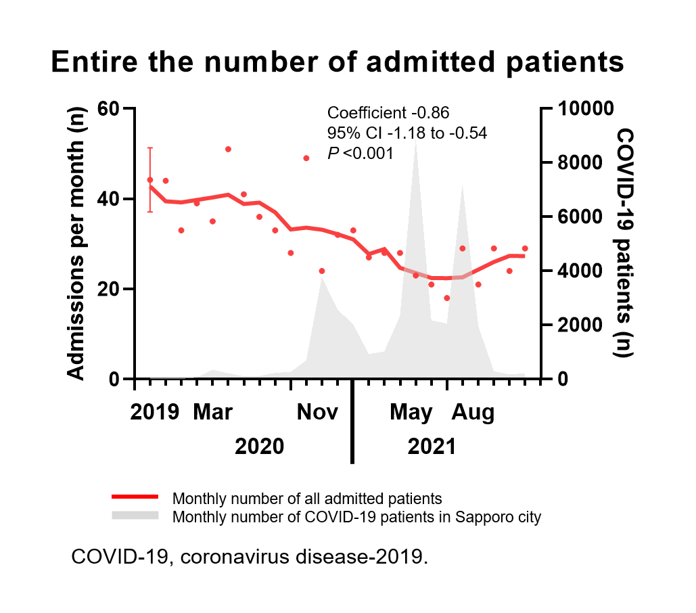
Supplementary Figure S2

