Slide 1
Supplemental Material – Original Blots
Relevant areas for cropped blots in the main and Extended Data figures are shown with a dashed box.

Slide 2
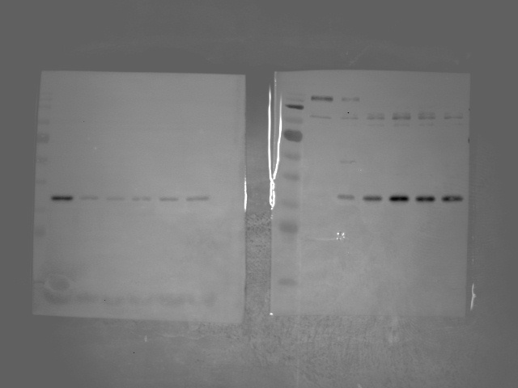
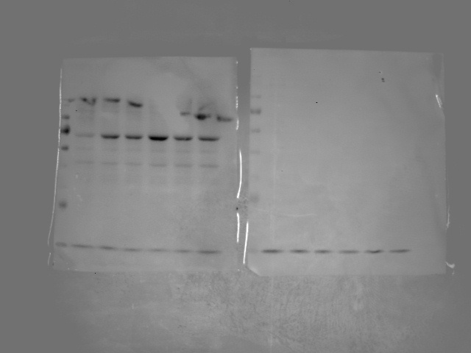
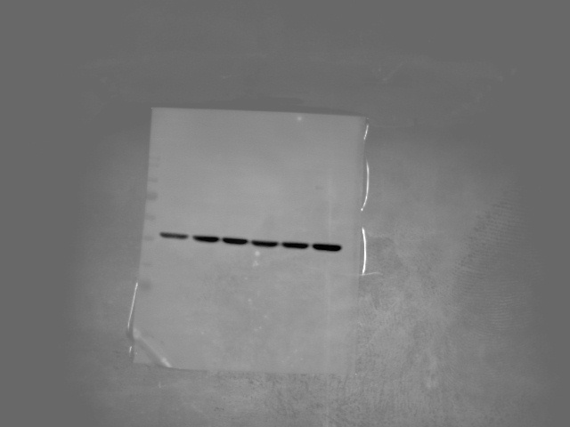
Supplemental Material to Fig 1A (original blots)
A
40
40
p-IκB
35
IκB
35
75
p-NF-κB
55
55
40
β-actin
35

Slide 3
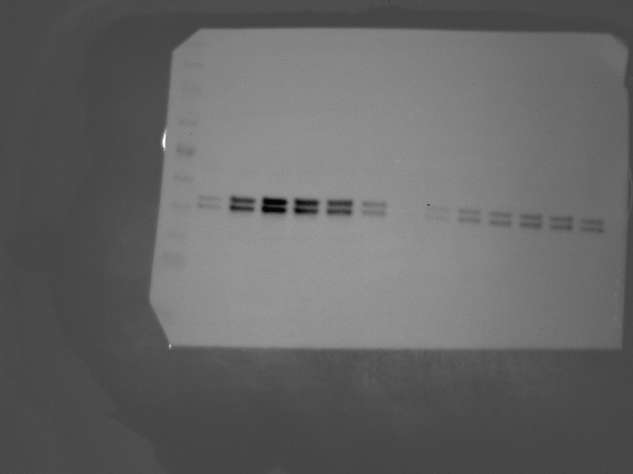
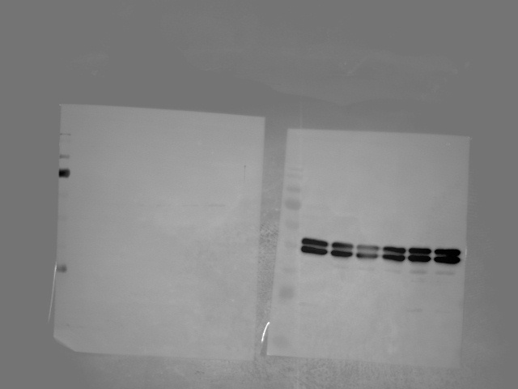
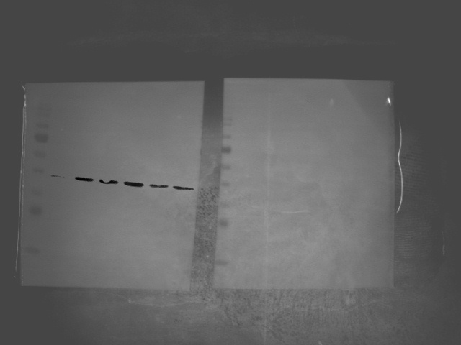
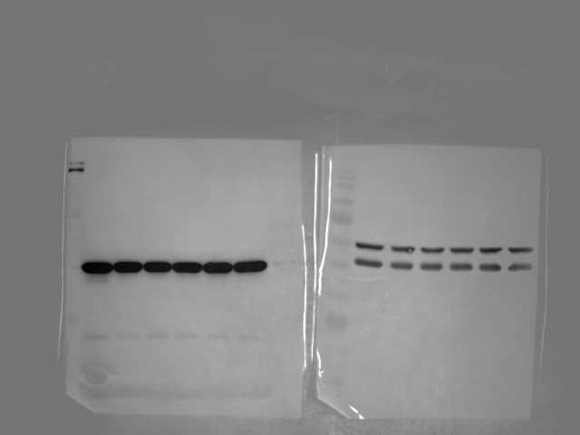
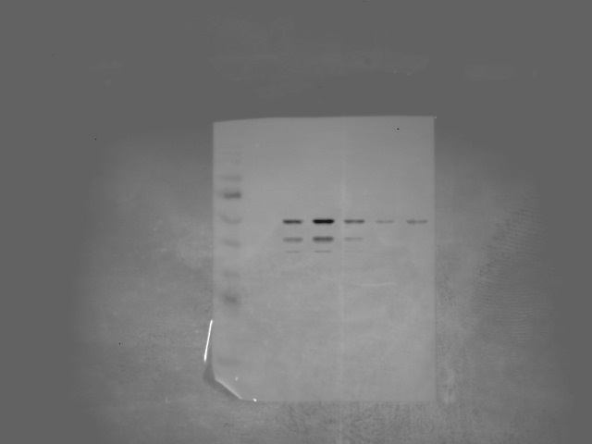
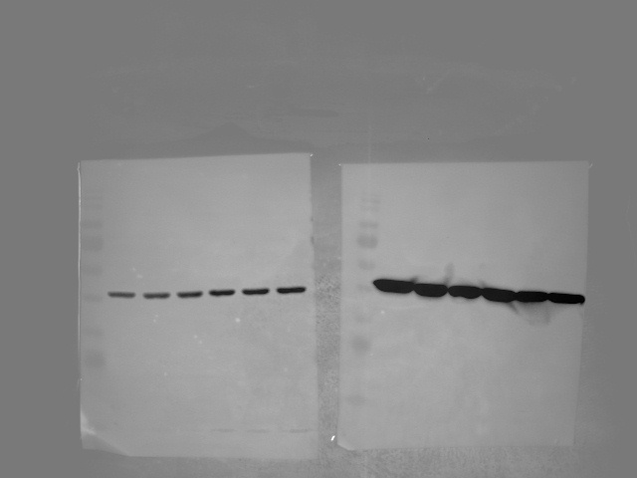
Supplemental Material to Fig 1B (original blots)
B
55
55
ERK
40
p-ERK
40
35
35
40
p-p38MAPK
40
p38MAPK
35
35
75
75
55
p-JNK
55
JNK
40
40
55
β-actin
40
35

Slide 4
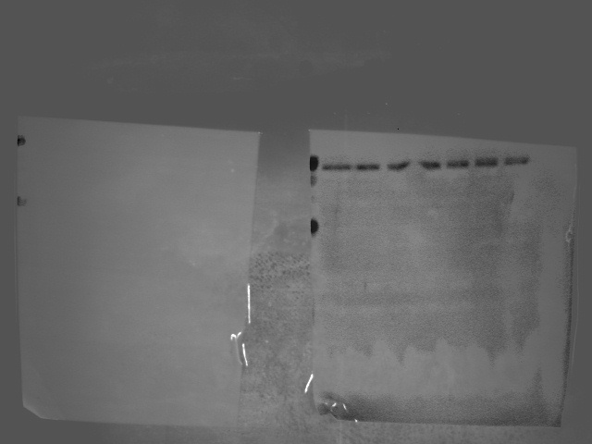
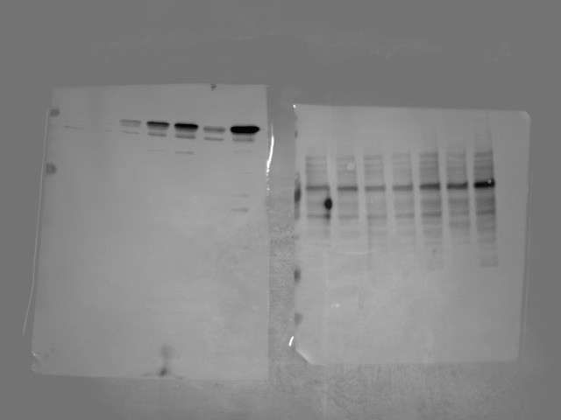
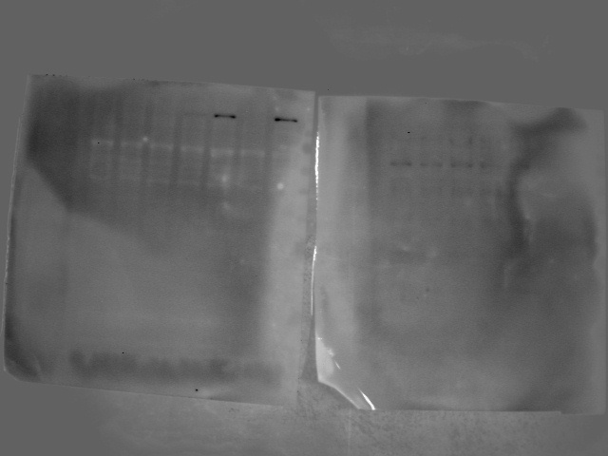
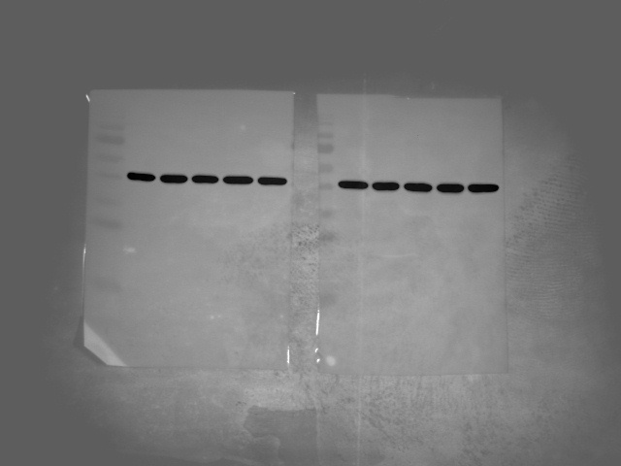
Supplemental Material to Fig 1D (original blots)
D
75
COX1
75
COX2
55
55
170
iNOS
130
55
100
40
β-actin
35

Slide 5
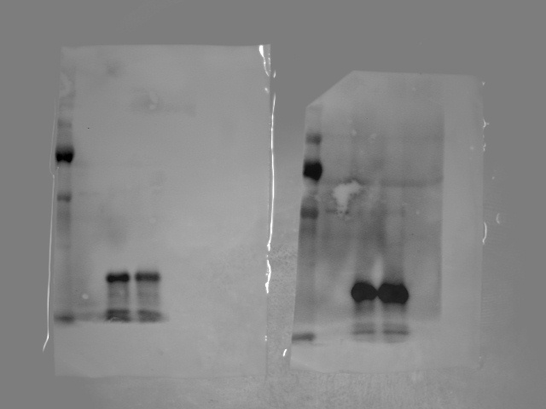
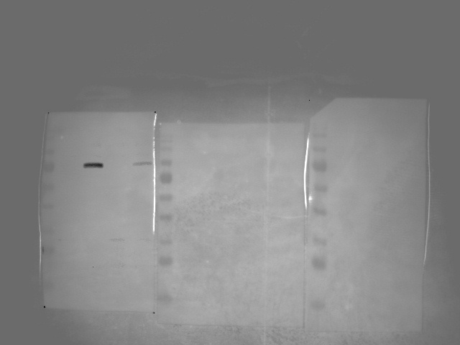
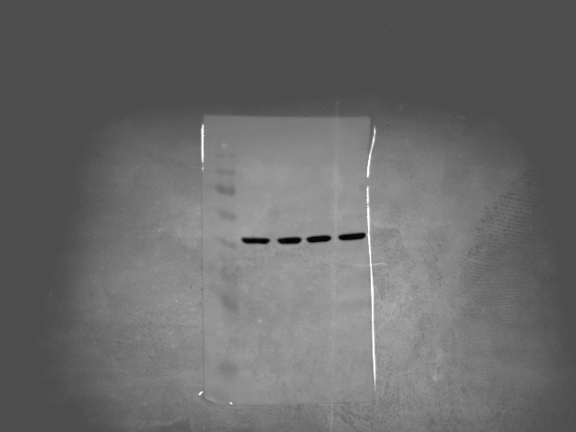
Supplemental Material to Fig 2B and D (original blots)
B
35
M1
17
7
D
75
COX2
55
55
40
β-actin
35

Slide 6
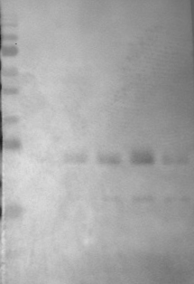
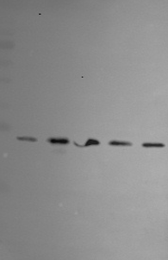
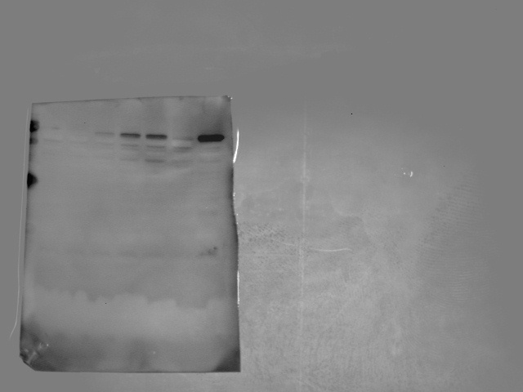
Supplemental Material to Fig 3A and B (original blots)
A
35
Bim _{EL}
35
BAK
17
Bim _{L}
17
7
7
55
40
β-actin
35
B
55
40
β-actin
35
17
Cytochrome C
7

Slide 7
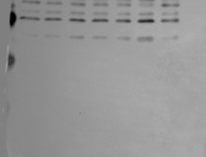
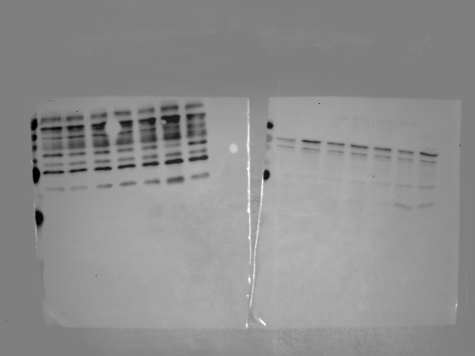
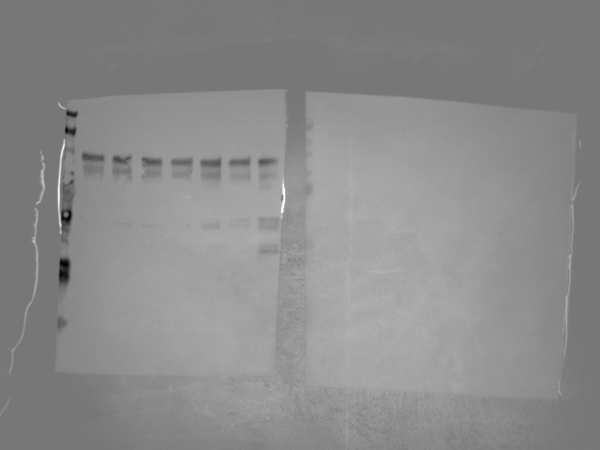
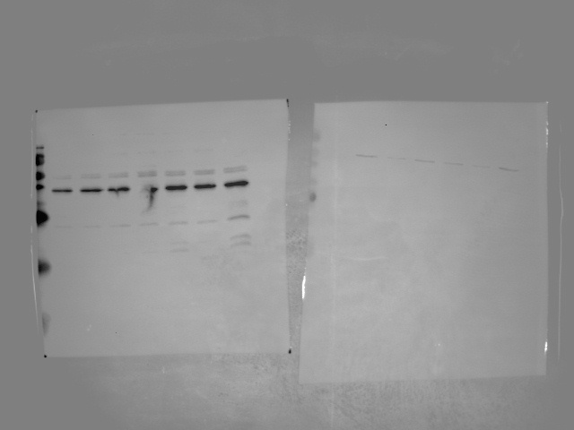
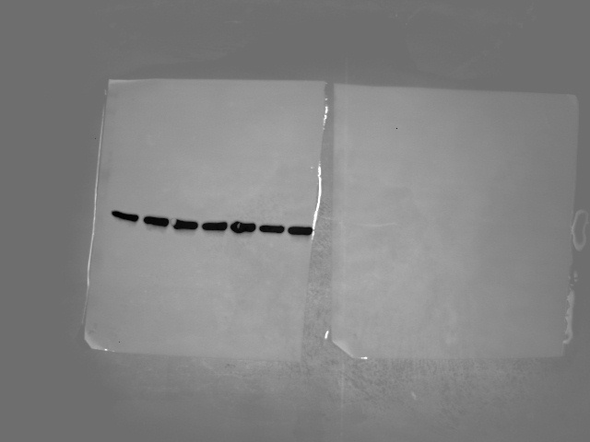
Supplemental Material to Fig 3C (original blots)
C
35
Caspase-6
75
17
Cleaved-caspase-6
55
Caspase-9
40
35
Cleaved-caspase-9
40
Caspase-7
35
Caspase-3
35
25
25
Cleaved-caspase-7
Cleaved-caspase-3
17
17
55
40
β-actin
35

Slide 8
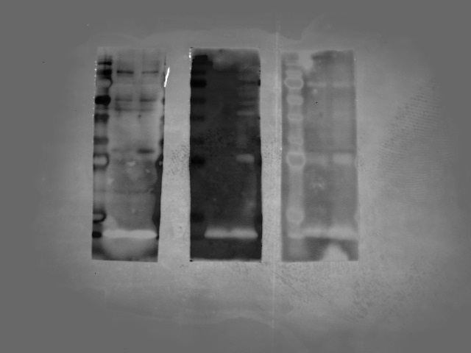
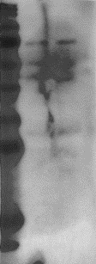
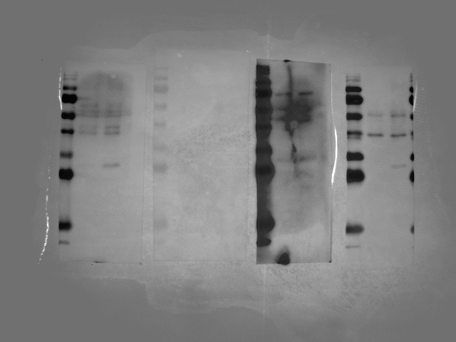
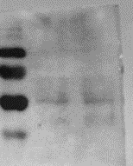
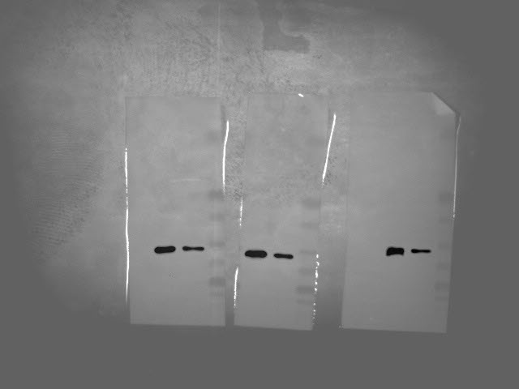
Supplemental Material to Fig 4B (original blots)
C
75
pNF-κB
55
55
40
pERK
40
pIκB
35
35
75
40
55
pJNK
35
p-p38 MAPK
40
55
40
β-actin
35

Slide 9
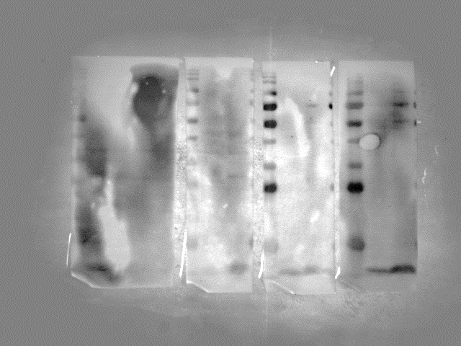
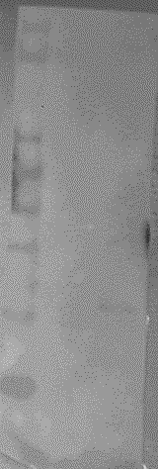
Supplemental Material to Fig 5A (original blots)
A
75
COX2
55
130
iNOS
100
55
40
β-actin
35

Slide 10
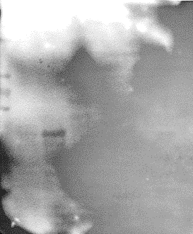
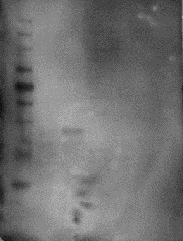
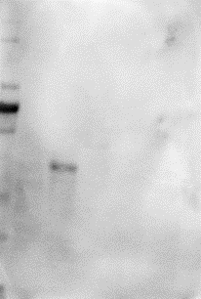
Supplemental Material to supplementary Fig. 1B (original blots)
B
Anti-M1 serum
Anti-M1 antibody
Anti-strep antibody
35
M1
35
M1
35
M1
25
25
25
17
17
17
7
7
7

