Slide 1
Supplementary material

Slide 2
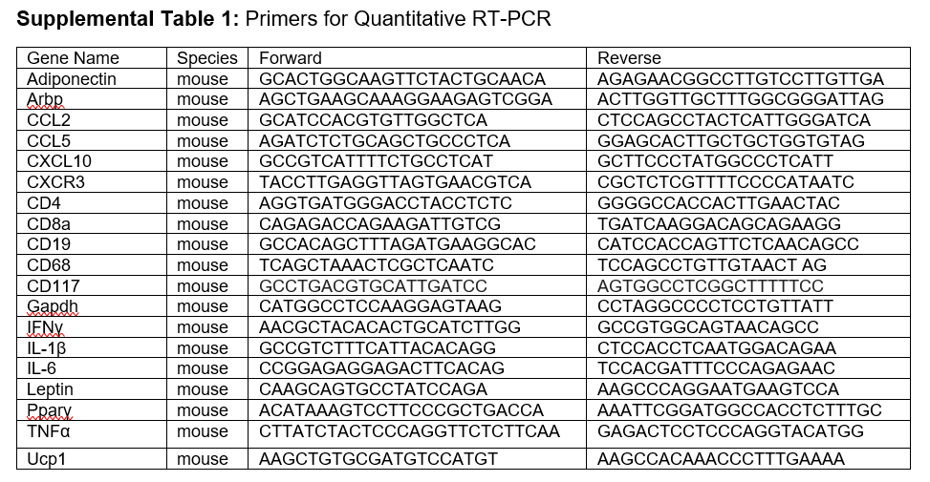

Slide 3
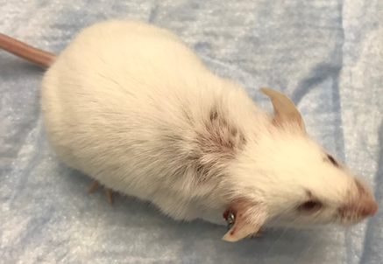
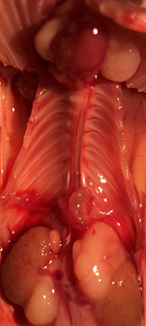
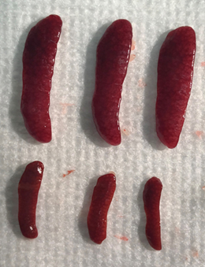
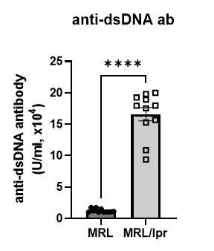
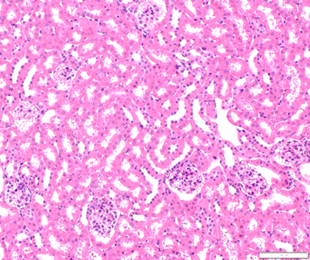
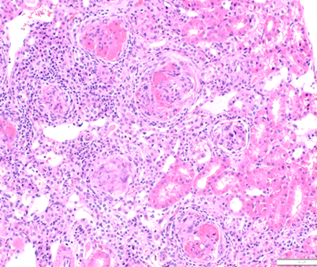
Supplemental Figure S1
A
B
C
D
E
F
MRL
MRL/lpr
H&E
Supplemental Figure S1. MRL/lpr mice recapitulated clinical manifestations of human SLE at age of 14 weeks. Clinical features include skin lesion (A), lymphadenopathy (yellow arrows, B), splenomegaly (upper: MRL/lpr and lower: MRL, C) elevated anti-dsDNA antibody (D), elevated UACR (E) and proliferative glomerulonephritis (F). Scale bar=200 μm. n=11. *p<0.05, ** p<0.01, ***p<0.001, ****p<0.0001 vs MRL (control).
Notes:
Supplementary Figure 1: MRL/lpr mice recapitulate clinical manifestations of human SLE at age of 14 weeks. Clinical features include (A) skin lesion, (B) lymphadenopathy (yellow arrows), and (C) splenomegaly (upper: MRL/lpr and lower: MRL); (D) elevated anti-dsDNA antibody; (E) elevated UACR, and (F) proliferative glomerulonephritis, scale bar=200 μm. N=11. *p<0.05, ** p<0.01, ***p<0.001, ****p<0.0001.

Slide 4
Supplemental Figure S2
Supplemental Figure S2. MRL/lpr mice exhibited lower core temperatures. Rectal body temperatures were measured by a BAT-12 thermometer at 11 am and 9pm respectively. n=10. *p<0.05, ** p<0.01, ***p<0.001, ****p<0.0001.

Slide 5
Supplemental Figure S3
A
B
Supplemental Figure S3. MRL/lpr mice exhibited intact endothelium-independent relaxation. (A) Concentration-response curves to SNP in the presence or absence of PVAT. (B) Area under the curve for all concentration-response curves. n=6. *p<0.05, ** p<0.01, ***p<0.001, ****p<0.0001. SNP, sodium nitroprusside; PVAT, perivascular adipose tissue.
Notes:
Supplementary Figure 2: MRL/lpr mice exhibited intact endothelium-independent relaxation. (A) Concentration-response curves to SNP in the presence or absence of PVAT. (B) Area under the curve for all concentration-response curves. Values are mean ± SEM. N=6. One-way ANOVA followed by Tukey’s multiple comparison test; *p<0.05, ** p<0.01, ***p<0.001, ****p<0.0001. SNP, sodium nitroprusside; PVAT, perivascular adipose tissue.

Slide 6
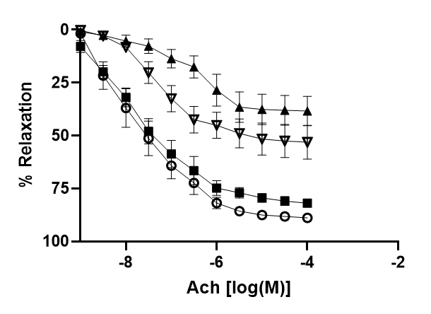
Supplemental Figure S4
A
C
B
D
Supplemental Figure S4. NZB mice exhibited impaired endothelium-dependent relaxation, which was exacerbated by PVAT. (A) Concentration-response curves to Ach in the presence or absence of PVAT. (B) Area under the curve for all concentration-response curves to Ach. (C) Concentration-response curves to SNP in the presence or absence of PVAT. (D) Area under the curve for all concentration-response curves to SNP. *p<0.05, ** p<0.01, ***p<0.001, ****p<0.0001. Ach, acetylcholine; SNP, sodium nitroprusside; PVAT, perivascular adipose tissue. NZB, lupus-prone mice; NZW, control mice.
Notes:
NZB mice exhibited impaired endothelium-dependent relaxation, which is exacerbated by PVAT. (A) Concentration-response curves to Ach in the presence or absence of PVAT. (B) Area under the curve for all concentration-response curves to Ach. (C) Concentration-response curves to SNP in the presence or absence of PVAT. (D) Area under the curve for all concentration-response curves to SNP. Values are mean ± SEM. N=6. One-way ANOVA followed by Tukey’s multiple comparison test; *p<0.05, ** p<0.01, ***p<0.001, ****p<0.0001. Ach, acetylcholine; SNP, sodium nitroprusside; PVAT, perivascular adipose tissue. NZB, lupus-prone mice; NZW, control mice.

Slide 7
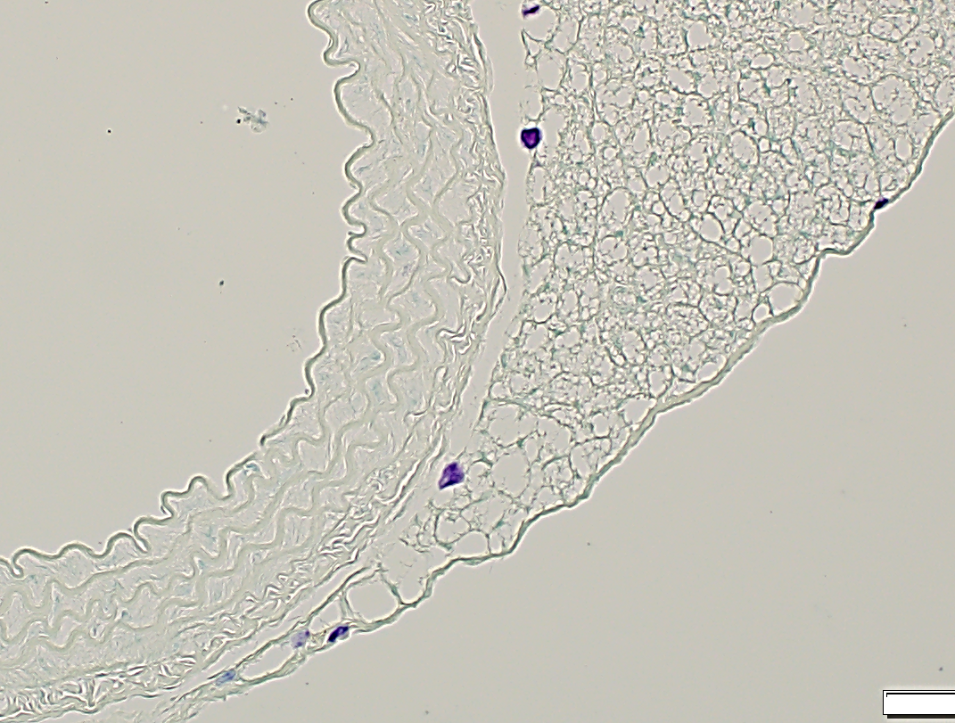
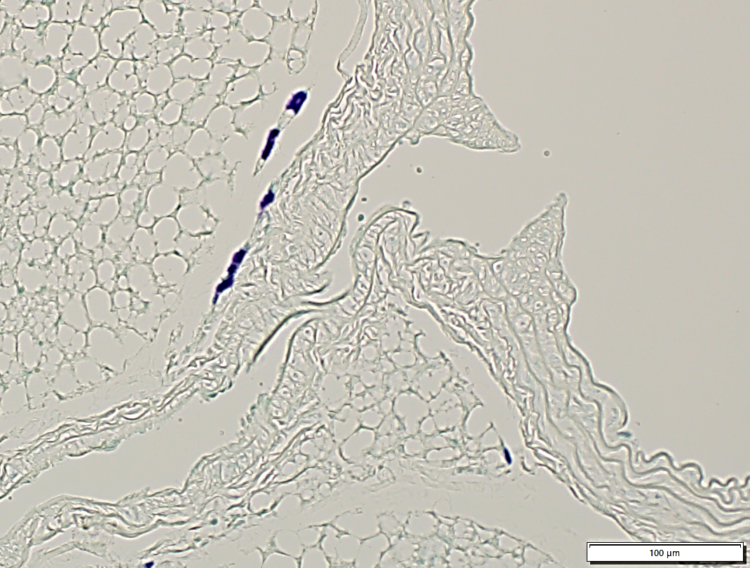
Supplemental Figure S5
A
MRL
MRL/lpr
B
Toluidine blue staining
Lumen
Lumen
C
D
Supplemental Figure S5. Mast cell staining and gene expression in PVAT as well as plasma level of mast cell specific protease-6. (A) Mast cells in PVAT were examined using Toluidine Blue staining, scale bar=200 μm, (B) quantitative analysis of distribution of mast cells, n=10. (C) Gene expression of mast cell in PVAT was performed by RT-qPCR with marker CD117, n=5. (D) Plasma levels of mast cell specific protease-6 were measured by ELISA Array, n=8. ns: non-significance.

Slide 8
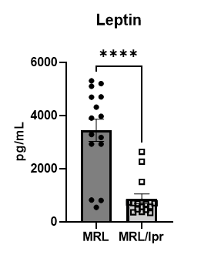
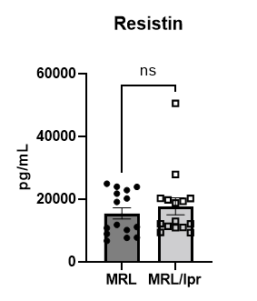
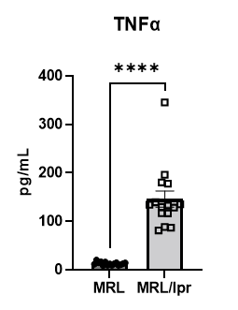
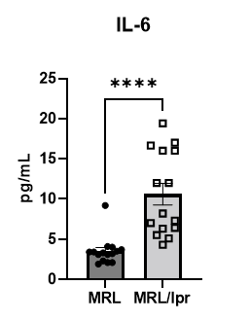
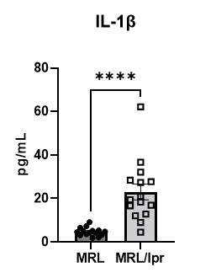
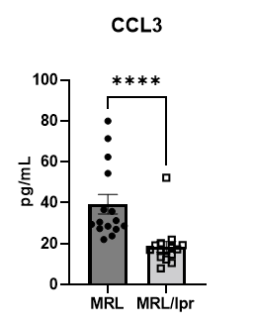
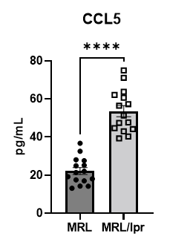
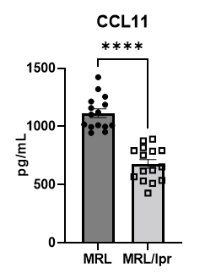
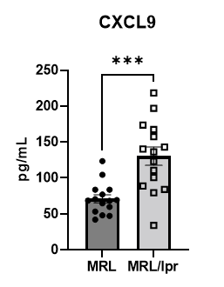
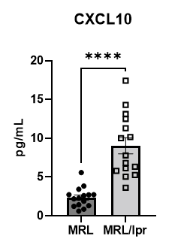
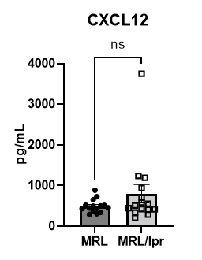
Supplemental Figure S6
A
Adipokines
B
Cytokines
C
Chemokines
Supplemental Figure S6. Plasma levels of adipokines (A), and cytokines (B) were measured by Luminex Assay, and chemokines (C) were measured by Flow Based Bead Array. n=15. *p<0.05, ** p<0.01, ***p<0.001, ****p<0.0001 vs MRL (control).
Notes:
Supplementary Figure 4. Plasma levels of adipokines (A), and cytokines (B) were measured by Luminex Assay, and chemokines (C) were measured by Flow Based Bead Array. N=15. *p<0.05, ** p<0.01, ***p<0.001, ****p<0.0001.

