Slide 1
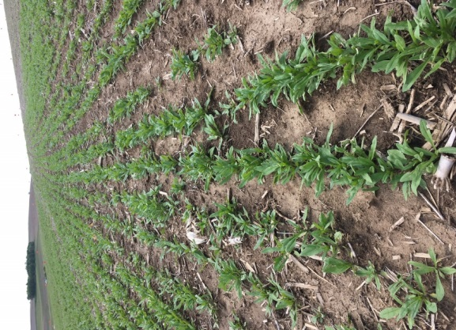
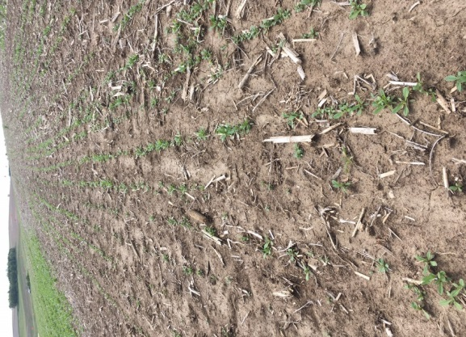
A
B
Fig. 1
P-sufficient P-deficient
Figure 1. Camelina growth and seed yield from plants harvested from fields with different P applications. A. Camelina seedlings growing in P-sufficient (left) and –deficient (right) fields. B. Seed yield from camelina plants harvested from field plots with different levels of P fertilizer and placements. P0 refers to no P fertilizer applied; P38 and P76 denote 38 kg/ha and 76 kg/ha P fertilizer applied; and the small b, k, or s following P38 and P76, refer to P fertilized applied by broadcast, knife, or starter, respectively. Values represent the average of four replicates ± standard error. Values followed by the same letters are not statistically different at p < 0:05 by one-way ANOVA.

Slide 2
A
B
C
D
Figure 2. Membrane glycerolipid composition of camelina leaves from field plots with different levels of P fertilizer and placements. Lipids extracted from newest fully expanded leaves of plants were quantified by ESI-MS/MS. A. Mole% of MGDG and DGDG of all PL (phospholipids) and GL (galactolipids) analyzed. B and C. A. Mole% of different PL classes of all PL and GL analyzed. D. Ratios of PL/GL. PL is the sum of phospholipids analyzed, including phosphatidic acid (PA), phosphatidylcholine (PC), phosphatidylethanolamine (PE), phosphatidylglycerol (PG), phosphatidylinositol (PI), and phosphatidylserine (PS), whereas GL is the sum of digalactosyldiacylglycerol (DGDG) and monogalactosylglycerol (MGDG). Values are means ± SD (n = 5). Values with different letters show significantly differences at p < 0.05 by one-way ANOVA.

Slide 3
A
B
C
D
E
F
Figure 3. Molecular species of glycerolipids of camelina leaves from field plots with different levels of P fertilizer and placements. Lipids from fully expanded leaves of camelina plants were quantified by ESI-MS/MS. A to F, Lipid species of various phospholipid classes. Two numbers separated by a colon, such as 36:6. refer to total acyl carbons: total double bonds of two fatty acid esters. Major molecular species are shown. Values are means ± SD (n = 5), and values with different letters denote significantly differences at p < 0.05 by one-way ANOVA.

Slide 4
A
B
Figure 4. Seed oil content and fatty acid composition of camelina from field plots with different levels of P fertilizer and placements. Fatty acid methyl esters were prepared from dry seeds and analyzed using GC to calculate oil content (A) and mol% of fatty acid composition (B). Values are means ± SD (n = 5), and different letters indicate significantly differences at p < 0.05 by one-way ANOVA.

Slide 5
A
Suneson Licalla
B
C
Figure 5. Oil content and fatty acid composition of camelina seeds from plants grown in greenhouse with different levels of P. Fatty acid methyl esters from dry seeds were analyzed using GC to calculate oil content (A) and mol% of fatty acid composition of ecotype Sunason (B) and Licalla (C). Values are means ± SD (n = 6), and different letters indicate significantly differences at p < 0.05 by one-way ANOVA.

Slide 6
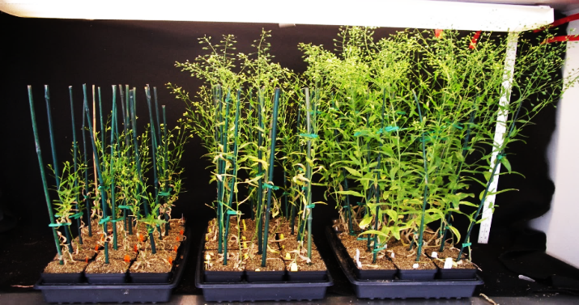
A
B
P50
P100
P1000
Suneson Licalla
C
E
E
Suneson Licalla
F
Suneson Licalla
Suneson Licalla
Figure 6. Camelina growth, branch number, seed yield and seed weight of camelina plants grown under different P levels. A-E. Data collected from camelina plants grown in greenhouse with 50, 100, and 1000 µM P. Values are means ± SD (n = 3), and different letters indicate significantly differences at p < 0.05 by one-way ANOVA. F. Seed weight of camelina plants from field plots with different levels of P fertilizer and placements. Values are means ± SD (n = 3).

Slide 7
Suneson
sFigure 1. Percentage of saturated (S), monounsaturated (MUS), polyunsaturated (PUS), and unsaturated (U) fatty acids of seed oils from field-grown camelina plants under different P levels (left panel), and greenhouse plants treated with 50, 100, and 1000 µM P (middle and right panels). Values are means ± SD (n = 5). Values with different letters show significantly differences at p < 0.05 by one-way ANOVA.

Slide 8
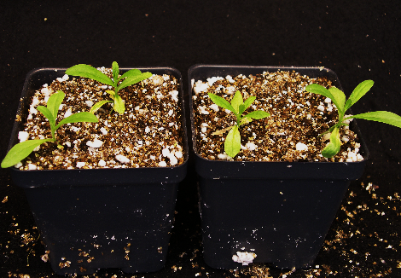
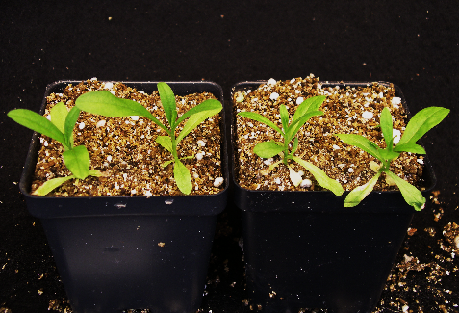
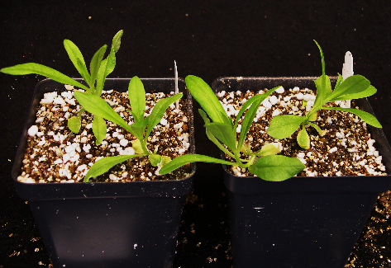
A
P50
P100
P1000
Suneson
Licalla
Suneson
Licalla
Suneson
Licalla
B
C
Suneson Licalla
Suneson Licalla
sFigure 2. Phosphorus deficiency alters plant growth and development. A. The representative images of three-week old seedlings under different phosphorus concentration treatments in greenhouse. Fresh weight (B) and dry weight (C) under different phosphorus concentration treatments in greenhouse. Values are means ± SD (n = 5). Values with different letters show significantly differences at p < 0.05 by one-way ANOVA.

Slide 9
A
B
Suneson Licalla
Suneson Licalla
sFigure 3. Camelina seed width (A) and length (B) of greenhouse grown-plants with 50, 100, and 1000 µM P treatments. Values are means ± SD (n = 5). Values with different letters show significantly differences at p < 0.05 by one-way ANOVA.

