Slide 1
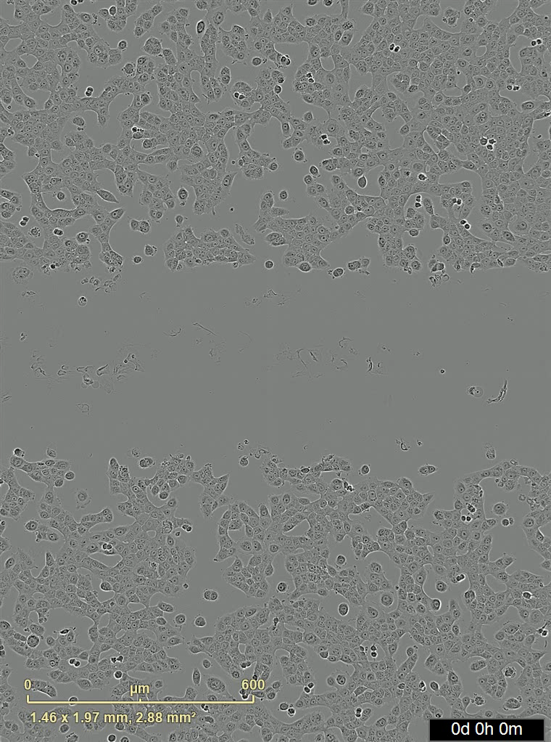
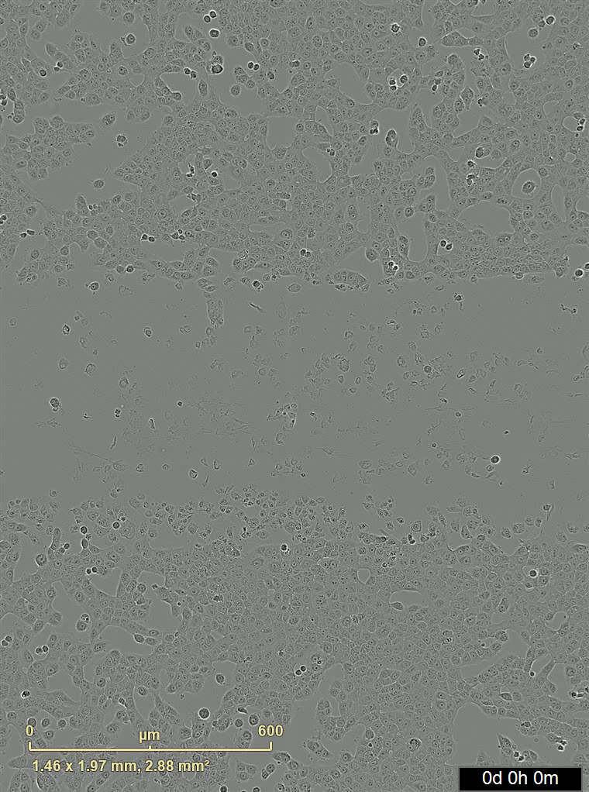

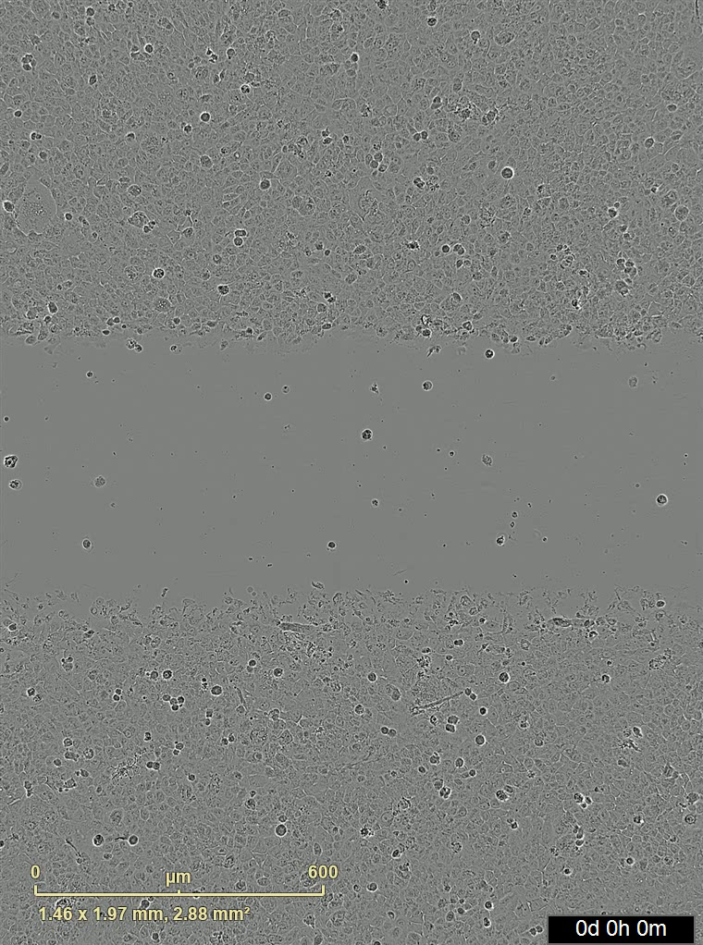
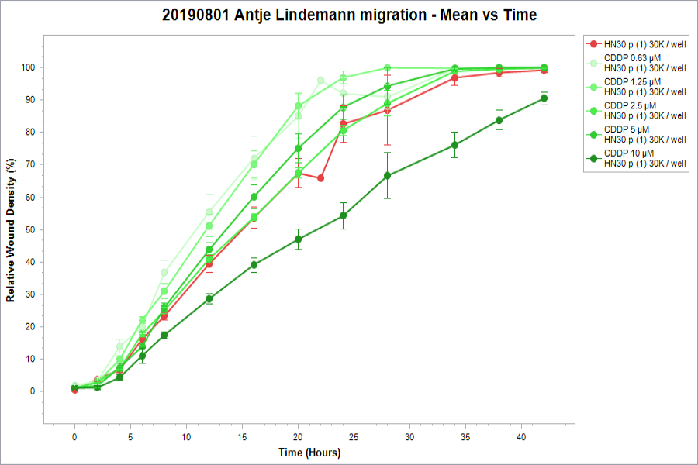
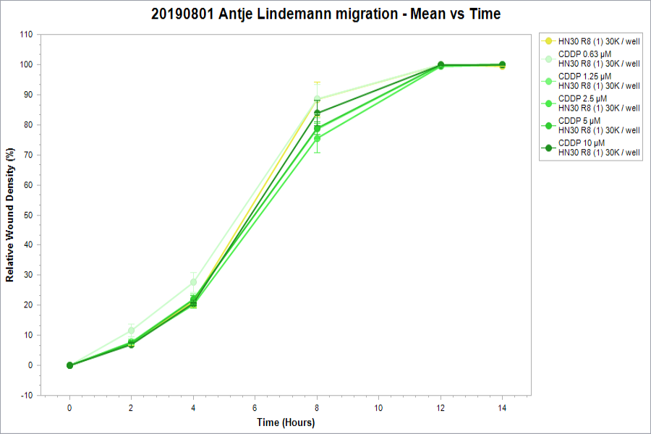
Supplementary Figure S1
A)
B)
HN30-P
HN30-R8
NT
CDDP
NT
CDDP
Wound closure movie clips
C)
D)
HN30-P cell migration-Mean vs Time
HN30-R8 cell migration-Mean vs Time
Supplementary Figure S1. Cisplatin resistant HNSCC cells migrate faster than their Cisplatin sensitive counterparts. HN30-P and HN30-R8 cells grown in 96-well plates were treated with various doses of cisplatin (CDDP) and subjected to Incucyte monolayer scratch assay as described in Methods. A and B) representative images of live scratch wound cell migration taken over time in the cells detected using a cell mask. C and D) quantification of the wound closure shown in A and B. CDDP treatment was performed in triplicates and data are presented as the mean ± SEM.

