Slide 1
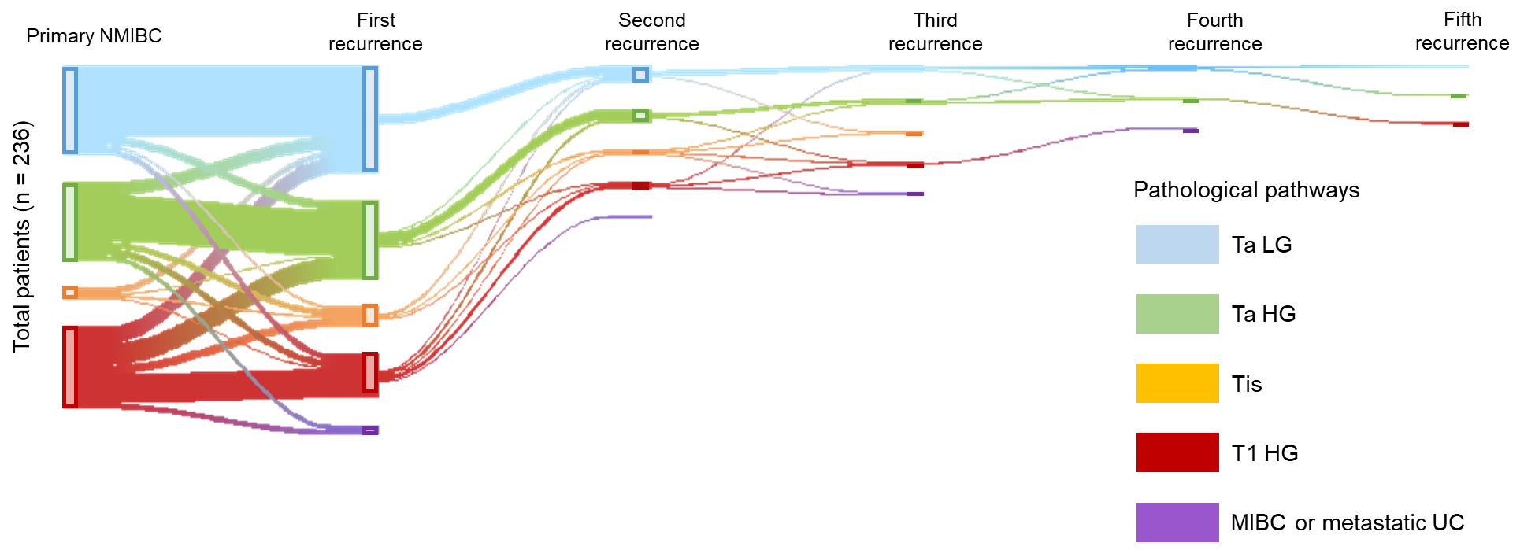
Figure S2: Sankey diagrams connecting the initial diagnosis of NMIBC and subsequent pathological pathways.
Of 990 patients, 236 had at least one instance of bladder cancer recurrence and/or progression. Each vertical bar represents a pathological category: Ta low-grade (LG), Ta high-grade (HG), isolated Tis, and T1HG. The height of the bars is proportional to the number of patients.
TURBT, transurethral resection of bladder tumor; WL, conventional white-light; PDD, photodynamic diagnosis-assisted; NMIBC, non-muscle-invasive bladder cancer; UC, urothelial carcinoma.

