Slide 1
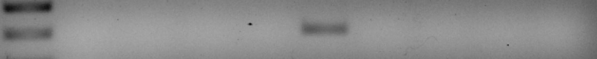
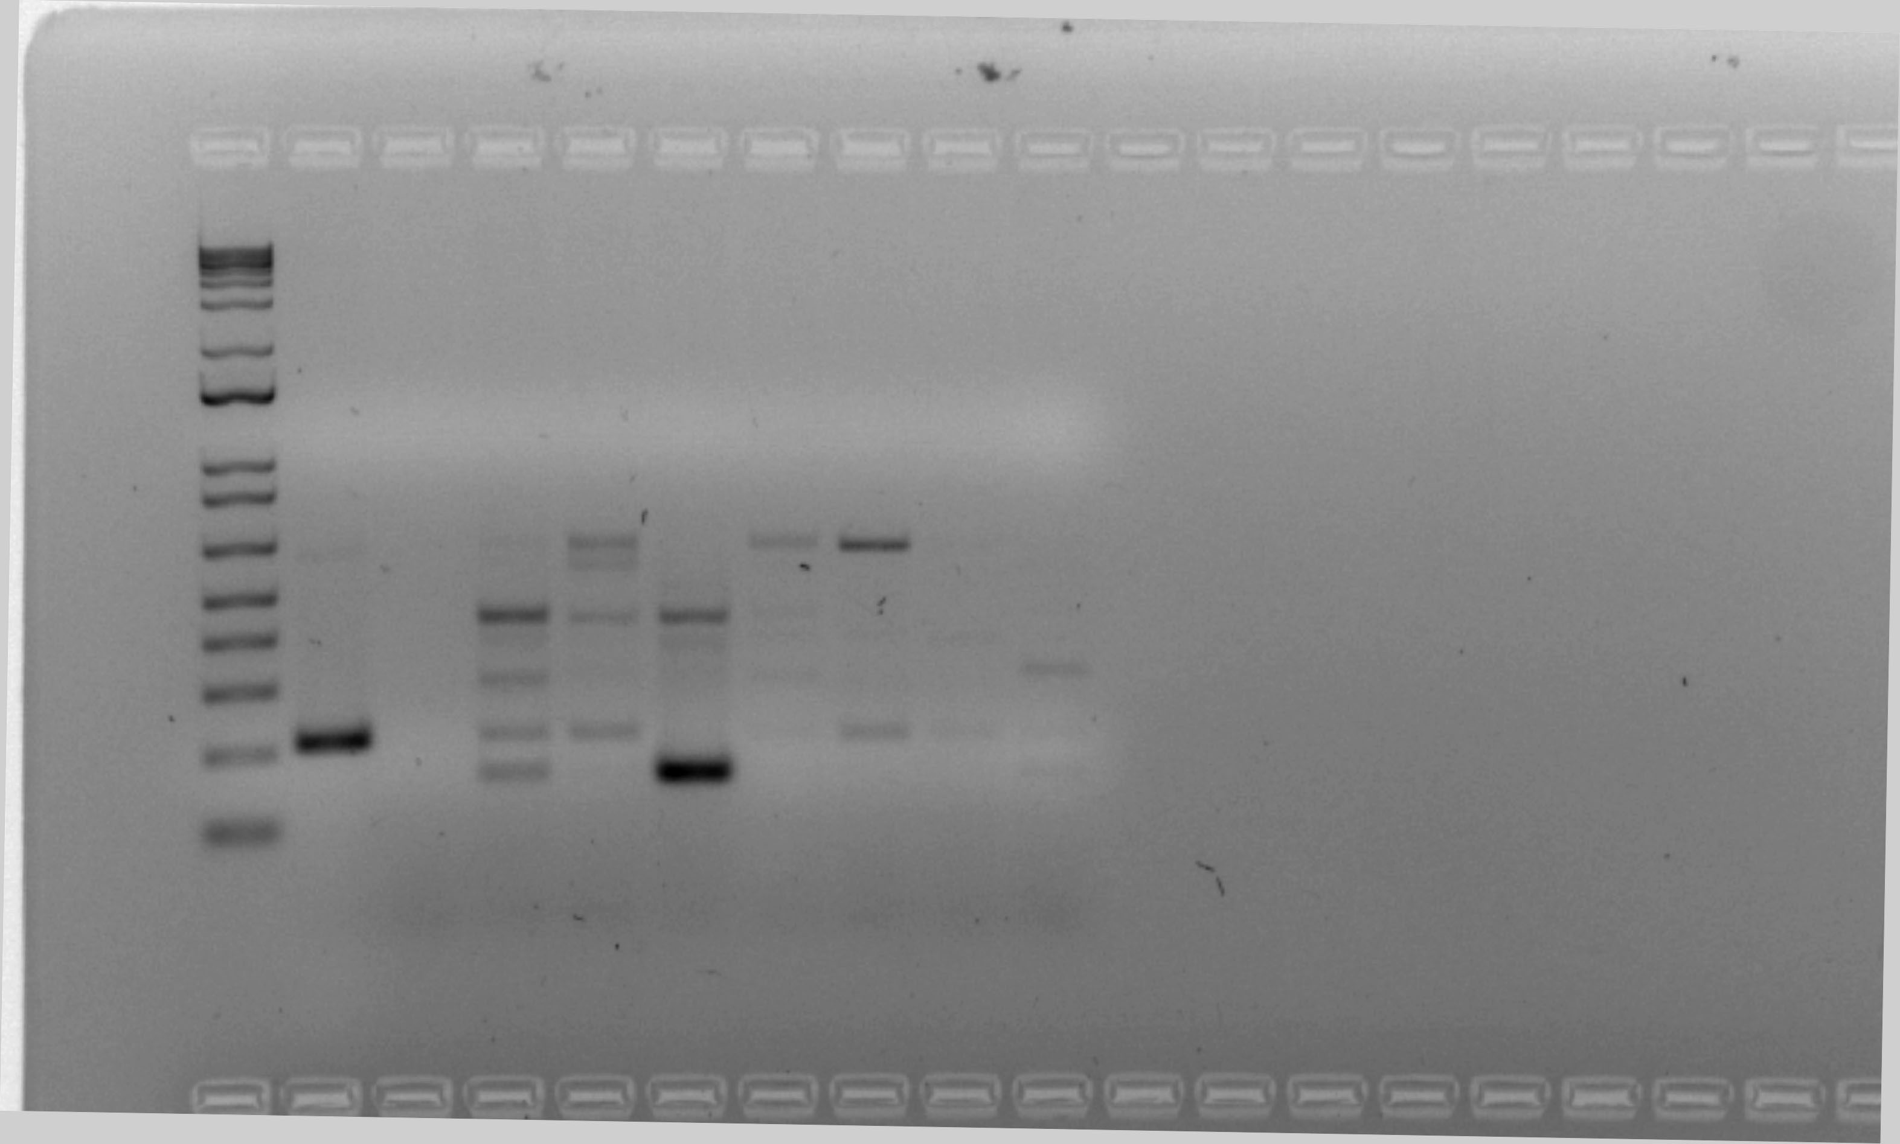
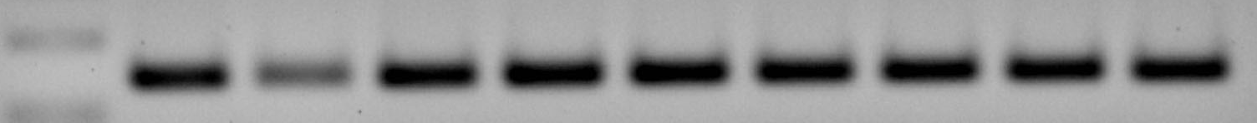
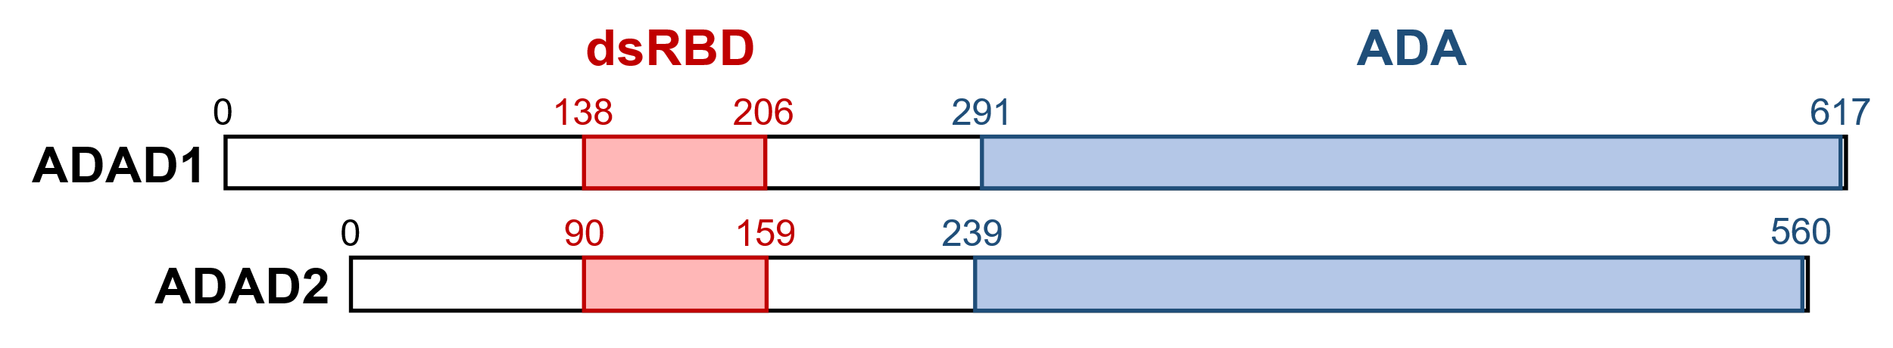
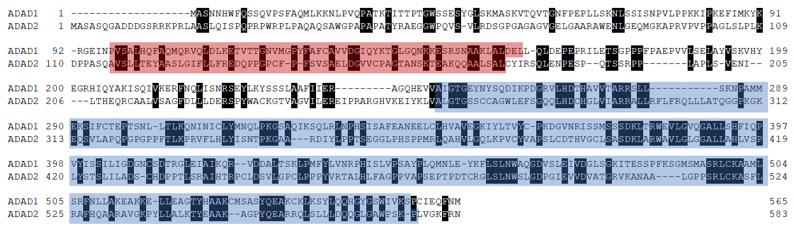
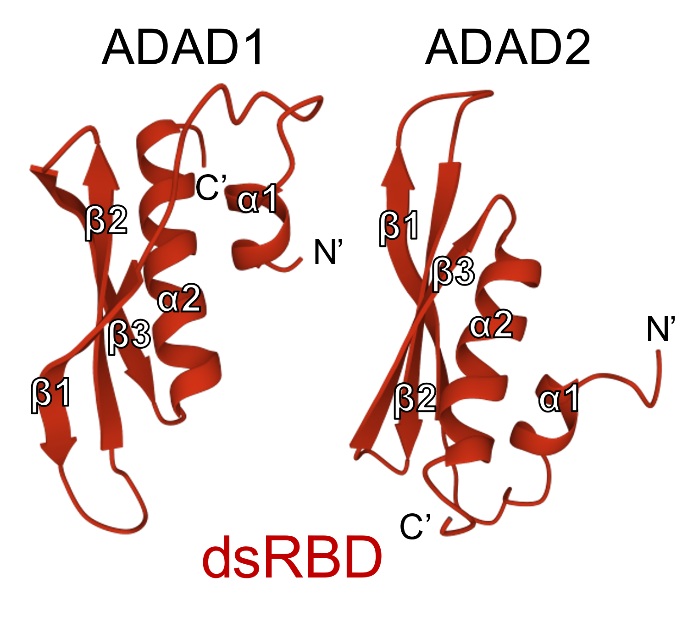
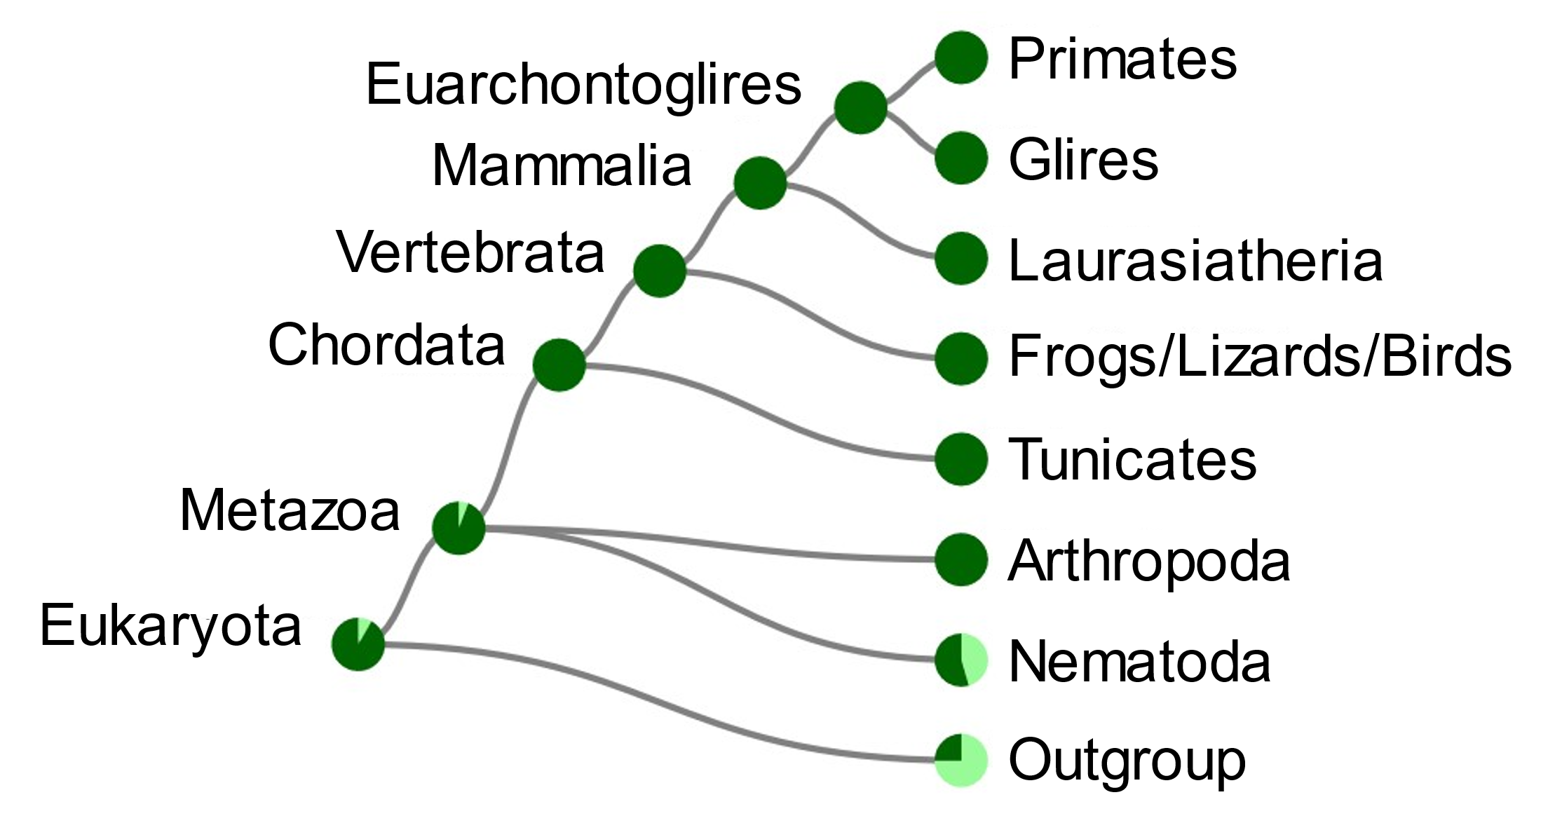
La
Li
Ki
Br
In
Te
Ut
Cap
Cor
Cau
Fig. S1
(A)
ADAD1
ADAD2
GAPDH
(B)
(C)
Spermatogonia
Spermatocytes
Round Spermatids
(D)
(E)
(F)

Slide 2
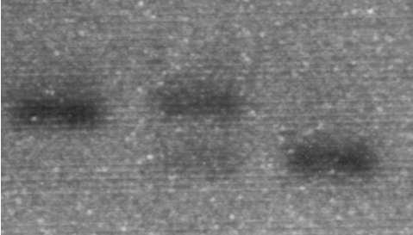
Fig. S2
(A)
(B)
(C)
Testis
(D)
Adad2 ^{Δ/Δ}
Adad2^{+/+}
Adad2^{+/Δ}
Adad2
+/Δ
Δ/Δ
60 kDa
ADAD2
WT
Mut
Fw’ – Rv’
75 kDa
MVH
(E)
(F)
+/Δ
Δ/Δ

Slide 3
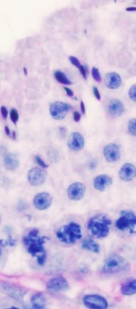
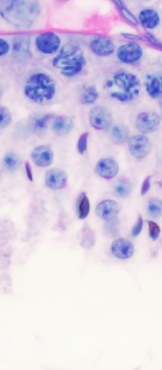
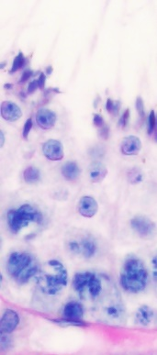
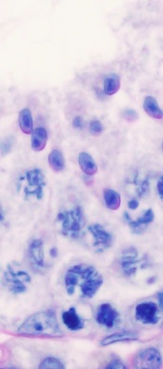
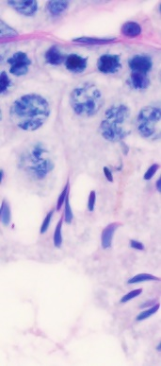
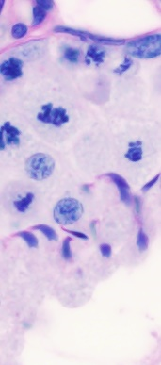
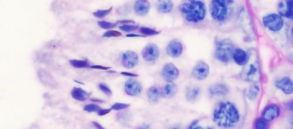
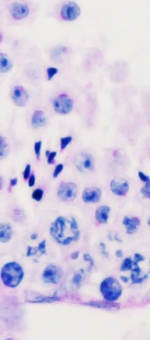
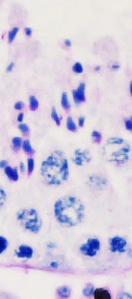
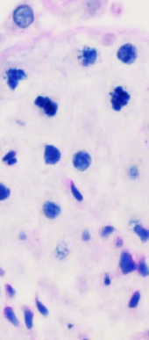
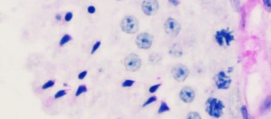
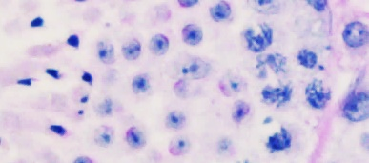
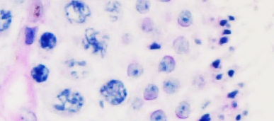
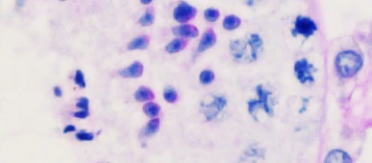
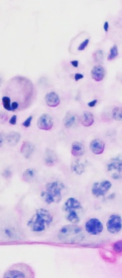
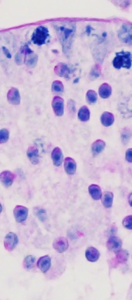
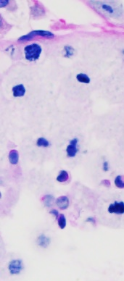
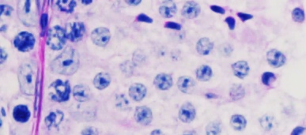
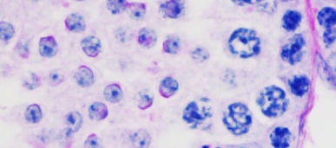
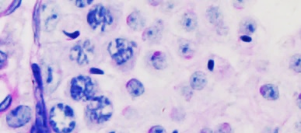
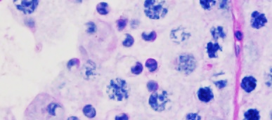
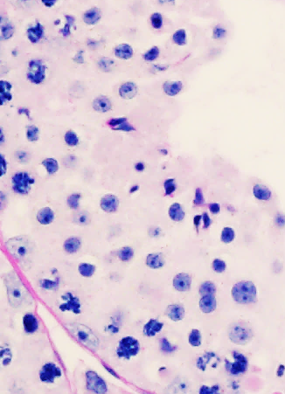
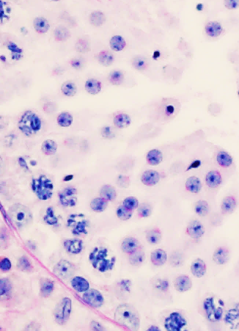
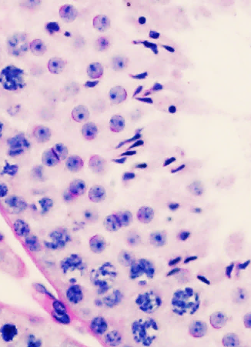
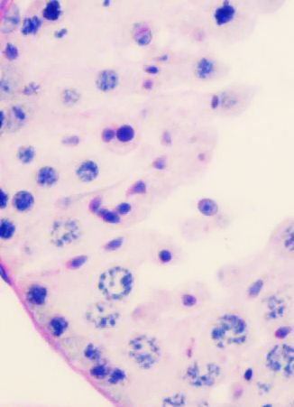
Fig. S3
(A)
I
II-III
IV-V
VI-VIII
IX-X
XI
XII
Adad2^{+/+}
*
Adad2–/–
*
Adad2^{Δ/Δ}
(B)
20 µm
I
II-III
IV-V
XI-XII
*
*
*
Adad2–/–
*
*
*
*
*
*
*
20 µm

Slide 4
Fig. S4
(A)
Downregulated genes
Biological process
Cellular component
Molecular function

Slide 5
Fig. S4 (cont.)
(B)
Downregulated
Upregulated

Slide 6
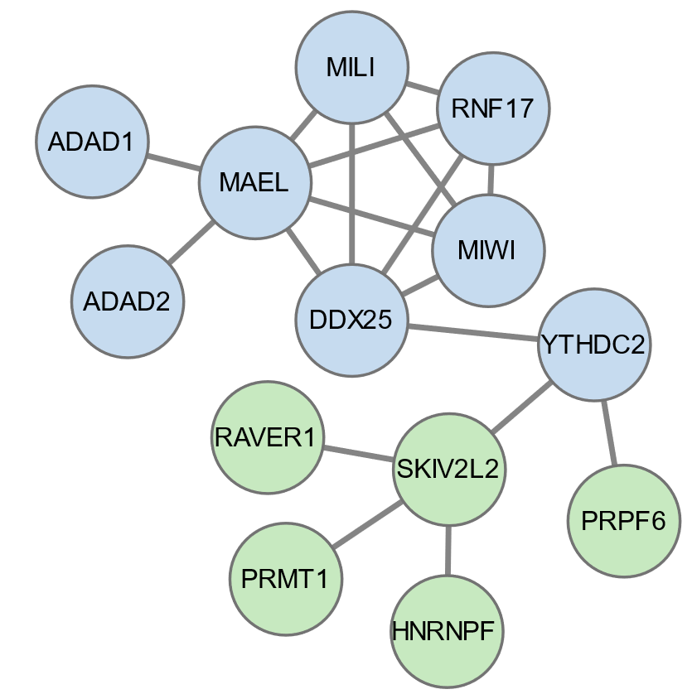
Fig. S5
(A)
Biological process
Cellular component
Molecular function
(B)
(C)
ACTL7A
ADAD2
ADAD1
BAG5
DDX25
GLRX3
MAEL
OPA1
OXCT2B
PPP3CC
SART1
RNF17
ADAD2 interactome
283 proteins
Castañeda et al., 2014
MAEL interactome
139 proteins
piRNA biogenesis; spermatogenesis
Spermatogenesis

Slide 7
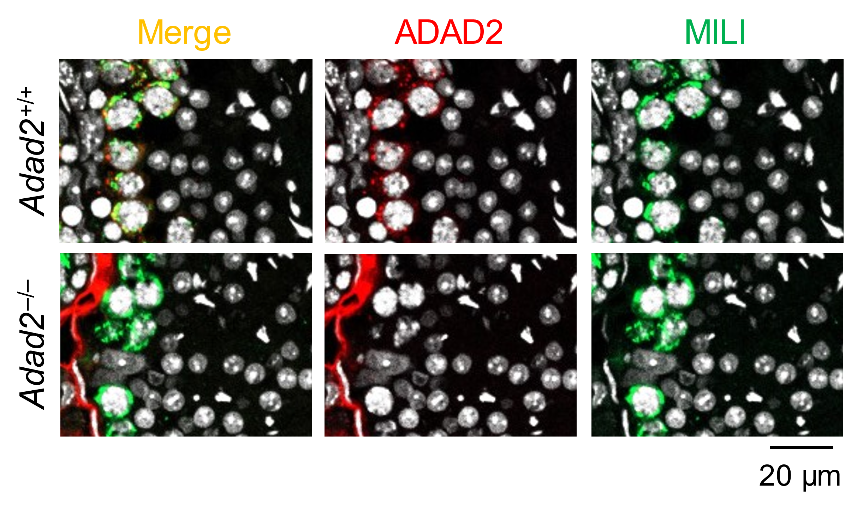
Fig. S6

Slide 8
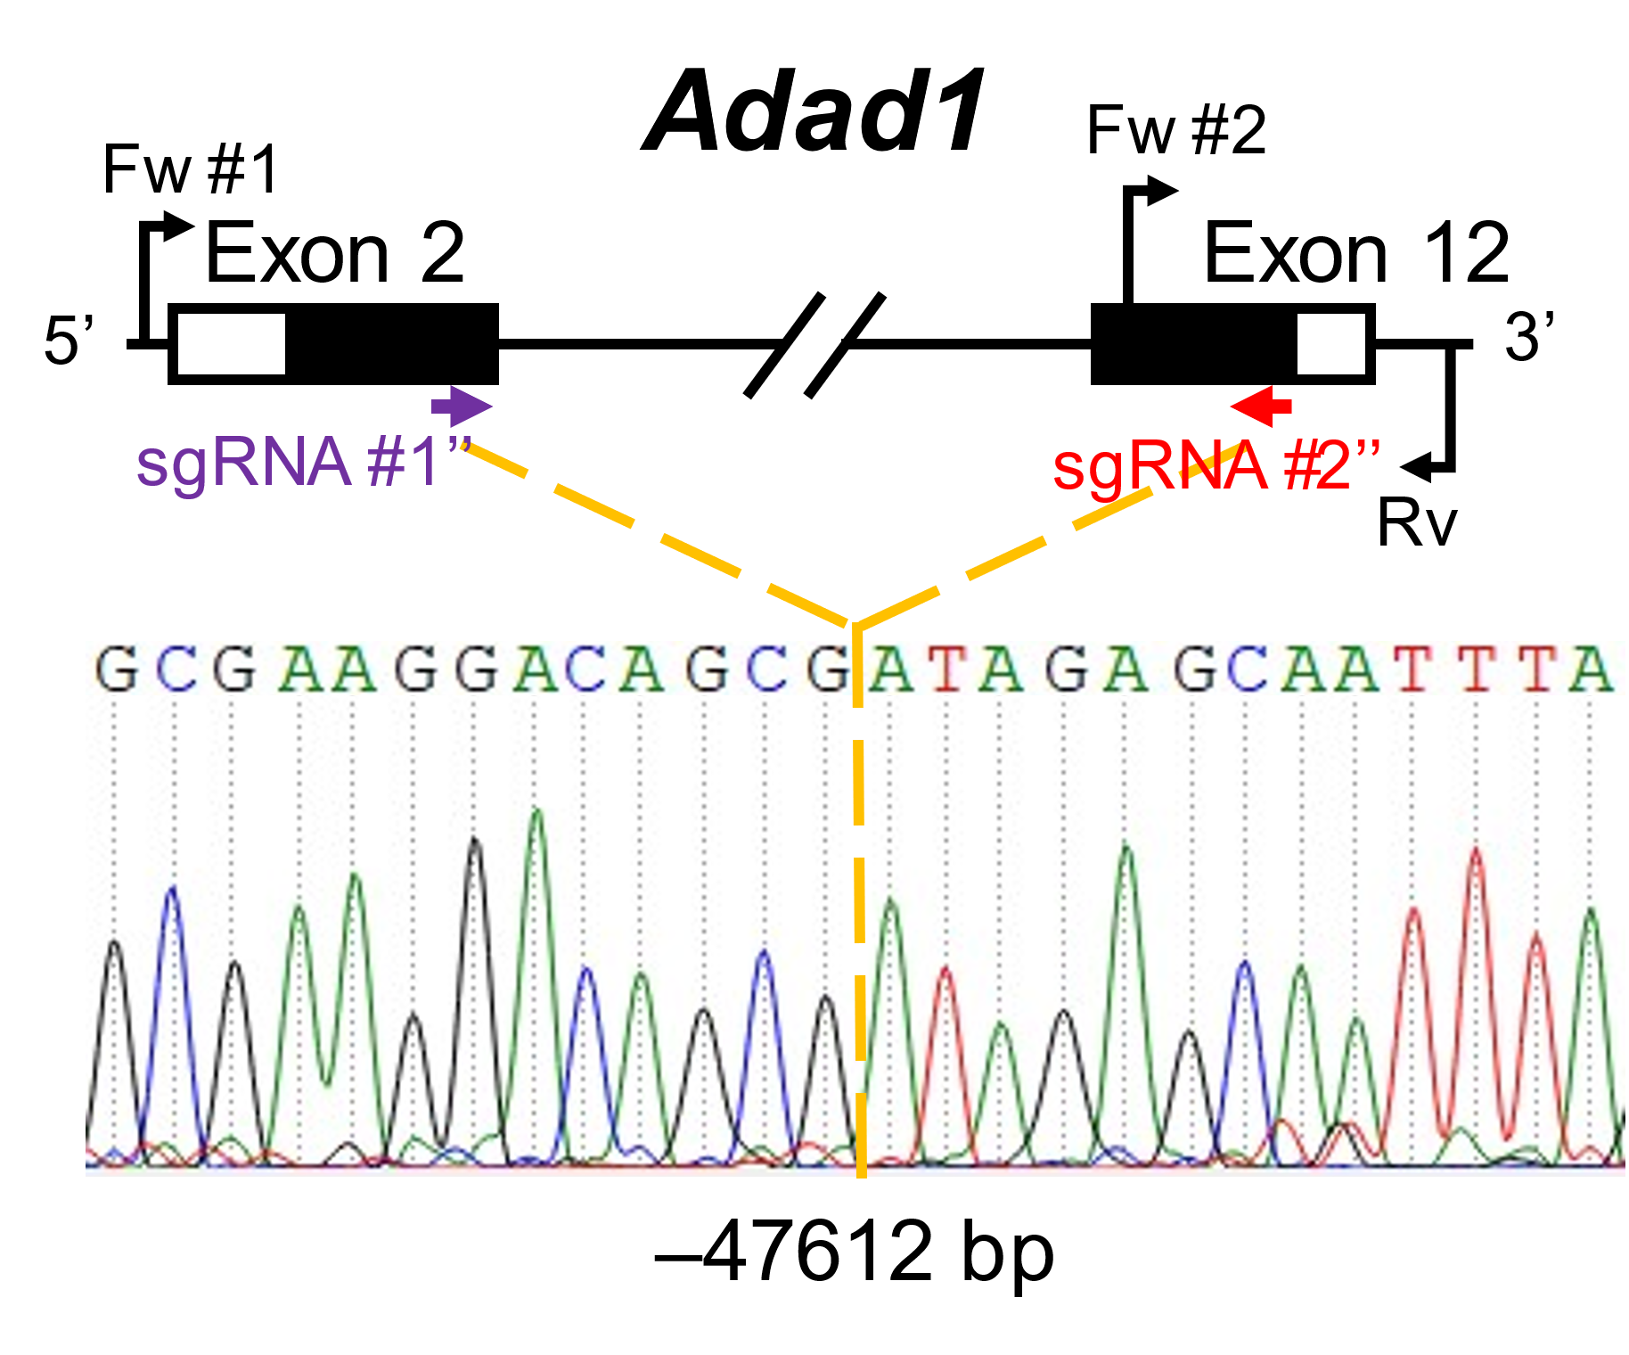
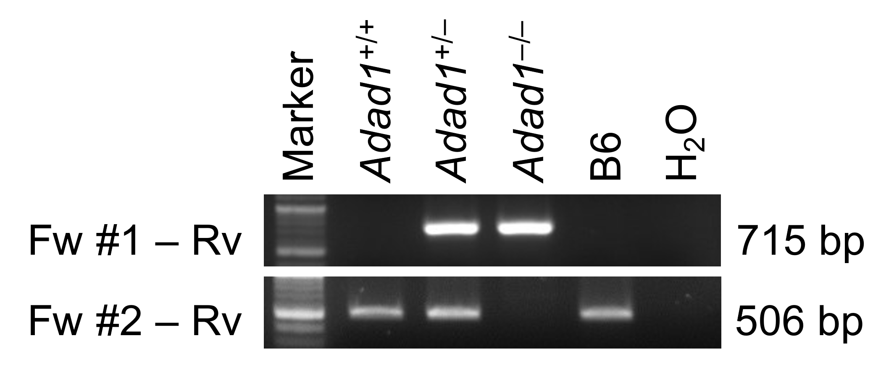
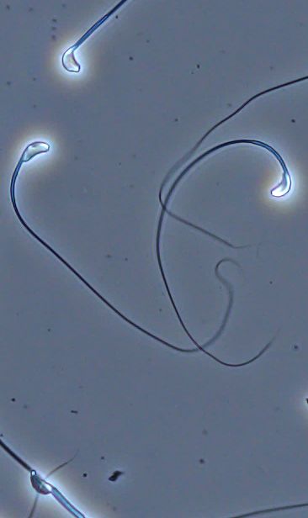
Fig. S7
(A)
(E)
Adad1–/–
Testis
(B)
(C)
(D)
Adad1–/–
Caput
20 µm
(F)
(G)
Cauda
Testis
Testis
Adad1
+/+
+/–
–/–
Adad2
+/+
+/–
–/–
ADAD1
ADAD2
100 µm
ADAD2
ADAD1
GAPDH
GAPDH

Slide 9
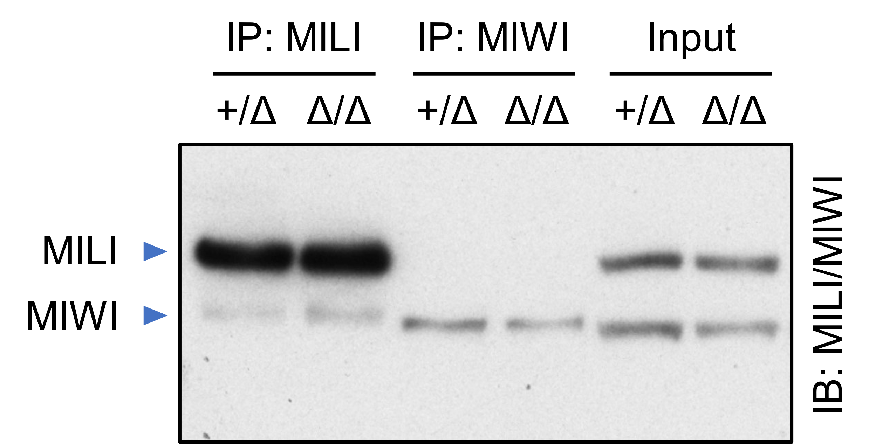
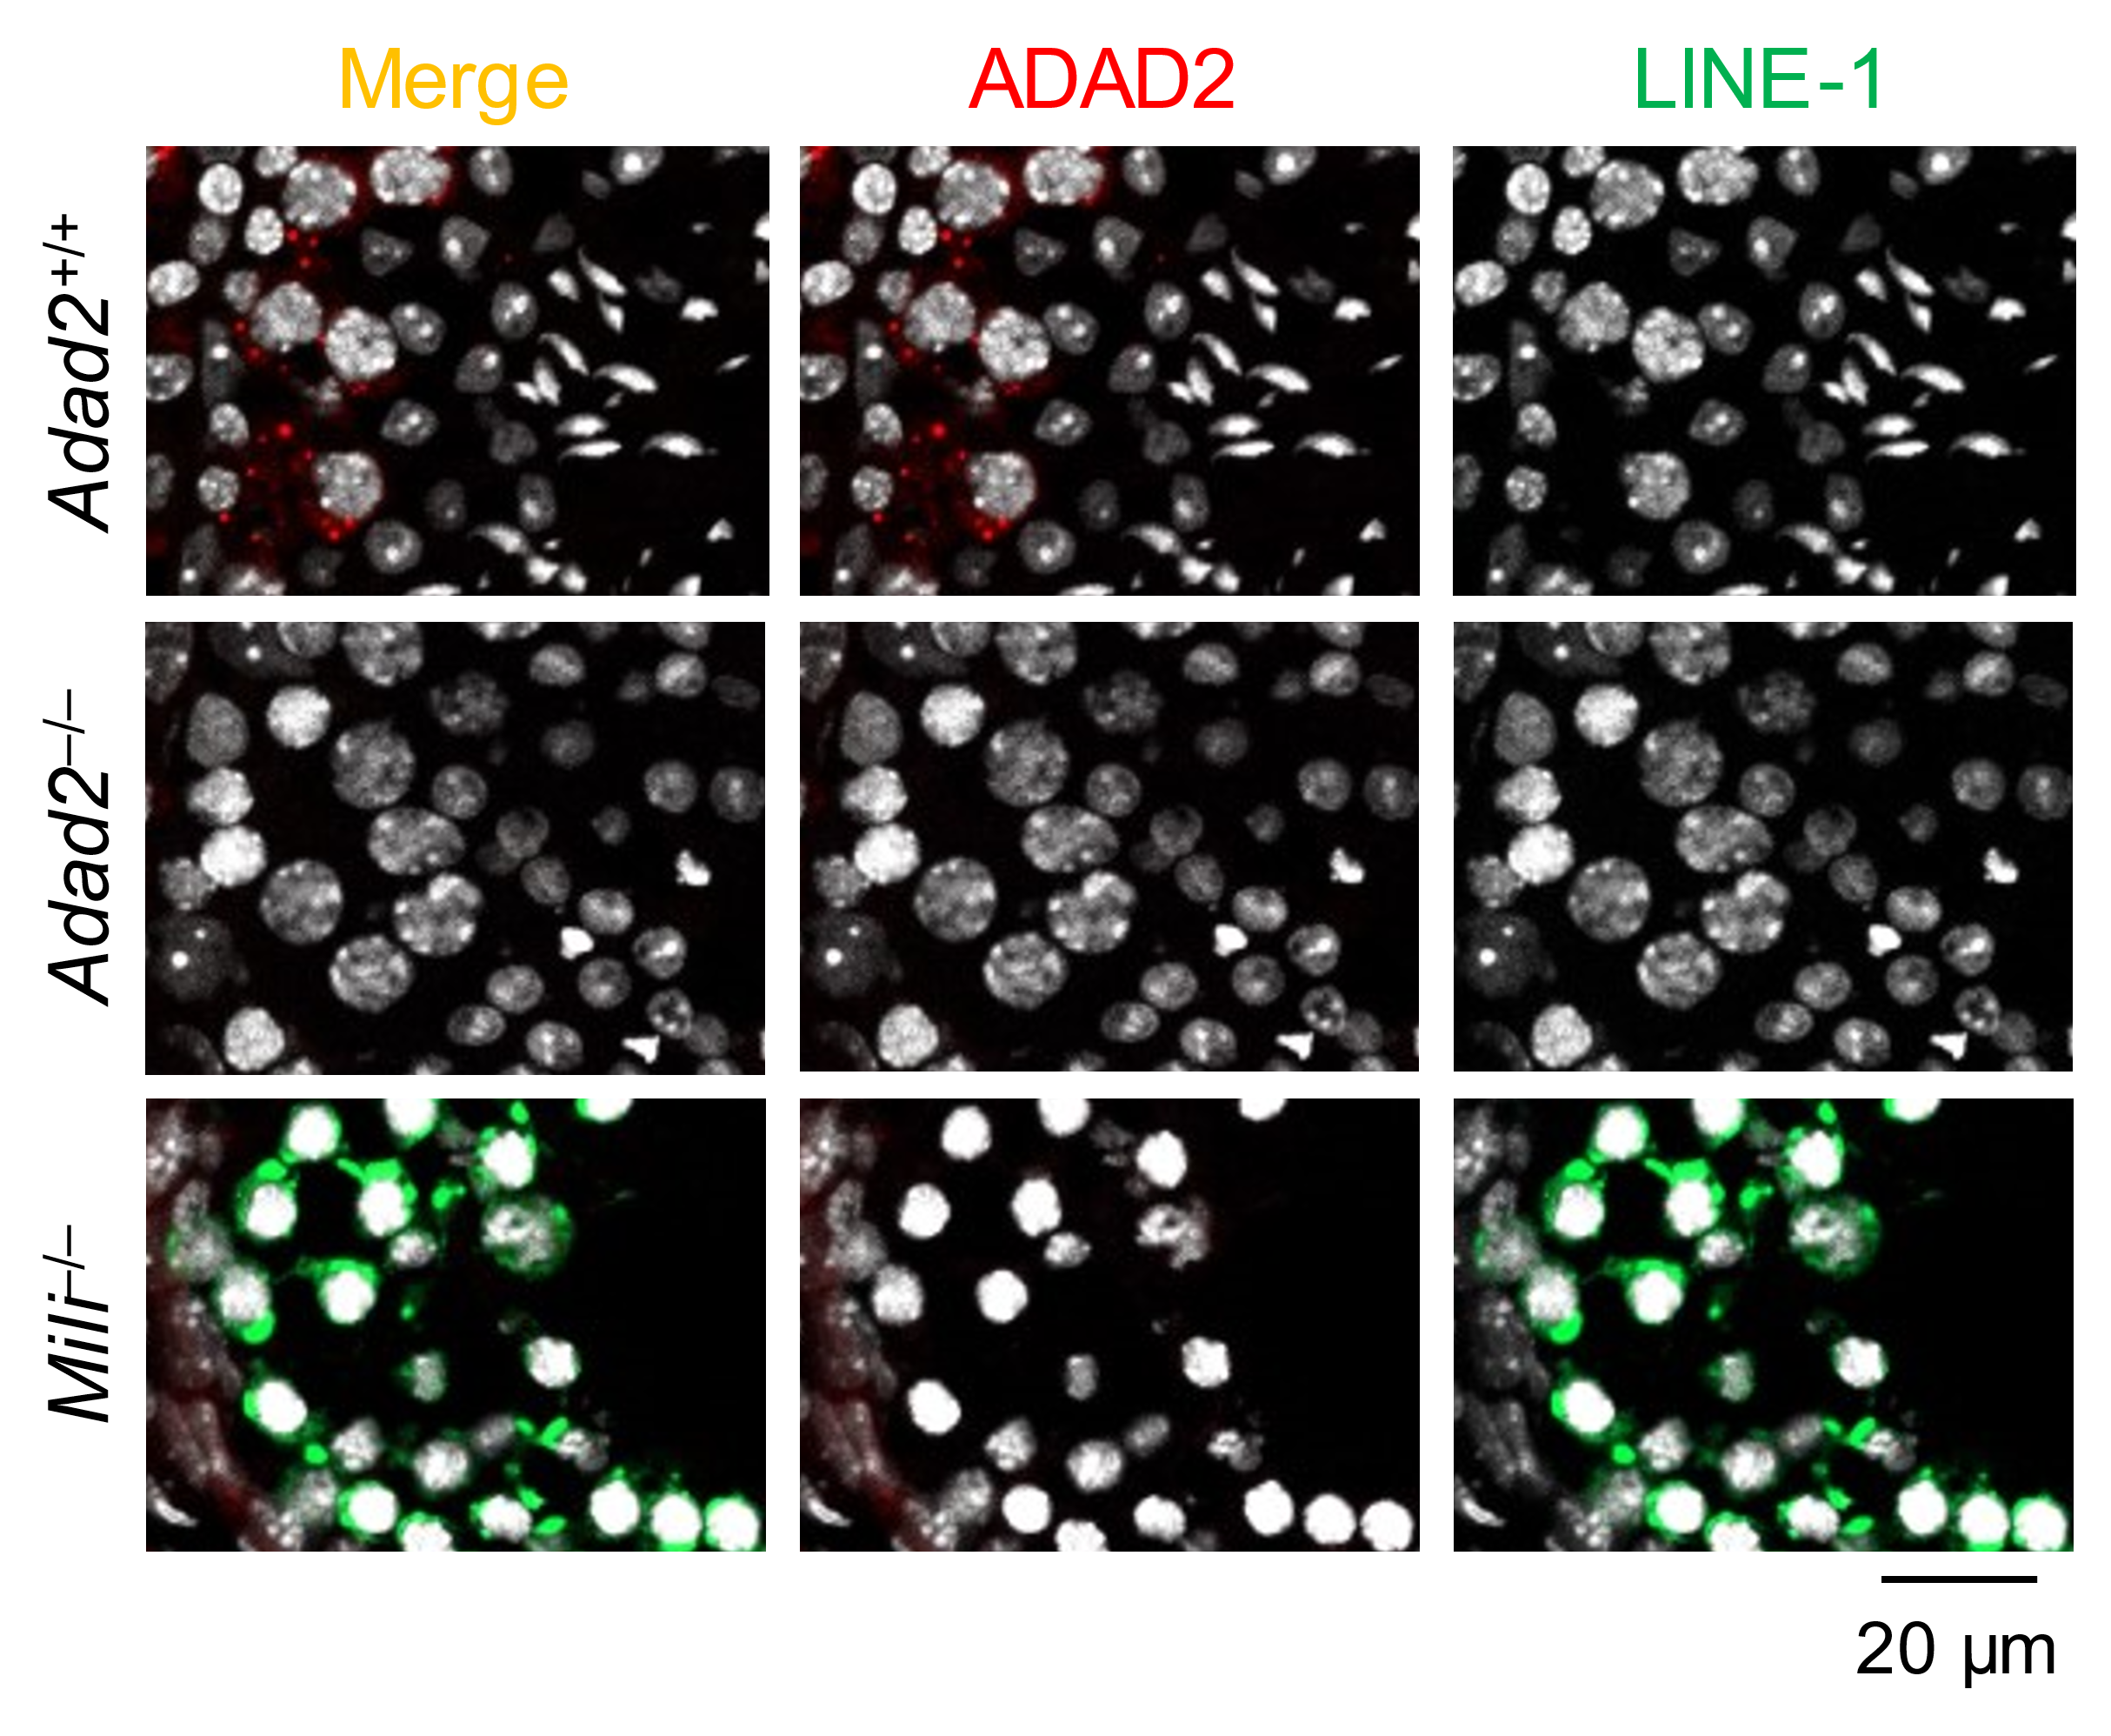
Fig. S8
(A)
(B)
Z score = 19.1
Z score = 33.1
(C)

