Slide 1
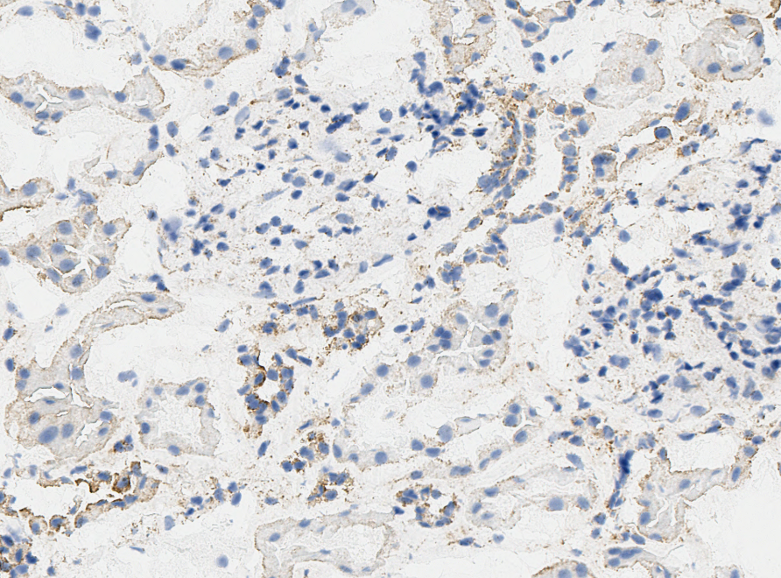
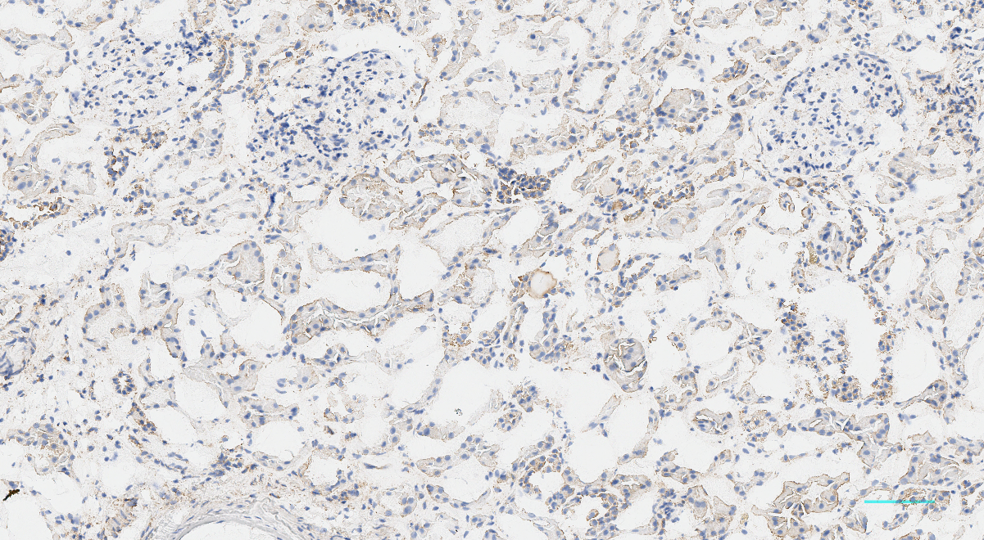
A
B
PT
B
100 µm
G
CD
G
*
CD
100 µm
Panx1 intensity, a.u.
PT
cyst
300 µm
CD
cyst
100 µm
Supplementary Figure 1. A - IHC staining with polyclonal antibodies in human ADPKD biopsy shows higher PANX1 level in cystic epithelium than collecting ducts (CD). The effect was observed in both non-truncating and truncating mutations in the Pkd1 structure (blue and red dots, respectively); B – Control experiment for Figure 1 stained with mouse IgG2aκ isotype antibodies in a healthy individual kidney. CD – collecting duct, G- glomeruli, PT – proximal tubules. *p<0.05 vs CD per paired t-test

