Slide 1
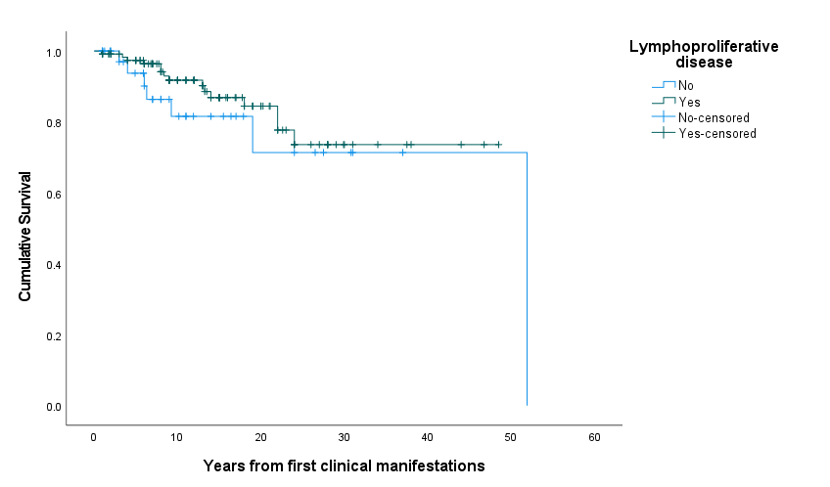
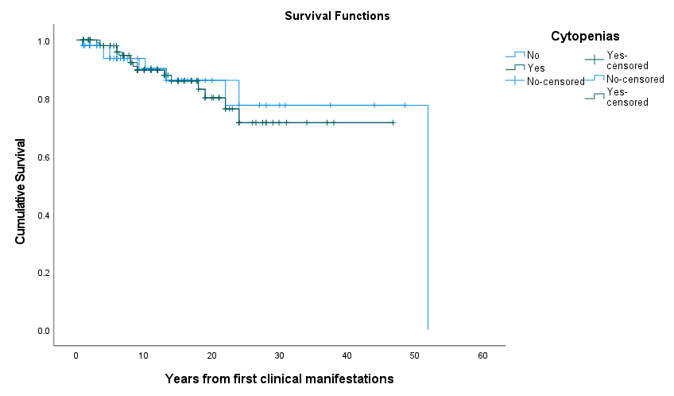
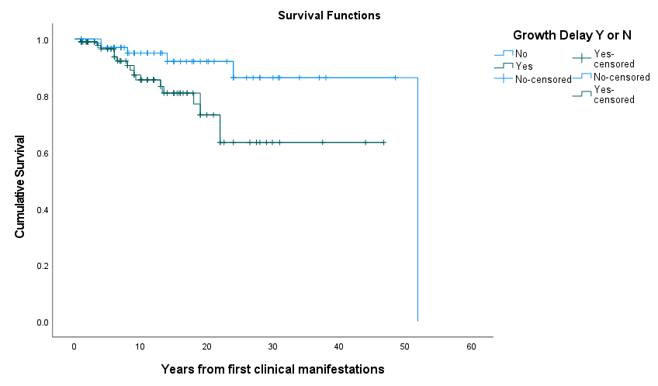
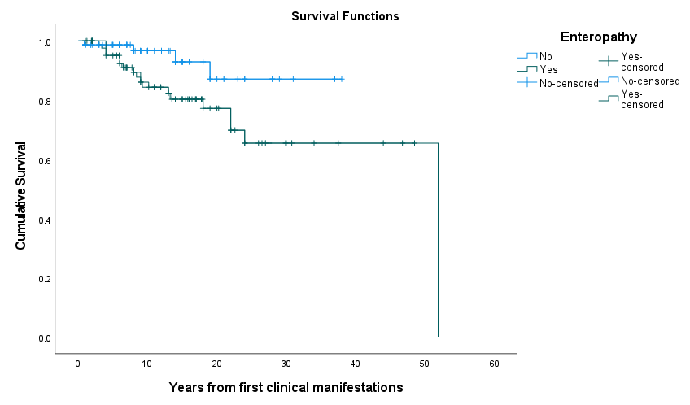
Figure E VI
Survival based on Clinical Manifestations
A.
Percent Cumulative Survival
100
B.
Percent Cumulative Survival
100
80
80
60
60
40
Lymphoproliferative Disease
40
Autoimmune Cytopenia
20
20
0
P=0.383
0
P=0.827
0
10
20
30
40
50
60
0
10
20
30
40
50
60
Years from first clinical manifestation
Years from first clinical manifestation
Percent Cumulative Survival
Percent Cumulative Survival
C.
100
D.
100
80
80
60
60
40
40
Enteropathy
Growth Delay
20
20
P=0.026
P=0.034
0
0
0
10
20
30
40
50
60
0
10
20
30
40
50
60
Years from first clinical manifestation
Years from first clinical manifestation

Slide 2
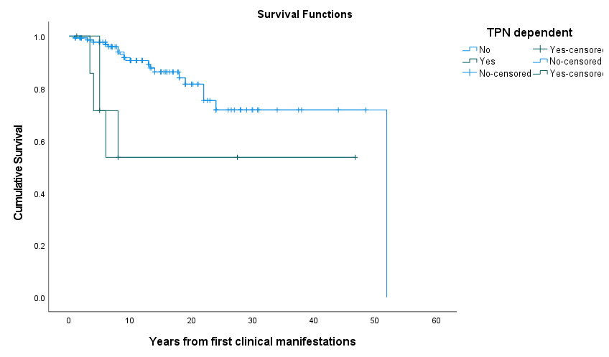
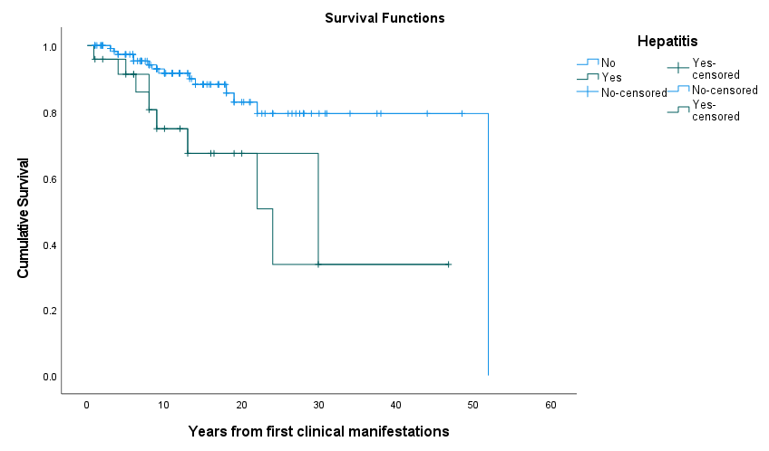
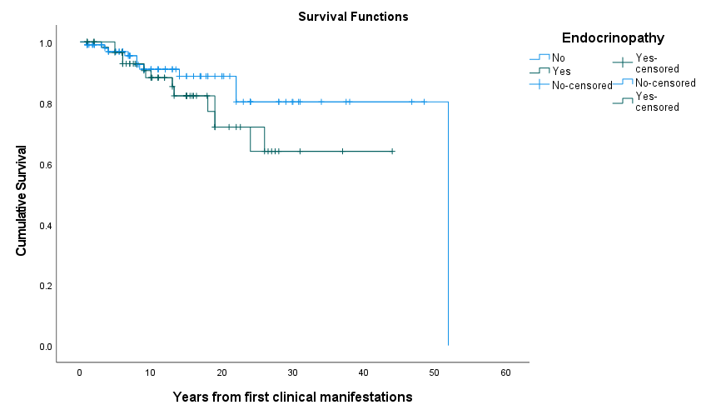
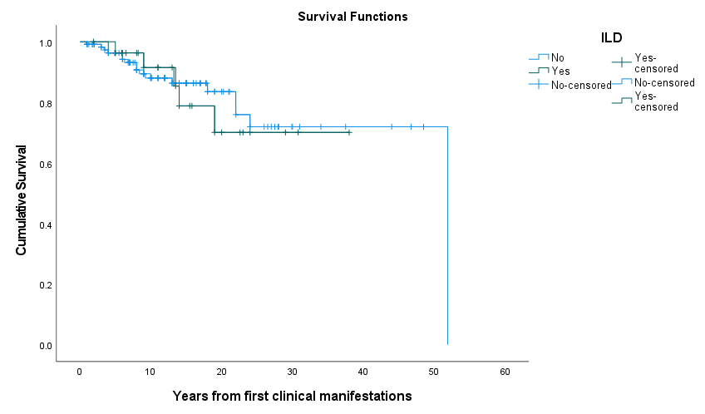
Figure E VI
E.
Percent Cumulative Survival
100
F.
Percent Cumulative Survival
100
80
80
60
60
40
40
20
TPN Dependence
20
Autoimmune Hepatitis
P=0.024
P=0.004
0
0
0
10
20
30
40
50
60
0
10
20
30
40
50
60
Years from first clinical manifestation
Years from first clinical manifestation
Percent Cumulative Survival
G.
Percent Cumulative Survival
H.
100
100
80
80
60
60
40
40
20
Endocrinopathy
20
Interstitial Lung Disease
0
P=0.203
0
P=0.799
0
10
20
30
40
50
60
0
10
20
30
40
50
60
Years from first clinical manifestation
Years from first clinical manifestation

Slide 3
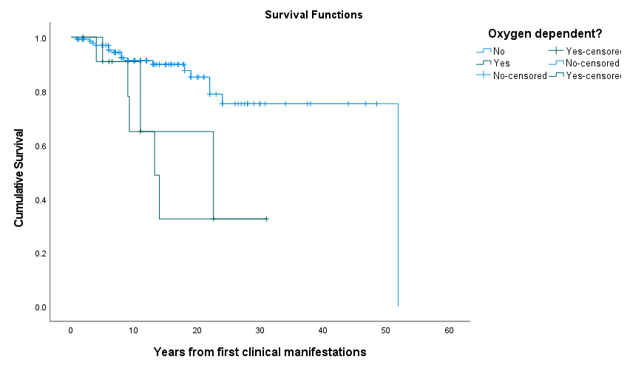
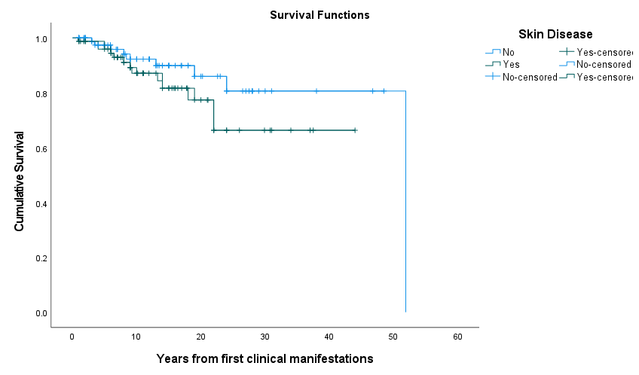
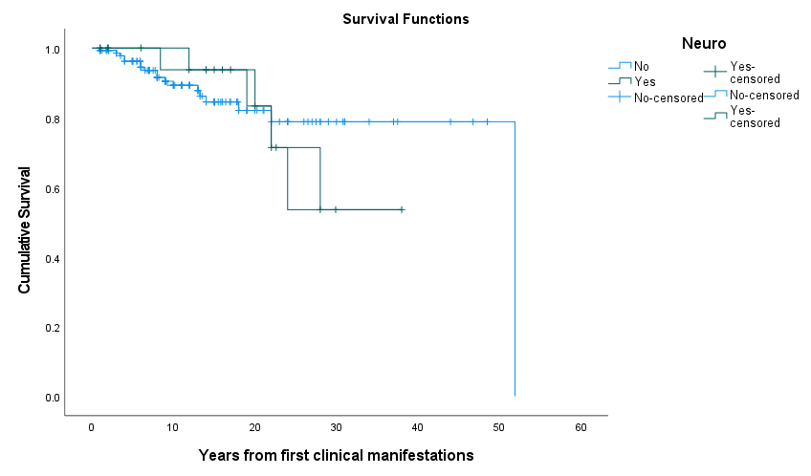
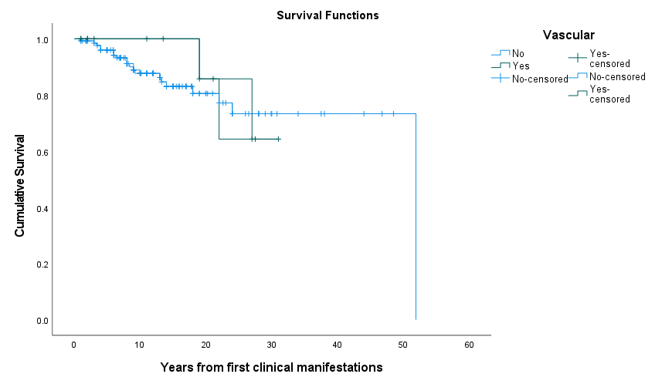
Figure E VI
I.
Percent Cumulative Survival
J.
100
Percent Cumulative Survival
100
80
80
60
60
40
40
20
20
Oxygen Dependency
Skin Disease
0
P=0.002
0
P=0.175
0
10
20
30
40
50
60
0
10
20
30
40
50
60
Years from first clinical manifestation
Years from first clinical manifestation
K.
Percent Cumulative Survival
100
L.
Percent Cumulative Survival
100
80
80
60
60
40
40
20
Neurologic Disease
20
Vasculopathy
0
P=0.716
0
P=0.854
0
10
20
30
40
50
60
0
10
20
30
40
50
60
Years from first clinical manifestation
Years from first clinical manifestation

Slide 4
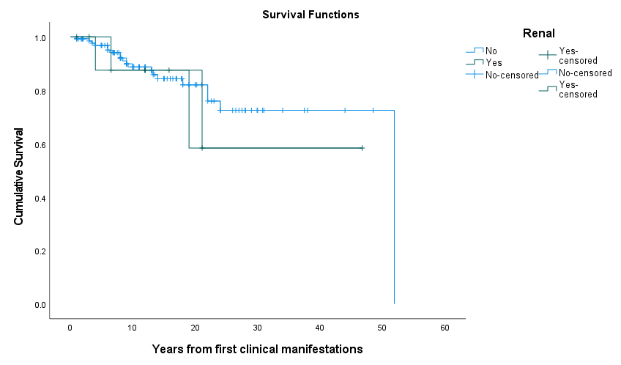

Figure E VI
M.
100
N.
100
Percent Cumulative Survival
Percent Cumulative Survival
80
80
60
60
40
40
Renal Disease
Arthritis
20
20
P=0.525
P=0.659
0
0
0
10
20
30
40
50
0
10
20
30
40
50
Years from first clinical manifestation
Years from first clinical manifestation

