Slide 1
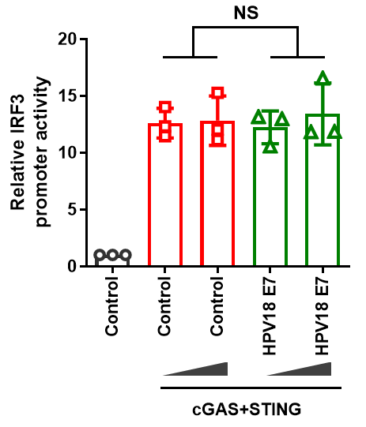
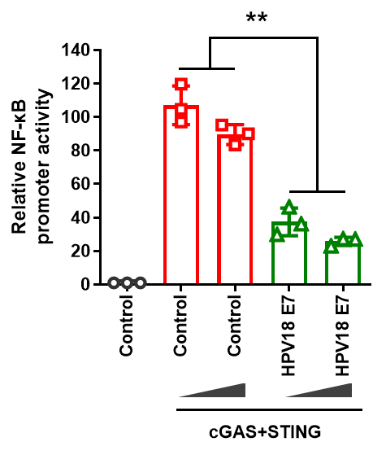
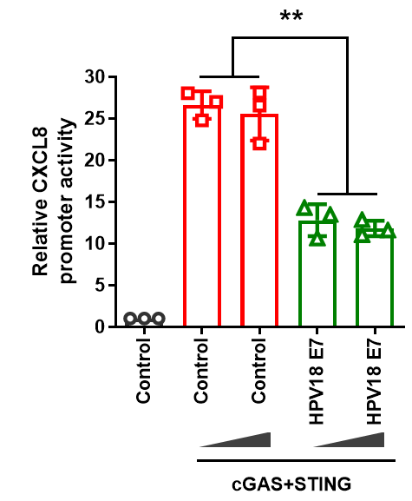
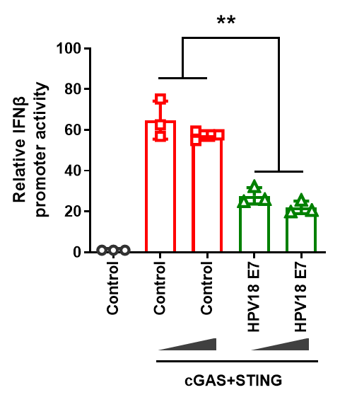



Supplementary Figure 1
HEK293T
A
B
C
HEK293T+cGAS+STING
HEK293T+cGAS+STING
+HPV18 E7
EA.hy926
THP1
HeLa
STING
GAPDH
cGAS
HPV18 E7
GAPDH
1 2 3
1 2

