Slide 1
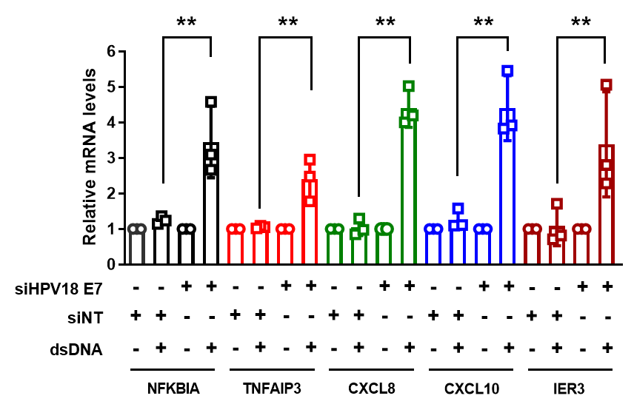
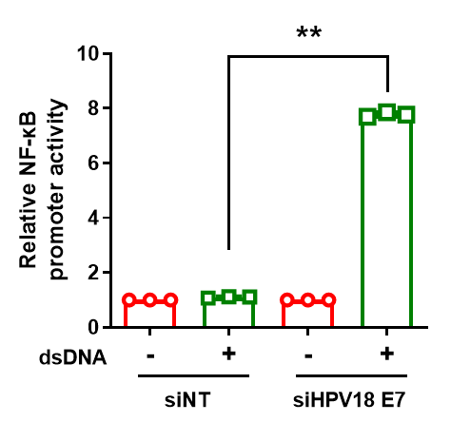


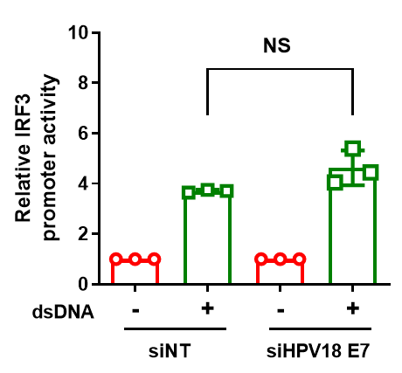
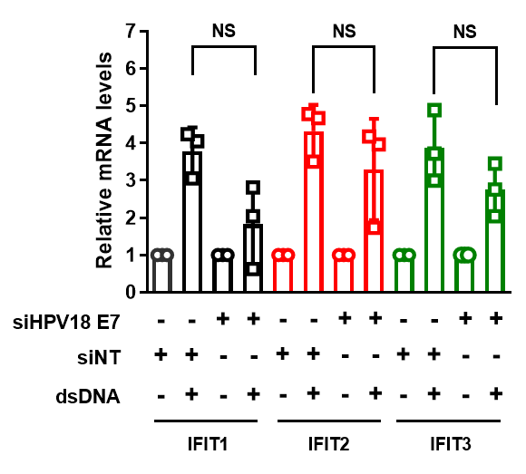
Supplementary Figure 2
HeLa
A
HeLa
B
HeLa
C
siNT siHPV18 E7
dsDNA
- + - +
STING
cGAS
HPV18 E7
GAPDH
1 2 3 4
HeLa
HeLa
D
E

