Slide 1
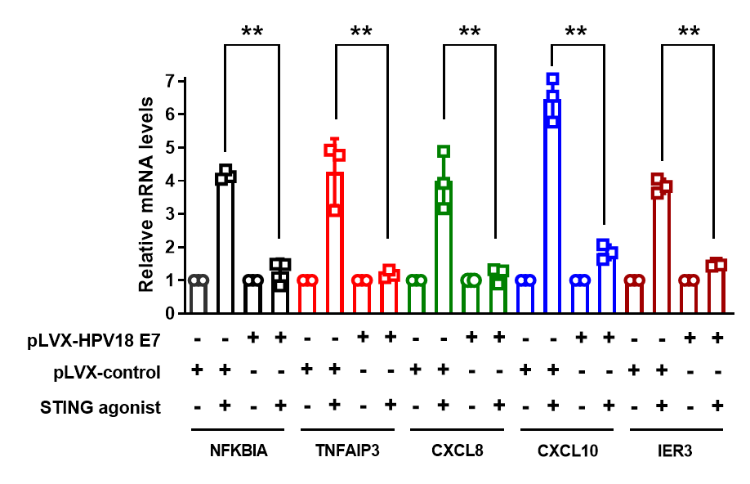
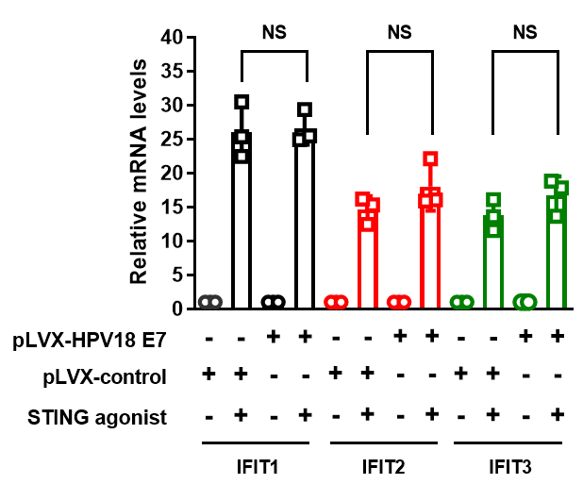



Supplementary Figure 3
A
B
EA.hy926
EA.hy926
EA.hy926
pLVX-control
pLVX-HPV18 E7
STING agonist
- + - +
HPV18 E7
STING
cGAS
GAPDH
1 2 3 4

