Slide 1
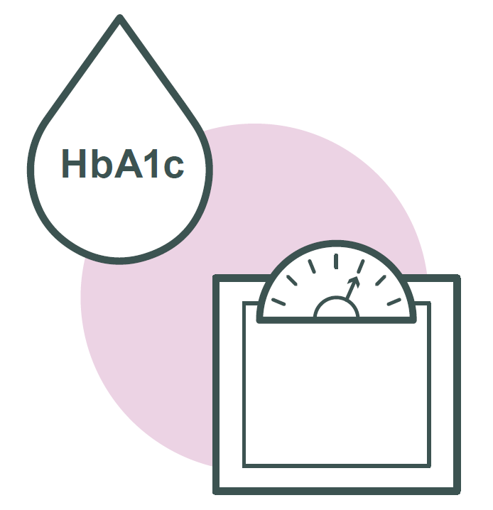
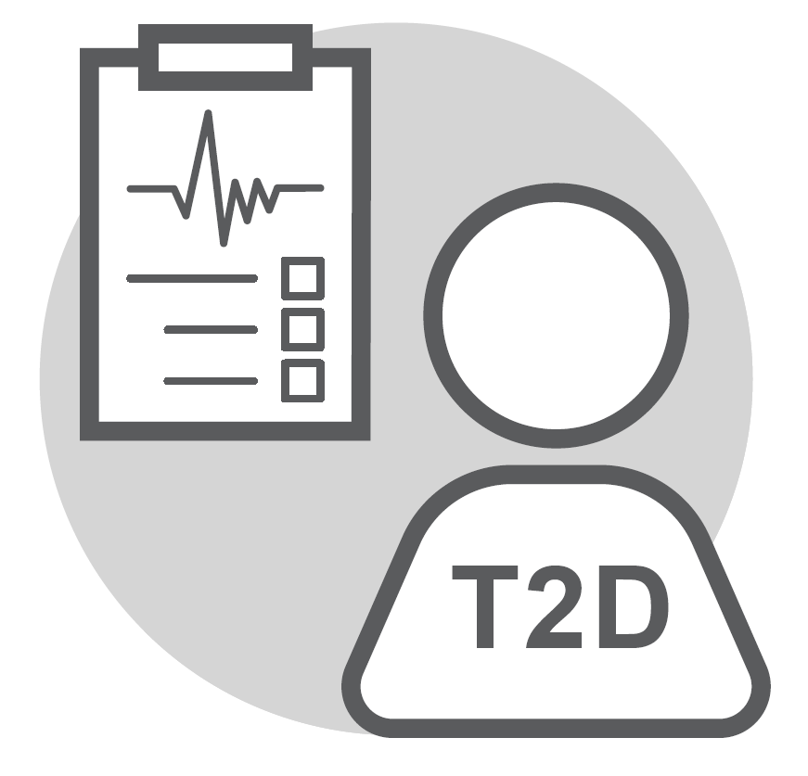

Biomedical characteristics do not affect the better blood glucose and weight change seen with iGlarLixi versus BIAsp 30 in the SoliMix trial
T2D
Overview
What did we find?
The SoliMix trial compared iGlarLixiª with premix BIAsp 30^{b}, two prescription medicines with insulin components but with different ways of working to lower high blood glucose levels, in people with type 2 diabetes (T2D).
The trial found that people taking iGlarLixi had a reduction in blood glucose and body weight, alongside fewer people experiencing low blood glucose levels, known as hypoglycaemia (hypo) compared with BIAsp 30.
We found no evidence that these characteristics had a significant impact on the lower blood glucose and beneficial body weight change shown in the SoliMix trial with iGlarLixi compared with BIAsp 30.
Similarly, the fewer hypos recorded with iGlarLixi versus BIAsp 30 did not appear to differ when people were grouped by different characteristics.
We found no proof that individual characteristics affected the results of iGlarLixi, resulting in reduced:
What do you need to know?
People with T2D often have a wide range of characteristics that may affect how they respond to medications. These include age, duration of diabetes, insulin dose, blood glucose, body mass index (BMI), lipid levels, sex, geographical region, and ethnicity.
A subgroup analysis can be used to determine the effect of these characteristics on the results of a clinical trial such as SoliMix.
Blood glucose
Body weight
Hypos
What did we do?
What does this mean?
The 26-week study split 887 adults with advanced T2D into two groups, to receive injections of once-daily iGlarLixi or twice-daily BIAsp 30.
The current study explored whether certain characteristics had an effect on
blood glucose levels, weight, and chance of hypos with iGlarLixi compared
with BIAsp 30.
People were grouped according to their age, duration of diabetes, insulin dose, blood glucose, BMI, and kidney health.
These results suggest that age, duration of diabetes, daily insulin dose, blood glucose, BMI, and kidney health did not significantly affect the better blood glucose and weight benefit with fewer hypos shown with iGlarLixi compared with BIAsp 30 in the SoliMix study.
vs

