Slide 1
Supplementary Figure 1
RT:
0.00 - 4.00
SM:
3G
RT: 2.14
NL: 3.19E6
Total ion chromatogram
AA: 2416596
TIC MS ICIS
100
10-6-
80
20_CBD_THC_CBN_he
60
mp_oil_methodev_36
Relative Abundance
RT: 2.28
40
AA: 8352
20
RT: 0.25
RT: 0.56
RT: 0.95
RT: 1.06
RT: 1.54
RT: 1.89
RT: 2.11
RT: 2.44
RT: 3.02
RT: 3.15
RT: 3.42
RT: 3.85
0
AA: 602
AA: 412
AA: 33854
AA: 1160
AA: 261
AA: 296
AA: 751
AA: 7860
AA: 2445
AA: 846
AA: 465
AA: 1320
NL: 1.03E5
CBN (m/z 309 > 279) (RT 2.28 min)
RT: 2.28
100
AA: 108552
TIC F: - c ESI SRM ms2
309.200
80
[278.700-279.700] MS
60
RT: 0.95
ICIS
Relative Abundance
AA: 128966
RT: 2.16
10-6-
40
AA: 71734
20_CBD_THC_CBN_he
RT: 3.04
mp_oil_methodev_36
20
AA: 1782
0
RT: 2.14
NL: 1.73E5
100
CBD/THC (m/z 313 > 191)
AA: 297460
TIC F: - c ESI SRM ms2
RT: 2.44
313.200
80
AA: 148825
[190.700-191.700] MS
60
ICIS
Relative Abundance
CBD
RT: 2.35
THC (RT 2.35 min)
10-6-
40
AA: 16189
20_CBD_THC_CBN_he
RT: 0.95
mp_oil_methodev_36
20
AA: 1861
RT: 1.14
RT: 3.05
RT: 3.83
0
AA: 292
RT: 2.14
AA: 542
AA: 464
NL: 3.48E6
100
AA: 6450801
TIC F: - c ESI SRM ms2
CBD/THC (m/z 313 > 245)
313.200
80
[244.700-245.700] MS
60
ICIS
Relative Abundance
10-6-
40
CBD
THC
20_CBD_THC_CBN_he
mp_oil_methodev_36
20
RT: 0.95
RT: 2.35
RT: 3.02
RT: 3.85
0
AA: 53236
RT: 2.13
AA: 30610
AA: 2087
AA: 6402
NL: 2.04E6
100
AA: 3072279
TIC F: - c ESI SRM ms2
CBD-d₉ (m/z 322 > 254)
322.200
80
[253.700-254.700] MS
60
ICIS
Relative Abundance
10-6-
40
20_CBD_THC_CBN_he
RT: 0.95
mp_oil_methodev_36
20
AA: 44622
RT: 1.05
RT: 2.02
RT: 2.37
RT: 3.04
RT: 3.76
0
AA: 561
AA: 1840
AA: 668
AA: 408
AA: 2124
0.0
0.2
0.4
0.6
0.8
1.0
1.2
1.4
1.6
1.8
2.0
2.2
2.4
2.6
2.8
3.0
3.2
3.4
3.6
3.8
4.0
Time (min)
Notes:
Possible other compounds present at RT = 2.44 min: cannabichromene (CBC), delta-8-THC

Slide 2
Supplementary Figure 1: Representative Chromatogram of Cannabinoids Measured in Hemp Oil. Hemp oil samples were diluted in a 1:2000 in 1:1 methanol:water containing 25 µg/mL of the internal standard CBD-d₉ prior to analysis by LC-MS/MS. Chromatograms show peaks for the following mass transitions: CBN, m/z 309>279 (red); CBD and THC, m/z 313>191 (green); CBD and THC, m/z 313>245 (blue); and CBD-d₉, m/z 322>254 (yellow). Note that CBD and THC have the same mass transitions but different retention times: CBD was found to elute at approximately 2.14 min, whereas THC eluted at 2.35 min. Peak identification was confirmed by comparing retention times to reference standards containing THC and CBD-d₉.

Slide 3
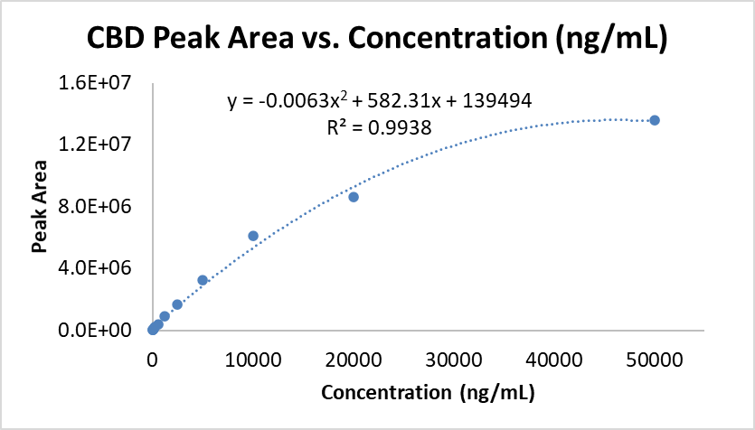
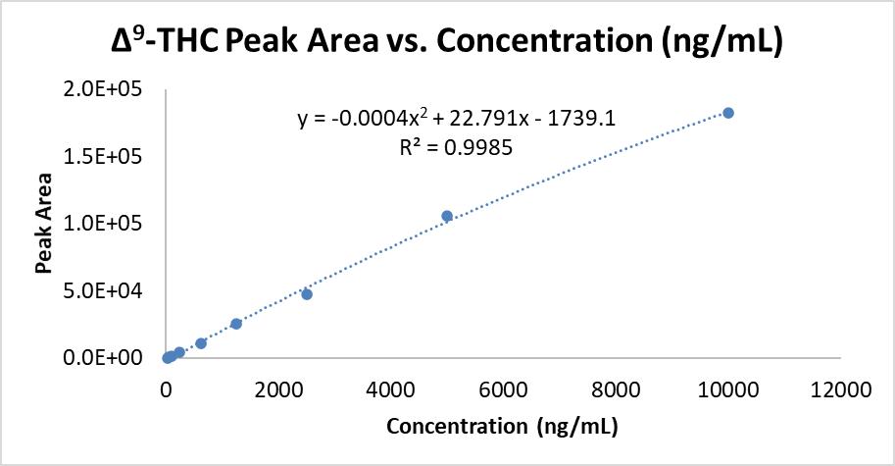
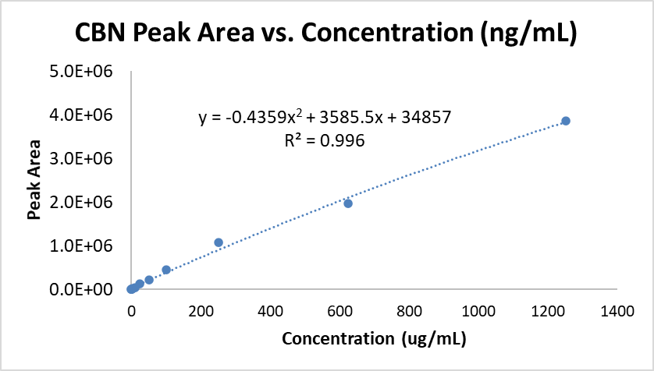
Supplementary Figure 2
CBD
hemp oil peak area | concentration (ng/mL) | Concentration in oil (ug/mL) | Average (ug/mL)
6933876.92 | 13698.00 | 27396.00 | 26232.00
6448417.69 | 12534.00 | 25068.00
THC
hemp oil peak area | concentration (ng/mL) | Concentration in oil (ug/mL) | Average (ug/mL)
23140.29 | 1113.39 | 2226.78 | 1898.80
15914.53 | 785.41 | 1570.83
CBN
hemp oil peak area | concentration (ng/mL) | Concentration in oil (ug/mL) | Average (ug/mL)
172186.64 | 38.48 | 76.96 | 63.86
125586.82 | 25.38 | 50.77
Analyte | Mass transition | Concentration
CBD | 313.2 → 245.2 | 26.2 ± 1.6 mg/mL
Δ⁹-THC | 313.2 → 191.2 | 1.90 ± 0.46 mg/mL
CBN | 309.2 → 279.2 | 63.9 ± 18.5 µg/mL
Supplementary Figure 2: Estimated Cannabinoid Concentrations in Hemp Oil Preparation. The concentrations of CBD, THC, and CBN in hemp oil were estimated by extrapolation from standard curves prepared using purchased reference standards analyzed by LC-MS/MS. Standard curve samples were prepared in the range of 0.25 – 50000 ng/mL and fitted with 1/X² weighting. Hemp oil samples were diluted 1:2000 in 1:1 methanol:water and injected in duplicate for analysis. Tables show calculated peak area, estimated concentration in ng/mL, and estimated concentration in hemp oil (multiplied to account for dilution factor). Mass transitions used for each analyte are shown, along with the average ± standard deviation of the calculated concentrations in the hemp oil sample.

Slide 4
Supplementary Figure 3
Supplementary Figure 3: Aerosol Particle sizes of the investigated e-liquid compositions. The Mass Median Aerosol Diameters (MMAD) of the investigated e-liquids did not significantly differ in this triplicate analysis. GSD=geometric standard deviation.

Slide 5
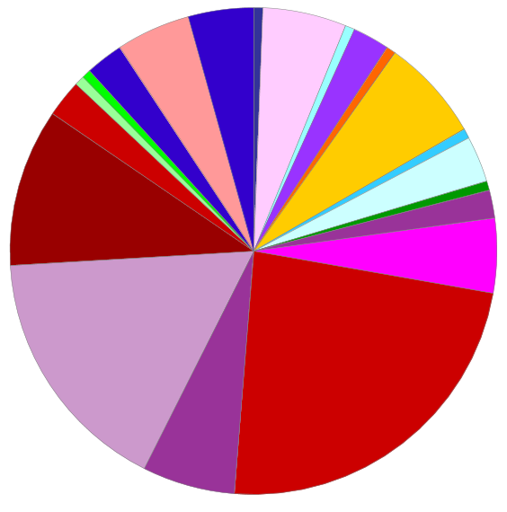
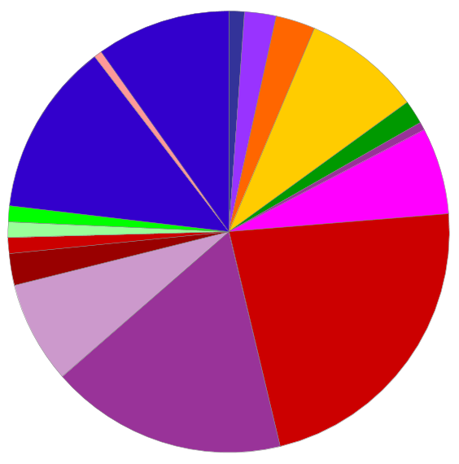
Supplementary Figure 4
PANTHER Protein Classes
 | calcium-binding protein (PC00060)
 | chaperone (PC00072)
 | chromatin-binding, or -regulatory protein (PC00077)
 | cytoskeletal protein (PC00085)
 | gene-specific transcriptional regulator (PC00264)
 | intercellular signal molecule (PC00207)
 | membrane traffic protein (PC00150)
 | metabolite interconversion enzyme (PC00262)
 | nucleic acid metabolism protein (PC00171)
 | protein modifying enzyme (PC00260)
 | protein-binding activity modulator (PC00095)
 | scaffold/adaptor protein (PC00226)
 | structural protein (PC00211)
 | transfer/carrier protein (PC00219)
 | translational protein (PC00263)
 | transmembrane signal receptor (PC00197)
 | transporter (PC00227)
PG/VG day 3
VEA day 3
Supplementary Figure 4: Pie chart distributions of gene ontology annotated protein classes for proteins displaying altered abundances in apical washes of 3-day-exposed PG/VG and PG/VG+VEA HBE cultures, (n=6/group): Protein classification analysis was performed using PANTHER.

Slide 6
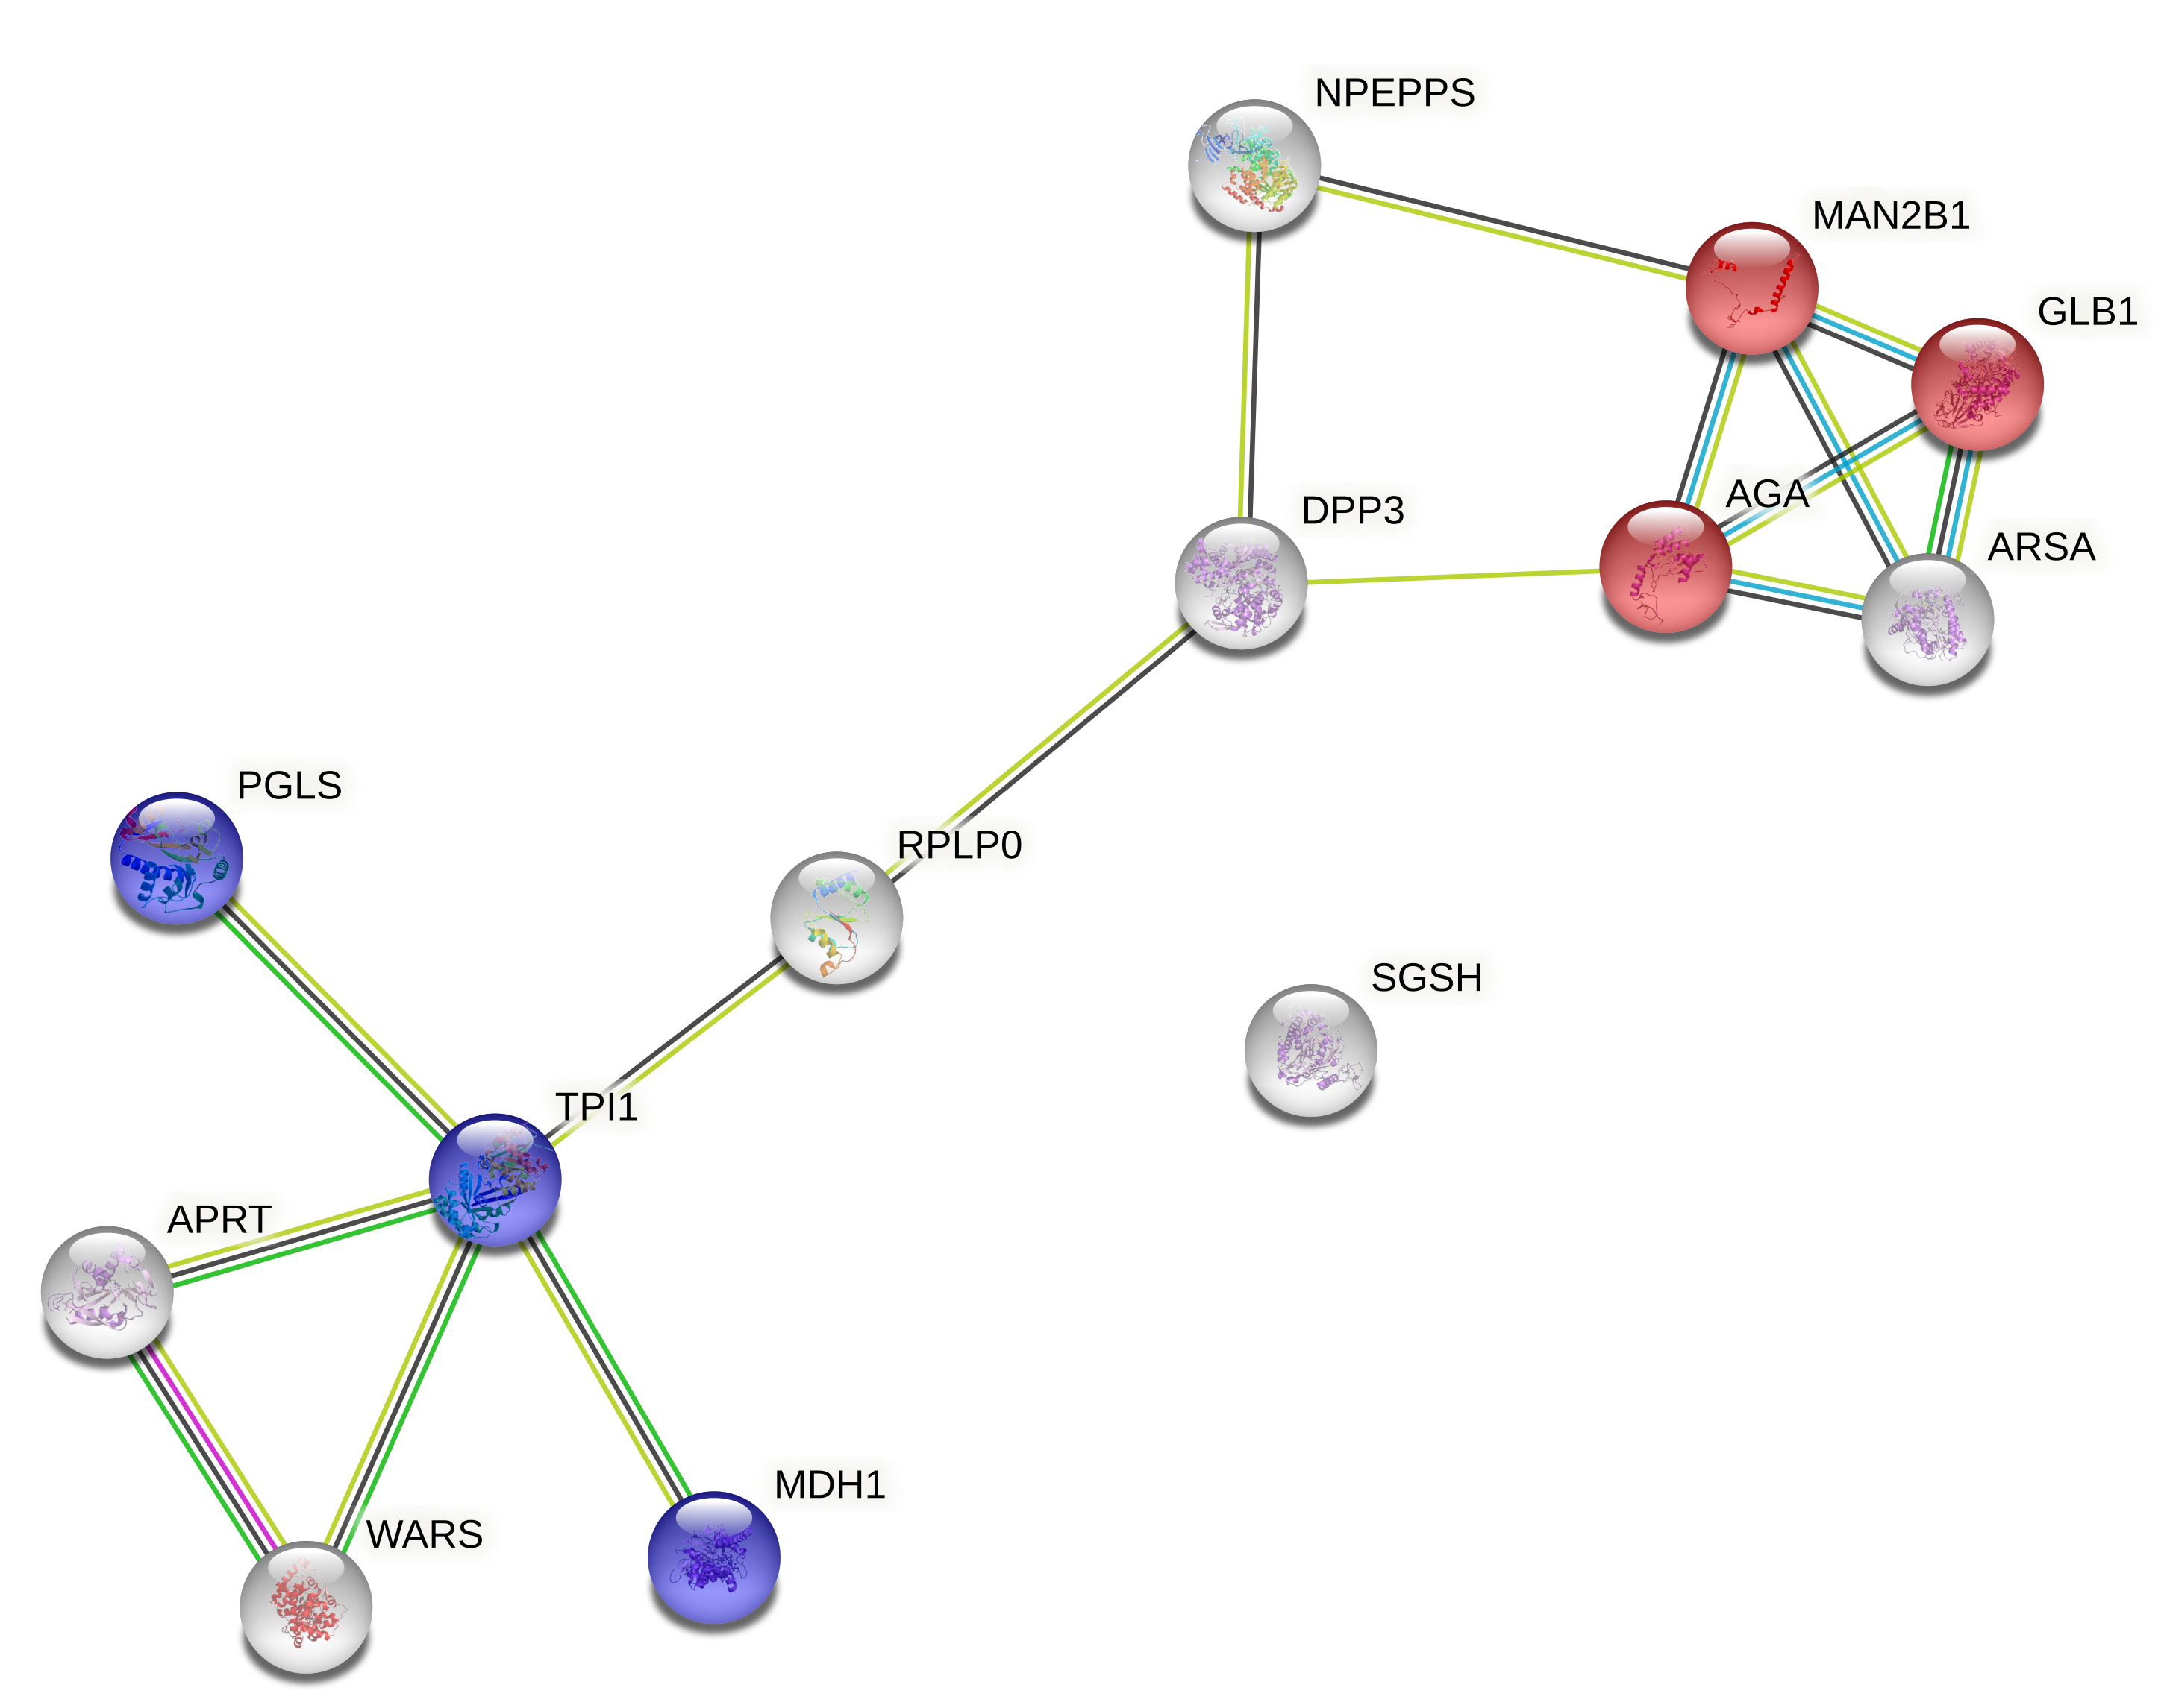
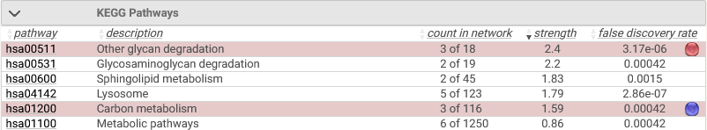
Group I proteins from VEA vs. PG/VG heatmap
Supplementary Figure 5
Supplementary Figure 5: Functional enrichment network analysis of the Group I proteins presented in the Figure 8 heatmap, showing the enriched KEGG (Kyoto Encyclopedia of Genes and Genomes) pathways in VEA vs PG/VG only exposures.

Slide 7
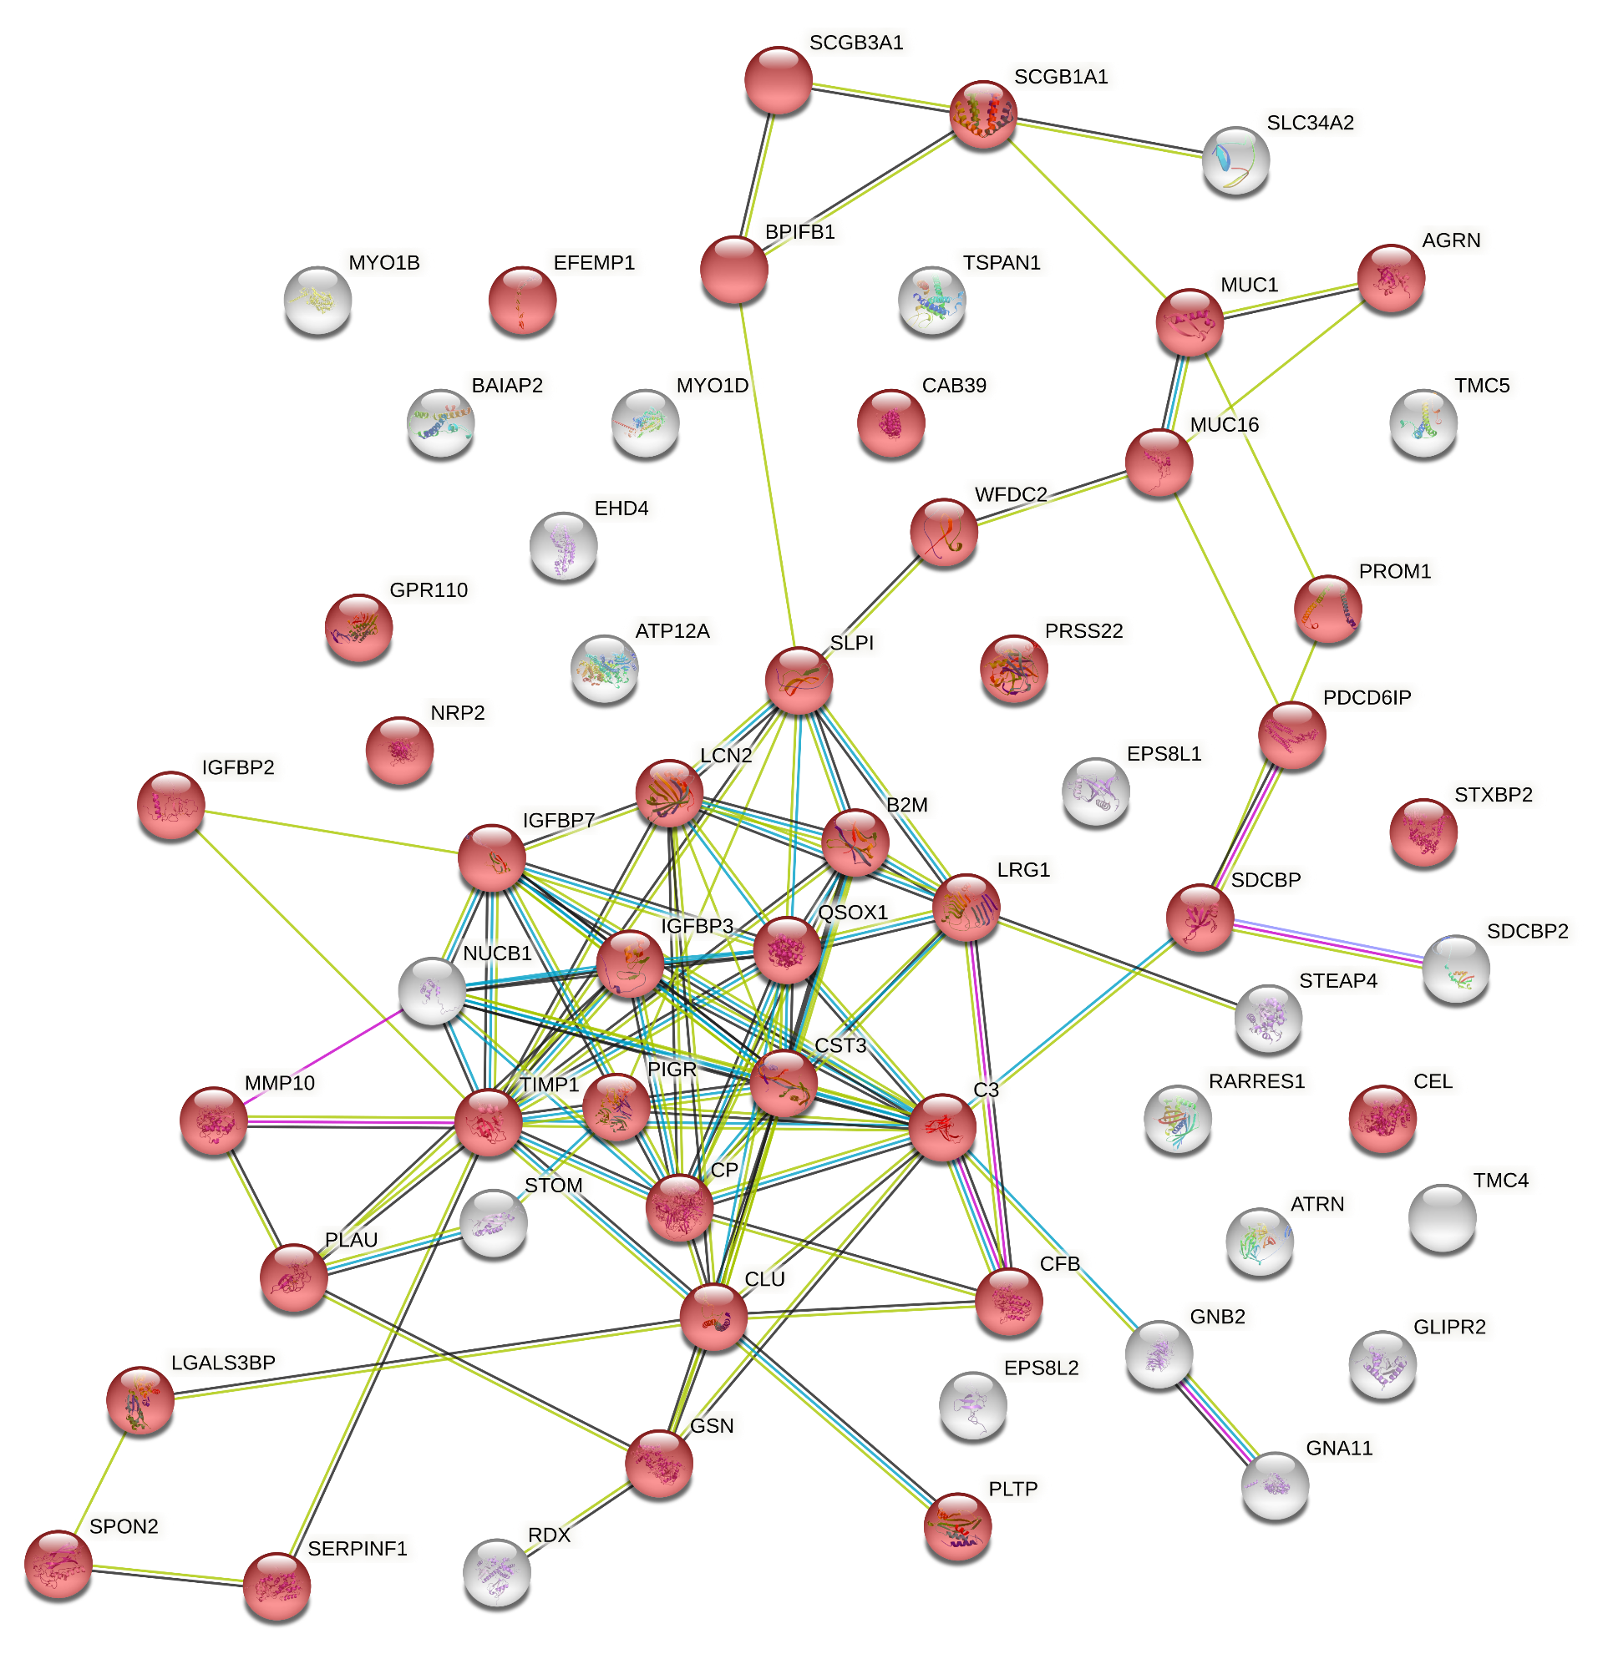
Group II proteins from VEA vs. PG/VG heatmap
Supplementary Figure 6

Slide 8
Supplementary Figure 6: The functional enrichment network analysis of the Group II proteins shown in the Figure 8 heatmap. The cellular component gene ontology analysis of this group shows that typically extracellular proteins were a major component of this cluster of decreased proteins in CBD oil and CBD oil+VEA exposed cultures.

Slide 9
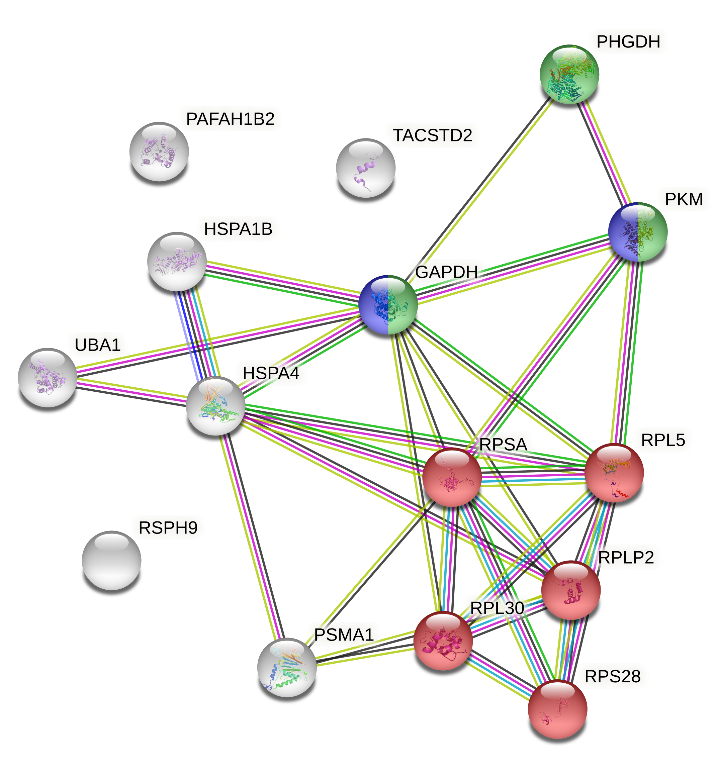
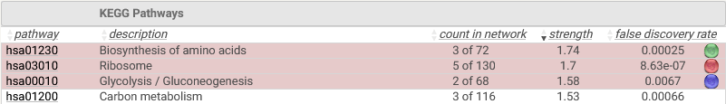
Group III proteins from VEA vs. PG/VG heatmap
Supplementary Figure 7
Supplementary Figure 7: Functional enrichment network analysis of the Group III proteins presented in the Figure 8 heatmap. The enriched KEGG (Kyoto Encyclopedia of Genes and Genomes) pathways of this cluster in VEA vs PG/VG only exposures are listed, and individual protein members highlighted.

