Slide 1

Endoscopic Debridement for non-insertional Achilles tendinopathy with and without Platelet-Rich Plasma
Hajo Thermann¹, Ralph Fischer¹, Nikolaos Gougoulias², Lucio Cipollaro^{3,4}, Nicola Maffulli^{3,4,5,6}
HKF-International Center for Hip, Foot and Knee Surgery, Bismarckstraße 9-15, 69115 Heidelberg, Germany
Footsurgery Clinic, 54631 Thessaloniki, Greece.
Department of Musculoskeletal Disorders, Faculty of Medicine and Surgery, University of Salerno, Salerno, Italy
Department of Medicine, Surgery and Dentistry, University of Salerno, Via S. Allende, 84081 Baronissi (SA), Italy
Centre for Sports and Exercise Medicine, Barts and The London School of Medicine and Dentistry, Mile End Hospital, 275 Bancroft Road, London E1 4DG, Queen Mary University of London, London, England
School of Pharmacy and Bioengineering, Keele University Faculty of Medicine, Thornburrow Drive, Stoke on Trent, England

Slide 2
Background
Non-insertional Achilles tendinopathy is considered the result of overuse injury and failed healing process
Nonoperative management may fail to improve symptoms in 25-45% of patients
Various open and endoscopic techniques have been proposed to manage those patients
Platelet-rich plasma (PRP) injections have been proposed as an adjunct to aid tendon healing

Slide 3
Methods
Prospective randomized controlled trial of 36 consecutive patients in 2018; aged 18-70 yrs
Center for Knee, Foot and Hip Surgery, Heidelberg, Germany
CONtrol group: included patients who underwent endoscopic debridement of the main body of the Achilles tendon only (n=19)
PRP group: Endoscopic debridement & PRP injection (n=17)
All procedures performed by Dr med. Hajo Thermann
Surgical technique: Thermann H, et al. Knee Surg Sports Traumatol Arthrosc 2009;17(10):1264-9.
PRP applied under direct visualization around the area of tendinopathy

Slide 4
Outcome assessment
Examination by orthopaedic fellow (independent from the surgeon) before surgery, and after 6 weeks, 3 months, 6 months and 12 months .
Data collection at each visit:
Visual analog scale (VAS) for pain, function and satisfaction
VISA-A questionnaire (Victorian Institute of Sports Assessment – Achilles)
MRI: preoperatively, at 3 months and 12 months
Complications recorded

Slide 5
Results:
Significant clinical improvement postop (p<0.05)
Similar between CON and PRP groups
Five minor complications (CON: 3; PRP: 2)

Slide 6
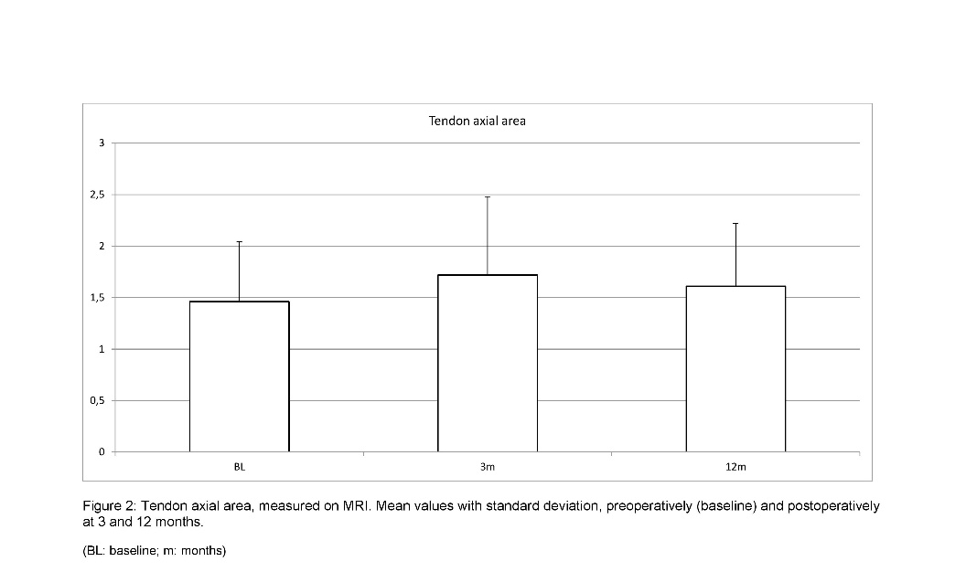
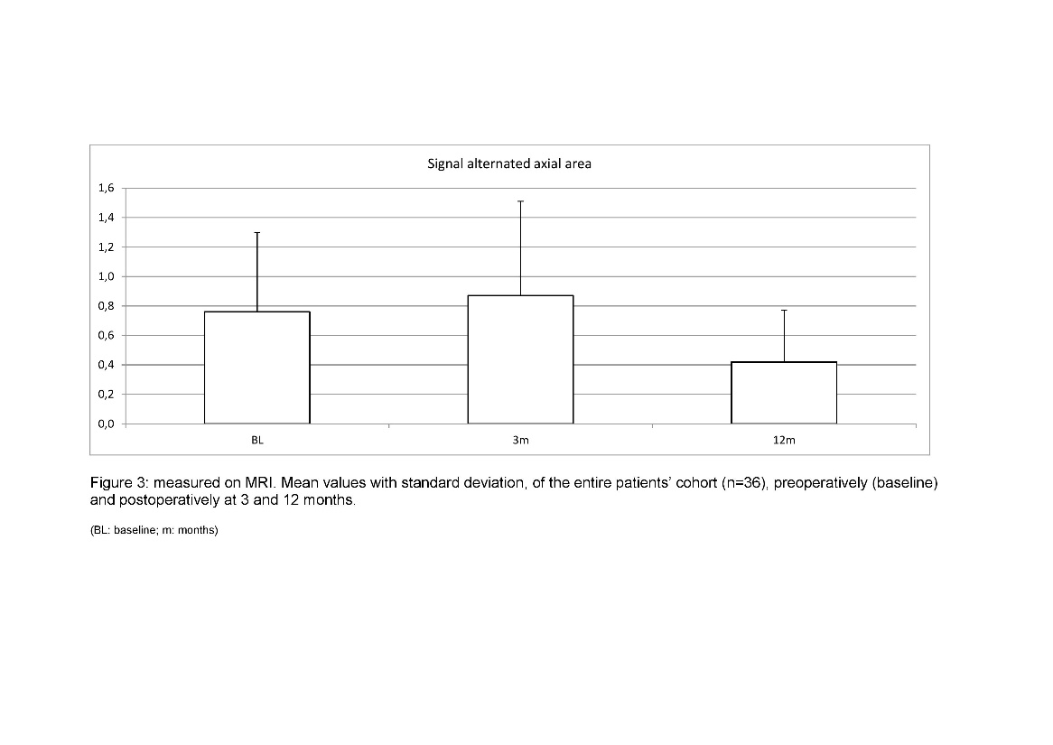
Results:
Nodular tendon thickening and MRI detected signal alteration persisted after surgery, with no association between imaging and clinical outcome.

Slide 7
Conclusions:
Endoscopic debridement improved clinical outcome in patients with mid-portion Achilles tendinopathy
Safe technique
Addition of PRP did not improve outcomes
Tendon thickening and signal alternated area was not affected
There was no correlation between clinical and imaging findings

