Slide 1
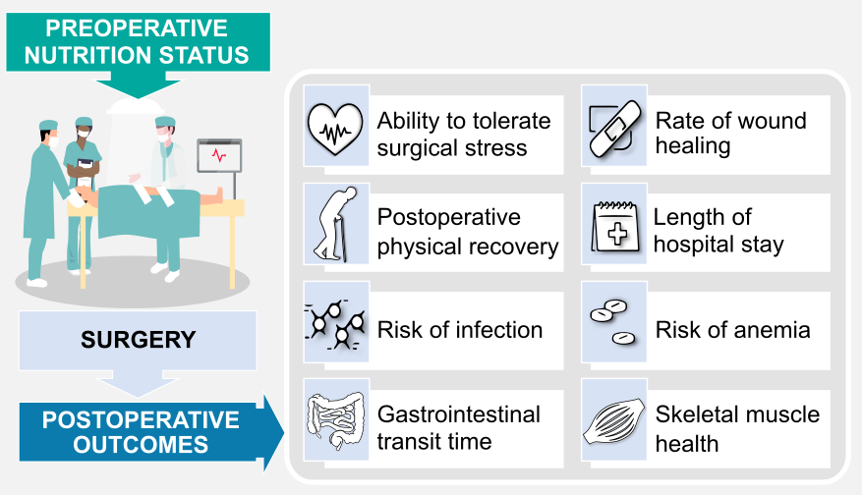
Supplemental Figure 1
Notes:
Supplemental Figure 1

Slide 2
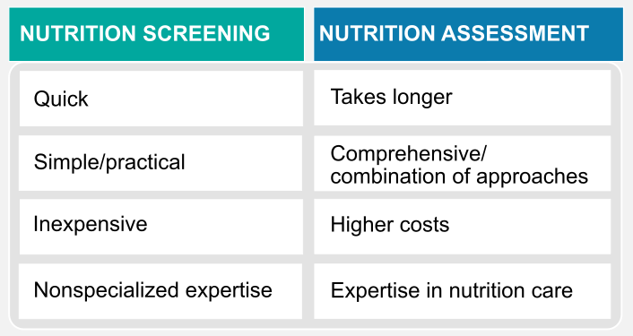
Supplemental Figure 3
Notes:
Supplemental Figure 3

Slide 3
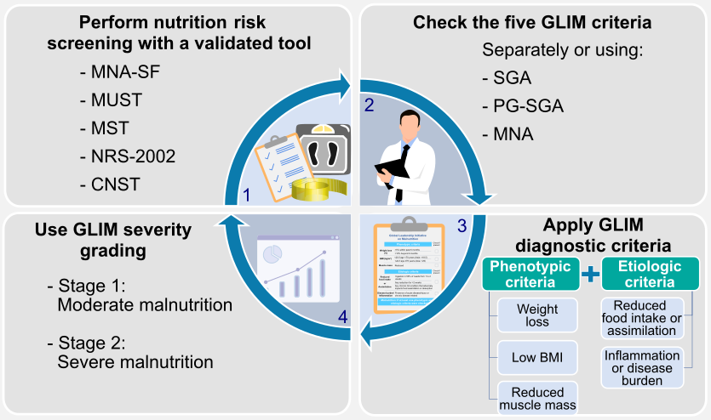
Supplemental Figure 4
Notes:
Supplemental Figure 4

