Slide 1
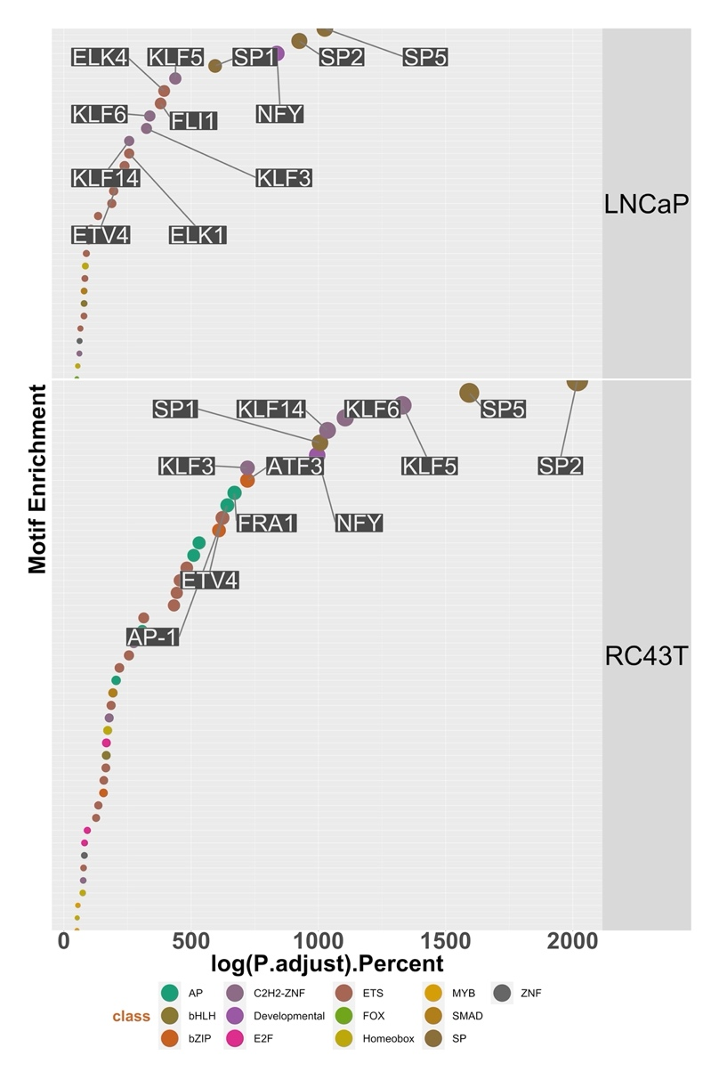
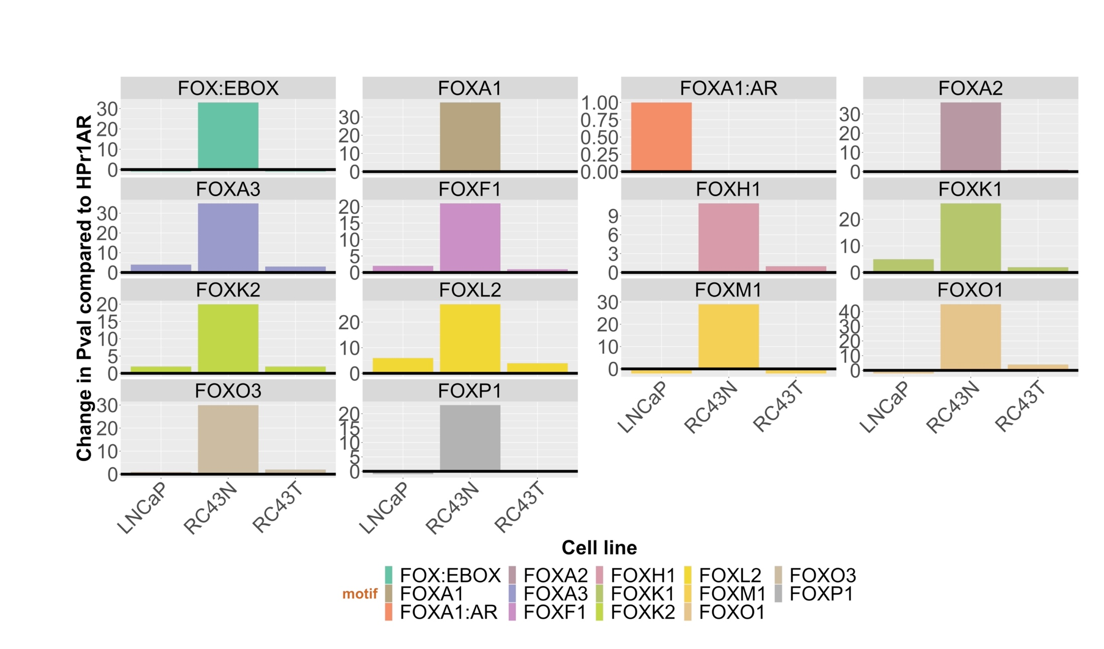
A
B
Supplementary Figure 3

Slide 2
Supplementary Figure 3. VDR ATAC-Seq in African and European American Cell lines. A. ATAC-Seq was undertaken in triplicate in HPr1AR, LNCaP, RC43N and RC43T following 1α,25(OH)₂D₃ treatment (100 nM, 4h) or vehicle control. Motif enrichment in mono nucleosome regions was undertaken with Homer and ranked by significance to visualize in descending significance. C. Frequency of enriched motifs by FOX family members.

