Slide 1
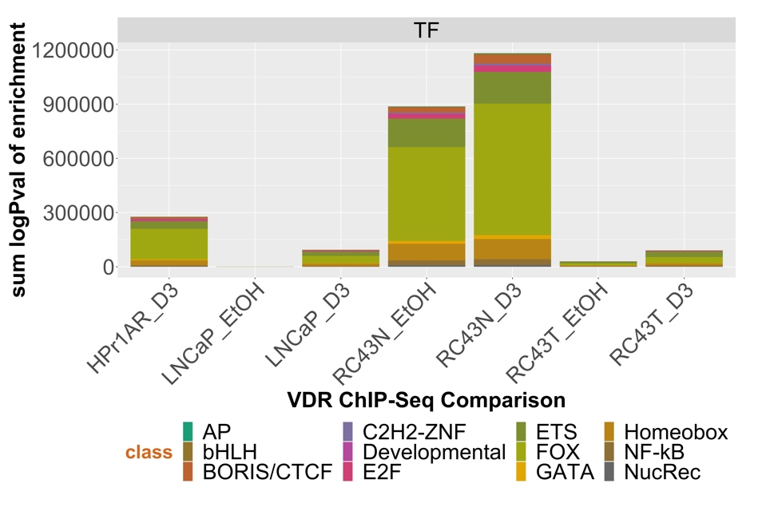
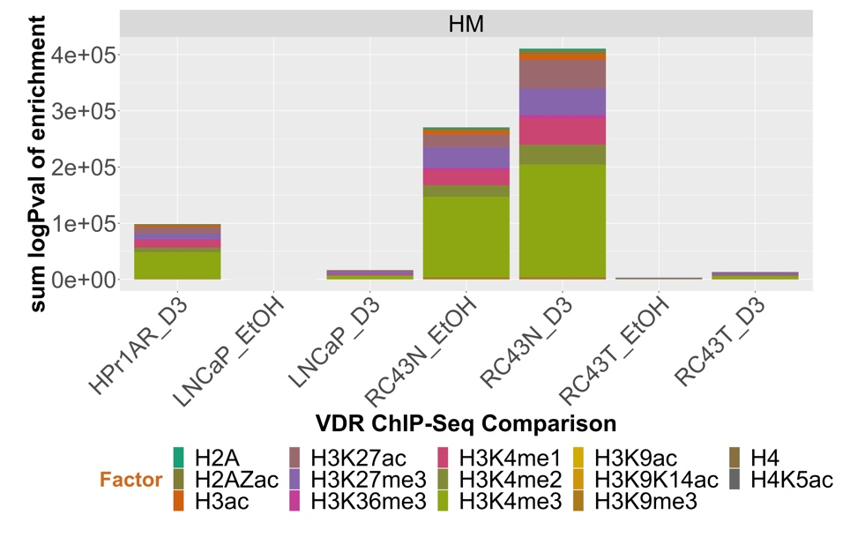
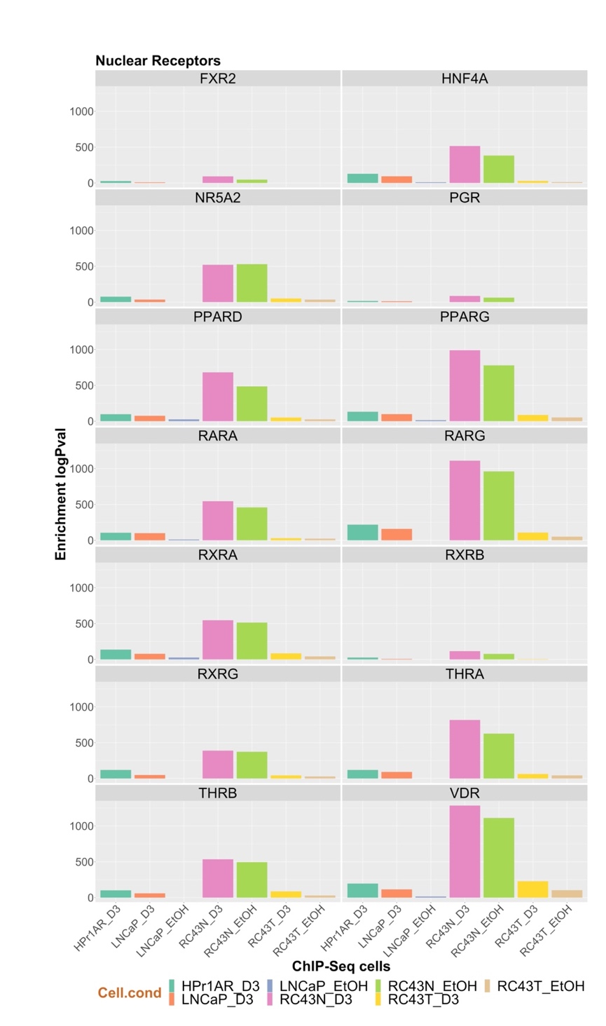
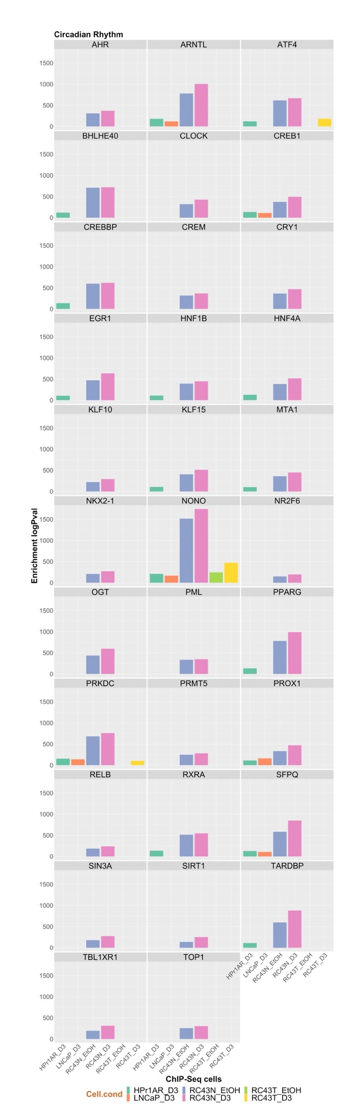
A
B
C
Supplementary Figure 5

Slide 2
Supplementary Figure 5. ChIP-Seq overlaps with VDR ChIP-Seq. A. VDR ChIP-Seq data were overlapped using GIGGLE for TF and histone modifications contained in the CistromeDB collection (> 10,000 total ChIP-seq datasets, across > 1100 factors). B, C. Bar chart of enrichment for nuclear receptors or circadian rhythm regulators respectively.

