Slide 1
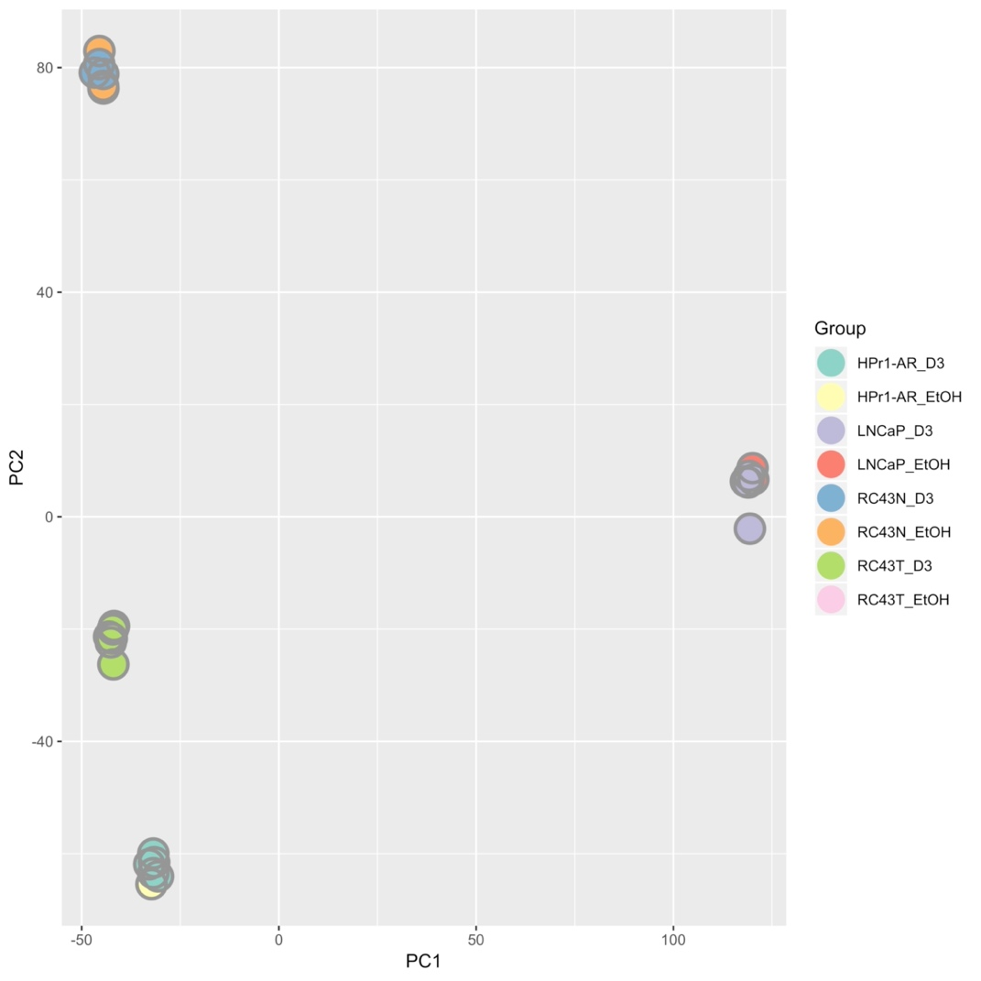
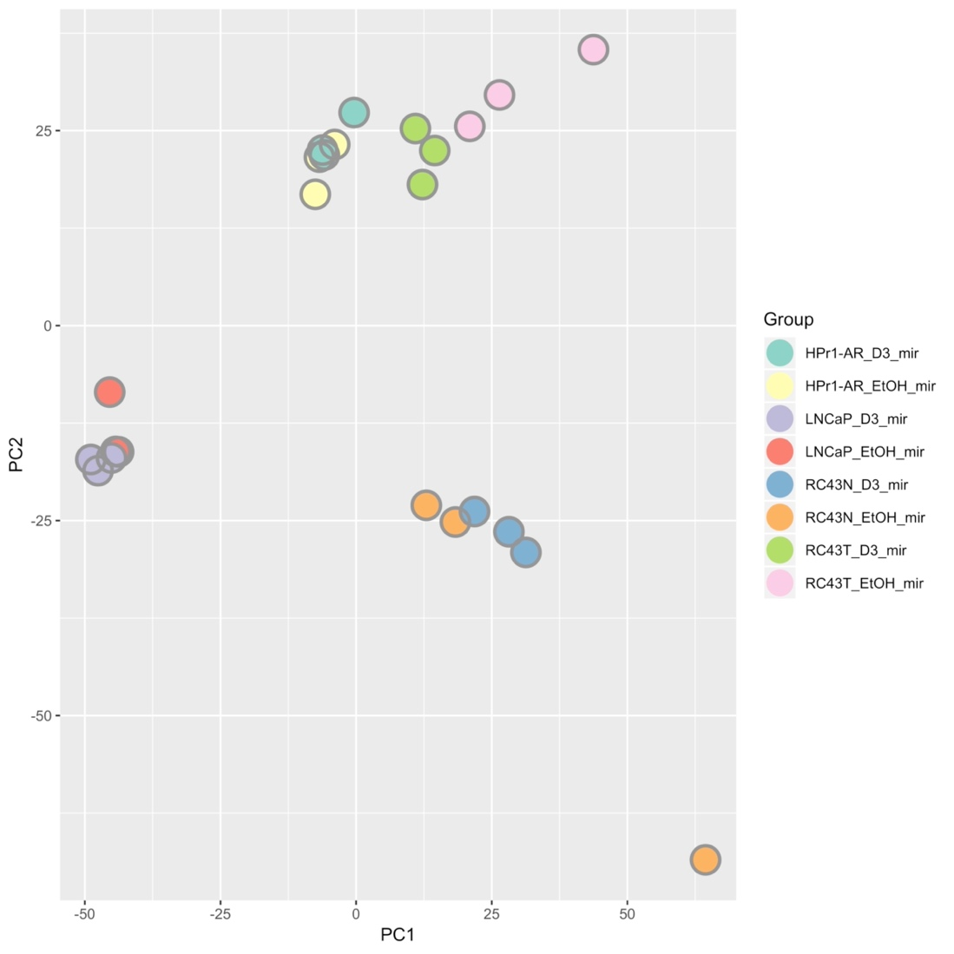
Supplementary Figure 6

Slide 2
Supplementary Figure 6. Principal component analyses for 1α,25(OH)₂D₃-dependent RNA- and small RNA-Seq in African and European American Cell lines. Basal and 1α,25(OH)₂D₃-stimulated (100 nM, 8h) RNA-Seq (A) and small RNA-Seq (B) was undertaken in triplicate in HPr1AR, LNCaP, RC43N and RC43T. FASTQ files were QC processed, aligned to hg38 (Rsubread), and processed with limma-voom and edgeR workflow.

