Slide 1
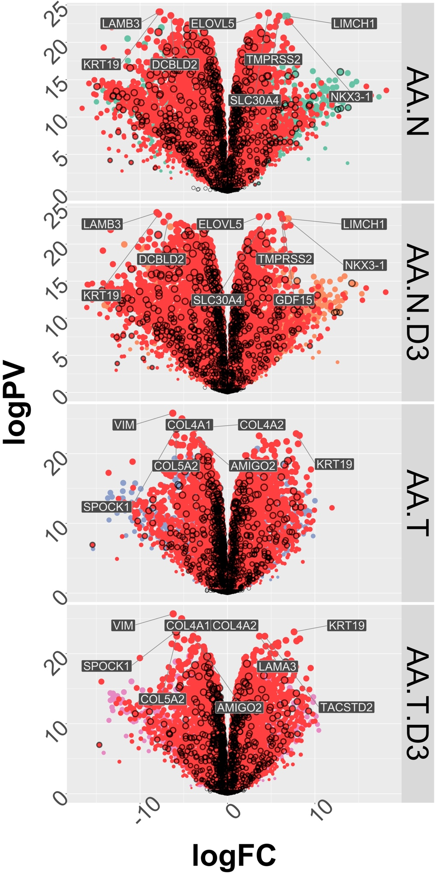
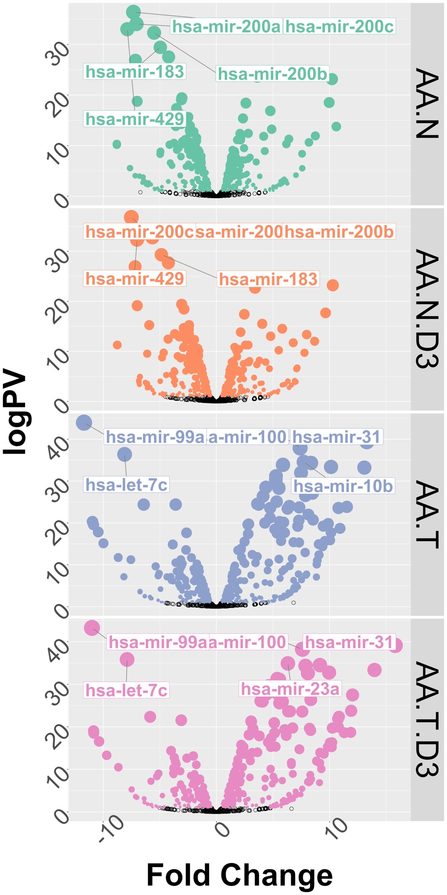
Supplementary Figure 7

Slide 2
Supplementary Figure 7. 1α,25(OH)₂D₃-dependent RNA- and small RNA-Seq in African and European American Cell lines. 1α,25(OH)₂D₃-stimulated (100 nM, 8h) RNA-Seq was undertaken in triplicate in HPr1AR, LNCaP, RC43N and RC43T. FASTQ files were QC processed, aligned to hg38 (Rsubread), and processed with limma-voom and edgeR workflow to identify significant differentially enriched genes (DEGs) (logPV > 1 & absFC > .37) are illustrated on Volcano plots with DEGs calculate between RC43N to HPr1AR (AA.N), and RC43T to LNCaP (AA.T).

