Slide 1
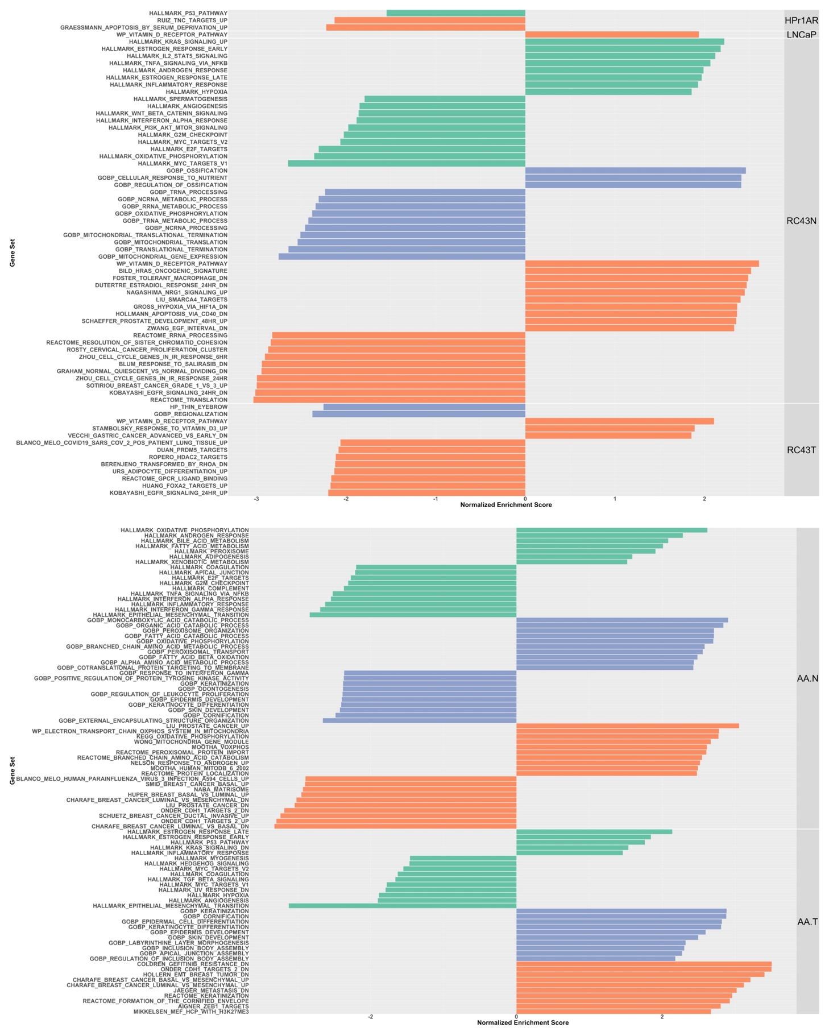
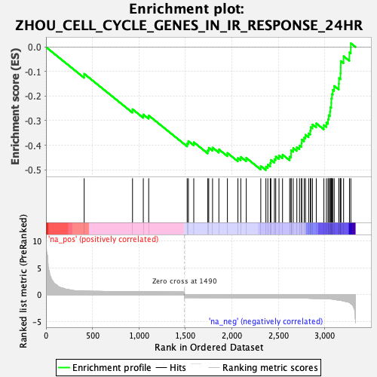
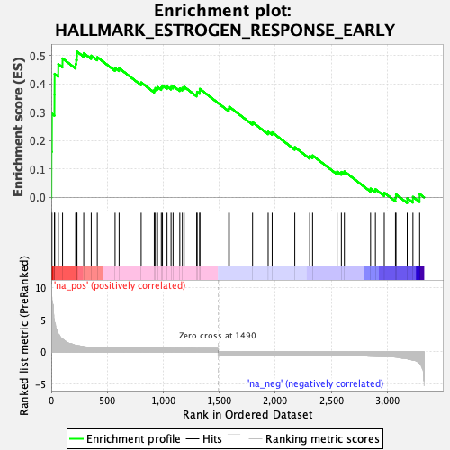
RC43N
Supplementary Figure 8

Slide 2
Supplementary Figure 8. GSEA analyses. The terms identified and visualized where the normalized enrichment score.

