Slide 1
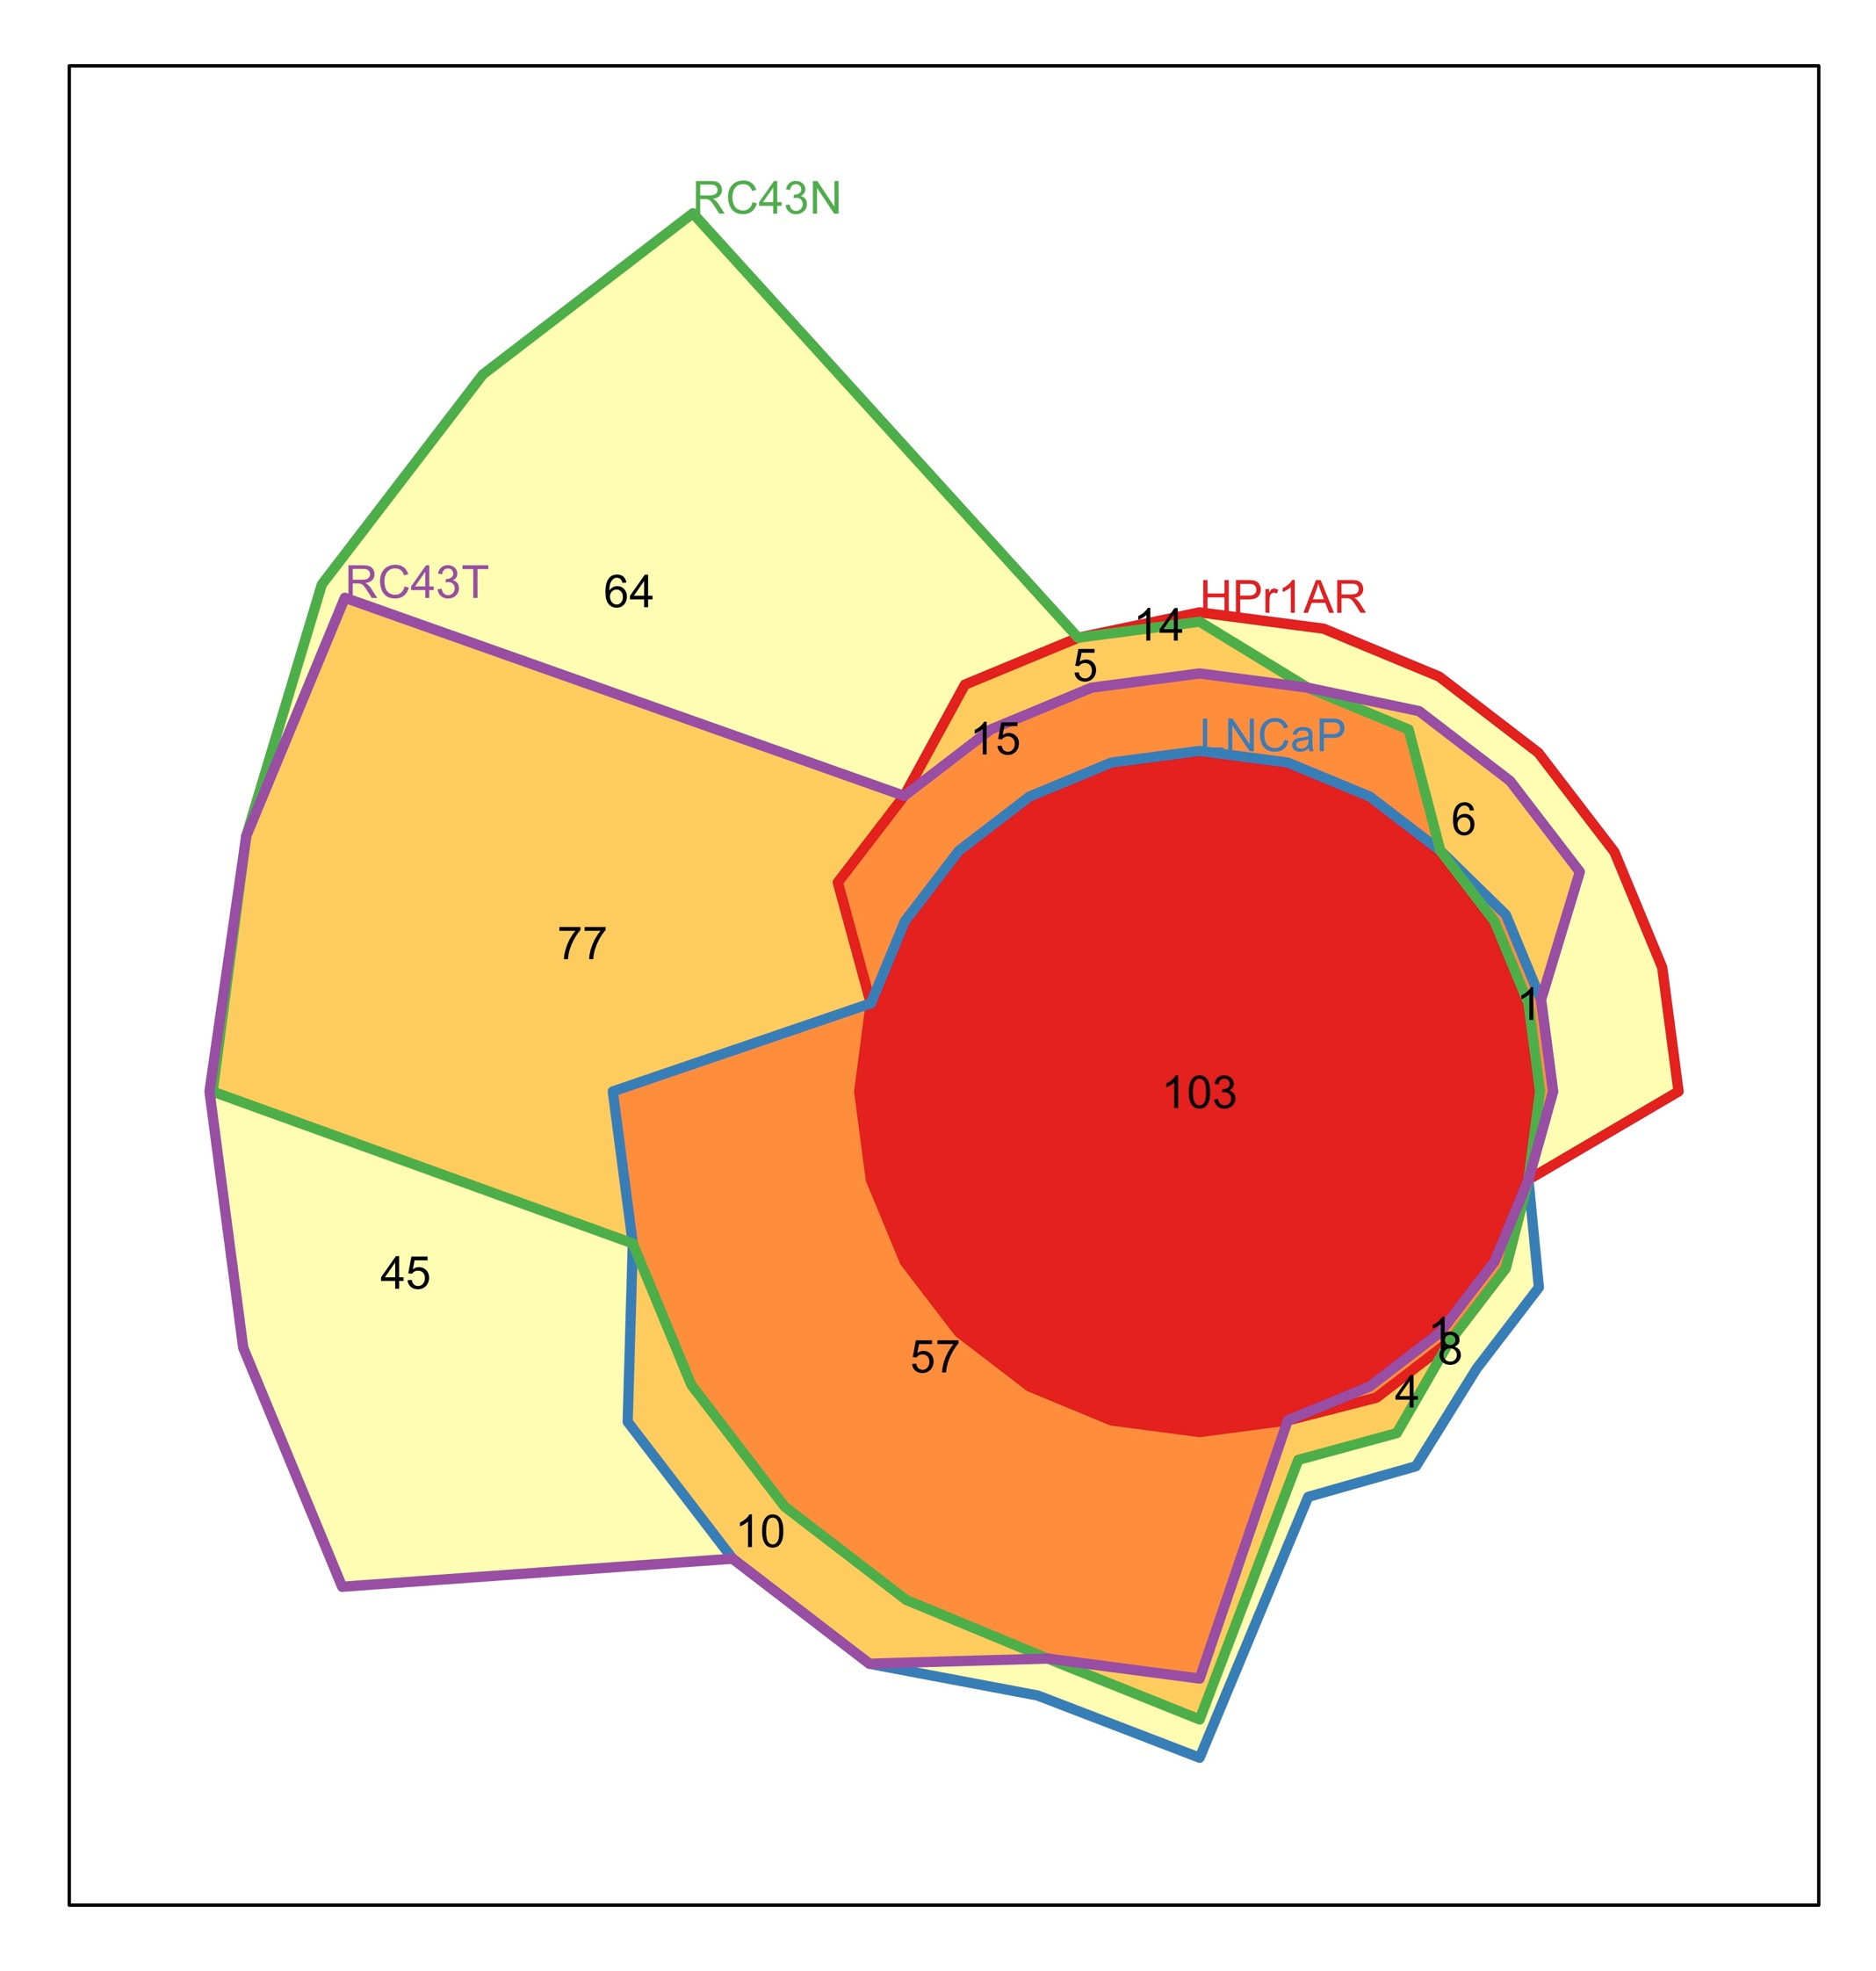
Supplementary Figure 9

Slide 2
Supplementary Figure 9. Euler diagram of enriched predicted transcription factors. Significant DEGs analyzed by epigenetic landscape in silico analysis to identify enrichment of TFs in the respective transcriptomes⁶⁴. TF overlaps were overlapped with Euler diagram analyses.

