Slide 1
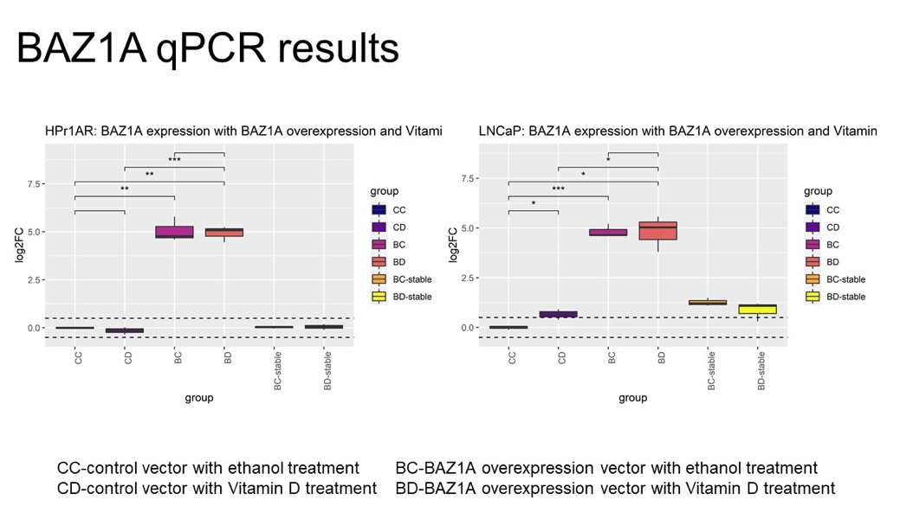
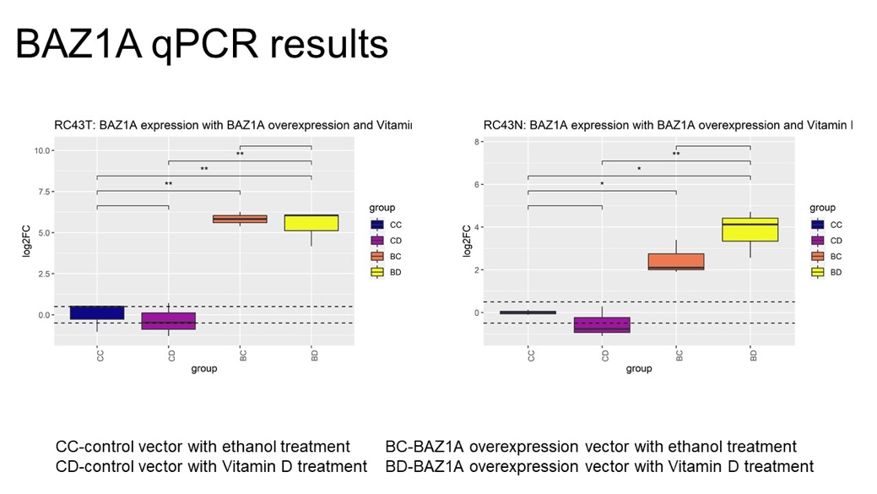
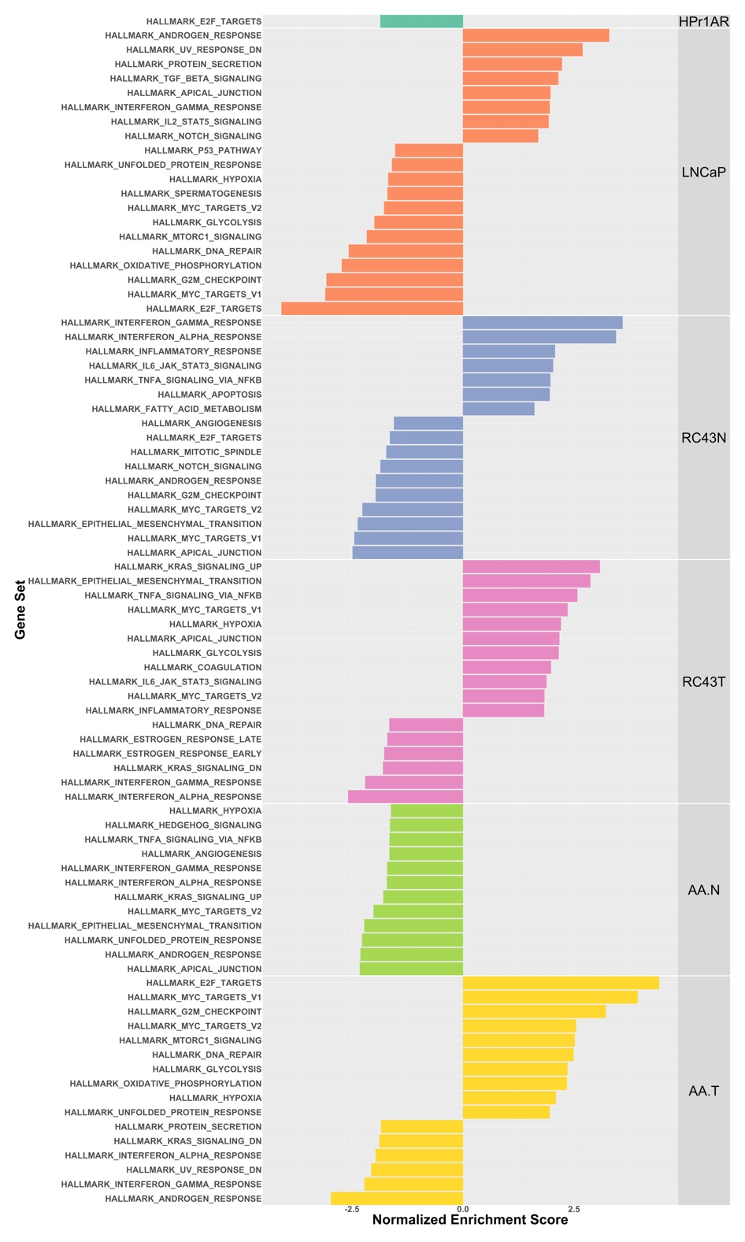
A
B
Supplementary Figure 12

Slide 2
Supplementary Figure 12. The impact of BAZ1A on gene expression. A. cell transfected with BAZ1A cDNA had elevated expression. B. GSEA terms identified and visualized where the normalized enrichment score.

