Slide 1
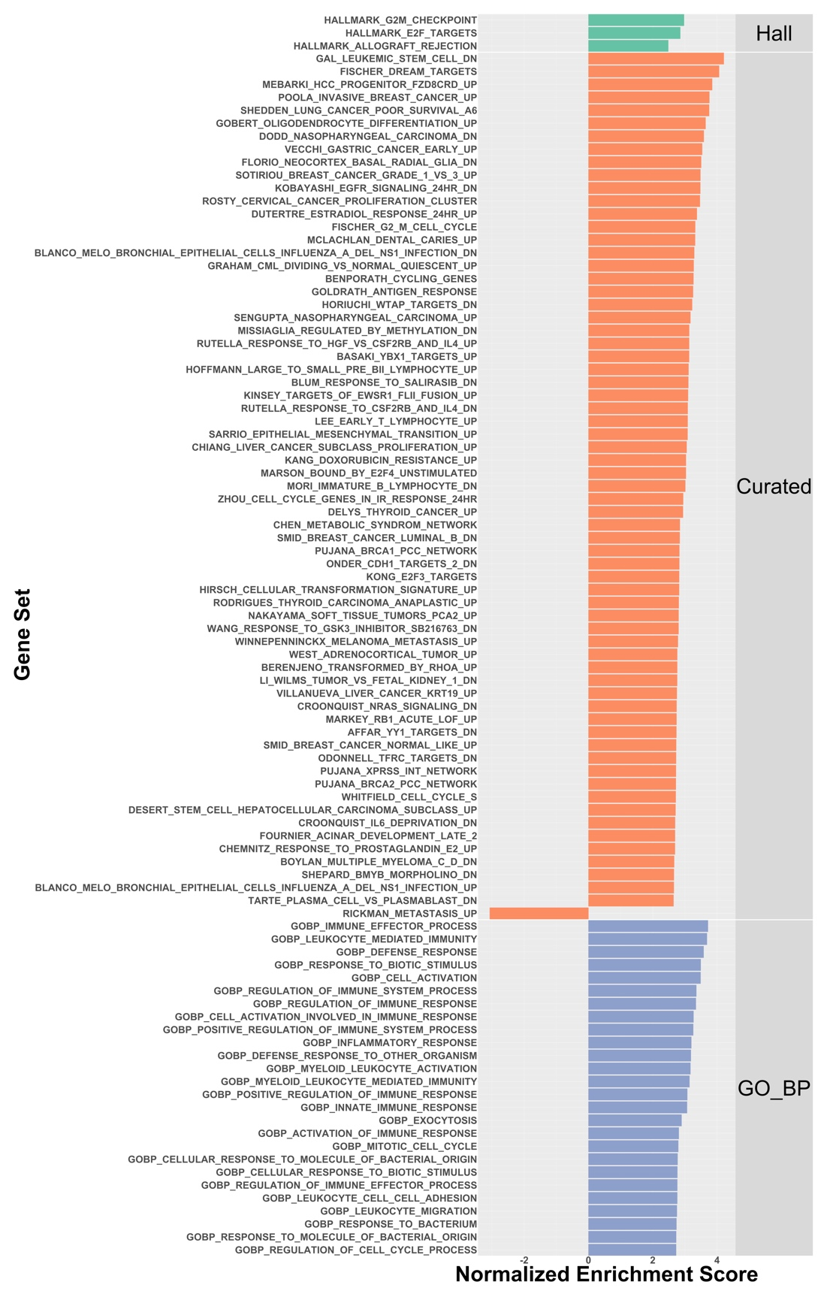
Supplementary Figure 13

Slide 2
Supplementary Figure 13. GSEA analyses of vitamin D₃ transcriptional response in AA patients associated within immuno-modulatory and PCa-relevant pathways.

