Slide 1
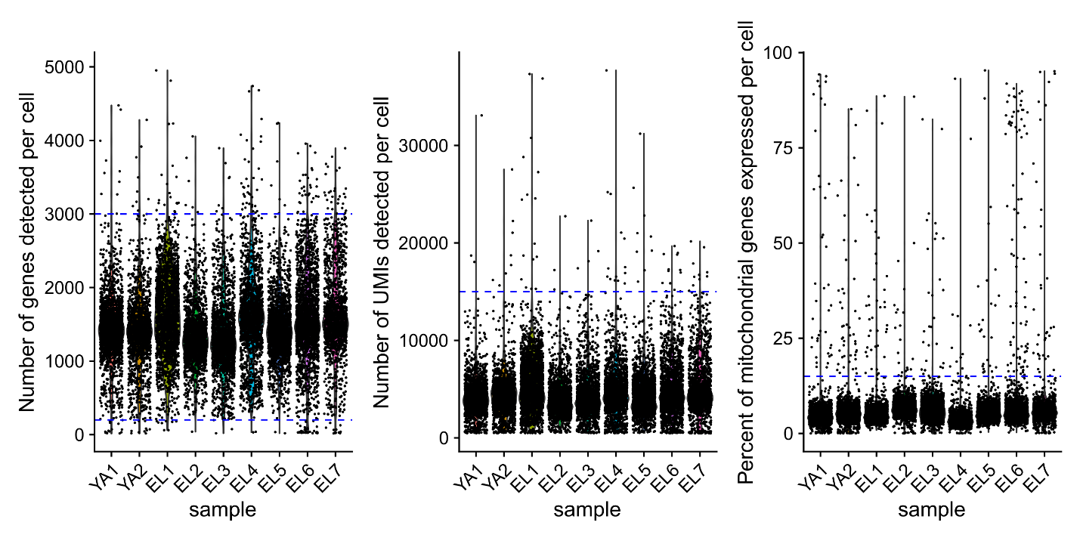
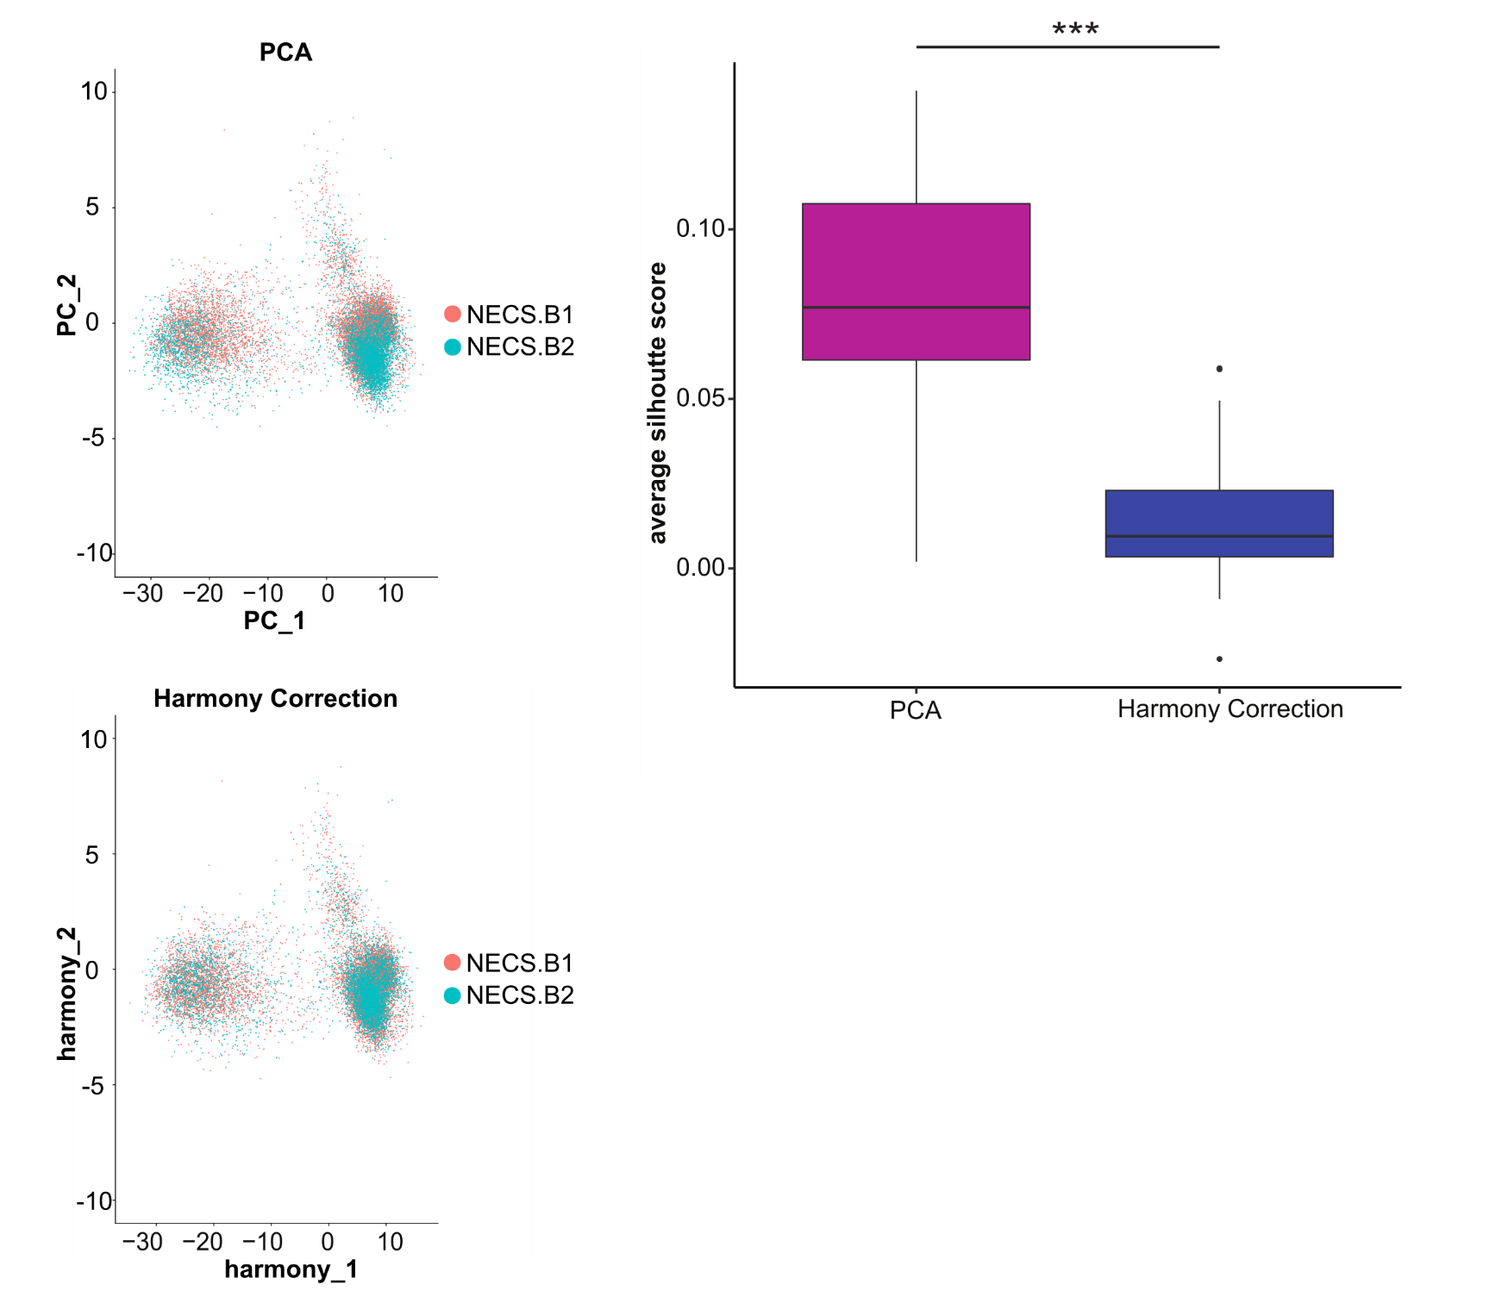
A
B
C
Notes:
Supplementary Figure 1. QC, filtering, and PCA correction for the New England Centenarian Study (NECS) CITE-seq dataset. a, Violin plots of the number of genes and UMIs detected per cell, and percent of mitochondrial genes expressed per cell to remove poor-quality, doublets, and outlier cells based on the thresholds (dashed blue lines). b, Batch correction of the NECS CITE-seq dataset using Harmony-based PCA correction: PCA plot before correction (top) and after Harmony correction PCA (bottom). c, Average silhouette score for each immune subpopulation before and after Harmony correction to assess mixing of batches of data. A higher average silhouette score towards 1 indicates poor mixing of batches, and a lower score towards 0 indicates good mixing of batches. We performed a Wilcoxon rank sum test on the scores with p-value significance of 0.05 (Wilcoxon, p-value = 1.985e-05): nsp > 0.05, *p<0.05, **p<0.01, ***p<0.001.

Slide 2
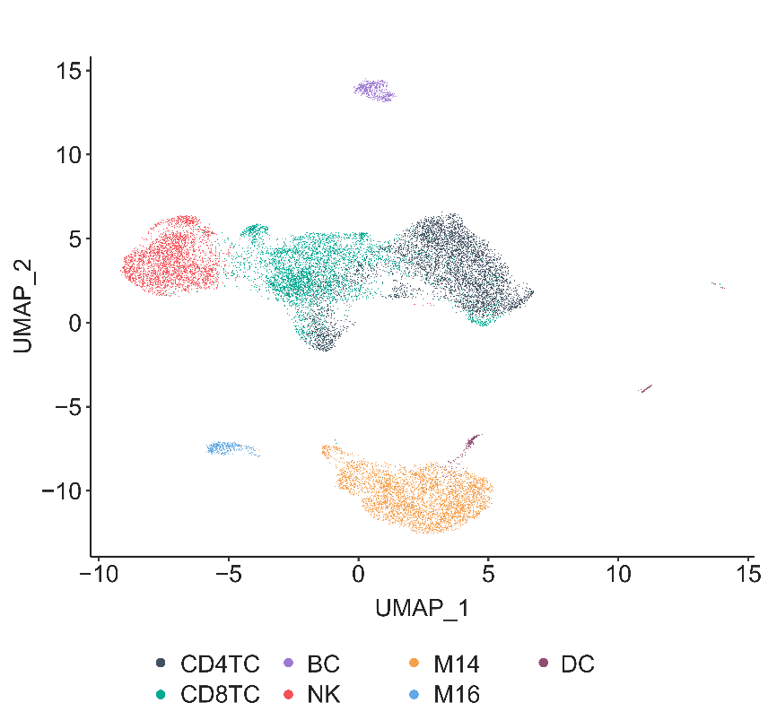
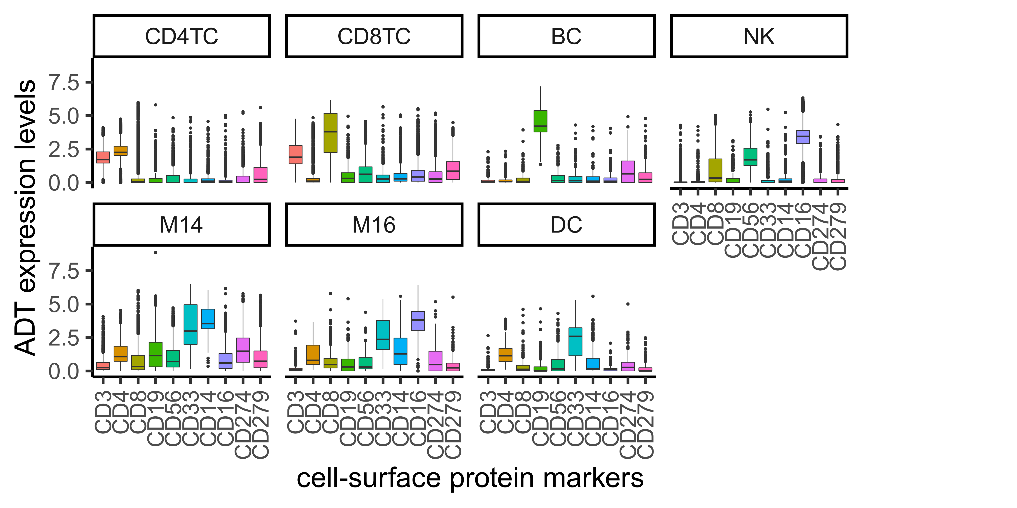
A
B
Notes:
Supplementary Figure 2. Protein expression levels across main immune populations of novel NECS CITE-seq dataset. Boxplots of normalized protein expression levels (y-axis) of 10 protein markers (x-axis) across immune populations of novel NECS CITE-seq dataset: CD4 T cells (CD4TC), CD8 T cells (CD8TC), Natural Killer cells (NK), B cells (BC), Monocytes (Mono: M14 and M16), and Dendritic cells (DC).

Slide 3
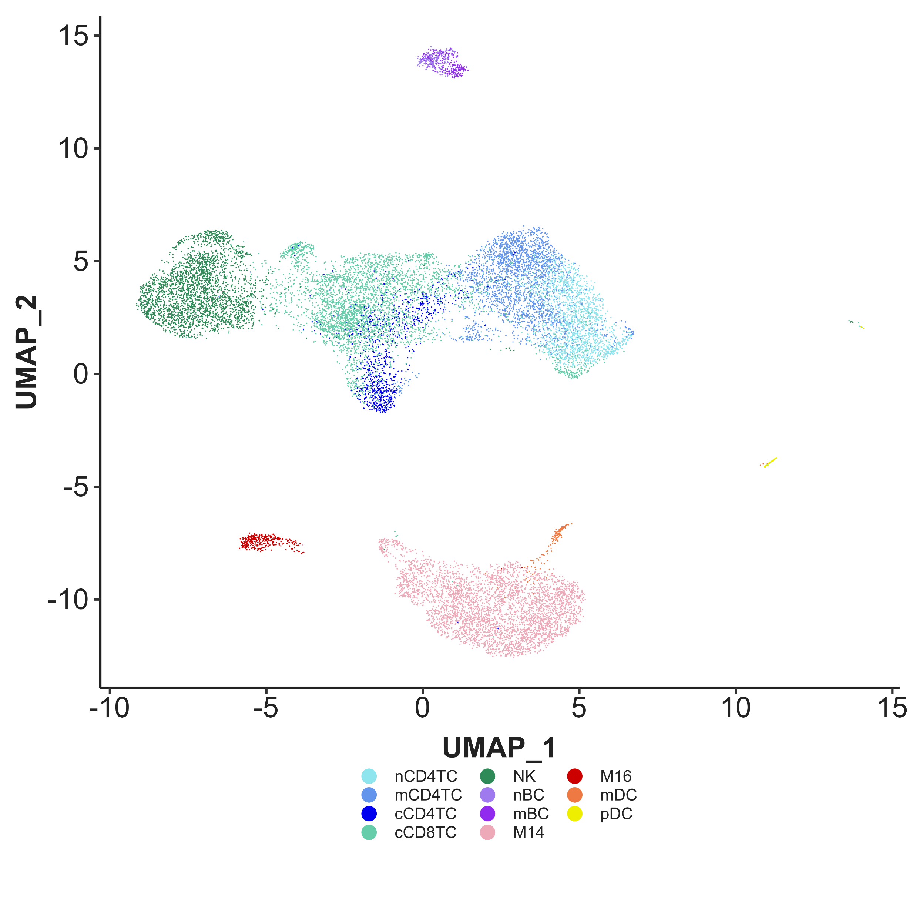
Notes:
Supplementary Figure 3. UMAP of immune subtypes in NECS CITE-seq dataset. UMAP embedding of PBMCs collected from 7 EL individuals from NECS and 2 younger age controls from the novel NECS CITE-seq dataset, labelled by the identified immune cell subtypes.

Slide 4
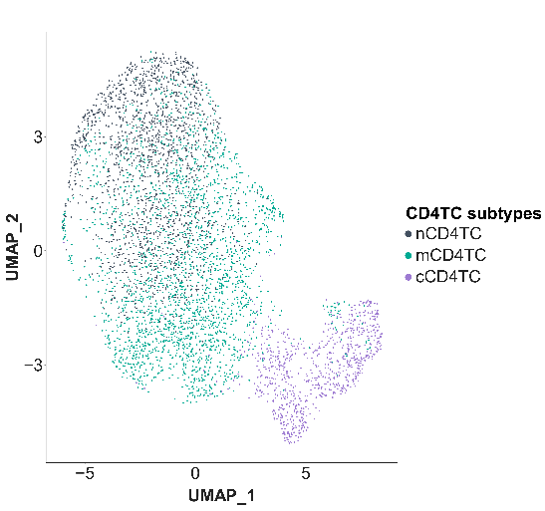
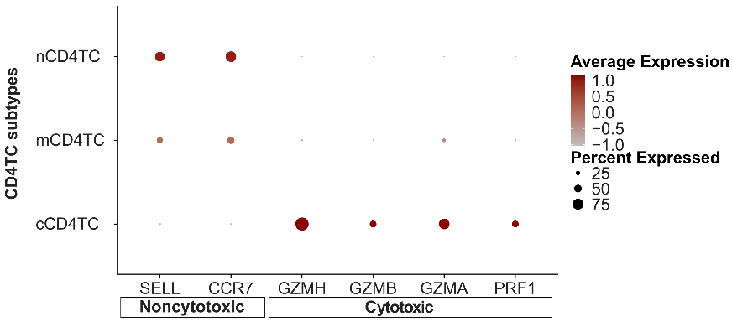
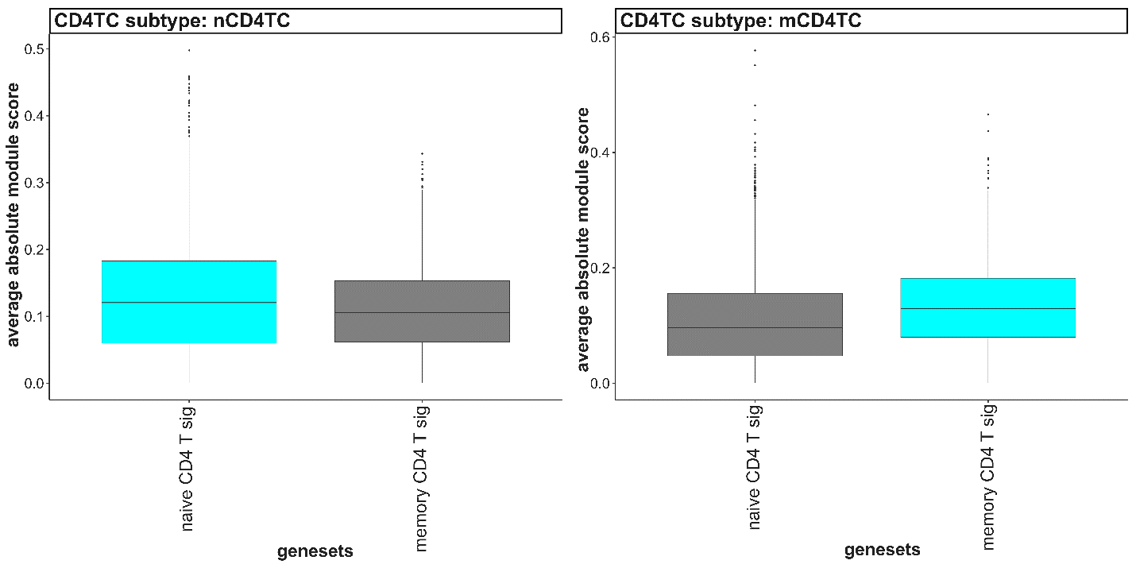
A
B
C
Notes:
Supplementary Figure 4. Identification of CD4TC subtypes in novel NECS CITE-seq dataset. a) UMAP plot of CD4TC in NECS CITE-seq dataset, clustered and identified by subtypes: nCD4TC, mCD4TC, and cCD4TC. b) Dotplot of average expression of noncytotoxic-specific genes (SELL, CCR7) and cytotoxic specific genes (GZMH, GZMB, GZMA, PRF1) in CD4TC subtypes: nCD4TC, mCD4TC, and cCD4TC. c) Boxplots of average absolute module scores (y-axis) of naive and memory CD4 T cell signatures (x-axis) for each CD4TC subtypes: nCD4TC and mCD4TC.

Slide 5
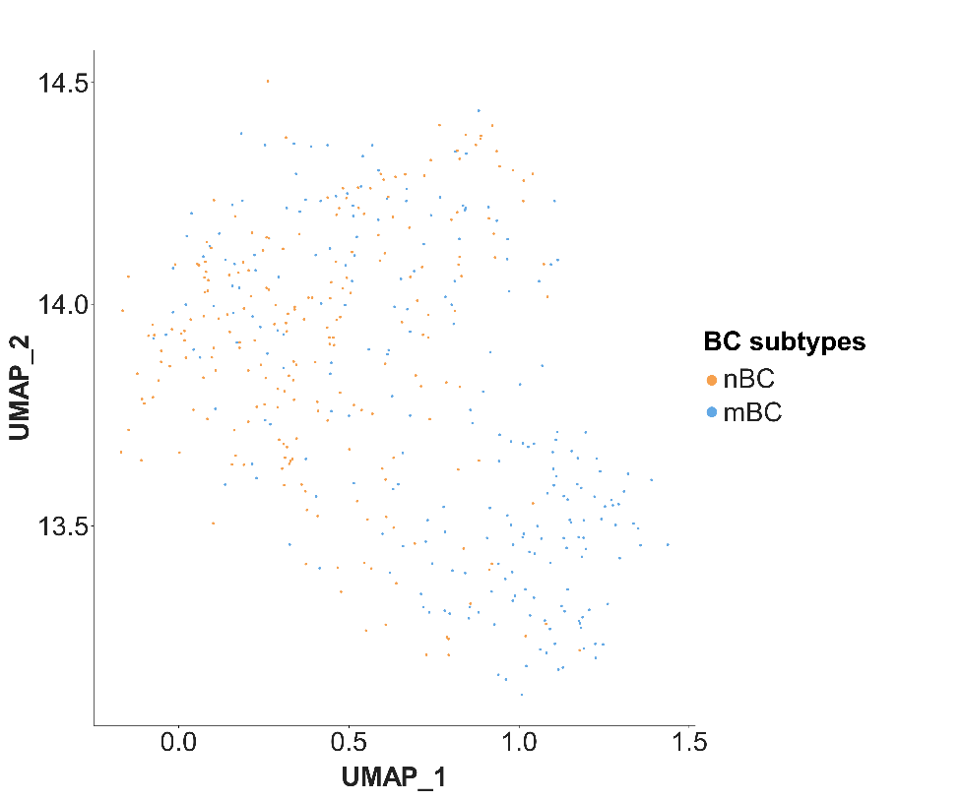
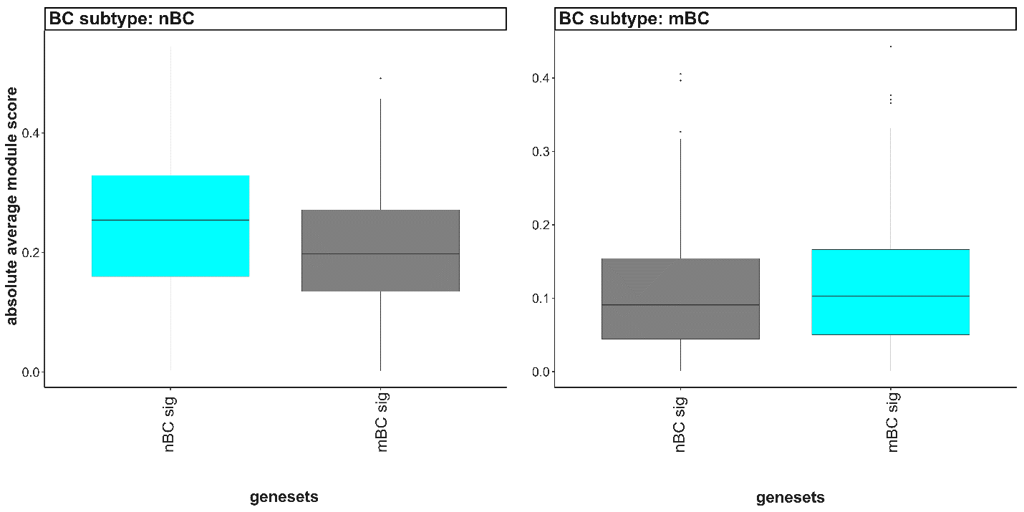
A
B
Notes:
Supplementary Figure 5. Identification of BC subtypes in novel NECS CITE-seq dataset. a) UMAP plot of BC in NECS CITE-seq dataset, clustered and identified by subtypes: nBC and mBC. b) Boxplots of average absolute module scores (y-axis) of nBC and mBC signatures (x-axis) for each BC subtype: nBC and mBC.

Slide 6
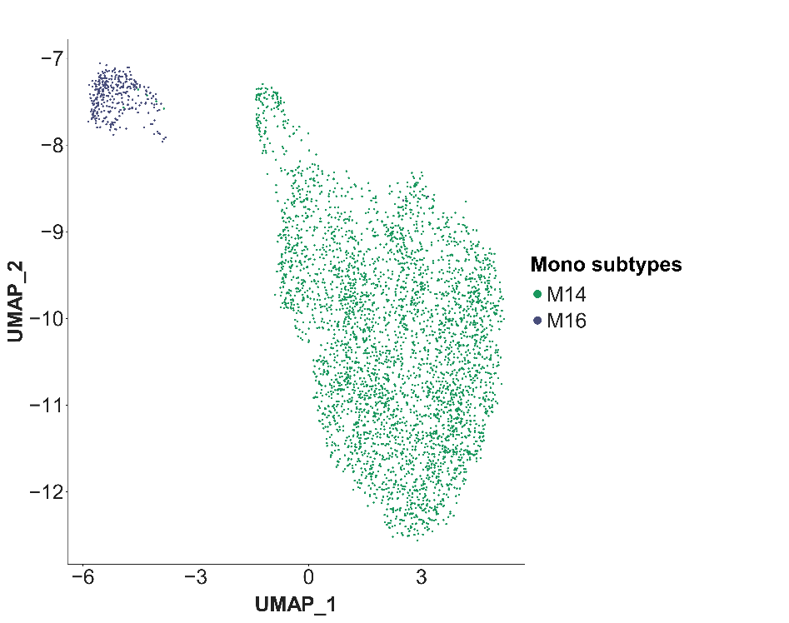
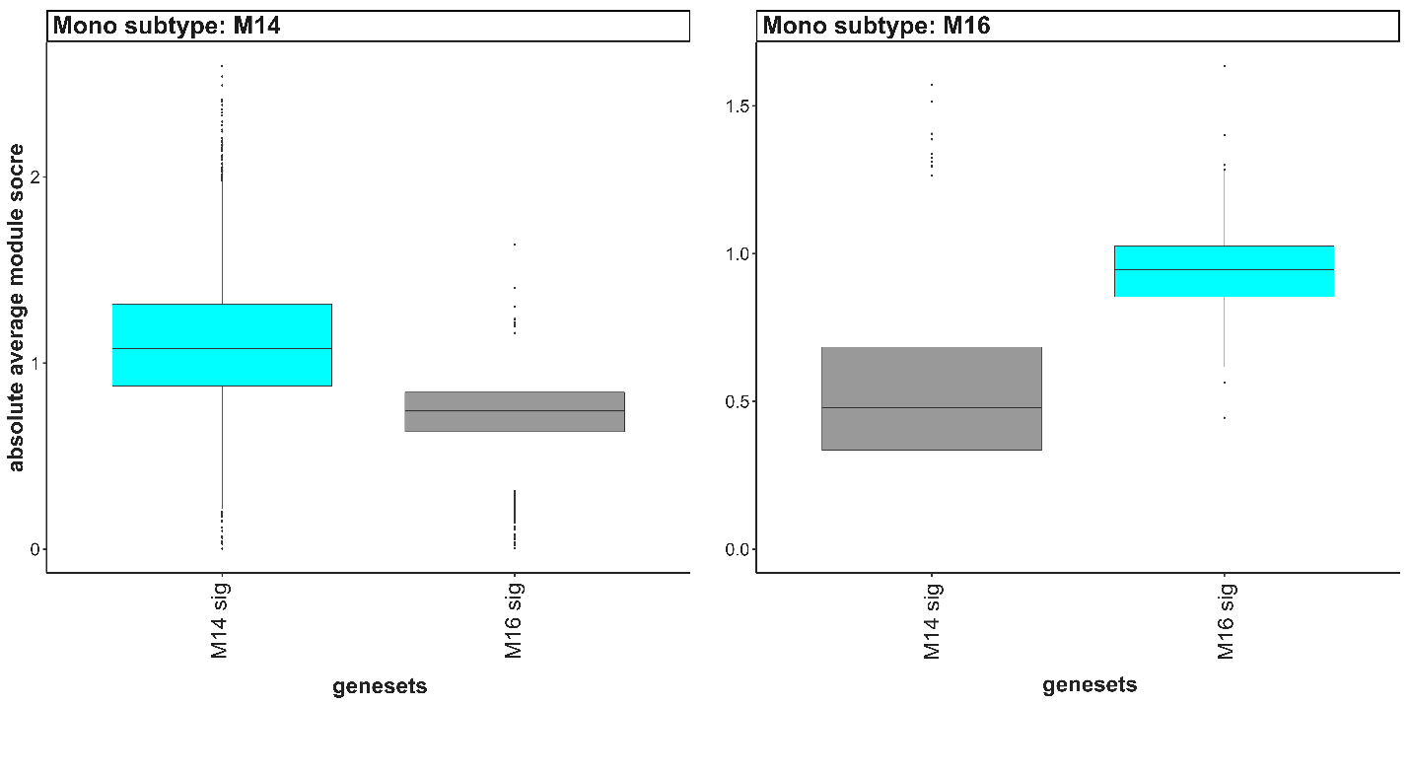
A
B
Notes:
Supplementary Figure 6. Identification of Monocyte subtypes in novel NECS CITE-seq dataset. a) UMAP plot of Mono in NECS CITE-seq dataset, clustered and identified by subtypes: M14 and M16. b) Boxplots of average absolute module scores (y-axis) of M14 and M16 signatures (x-axis) for each Mono subtype: M14 and M16.

Slide 7
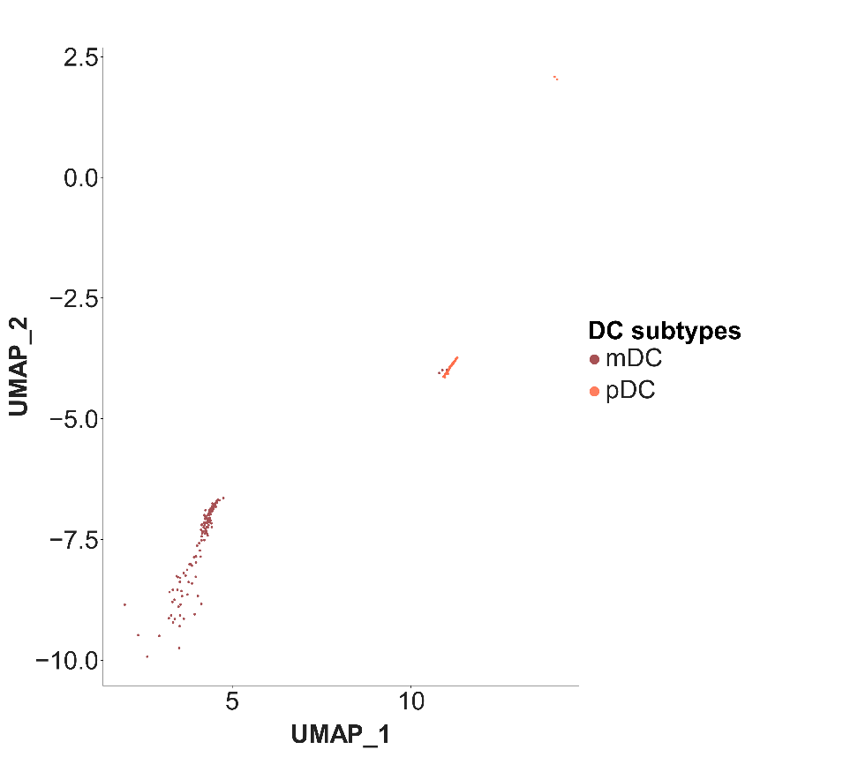
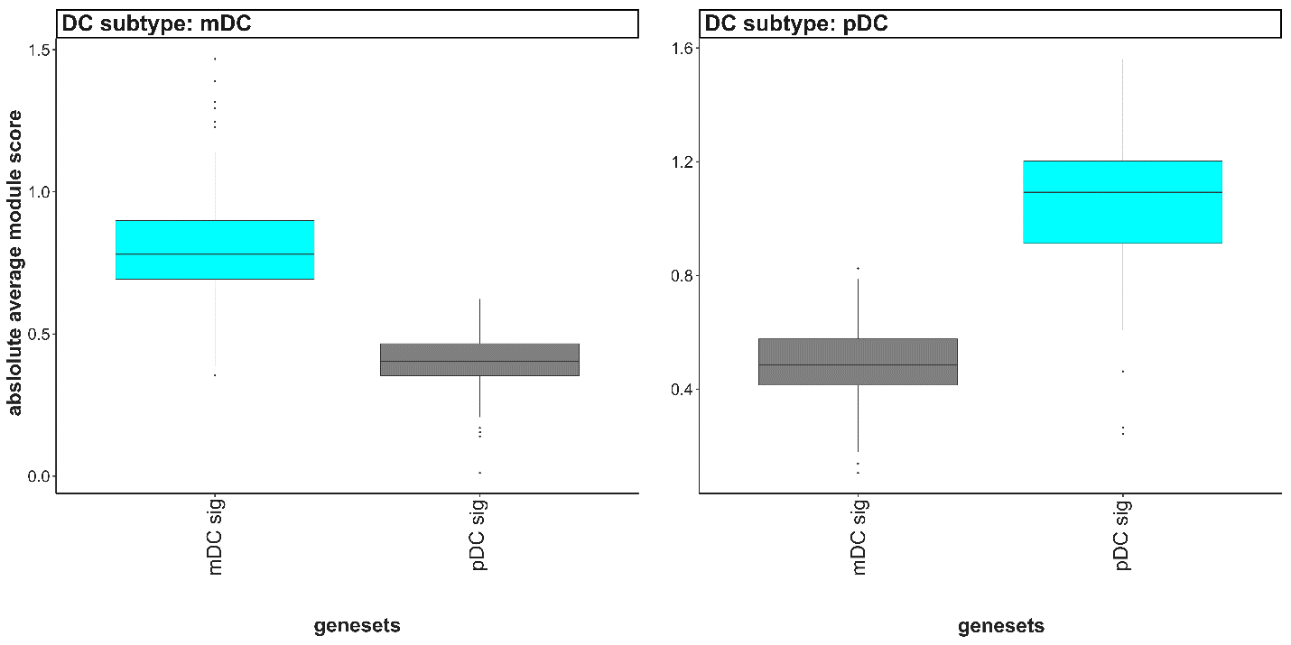
A
B
Notes:
Supplementary Figure 7. Identification of DC subtypes in novel NECS CITE-seq dataset. a) UMAP plot of DC in NECS CITE-seq dataset, clustered and identified by subtypes: mDC and pDC . b) Boxplots of average absolute module scores (y-axis) of mDC and pDC signatures (x-axis) for each DC subtype: mDC and pDC.

Slide 8
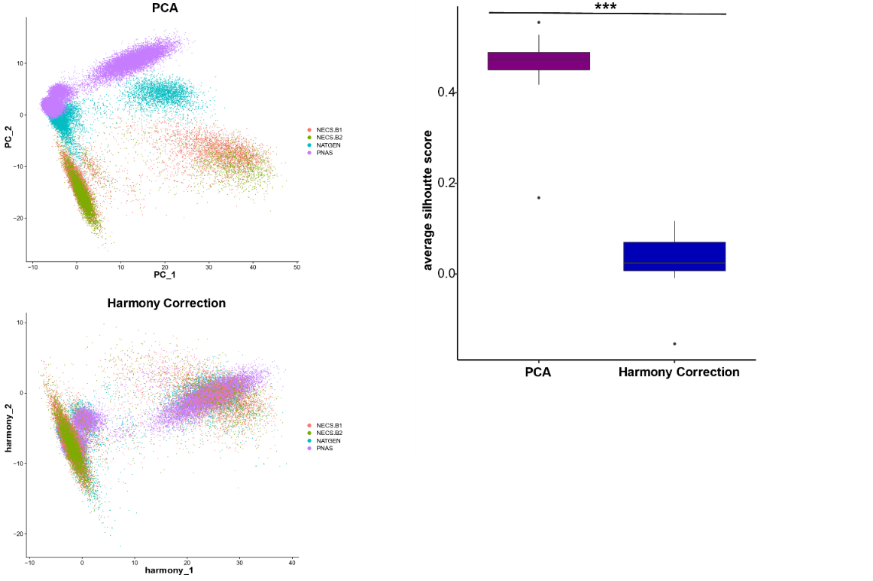
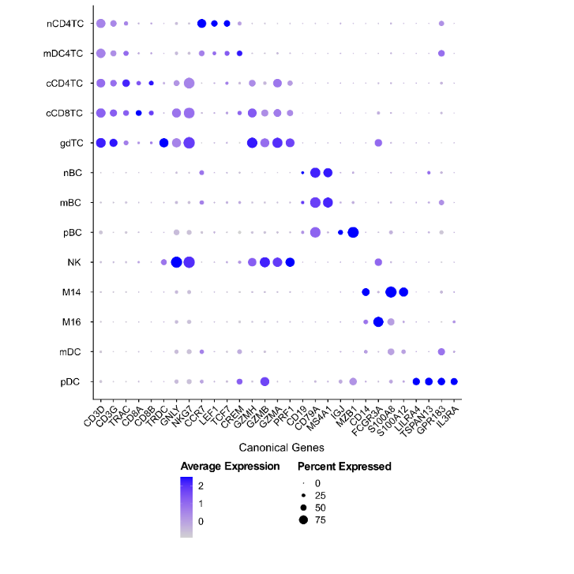
A
B
C
Notes:
Supplementary Figure 8. Harmonization of NECS and publicly available SINGLE CELL datasets of aging and longevity. a, Batch correction of NECS CITE-seq dataset with PNAS and NATGEN scRNA-seq datasets using Harmony-based PCA correction: PCA plot before correction (top) and after Harmony correction. b, Average silhouette score for each immune subpopulation before and after Harmony correction to assess mixing of datasets. A higher average silhouette score towards 1 indicates poor mixing of batches, and a lower score towards 0 indicates good mixing of batches. We performed a Wilcoxon rank sum test with p-value significance of 0.05 and found a significant decrease in scores after Harmony based correction (Wilcoxon, p-value = 1.083e-05): nsp > 0.05, *p<0.05, **p<0.01, ***p<0.001. c, Dot plot of average expression of canonical gene markers of immune cell populations in the integrated datasets.

Slide 9
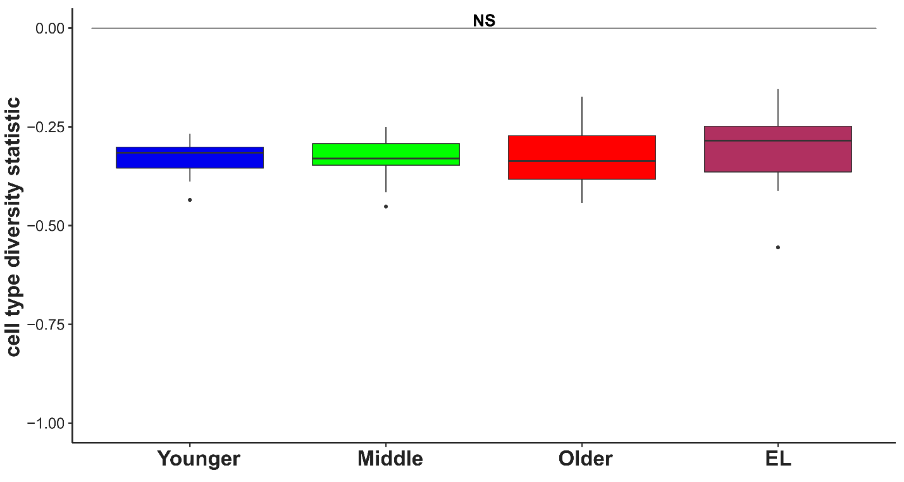
Notes:
Supplementary Figure 9. Cell type diversity statistic based on the 13 immune subtypes in the integrated SINGLE CELL data. Boxplot of cell type diversity statistic calculated on the 13 immune cell subtypes per sample and grouped across age groups, with increased cell type diversity in EL compared to younger age groups although not found to be statistically significant (F-test, p-value = 0.7231).

Slide 10
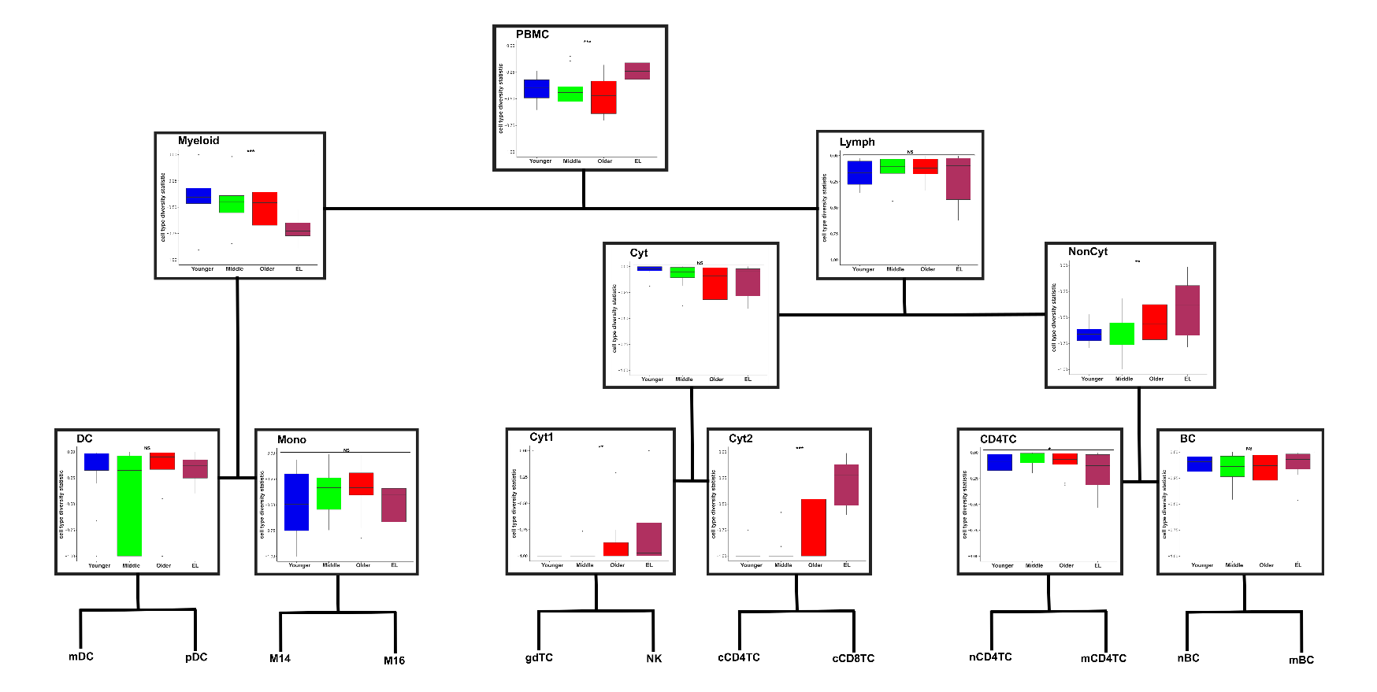
Notes:
Supplementary Figure 10. Diversity along the hierarchy of peripheral immune compartments of the SINGLE CELL data. A. Boxplots of the cell type diversity statistic for each sample based on the cell type proportions within each peripheral immune compartment compared across age groups.

Slide 11
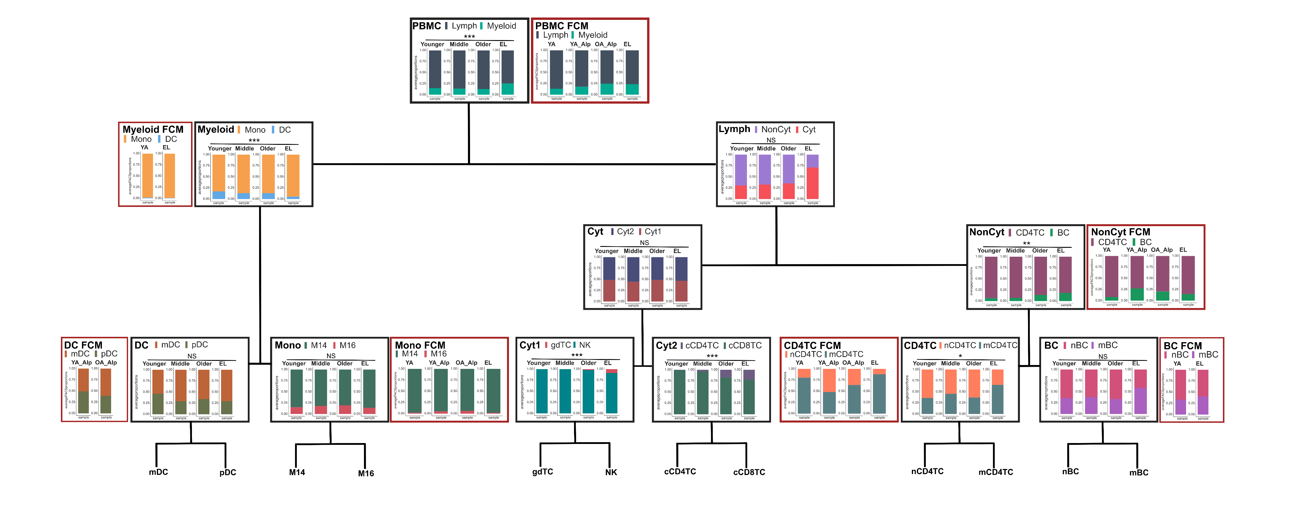
Notes:
Supplementary Figure 11. FLOW CYTOMETRY validation of cell type proportions based on the hierarchy of peripheral immune compartments. The average immune cell type proportions based on CYTOMETRY data (FCM) compared to the average immune cell type proportions at the single cell level along the hierarchy of peripheral immune compartments. The CYTOMETRY data include 3 younger age individuals (YA) and 7 EL individuals (EL) from the NECS cohort, and 39 younger age individuals (YA Alp) and 50 older individuals (OA Alp) from Alpert et al.

Slide 12
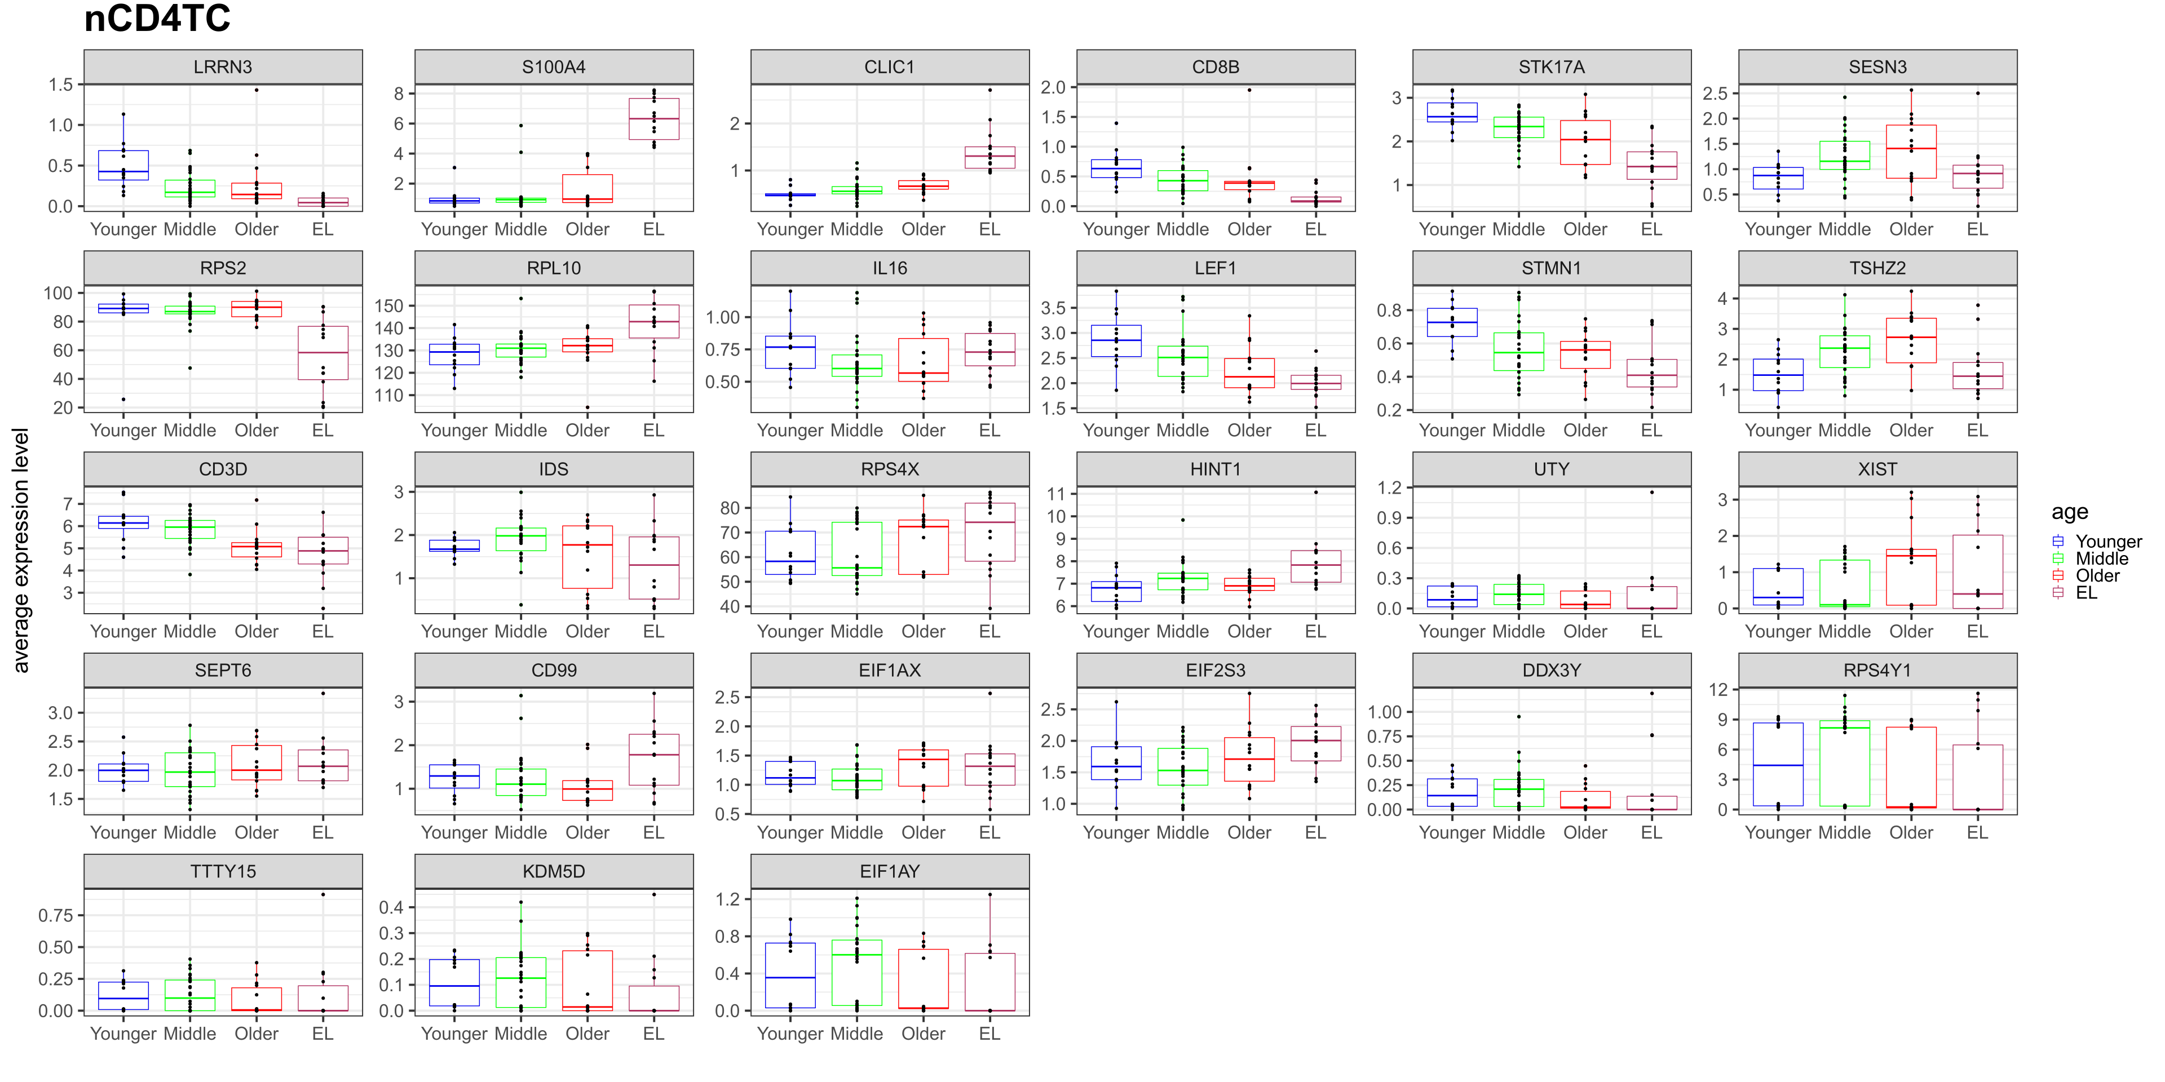
Notes:
Supplementary Figure 12. Transcriptional signatures across the human lifespan in nCD4TC at the SINGLE CELL level. Boxplots of average expression levels per sample of significant differential genes in nCD4TC across younger age, middle age, older age, and EL.

Slide 13
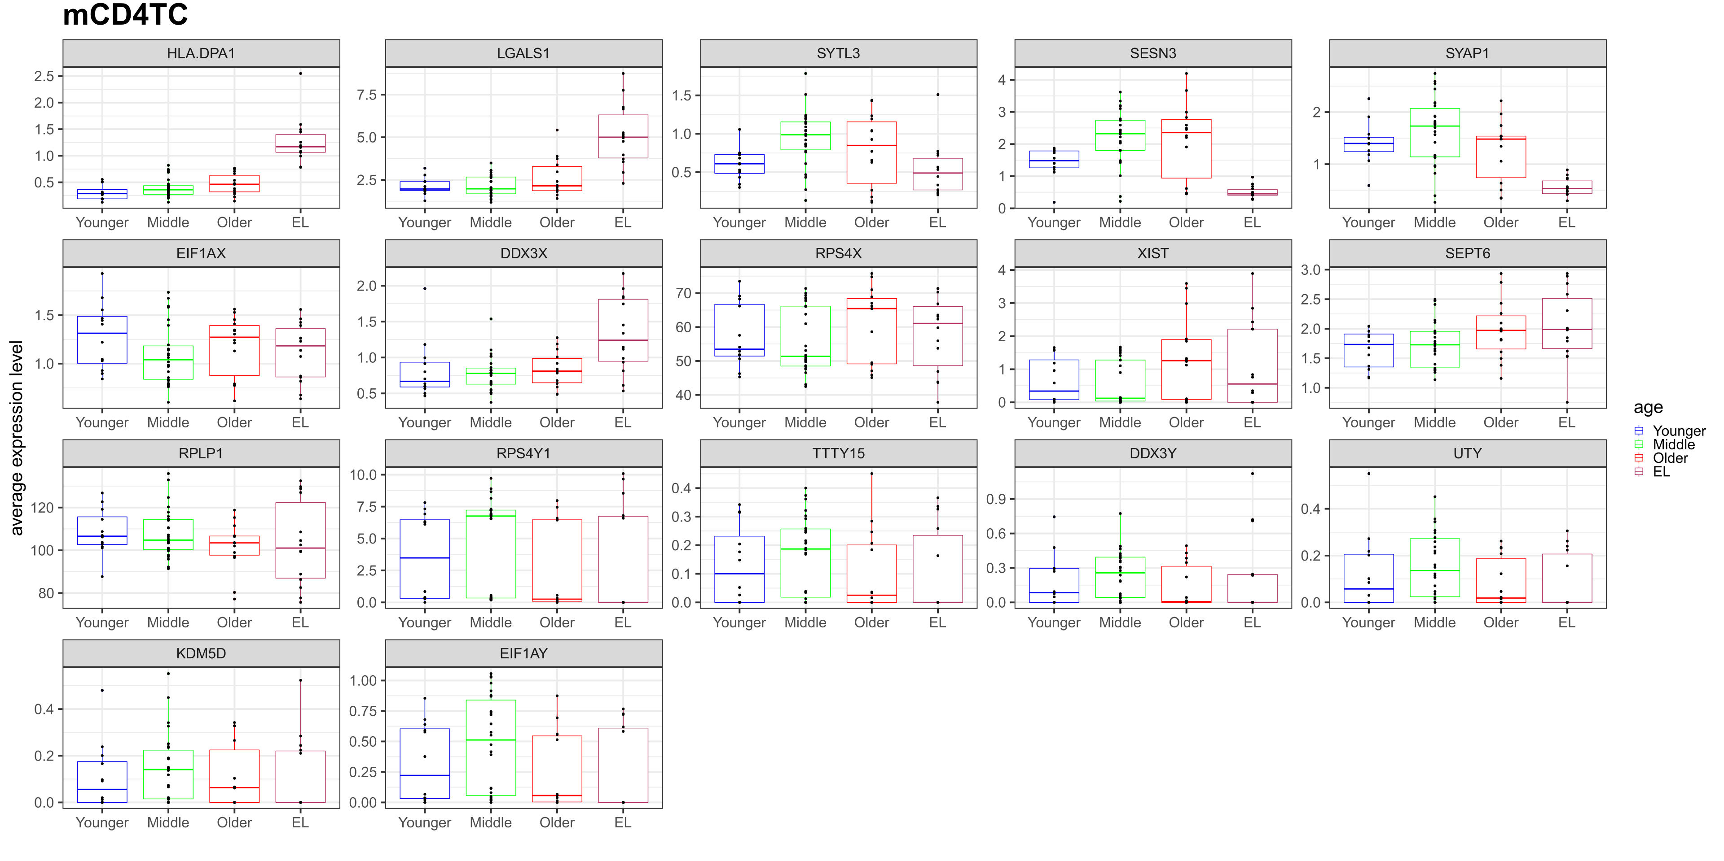
Notes:
Supplementary Figure 13. Transcriptional signatures across the human lifespan in mCD4TC at the SINGLE CELL level. Boxplots of average expression levels per sample of significant differential genes in mCD4TC across younger age, middle age, older age, and EL.

Slide 14
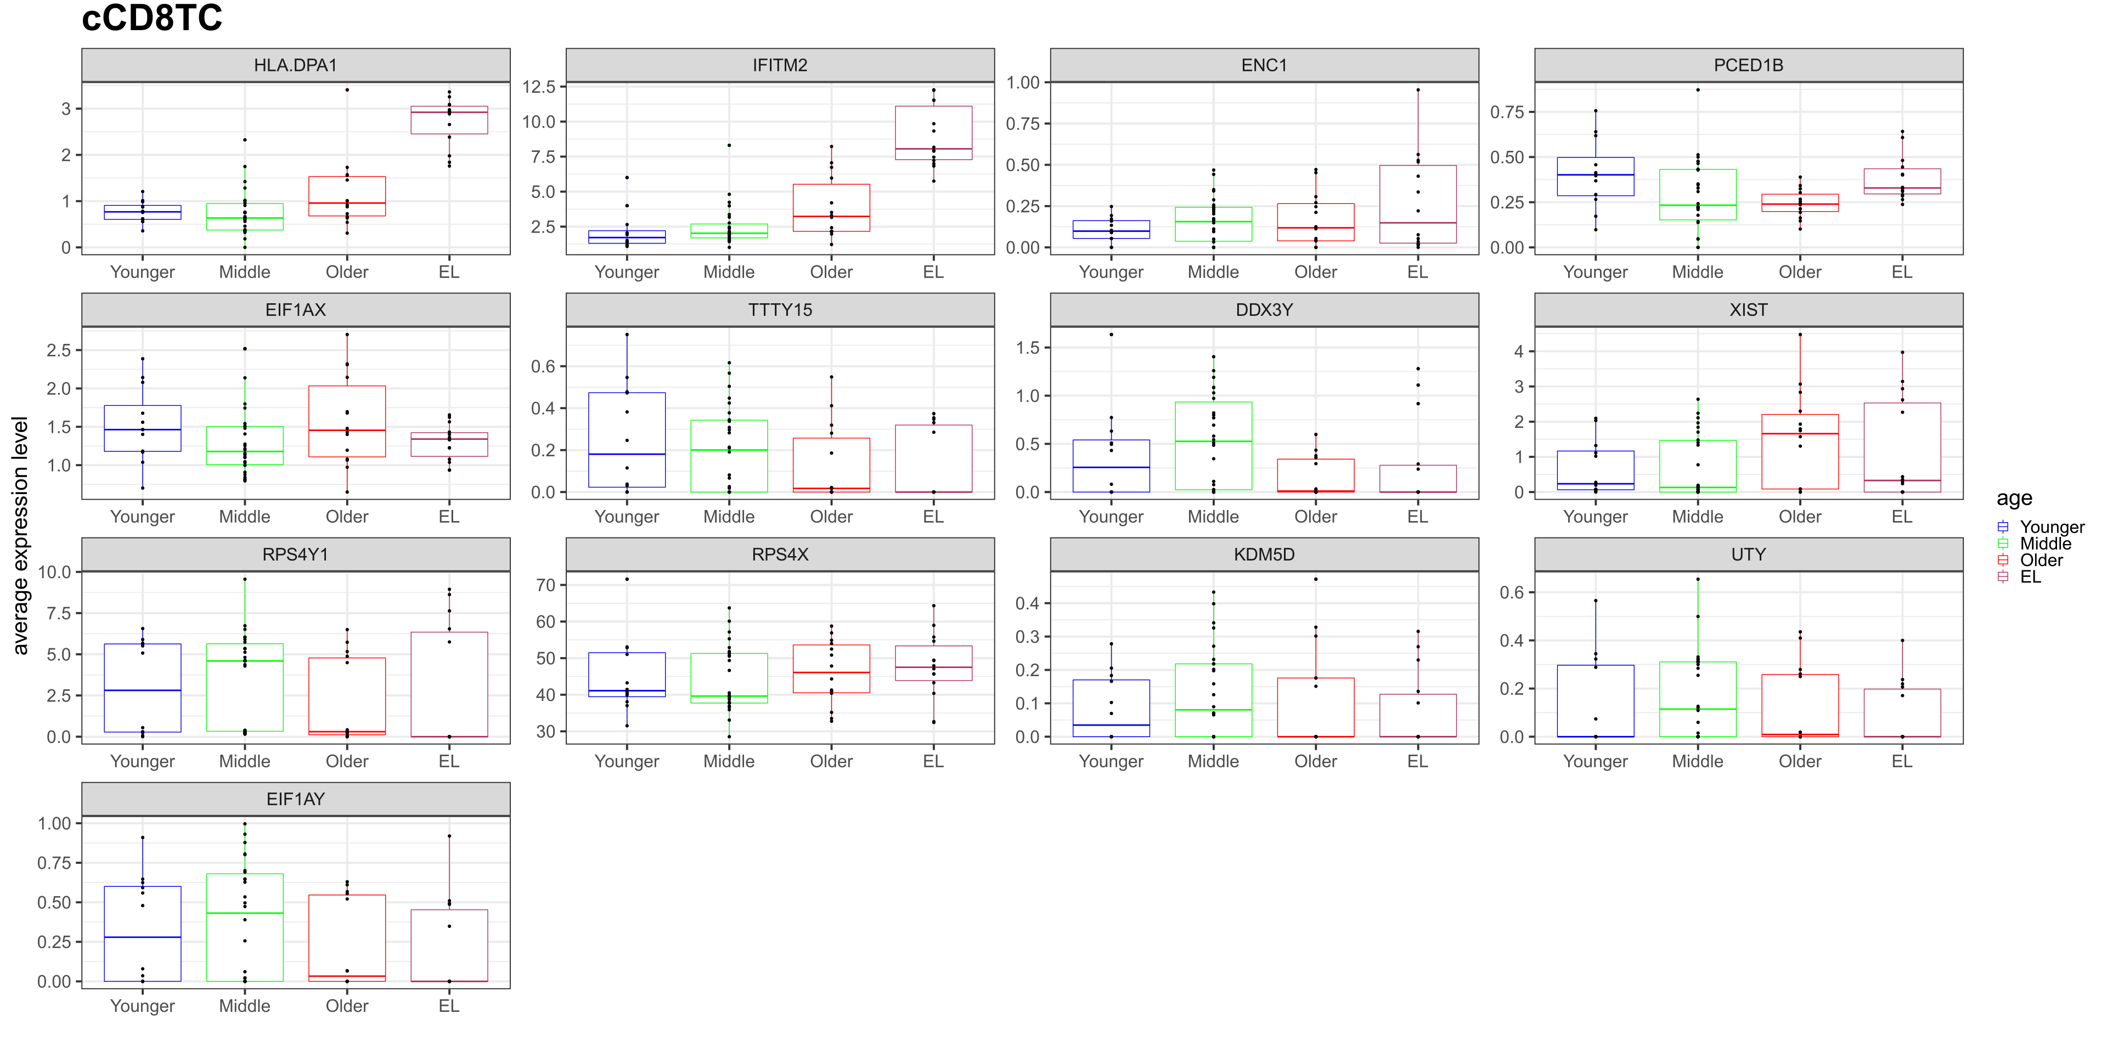
Notes:
Supplementary Figure 14. Transcriptional signatures across the human lifespan in cCD8TC at the SINGLE CELL level. Boxplots of average expression levels per sample of significant differential genes in cCD8TC across younger age, middle age, older age, and EL.

Slide 15
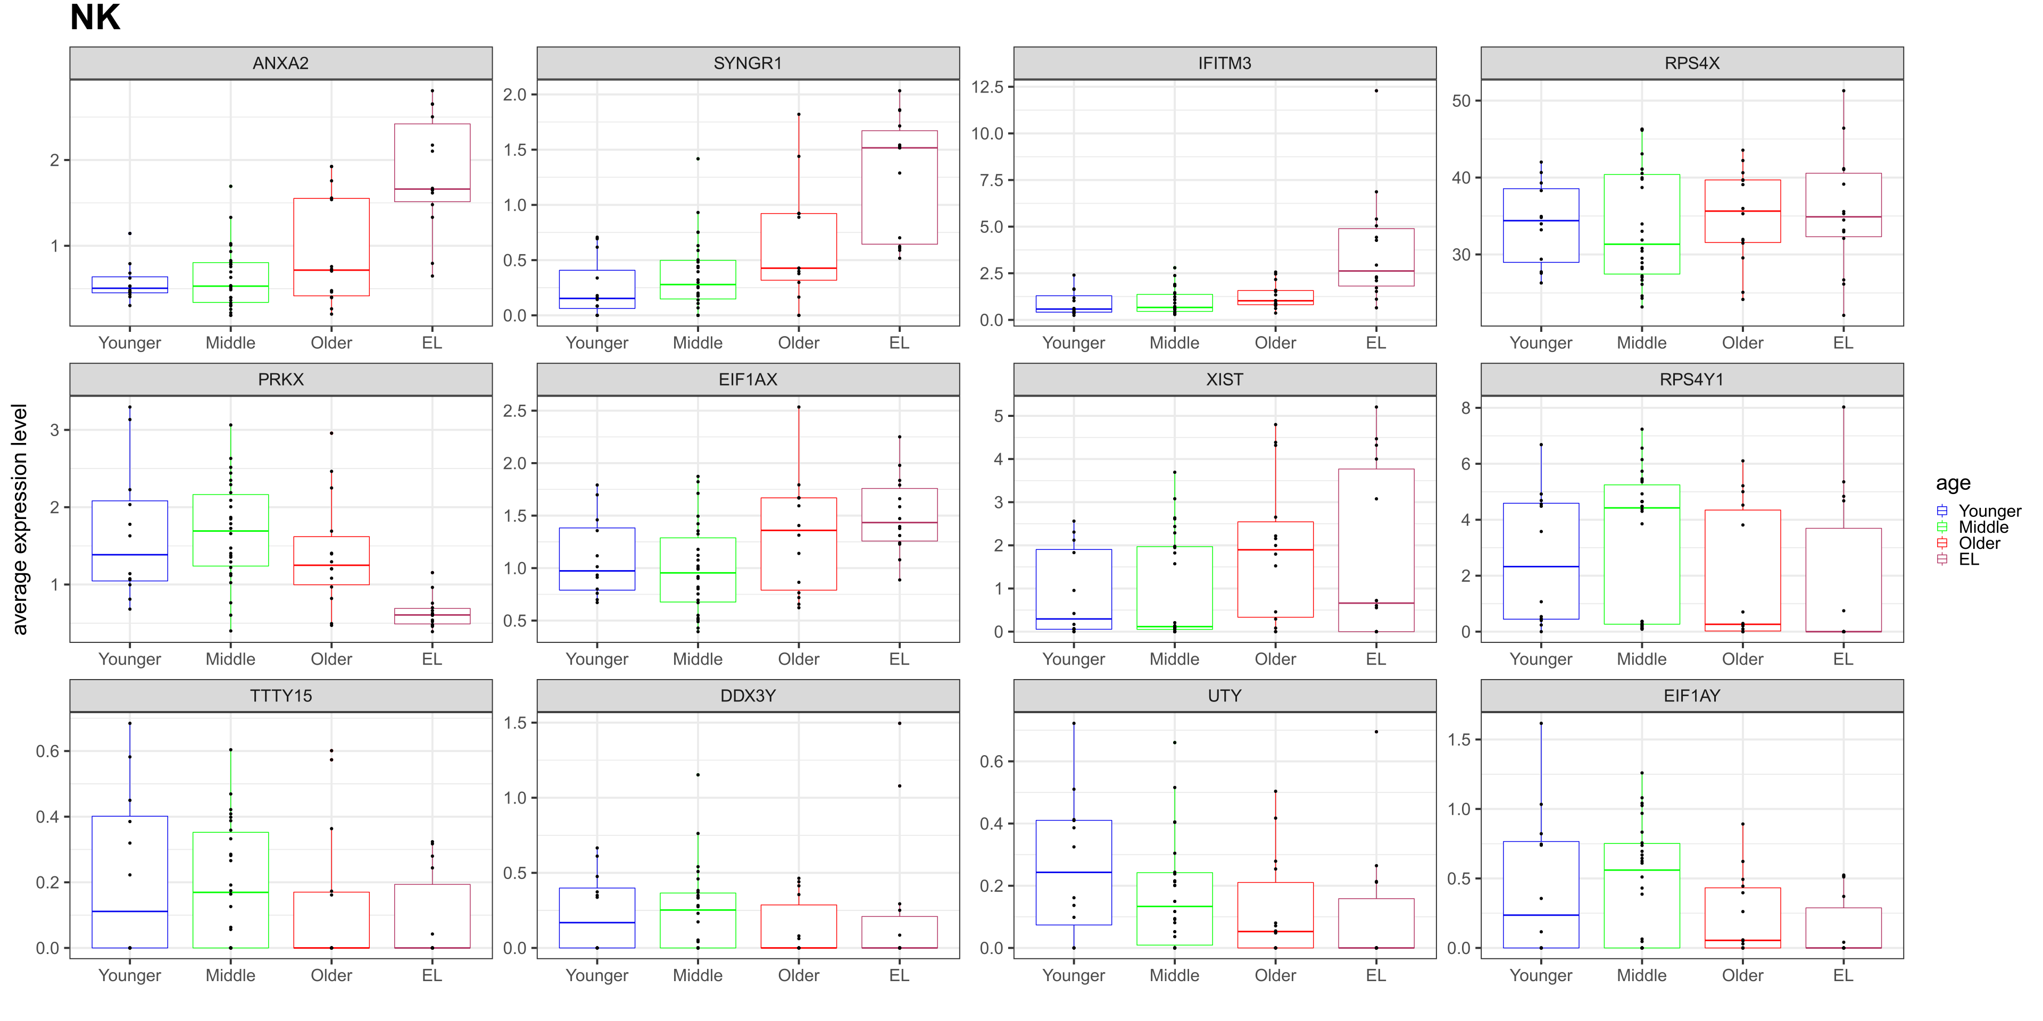
Notes:
Supplementary Figure 15. Transcriptional signatures across the human lifespan in NK at the SINGLE CELL level. Boxplots of average expression levels per sample of significant differential genes in NK across younger age, middle age, older age, and EL displaying age-related patterns.

Slide 16
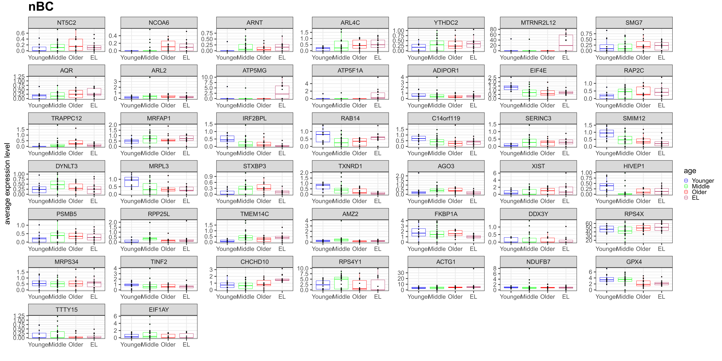
Notes:
Supplementary Figure 16. Transcriptional signatures across the human lifespan in nBC at the SINGLE CELL level. Boxplots of average expression levels per sample of significant differential genes in nBC across younger age, middle age, older age, and EL.

Slide 17
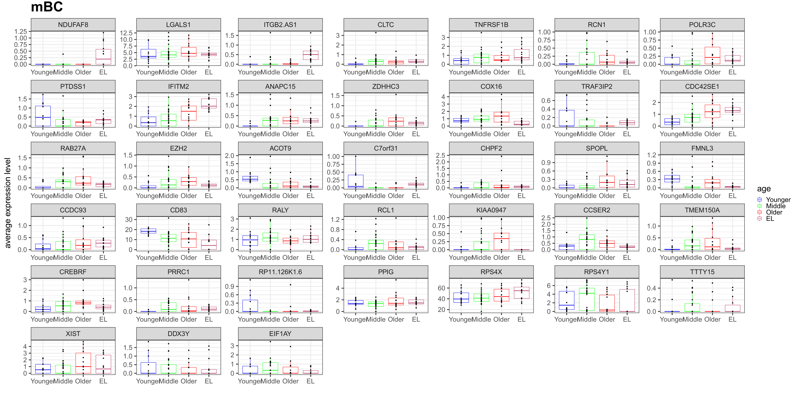
Notes:
Supplementary Figure 17. Transcriptional signatures across the human lifespan in mBC at the SINGLE CELL level. Boxplots of average expression levels per sample of significant differential genes in mBC across younger age, middle age, older age, and EL.

Slide 18
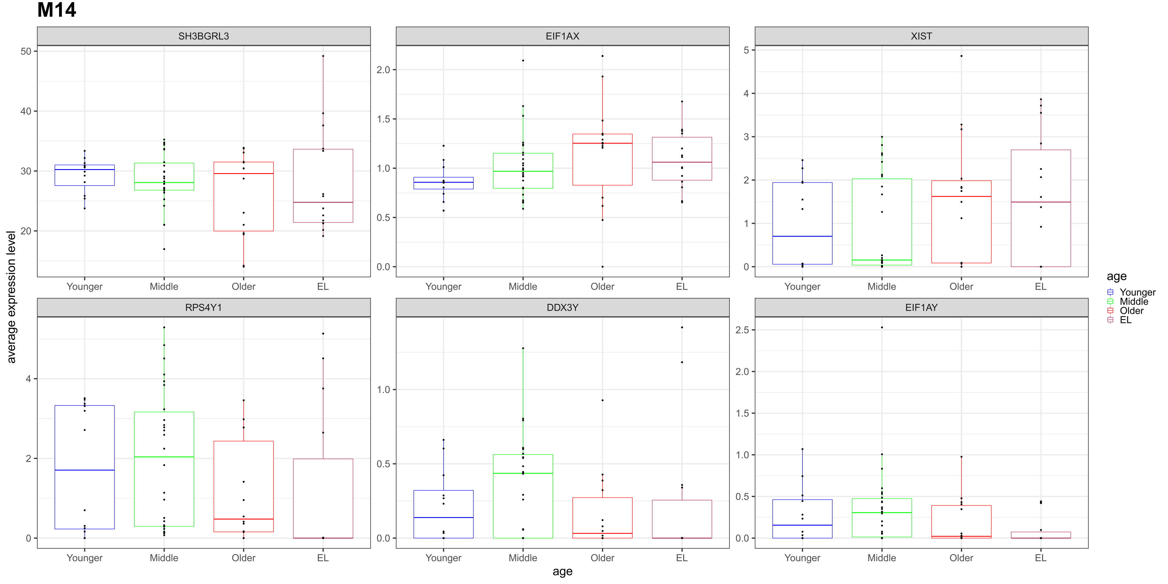
Notes:
Supplementary Figure 18. Transcriptional signatures across the human lifespan in M14 at the SINGLE CELL level. Boxplots of average expression levels per sample of significant differential genes in M14 across younger age, middle age, older age, and EL.

Slide 19
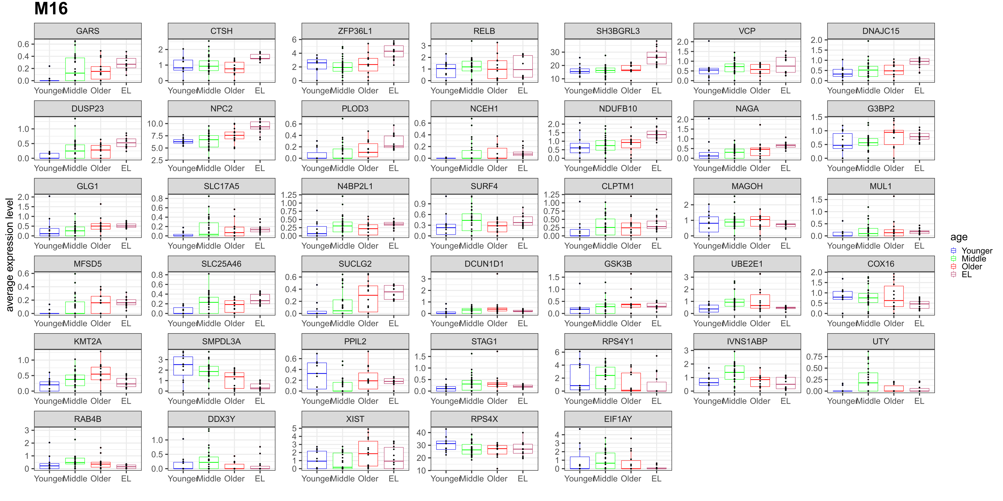
Notes:
Supplementary Figure 19. Transcriptional signatures across the human lifespan in M16 at the SINGLE CELL level. Boxplots of average expression levels per sample of significant differential genes in M16 across younger age, middle age, older age, and EL.

Slide 20
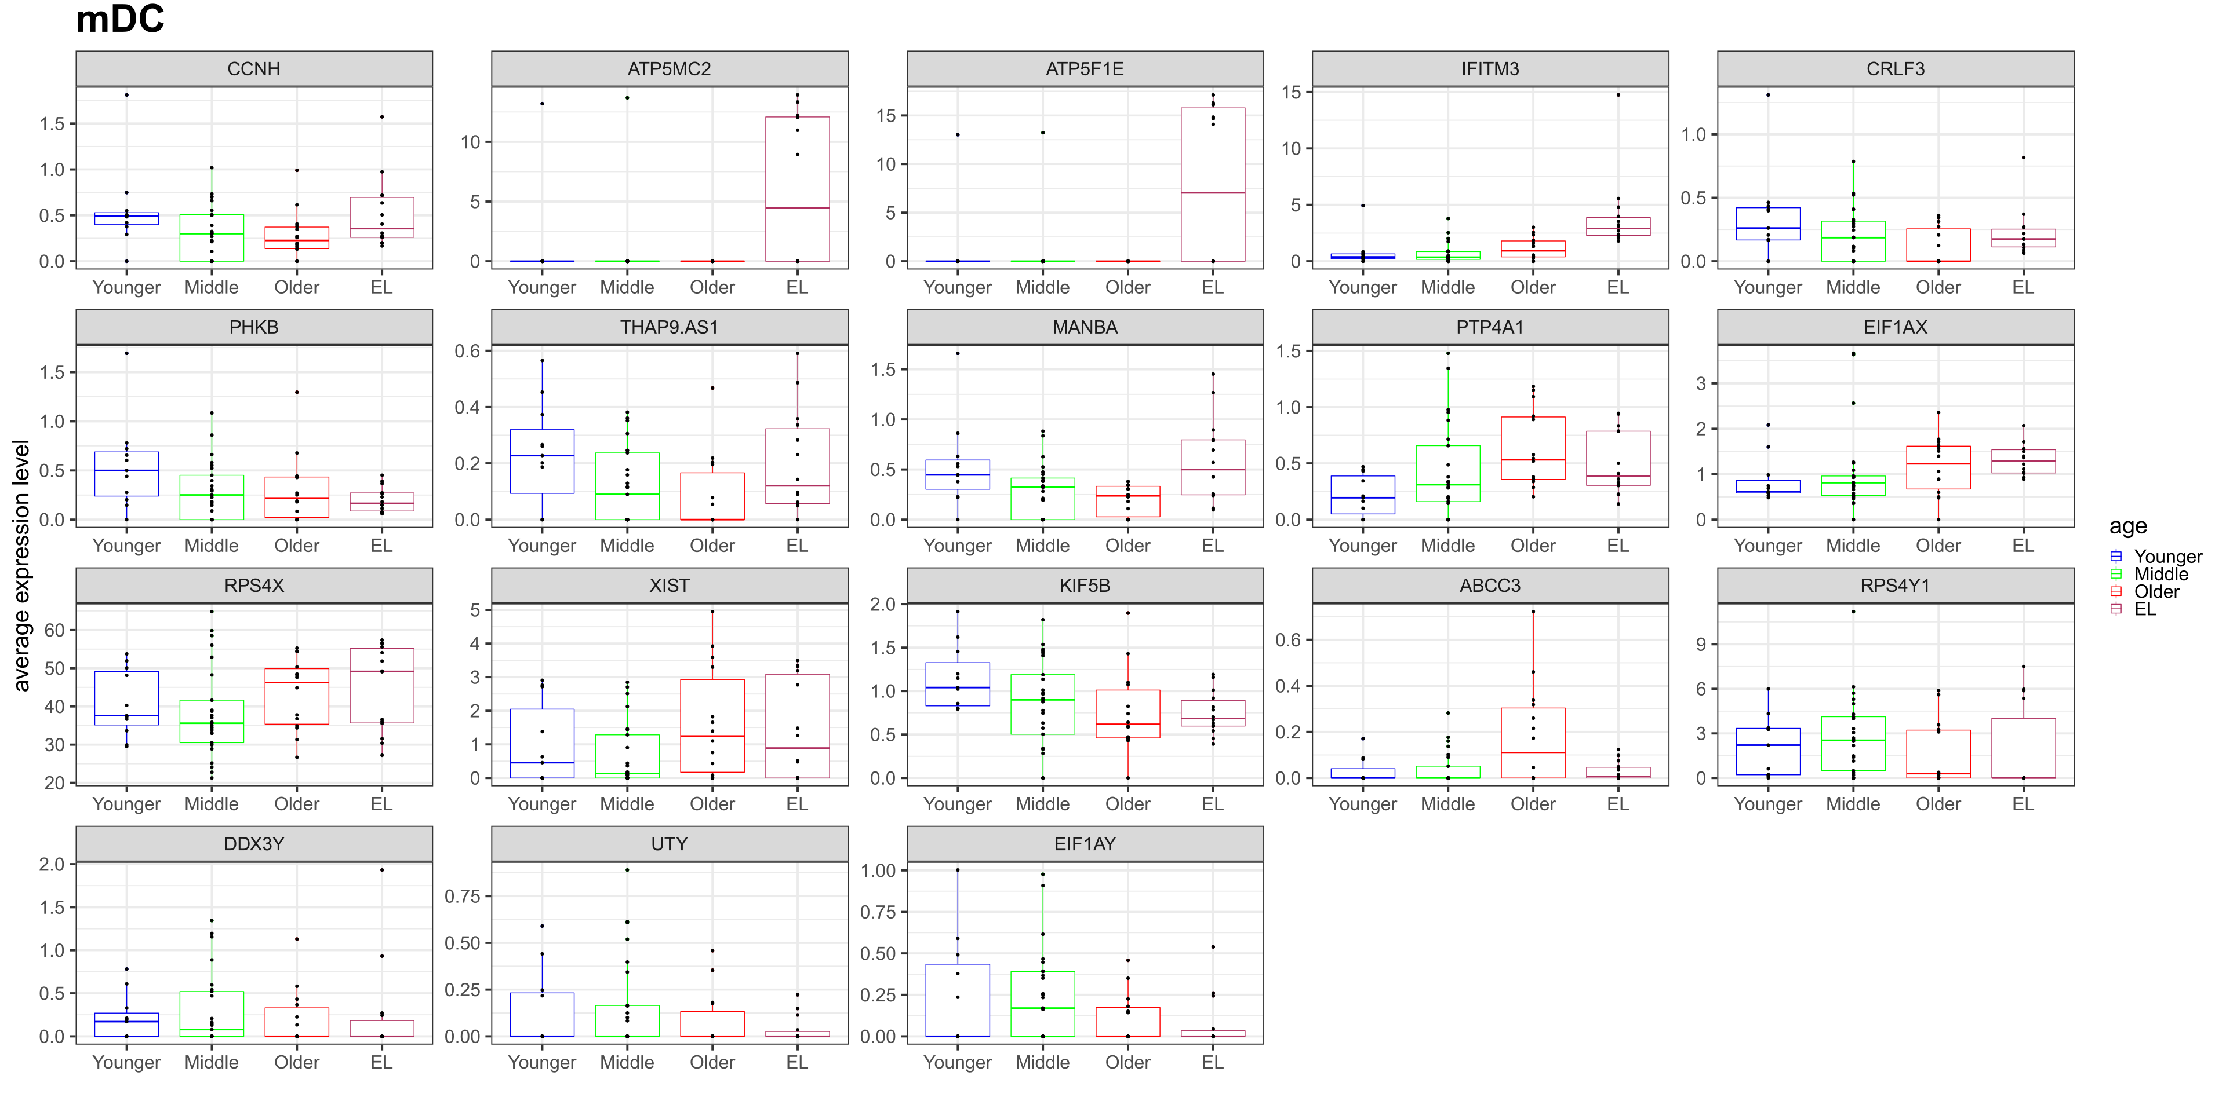
Notes:
Supplementary Figure 20. Transcriptional signatures across the human lifespan in mDC at the SINGLE CELL level. Boxplots of average expression levels per sample of significant differential genes in mDC across younger age, middle age, older age, and EL.

Slide 21
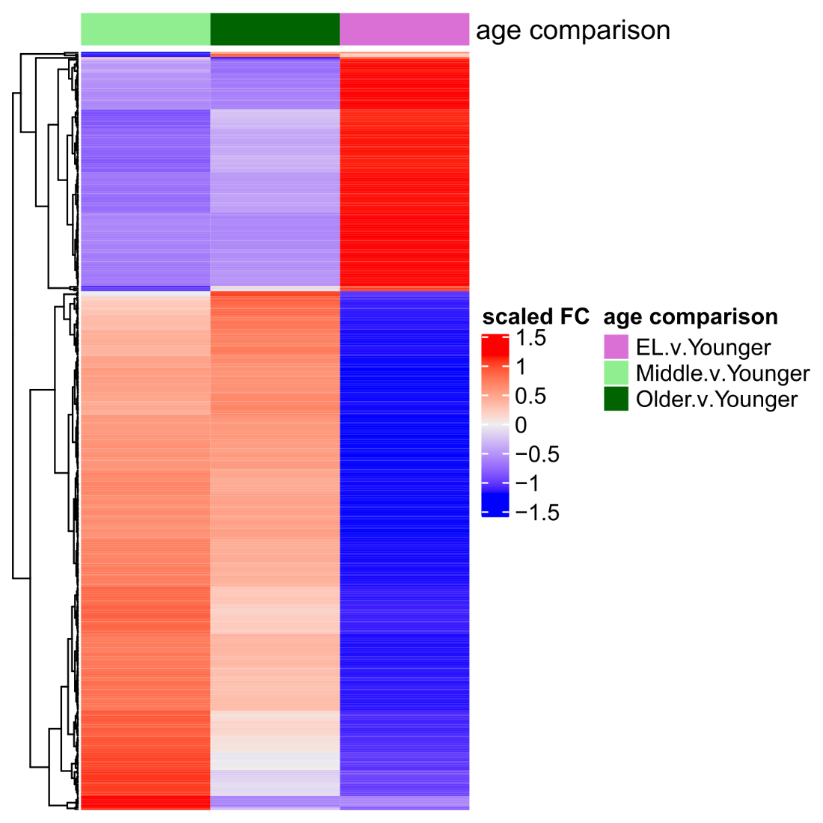
A
B
Notes:
Supplementary Figure 21. BULK level gene expression changes across the human life span. a, Table of number of significant genes upregulated and downregulated for each age comparison: Middle v. Younger age, Older v. Younger age, and EL v. Younger age. b, Heatmap of BULK level significant genes across sample level expression data.

