Slide 1
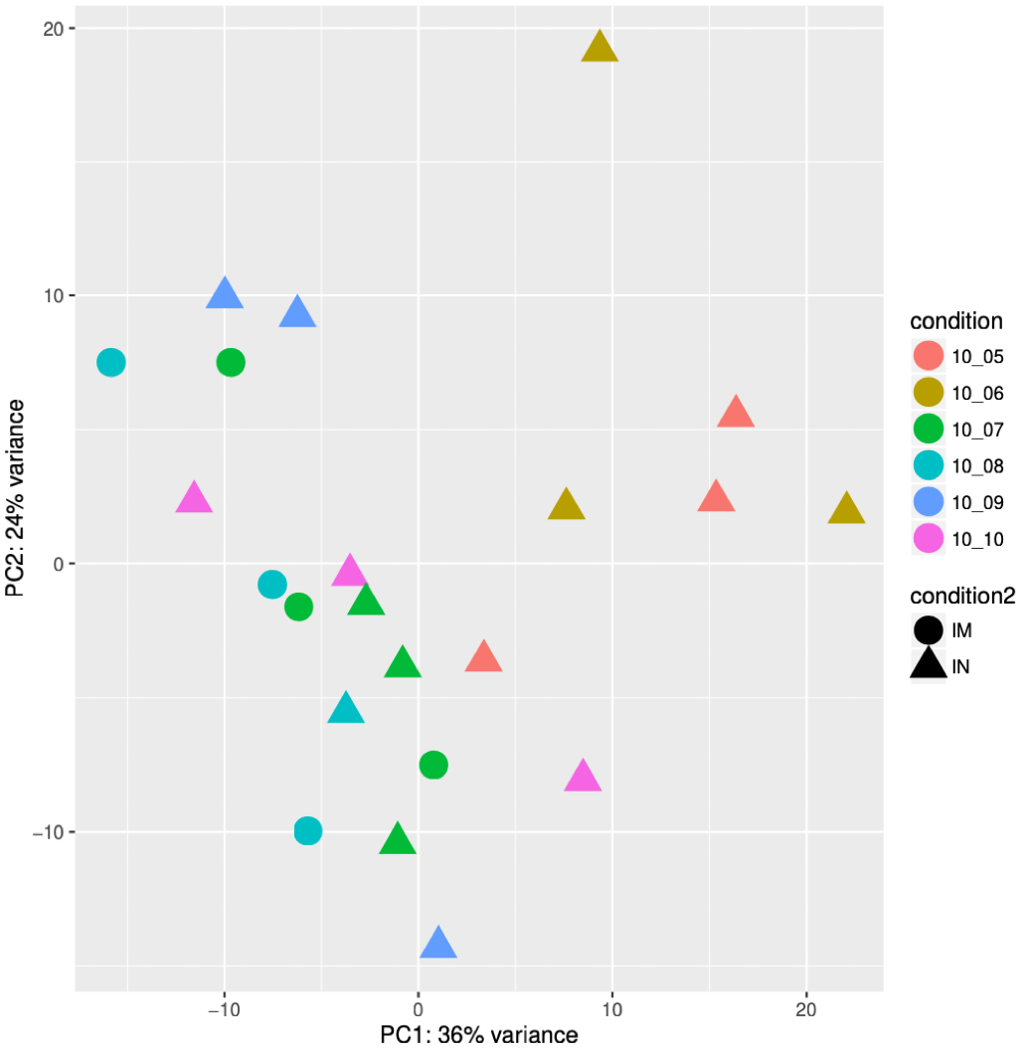
Supplementary figure X
10⁵
10⁶
10⁷
10⁸
10⁹
10¹⁰
i.m.
i.n.

