Slide 1
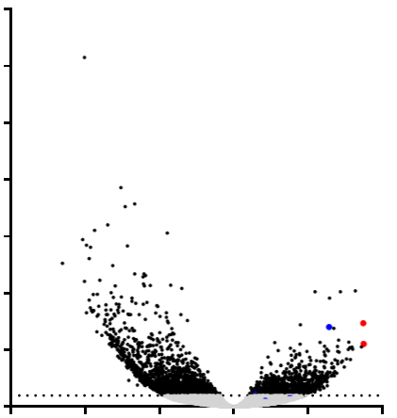
FIGURE 1
70
60
50
40
-Log10 adjusted p value
30
20
KIT
CALML5
10
TMPRSS4
SLC2A1
0
adjusted p value = 0.01
-15
-10
-5
0
CD5
5
10
Log2 fold change

Slide 2
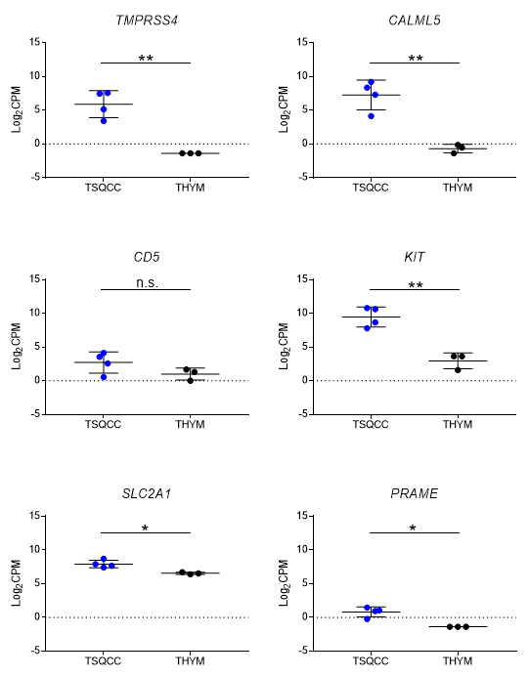
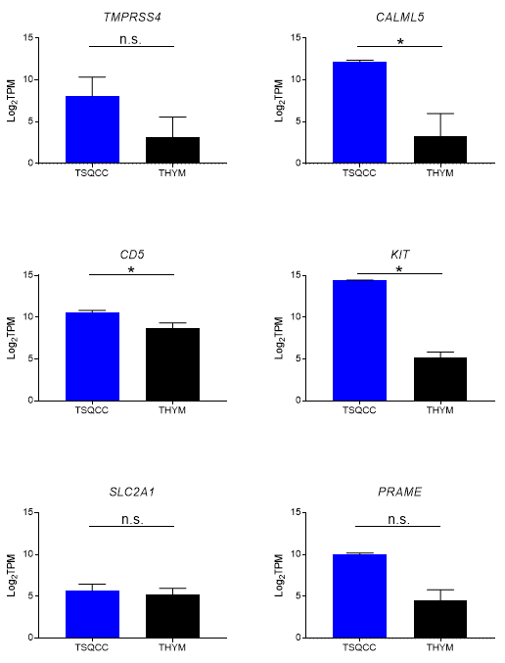
FIGURE 2
A
B

Slide 3
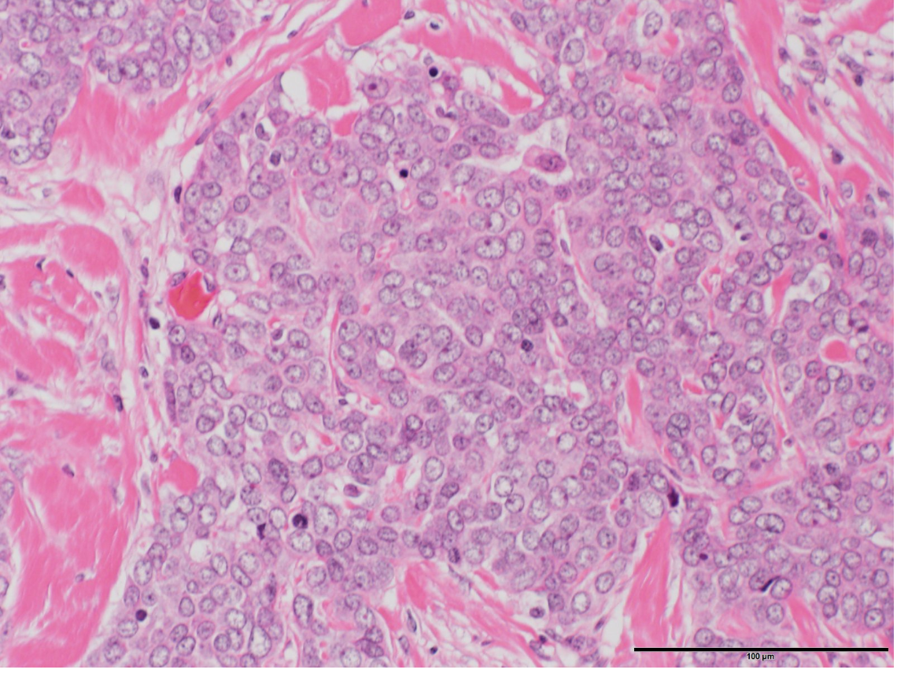
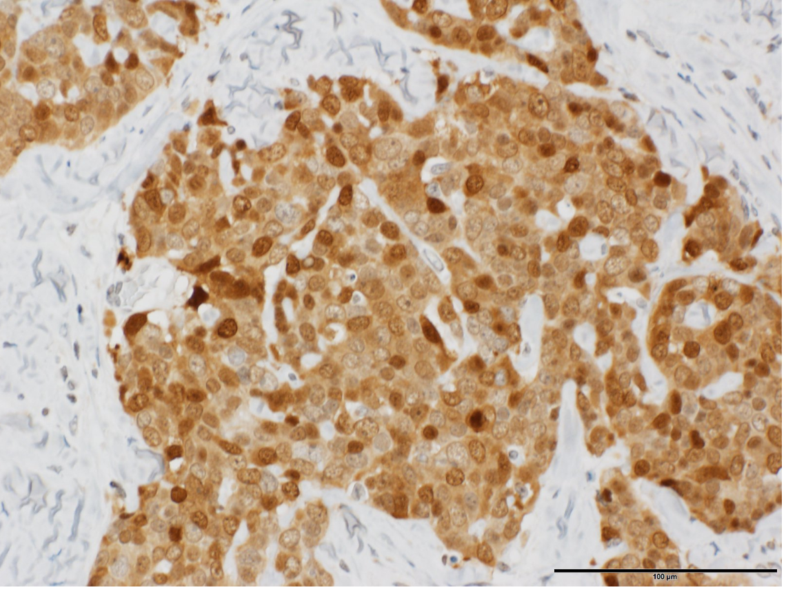
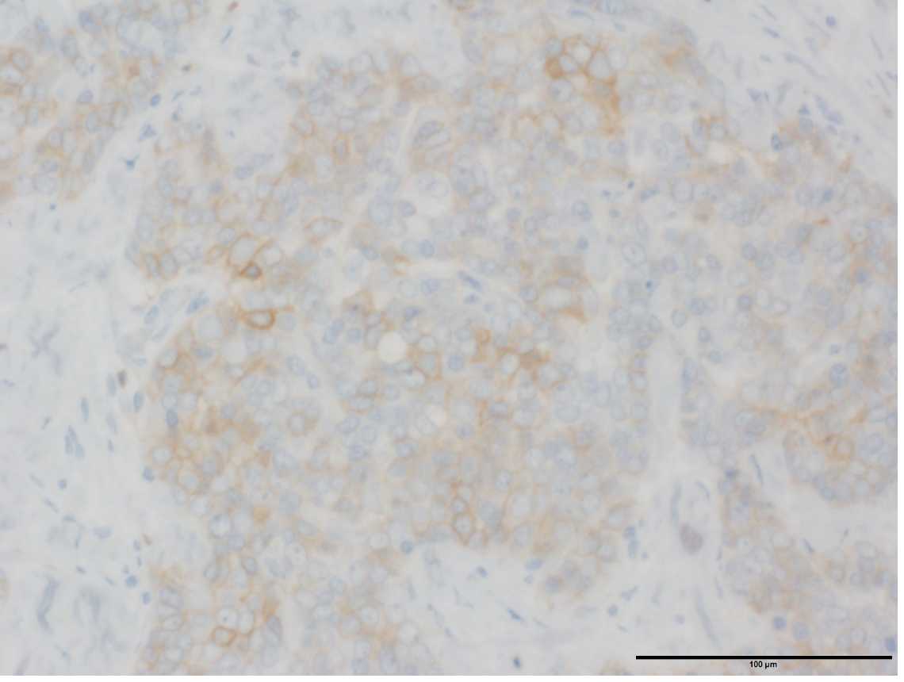
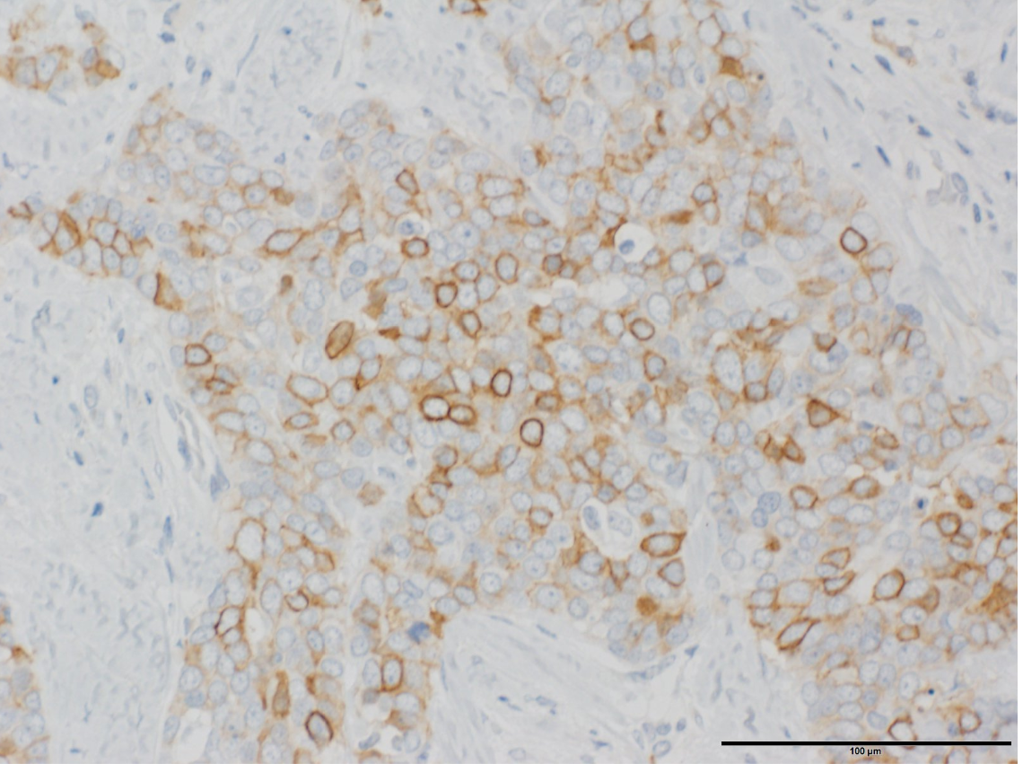
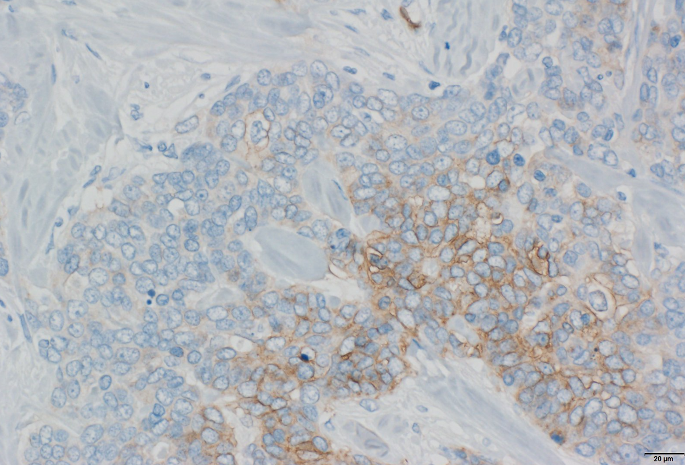
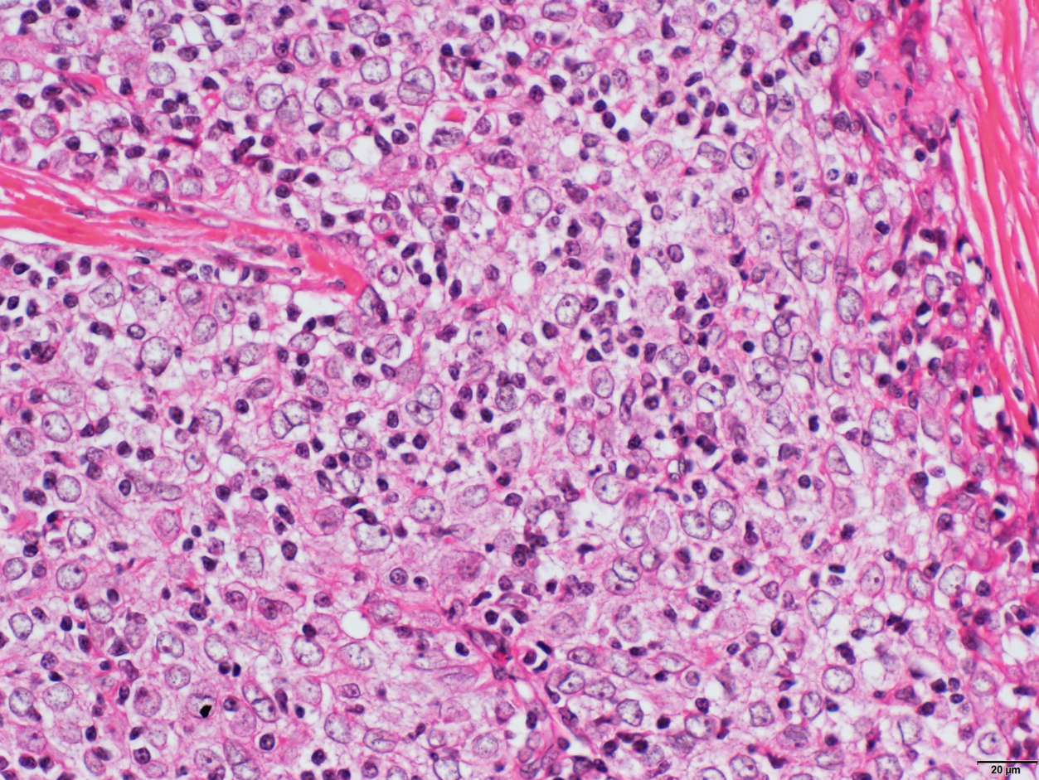
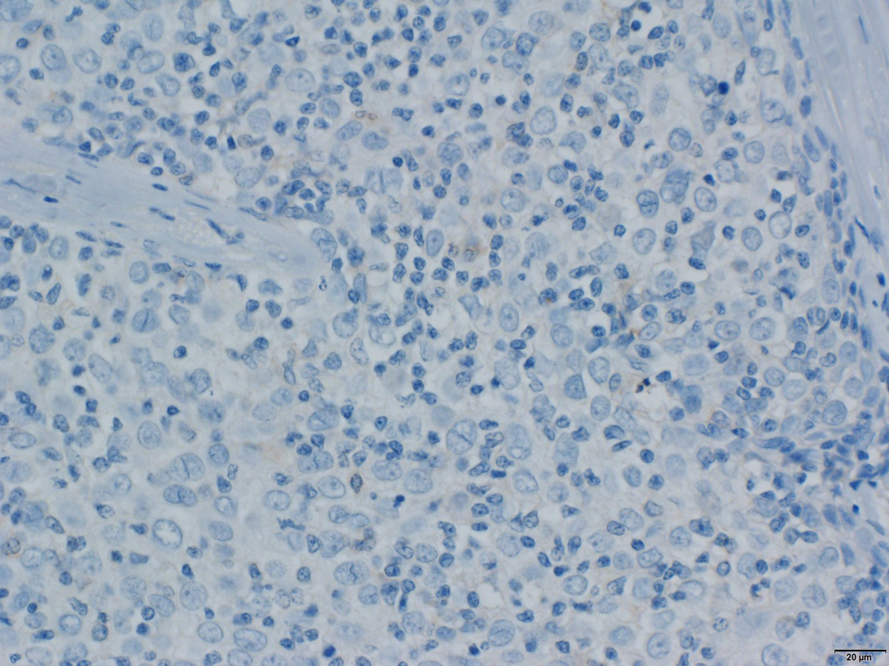
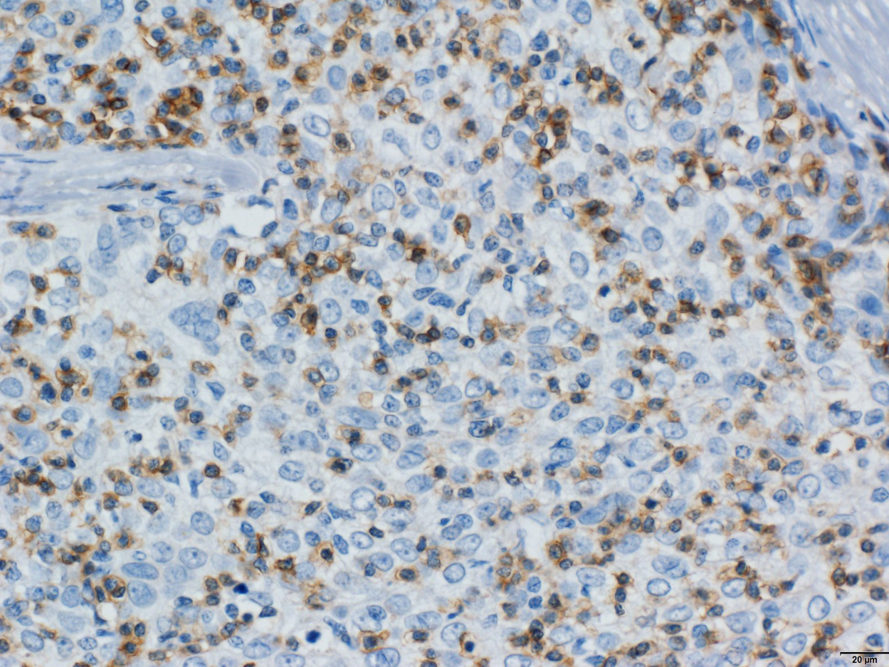
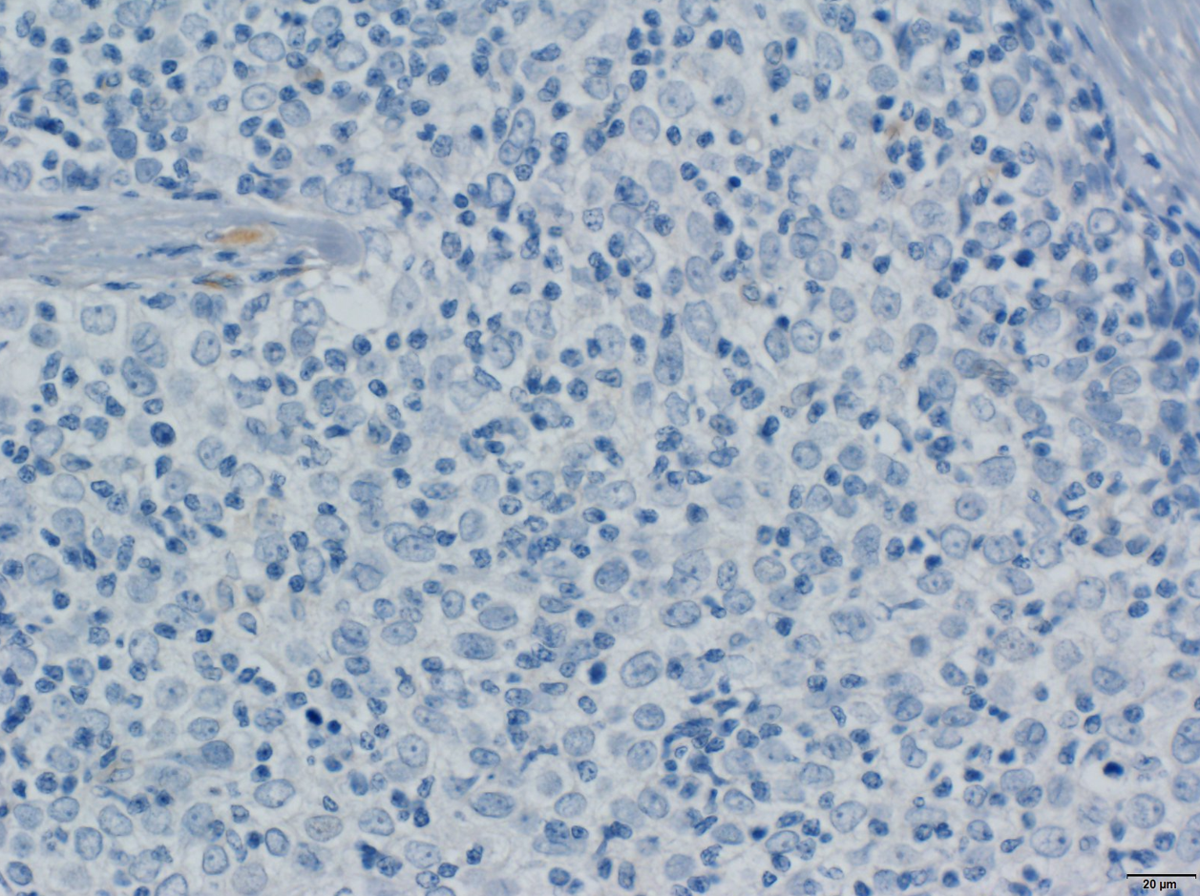
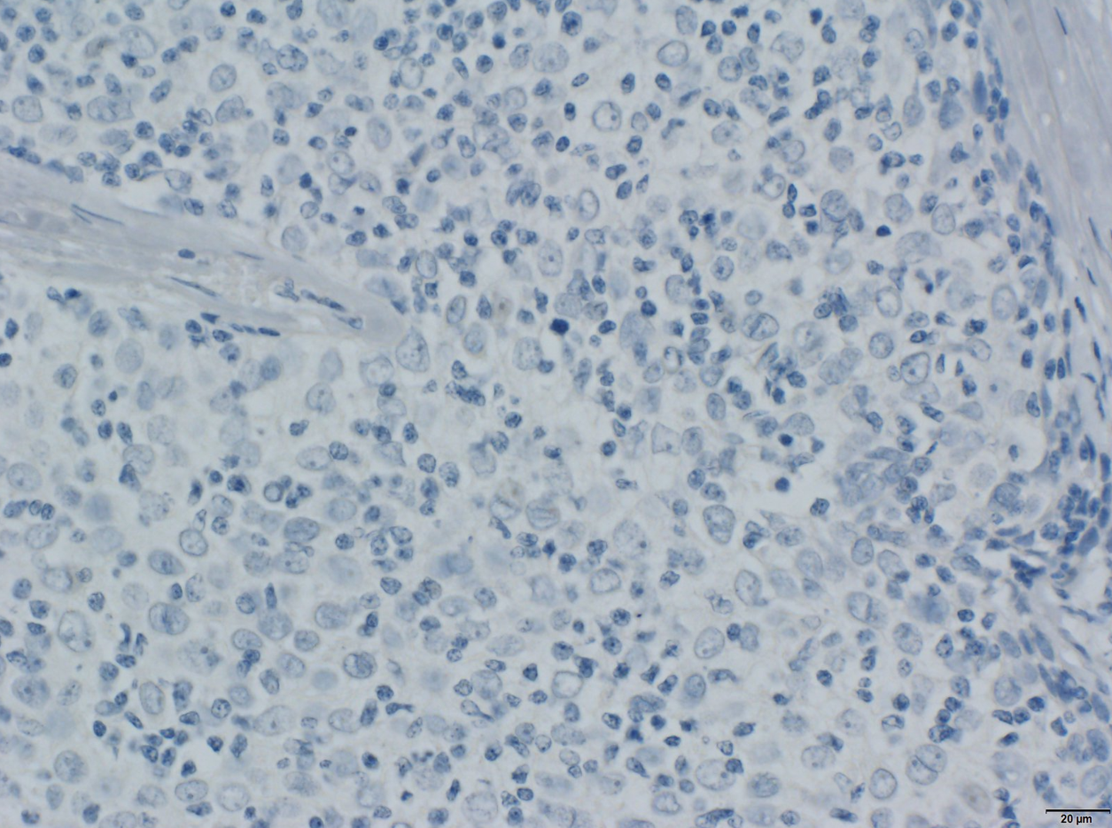
FIGURE 3
H&E
CALML5
CD5
c-kit
GLUT-1
A
B
C
D
E
TSQCC
F
G
H
I
J
THYM

Slide 4
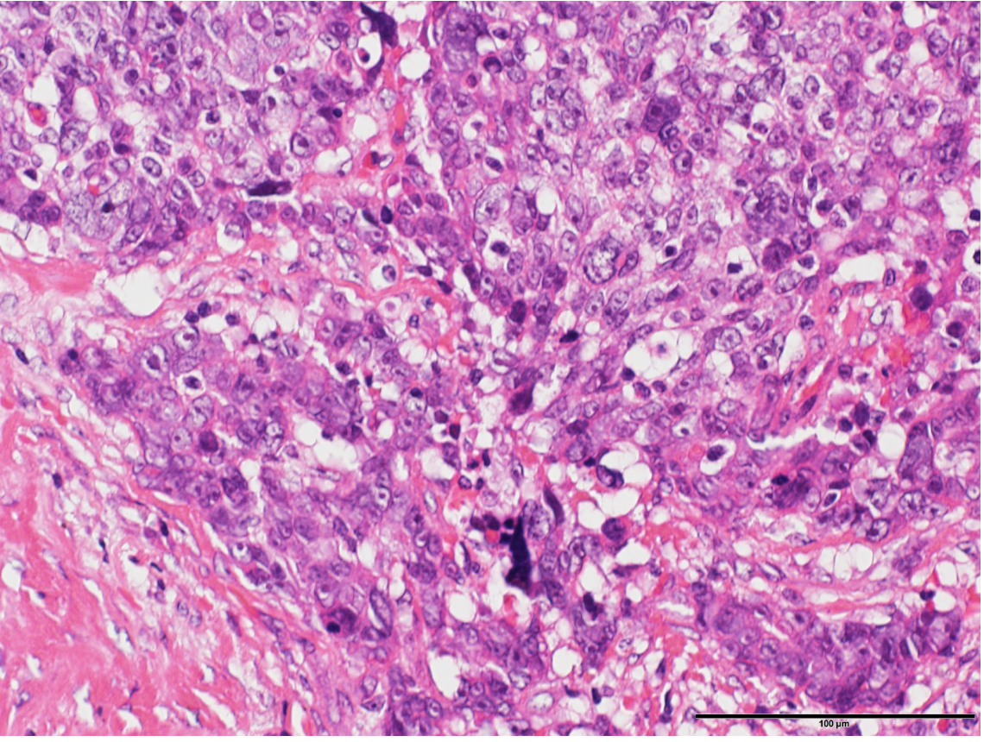
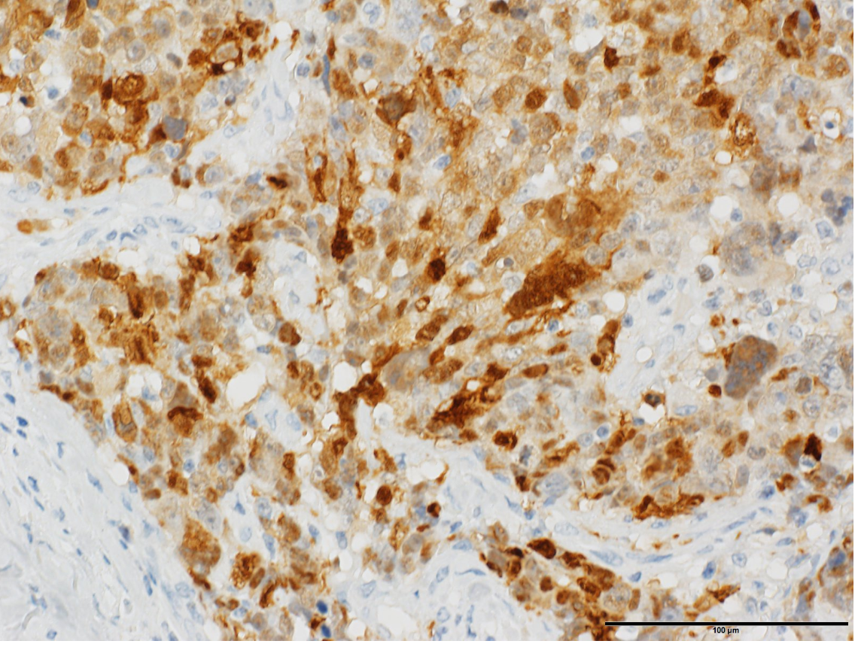
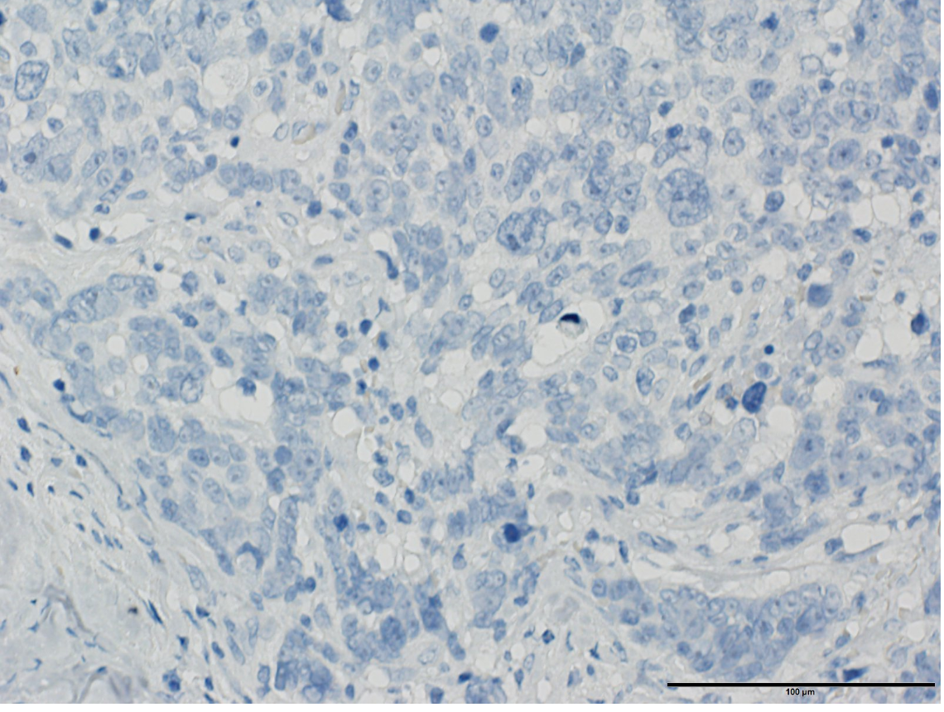
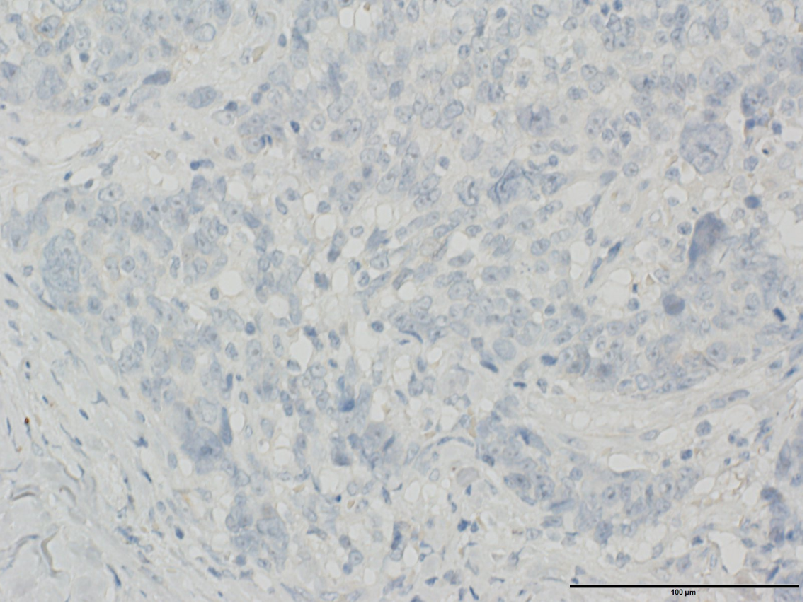
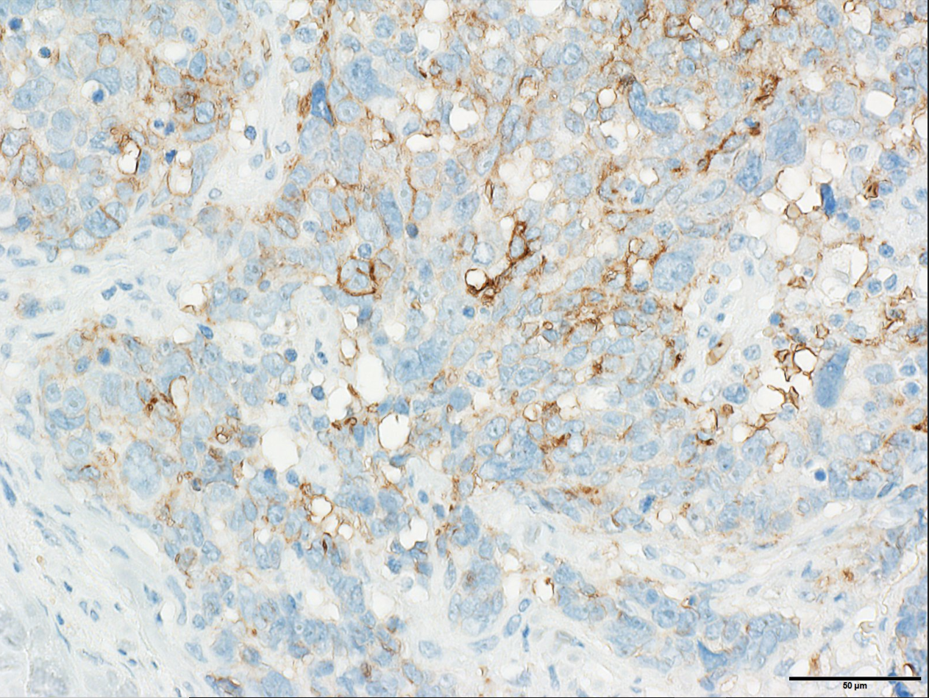
FIGURE S1
H&E
CALML5
CD5
c-kit
GLUT-1
TSQCC

Slide 5
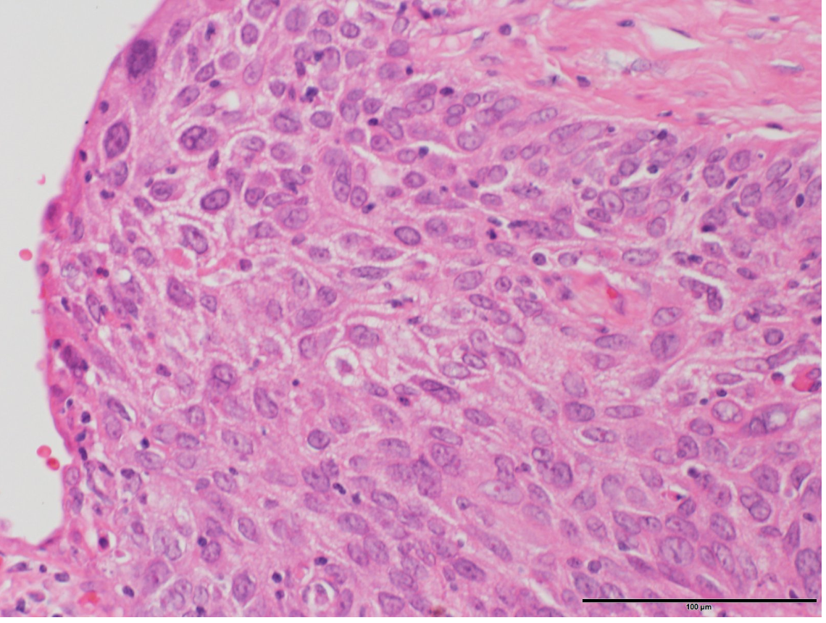
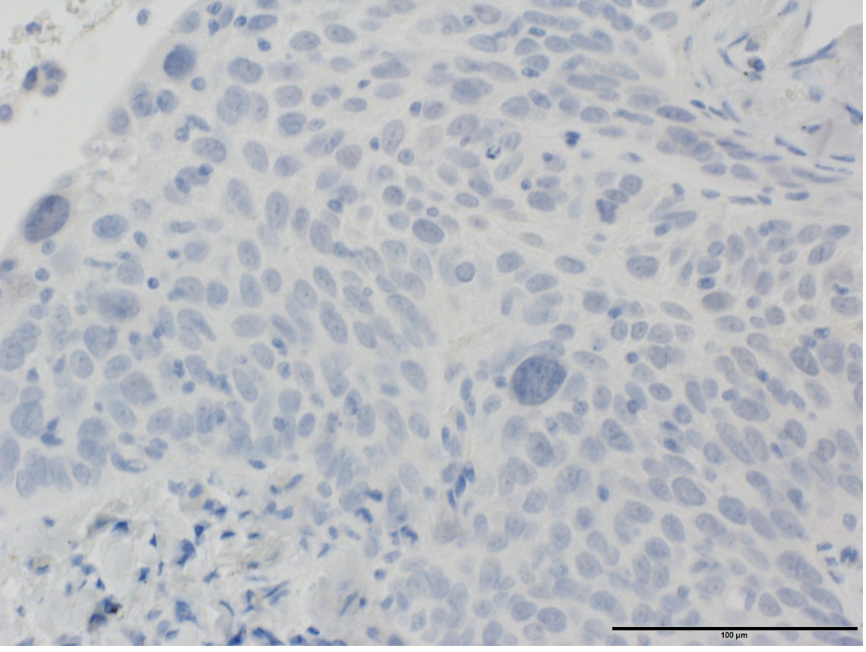
FIGURE S2
H&E
CALML5
LSQCC

Slide 6
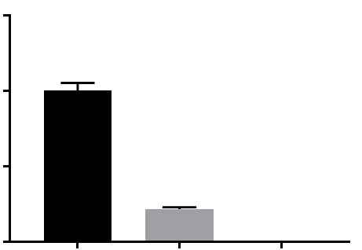
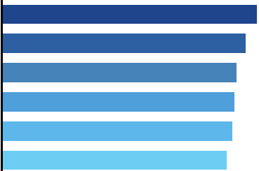
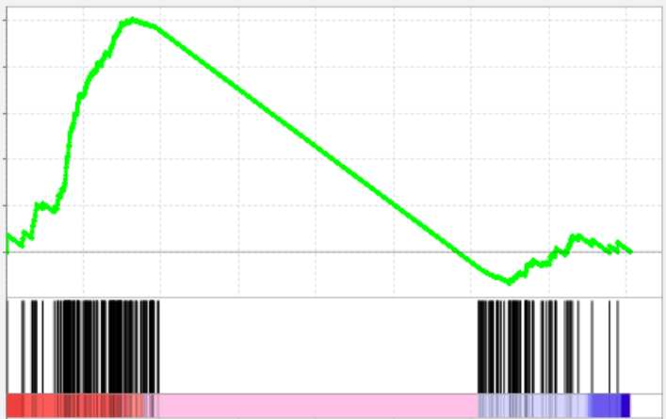


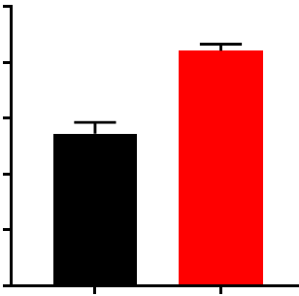
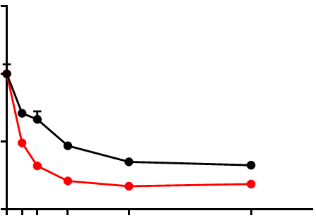

FIGURE S3
A
B
0
0.5
1.0
C
NES
E2F_TARGETS
1.5
ThyL-6
_
E2F_TARGETS
NOM p = 0.004
1.37
1.0
EGFP cDNA
+
_
G2M_CHECKPOINT
NOM p = 0.010
1.31
Relative mRNA expression of CALML5
CALML5 cDNA
+
WNT_BETA_
CATENIN_SIGNALING
NOM p = 0.109
1.26
0.5
CALML5
MYC_TARGETS_V1
NOM p = 0.040
1.25
0.0
INFLAMMATORY_
RESPONSE
NOM p = 0.025
1.24
A431
ThyL-6
β-actin
MDA-MB-468
DNA_REPAIR
NOM p = 0.077
1.21
Positively
correlated
Negatively
correlated
D
D
E
10
**
1.5
8
EGFP
6
1.0
CALML5
Relative cell number
Cell viability
4
0.5
2
0
0.0
2
EGFP
0
4
8
16
32
CALML5

