Slide 1
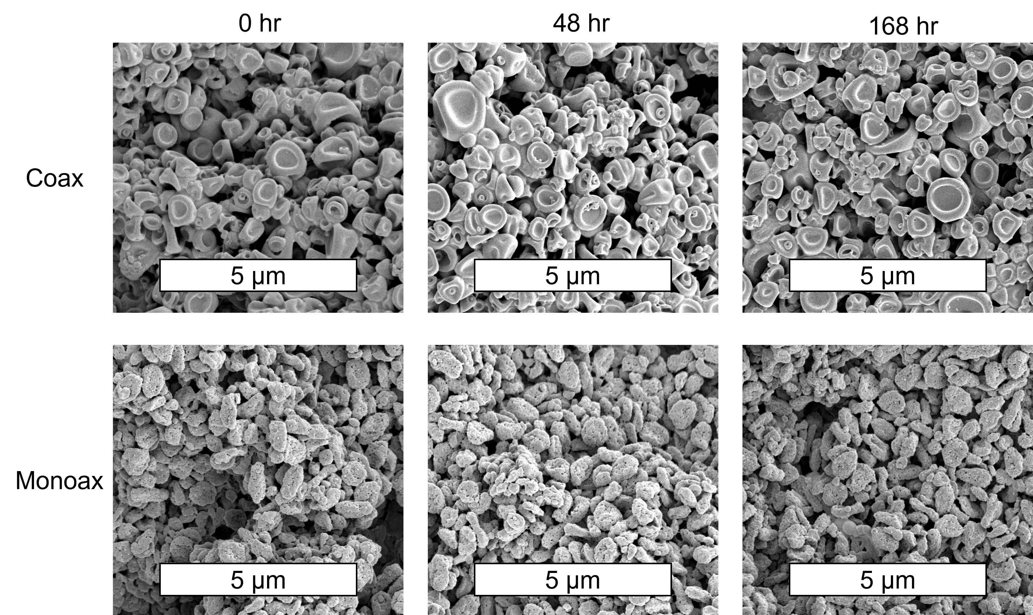
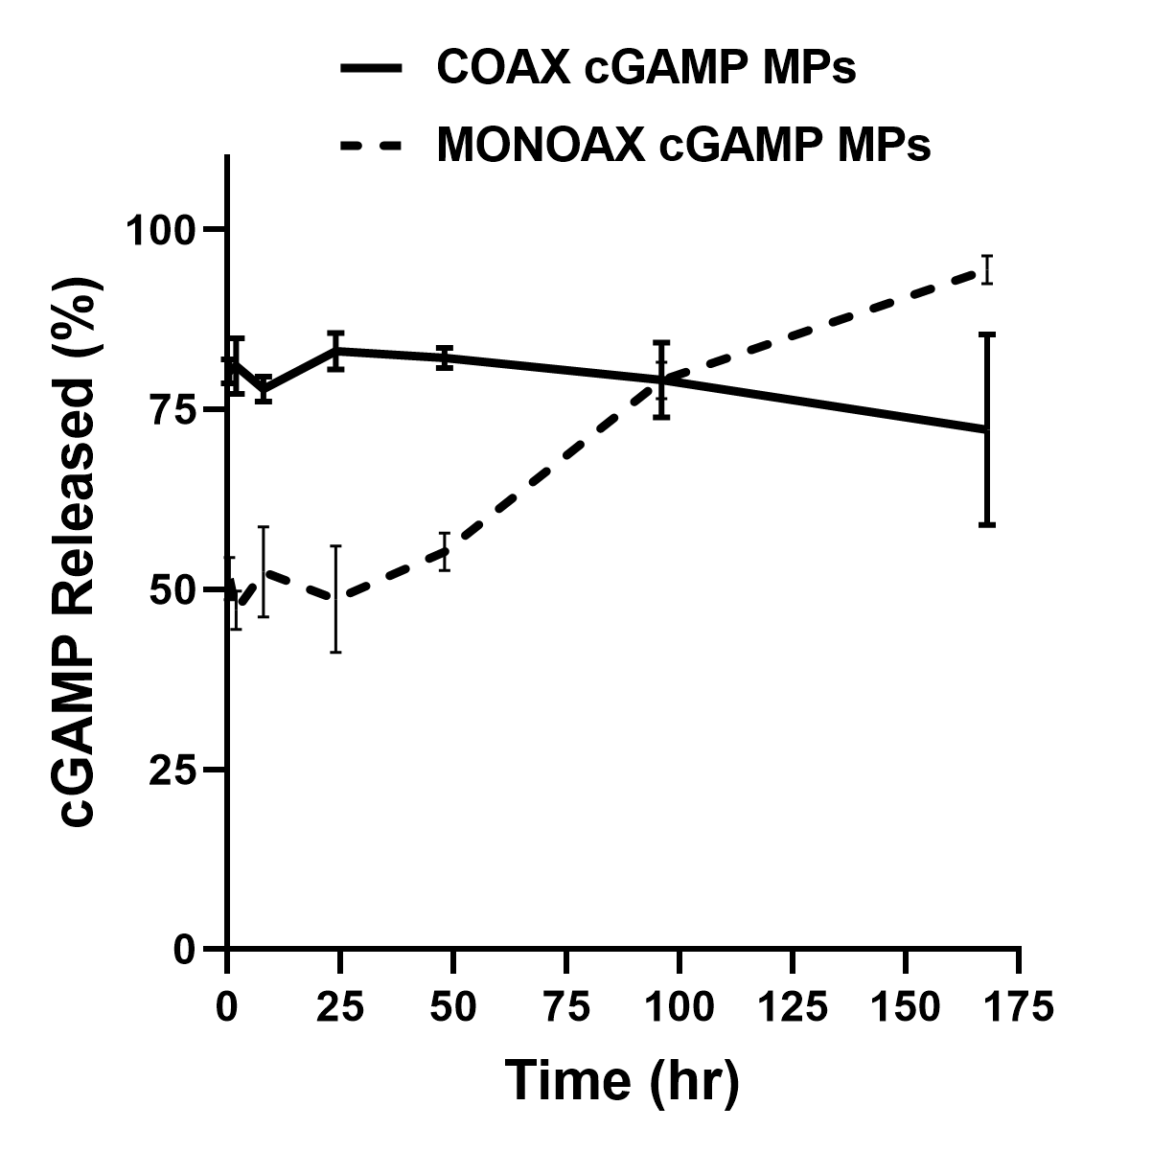
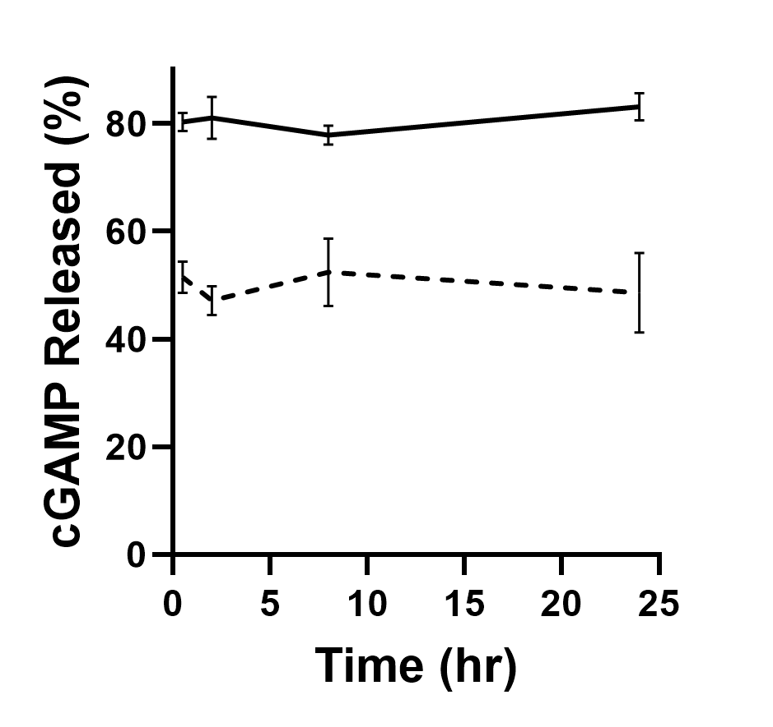
A
B
Figure S1. Ace-DEX cGAMP MPs formulated via monoaxial or coaxial electrospray remain stable when suspended in PBS with 10% FBS. (A) Scanning electron microscopy (SEM) images were taken of the coaxial and monoaxial MPs at 0, 48, and 168 hr timepoints. (B) The release of cGAMP from coaxial or monoaxial electrospray MPs when incubated at 37°C in PBS with 10% (v/v) FBS (n=3 ±SD) was measured.

Slide 2
A
MHCII
CD40
CD80
CD86
4 hrs
24 hrs
48 hrs
No Stim.
Blank MPs
Sol. cGAMP
cGAMP MPs
B
C
D
E
Figure S2. Ace-DEX cGAMP MPs formulated via monoxial upregulation of antigen presentation and costimulatory molecules: Bone marrow derived dendritic cells (BMDCs) from C57BL/6 mice were treated with 1 µg/mL cGAMP delivered as soluble cGAMP, or encapsulated within Ace-DEX cGAMP MPs at a loading of 10 µg/mg MP monoaxial electrospray. After culture for 4, 24, and 48 hours, expression of antigen presentation and co-stimulation molecules were analyzed by flow cytometry. A) Representative histograms of MHCII, CD40, CD80, CD86 antibody staining on treated BMDCs gated on singlets, debris negative, and CD11c+ cells at 4 (black), 24 (blue) and 48 (red) hours. (B-C) Quantification of mean fluorescent intensity (MFI) of (B) MHCII, (C) CD40, (D) CD80, (E) CD86 over time after treatment. (n=6 ± SEM).

Slide 3
A
B
C
D
Figure S3. Cellular T cell responses early after prime-boost immunization with MPs generated by monoaxial electrospray. Eight week old female C57BL/6 mice were immunized i.m. with PBS, or recombinant HA from influenza strain A/Puerto Rico/8/34 (1 µg) adjuvanted with soluble cGAMP (0.2 µg), or Ace-DEX cGAMP MPs (0.2 µg cGAMP in 20 µg MPs) formulated through monoaxial (mono) electrospray. Animals received a boost with the same formulation 21 days post-prime and T cell responses in the draining PLN were analyzed by flow cytometry on day 26. (A-D) Quantification of total number of (A) CD8 (defined as CD3⁺CD8⁺), (B) MPEC CD8 (defined as CD3⁺CD8⁺CD44^{hi}CD127⁺KLRG1⁻), (C) total CD4 (defined as CD3⁺CD4⁺), and (D) Tfh CD4 T cells (defined as CD3⁺CD4⁺CXCR5⁺PD-1⁺) per draining popliteal lymph node (PLN). (n=10 ± SEM. Samples also gated for live singlet lymphocytes. Significance determined by one way annova.).

Slide 4
A
B
C
Figure S4. Infection was confirmed with post-infection neutralizing titers. Ferrets were immunized according to the experimental design described in (A) Figure 3, (B) Figure 4 or (C) Figure 5. Serum was collected 21-28 days post influenza challenge and infection was confirmed by virus neutralizing titer. (n=4 ± SD. All data are n.s.).

Slide 5
Figure S5. Immunization does not increase serum ALT activity. Ferrets were immunized according to experimental outline in Figure 4. Serum was collected on day -7 (Pre-Bleed), Day 21 (Post-Prime) and day 49 (Post-Boost) and on day 84 (Post-Infection) ALT activity was assessed. (n=4 ± SD).

Slide 6
A
B
C
D
E
Figure S6. Prime-Boost of cGAMP MPs and AddaVax provide comparable protection: Four to six month old male ferrets were immunized IM with a single dose of HA from A/California/07/09 (15 µg) adjuvanted with either monoaxial Ace-DEX cGAMP MPs (15 µg cGAMP @ 1% weight loading) or AddaVax (9.75 mg squalene). (A) Serum was collected monthly and virus neutralizing titers against A/California/07/09 were assessed. (n=4 ± SD, *p < 0.05). One year after immunization, ferrets were challenged intranasally with 1.25 x 10⁷ FFU of influenza strain A/California/07/09. Nasal lavage was collected (B) day 2 and (C) day 4 post challenge and viral load was assessed by foci forming assay. (D) Animal weights and (E) the periodic combined clinical index, a composite measure of animal activity and respiratory index (sneezing and nasal discharge), were assessed daily following infection. (n=4 ± SD, *p < 0.05, ****p < 0.0001).

