Slide 1
# | Inhibitor Name | Type | MW | Final Conc | Vendor
1 | Dexamethasone | cholesterol like | 392.46 | 1 µM | Med Chem Express
2 | rapamycin | Cyclic lipid | 914.17 | 10 nM | Med Chem Express
3 | Ridaforolimus | Cyclic lipid | 990.21 | 10 nM | Selleck Chem
4 | acetylsalicylic acid | Small molecule | 180.16 | 1 mM | Sigma
5 | ly294002 | small molecule | 343.8 | 1 µM | Med Chem Express
6 | simvastatin | small molecule | 418.57 | 10 ug/mL | Med Chem Express
7 | IRF3-siRNA | siRNA | 13300 | 10 nM | Sigma
8 | 3'-Sialyl Lewis X | Sugar | 820.74 | 10 ug/mL | Carbo Synth
9 | Cholecalciferol (Vitamin D3) | Cholesterol-like | 384.46 | 1 µM | Sigma
10 | Vasoactive intestinal peptide | Peptide | 3325 | 10 nM | Sigma
11 | Lifitegrast | small molecule | 615.5 | 100 nM | Camen Chemical
12 | TSLP | protein | 15.4 kDA | 10 ng/mL | SinoBiologicals
13 | minocycline | antiboiotic | 493.94 | 5 µM | Sigma
14 | Hydroxychloroquine | small molecule | 433 | 1 µM | Med Chem Express
15 | Ligustilide | small molecule | 190.4 | 20 µM | Med Chem Express
16 | Sapanisertib | small molecule |  | 10 nM | Selleck Chem
17 | HGF mouse protein | protein | 79.3 kDa | 100 ng/mL | Sino Biological
18 | Retinoic acid | Small Molecule | 300.44 | 1 µM | Med Chem Express
19 | BX-795 | Small molecule | 591.47 | 1 µM | Sigma
20 | SB203580 | small molecule | 377.44 | 10 µM | Invivogen
21 | SP600125 | small molecule | 220.2 | 10 µM | Invivogen
22 | Curcumin | small molecule | 368.38 | 25 µM | Sigma
23 | Bee venom PLA2 | enzyme |  | 0.1 ug/mL | Sigma
24 | PI103 | small molecule | 348.36 | 100 nM | abcam
25 | Parthenolide | small molecule | 248.3 | 100 nM | abcam
26 | SC 514 | small molecule | 224.3 | 100 nM | Tocris
 | Agonist Name | TLR |  | Concentration
 | LTA (Lipoteichoic acid BS) | TLR2 | 4-12 kDa | 10 ug/mL | Invivogen
 | LPS (Lipopolysaccaride EK) | TLR4 | 50-100 kDa | 0.1 ug/mL | Invivogen
 | FLA (Flagellin BS) | TLR5 | 32 kDa | 0.1 ug/mL | Invivogen
 | R848 | TLR7 | 350.8 Da | 1 ug/mL | Invivogen
 | GpG (ODN 1826) | TLR9 | 6383 Da | 1 µM | Invivogen
 | BF (bacteria fragilis, heat killed) | TLR2 | n/a | 10^6 cells per mL | Invivogen
 | HSP60 (Heat Shock Protein 60) | TLR4 | 57-59 kDa | 1 ng/mL | NovusBio
Table S-1. List of immunomodulators and TLR agonists tested.

Slide 2
First Agonist | Second Agonist | Inhibitor | Tolerance Score
FLA | CpG | 6 | 38.9
None | CpG | 6 | 33.5
BF | CpG | 6 | 23.4
FLA | CpG | 1 | 23.1
CpG | FLA | 6 | 22.7
HSP60 | CpG | 6 | 20.6
FLA | CpG | 26 | 15.0
HSP60 | CpG | 5 | 11.7
None | CpG | 13 | 11.1
CpG | FLA | 14 | 11.0
CpG | FLA | 8 | 10.8
None | CpG | 12 | 10.1
FLA | CpG | 11 | 10.0
HSP60 | CpG | 12 | 9.6
None | CpG | 11 | 9.6
HSP60 | CpG | 14 | 9.4
None | CpG | 5 | 8.2
CpG | FLA | 1 | 8.1
CpG | FLA | 5 | 8.0
CpG | FLA | 5 | 7.9
None | CpG | 1 | 7.5
None | CpG | No Inhibitor | 7.3
HSP60 | CpG | No Inhibitor | 7.1
CpG | FLA | No Inhibitor | 6.9
FLA | CpG | No Inhibitor | 6.9
None | CpG | 14 | 6.7
Table S-2. Preliminary screen of tolerizing and agonist combinations. See materials and methods for more detail on how “tolerance score” was calculated. Higher tolerance score indicates more tolerizing potential.

Slide 3
A.
B.
C.
D.
E.
Figure S-1. Combining two doses of inhibitors with FLA and CpG is the optimal formulation for inducing tolDCs. 1 million BMDCs per sample were incubated with 0.1 ug/mL FLA and/or inhibitors or just PBS on day 1. 16 hr later, cells were washed and incubated with 0.5 µM CpG or PBS with or without inhibitors. After 4 h supernatants were tested for TNFα and after 20 h tested for IL-10 (part D and E). Cell surface markers PD-L1 (A), CD80 (B) and CD40 (C) were tested after 20 h via flow cytometry. Error bars indicate ± of biological triplicate experiments.

Slide 4
A.
RAW cells
DC 2.4 cells
B.
C.
Figure S-2. Combination of tolerogenic drugs with TLR agonists shows increase in tolerance markers and decrease in inflammatory cell markers in mouse APC cell lines. 200k of either RAW (left) or DC2.4 (right) cells were treated similarly as in figure 1B, then analyzed via flow for (A) PD-L1, (B) CD80, (C) CD40. N=3 and error bars indicate SD.

Slide 5
A.
B.
C.
Figure S-3. Altering ratios of inhibitors induces varying levels of tolDC phenotypes. 200k BMDCs were treated as in Figure 1B (FLA followed by CpG treatment) varying by the ratios of Dex, Sim and SC-514 at either a 10 µM (left) or 1 µM (right) total inhibitor concentration. BMDCs were analyzed by flow cytometry for (A) CD40, (B) CD80, (C) PD-L1. N=3 and error bars indicate SD.

Slide 6
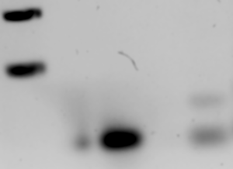
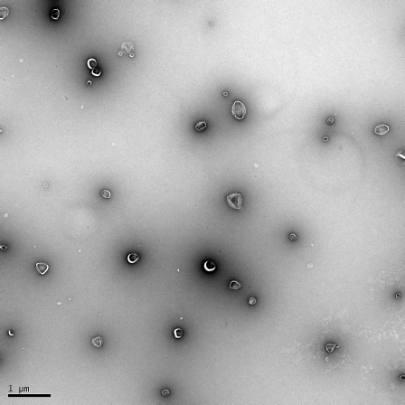
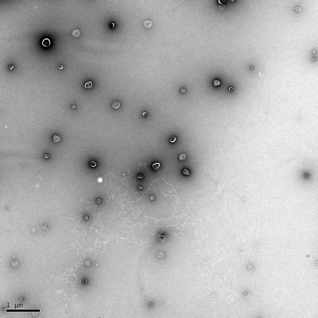
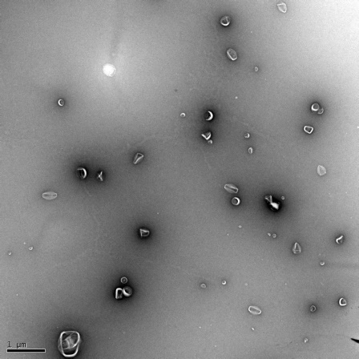
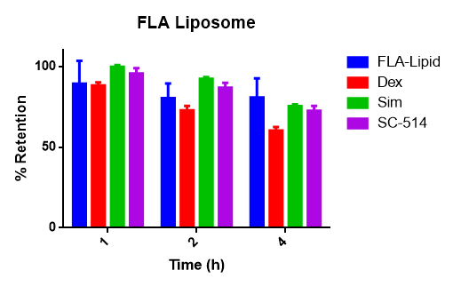
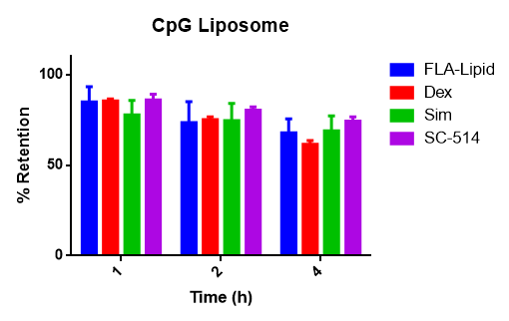
A.
B.
CpG-Lipid
7.8 kDa
FLA
32 kDa
FLA-Lipid
33 kDa
C.
Liposome | DLS |  |  | TEM
 | Diameter (nm) | PDI | Zeta potential (mV) | Diameter (nm)
Blank | 231.6 | 0.125 | -22.4±2.1 | 286±67
FLA/OVA | 177.3 | 0.122 | -18.3±1.3 | 251±58
CpG/OVA | 291.2 | 0.085 | -29.2±4.1 | 290±70
kDa
CpG
6.3 kDa
kDa
15
50
10
37
25
D.
Blank Liposome
FLA Liposome
CpG Liposome
E.
F.
G.
Figure S-4. Synthesis of FLA and CpG lipids and characterization of liposomes. (A) Synthesis schematic of CpG-lipid conjugate (top) and FLA-lipid conjugate (bottom). (B) Gel electrophoresis of CpG (left) and FLA (right) lipid conjugates. GpG lipid was run on a 2.5% agarose-TBE gel and stained with Sybr Safe DNA stain (thermo). FLA lipid was run on a 4–15% Mini-PROTEAN TGX precast gel (Bio-Rad) and stained with coomassie blue. Red arrows indicate TLR agonist lipid conjugates with slight increases in MW. (C) Table showing dynamic light scattering (DLS) data and TEM data for 200 nm, 10 mM total lipid liposomes made with 3.33 mM of each inhibitor, 1 mg/mL OVA and either 10 µg/mL FLA-lipid or 100 µg/mL CpG or none (Blank) as described from the in vivo study in figure 2. PDI= polydispersity index. TEM sizing was taken based on average of 50-60 liposomes from 3 separate images and show +/- SD. (D) Example TEM images. Left- Blank liposomes, middle- FLA liposome, Right- CpG liposome. Scale bar is 1 µm. (E) Liposomes from part C were tested via HPLC against standard injections and a percent liposomal loading calculated for each inhibitor and TLR agonist. (F) OVA containing liposomes from part C, a blank OVA liposome and MOG peptide containing liposomes were similarly analyzed via HPLC and compared to a standard injection of OVA or MOG and a percent loading calculated. (G) TLR bearing liposomes do not release free TLR agonist prior to liposomes uptake. 100 µL of 10 mM total lipid of Blank, FLA or CpG liposomes were similarly synthesized as in part C, but without OVA, and dialyzed against PBS with a 100 kDa dialysis tube at 37°C for 1, 2 or 4 h. The remaining liposomes were analyzed via HPLC for % retention of FLA or CpG lipid by dividing integrated signals for TLR-lipids and inhibitors from dialyzed liposomes over fresh (undialyzed) liposomes. Left- FLA liposome, right- CpG liposome N=3.

Slide 7
A.
B.
Figure S-5. Inhibitors packaged in liposomes have induce a similar tolDC phenotype in vitro as free inhibitors. 1 million BMDCs were incubated in vitro with FLA + I then 16 h later treated with CpG + I, then 20 h later analyzed via flow. Cells were treated with 0.2 ug/mL FLA or 1 µM CpG with 20 µM of total inhibitors (1:1:1 ratio) and serially diluted (concentrations indicate total inhibitor concentrations). (A) free I (B) Lipo^{TLR+I} . N=3 and error bars indicate SD.

Slide 8
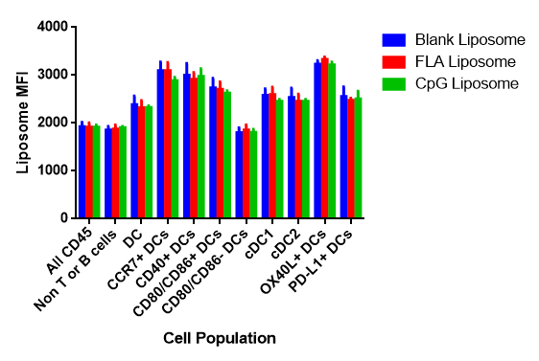
A.
B.
C.
D.
E.
***
***
***
Figure S-6. OVA bearing tolerogenic liposomes have high levels of antigen presentation. 1 million BMDCs were treated similarly as figure S-6 with AF647 labeled OVA at 10 µg/mL (OVA), or OVA + agonist at 0.1 µg/mL FLA and 0.5 µM CpG (Free TLR), inhibitors at 10 µM total inhibitor concentration+ OVA (Free I), OVA + agonist +inhibitor (Free TLR+I) or liposomal versions of each of these. Cells were treated with these formulations or 10x and 100x dilutions of each. Cells were treated with FLA formulations then CpG/OVA formulations (note that OVA was only added in CpG treatment). 1 hr after CpG/OVA treatment, cells were analyzed via flow cytometry for (A) major OVA MHCI-I peptide- MHCI expression total signal, (B) percent MHCI-peptide positive cells, (C) OVA signal and (D) OVA positive cells. (E) Tolerogenic liposomes are not selectively uptaken by any DC subset. Blank, FLA or CpG bearing lipsomes similarly made in part A-D except without any OVA but with addition of 0.1% DiD dye were incubated with splenocytes at 10 μM total lipid for 30 mins, washed, stained for live/dead and surface markers and analyzed via flow. Cells were gated into all CD45+ live cells or further gated into CD45+, CD19-, CD3- populations and then into CD11c+, MHCII+ populations (DCs). These DCs were further gated into various cell populations via markers of DC maturation and MFI of liposome uptake calculated. Note there was no difference in any group between blank and FLA or CpG formulations. Error bars indicate ± of biological triplicate experiments for A-D or N=5 or E. Significance was determined by a two-way ANOVA with Tukey post hoc test for multiple comparisons. ***p<1x10⁻⁴

Slide 9
Figure S-7. Gating Strategy of Tolerogenic Liposome treated mouse lymphocytes. Lymphocytes from treated mice from experiment 2B-G were gated for live cells on FSC and SSC, then gated for single cells on SSC-A and SSC-H (not shown), gated on lymphocytes by DAPI and CD45 intensity, then gated for DCs on MHCII+ and CD11c+. These cells were gated on CD103, CD40, CD80, CD86, PD-L1, and PD-L2.

Slide 10
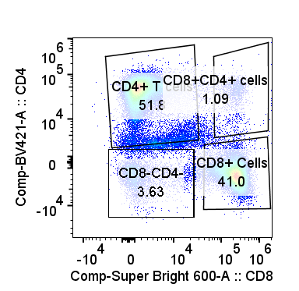
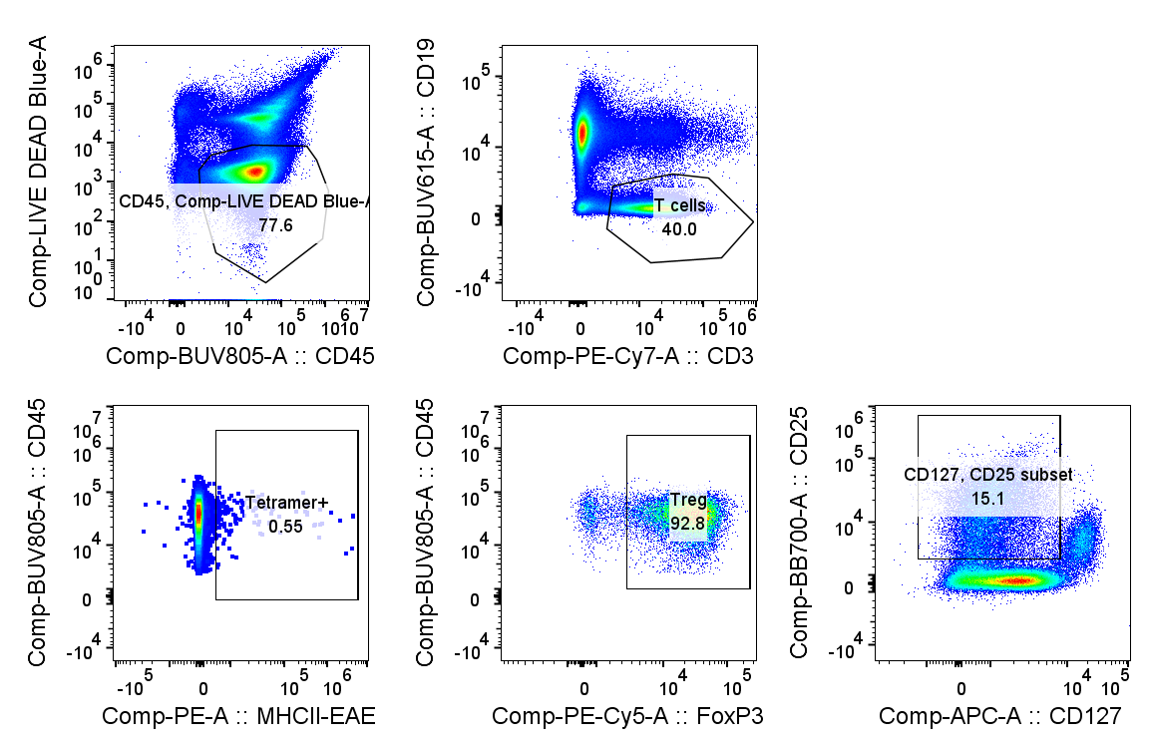
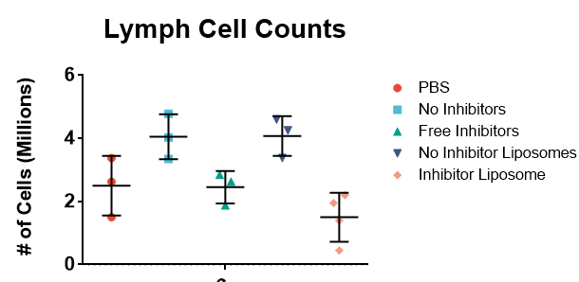
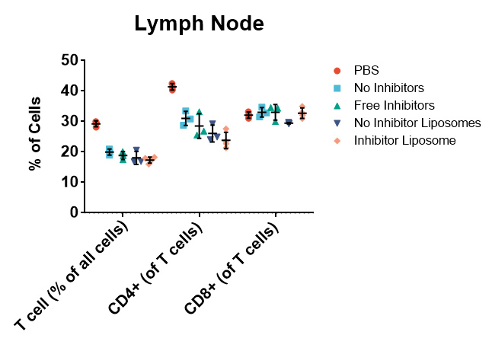
A.
B.
PBS
Free TLR
Free TLR+I
Lipo^{TLR}
Lipo^{TLR+I}
C.
PBS
Free TLR
Free TLR+I
Lipo^{TLR}
Lipo^{TLR+I}
Figure S-8. T cell analysis of mouse lymph nodes from experiment in Figure 3B,C. (A) Gating strategy for lymphocytes identifying MHCII-epitope tetramer+ Tregs. (B) Cell counts of live lymphocytes from various treatment groups (C) T cell distribution of lymphocytes for various treatment groups. Error bars indicate ±SD of N=3-4 mice per group.

Slide 11
A
B
PBS
Free TLR
Lipo^{TLR+I}
Lipo^{TLR}
Free TLR+I
Figure S-9. Cultured Splenocytes taken from mice treated with tolerogenic liposomes reduce IL-2 and INFγ production. Splenocytes from figure 3D were tested for (A) IL2 and (B) INFγ production using via CBA. Error bars indicate ±SD of N=3-4 mice per group. Significance was determined by a two-way ANOVA with Tukey post hoc test for multiple comparisons. *p<0.5, **p<0.01, ***p<1x10⁻⁴, ****p<1x10⁻⁵

Slide 12
A.
B.
C.
D.
E.
F.
G.
H.
Figure S-10. Lipo^{TLR+I} suppresses antigen specific T cell responses with minimal disruption of other antigen specific responses. Mice treated in Figure 3E-H with MOG or OVA specific liposomes and then challenged with either EAE or OVA/CpG were further analyzed. Lymph cells from these mice were analyzed for (A) populations of CD4, CD8 T cells and B cells and show no change (B) total Treg populations, showing a slight but insignificant increase in Lipo^{TLR+I} treated groups. (C) Lymph cells were analyzed with tetramers for the major MHCI and MHCII OVA epitopes, showing no decrease for MOG-Lipo^{TLR+I} treatment groups for either epitope. (D) Similarly there was no decrease in MOG tetramer positive cells between NT and OVA-Lipo^{TLR+I} groups indicating no reduction in antigen specific T cells for perpendicular treatment groups. (E-H). Splenocytes from these mice were analyzed with ICS for antigen specific T cell responses. 1 million splenocytes were incubated with either 10 ug/mL of OVA₂₅₇₋₂₆₈ (OVAI), OVA₃₂₃₋₃₃₉ (OVAII) or MOG₃₅₋₅₅ (EAE) for 6 hours with brefeldin A and monensin (BD biosciences). Cells were then fixed and analyzed for (E) CD4+, INFγ+ (F) CD4+, IL4+, (G) CD4+, IL17A+, or (H) CD8+, INFγ+ T cells. Error bars indicate ±SD of N=3-4 mice per group.

Slide 13
200 ng PTX
A.
PBS
Free I
B.
PBS
Free I
Figure S-11. EAE testing optimization. Mice (N=10 per group) were treated 3 days prior with PBS or an injection of EAE peptide (10 ug per mouse) and free combination of inhibitors for a total of 10 µmols. EAE was induced with either (A) 200 ng or (B) 100 ng to determine optimal formulation. 200 ng was used in following EAE studies.

Slide 14
A.
B.
Figure S-12. Lipo^{TLR+I} treated mice generate EAE protection via T cell suppression. (A) Spleenocytes from mice in figure 4B were isolated, stained with CFSE and incubated with BMDCs (3:1 Spleenocyte to BMDCs) for 16 h. Cells were incubated with MOG peptide (10 ug/mL) for 48 h then analyzed via flow. No peptide indicates spleenocytes from a naïve mouse that were not given MOG peptide. (B) Supernatants from part A was analyzed via CBA for IL-2/IL-6 secretion. Blank indicates signal from blank media. For parts B-F, error bars indicate ± of SD of each mouse group (between 3-5 per group). Significance was determined by a two-way ANOVA with Tukey post hoc test for multiple comparisons. *p<0.5

