Slide 1
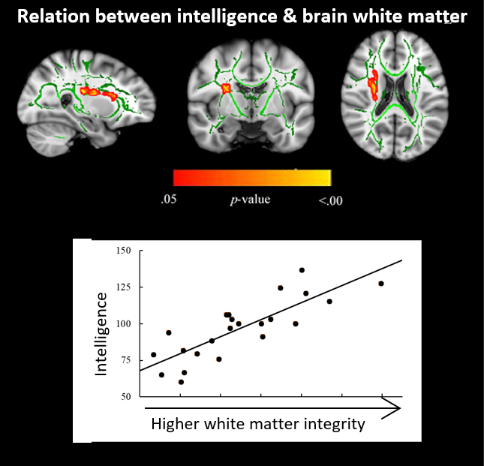
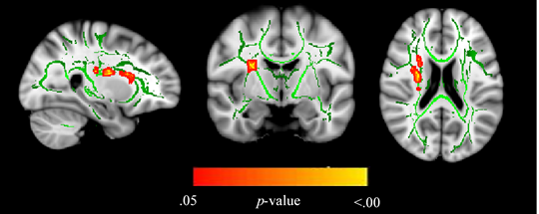




Risk factors for neurocognitive impairment and the relation with structural brain abnormality in children and young adults with severe chronic kidney disease
HYPOTHESIS: There is an association between CKD-associated structural brain abnormalities and neurocognitive functioning
DESIGN:
OUTCOMES
Risk factors for lower intelligence, and/or poorer processing speed and working memory are:
Longer duration since kidney transplantation
Longer dialysis duration
Older age at diagnosis
More abnormalities in a cluster of white matter tracts mediated the relation between clinical risk factors and intelligence.
Participants:
28 patients with severe CKD aged 8–30 on predialysis, dialysis or transplanted therapy
Materials
Neuropsychological assessment
Magnetic Resonance Imaging / Diffusion Tensor Imaging
CONCLUSION: Children and young adults with severe CKD who have a prolonged duration of kidney replacement therapy, either dialysis or transplantation, are at risk for neurocognitive impairments. CKD-related brain white matter abnormalities may importantly contribute to these neurocognitive impairments.
Lijdsman et al. 2022

