Slide 1
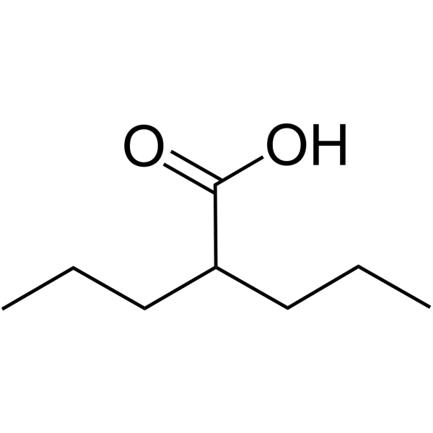
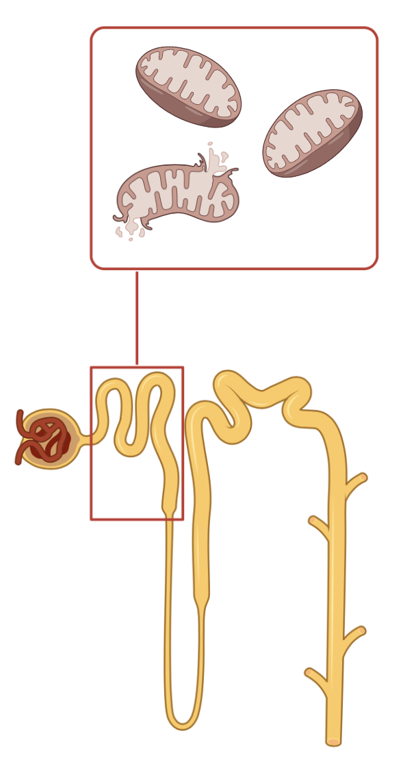


Kidney-tubular injury induced by valproic acid:
systematic literature review
What is known: It has been documented that valproic acid may induce a kidney-tubular injury.
DESIGN & OUTCOMES: A systematic review found 48 patients affected by epilepsy on valproic acid who presented with otherwise unexplained laboratory abnormalities consistent with kidney-tubular injury.
%
100
75
Hypo-
calcemia
Blood
Values
Hypo-
phosphatemia
Metabolic
Acidosis
50
Hypouricemia
Hypo-
kalemia
25
Valproic Acid
0
100
N = 48
%
75
Urinary
Parameters
Total
Proteiunria
Tubular
Proteiunria
50
Glucosuria
Aminoaciduria
N=43
N=5
25
0
Anguissola et al. 2023
CONCLUSION: In epileptic patients, valproic acid may induce a kidney tubular mitochondrial dysfunction with subsequent kidney tubular injury (de Toni-Debré-Fanconi syndrome).

