Slide 1
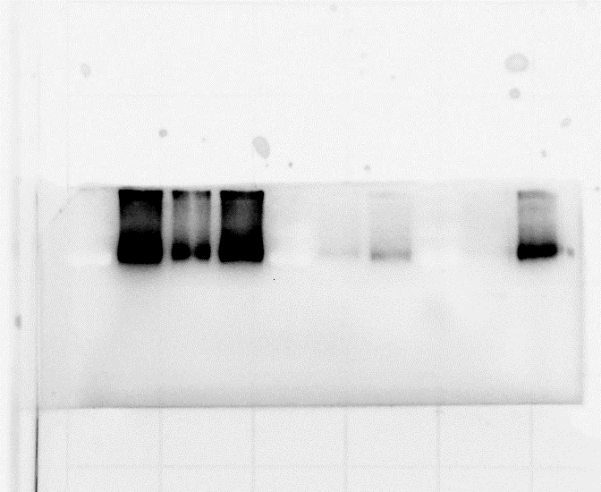
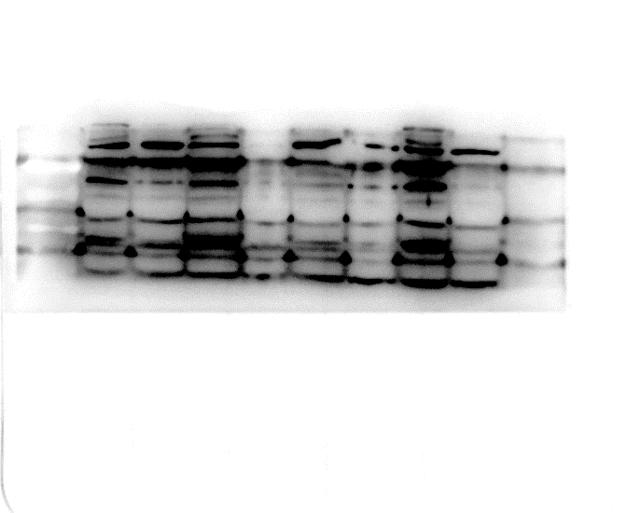
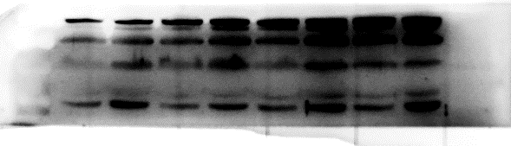
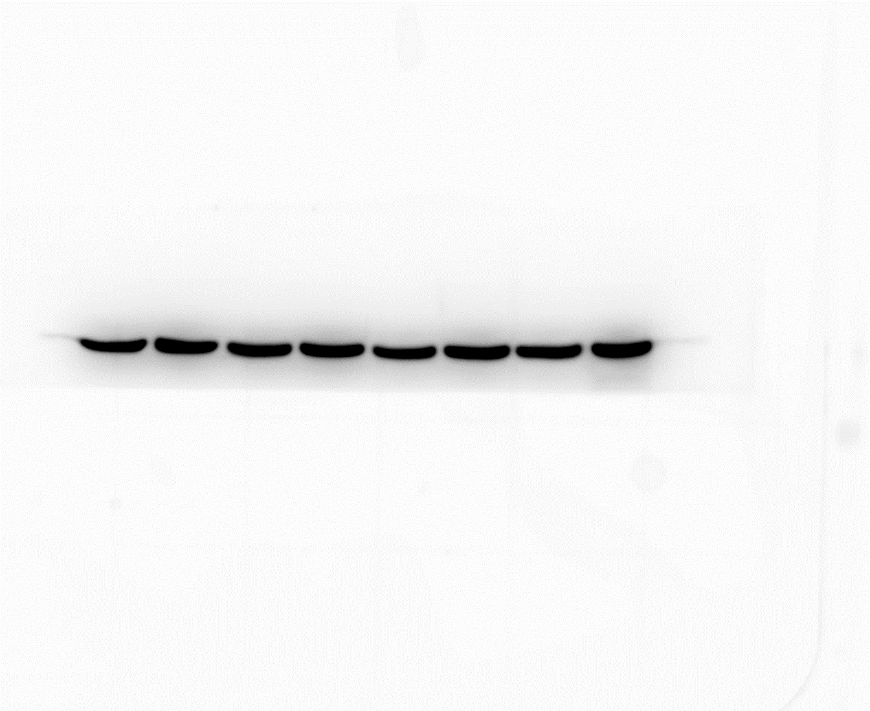
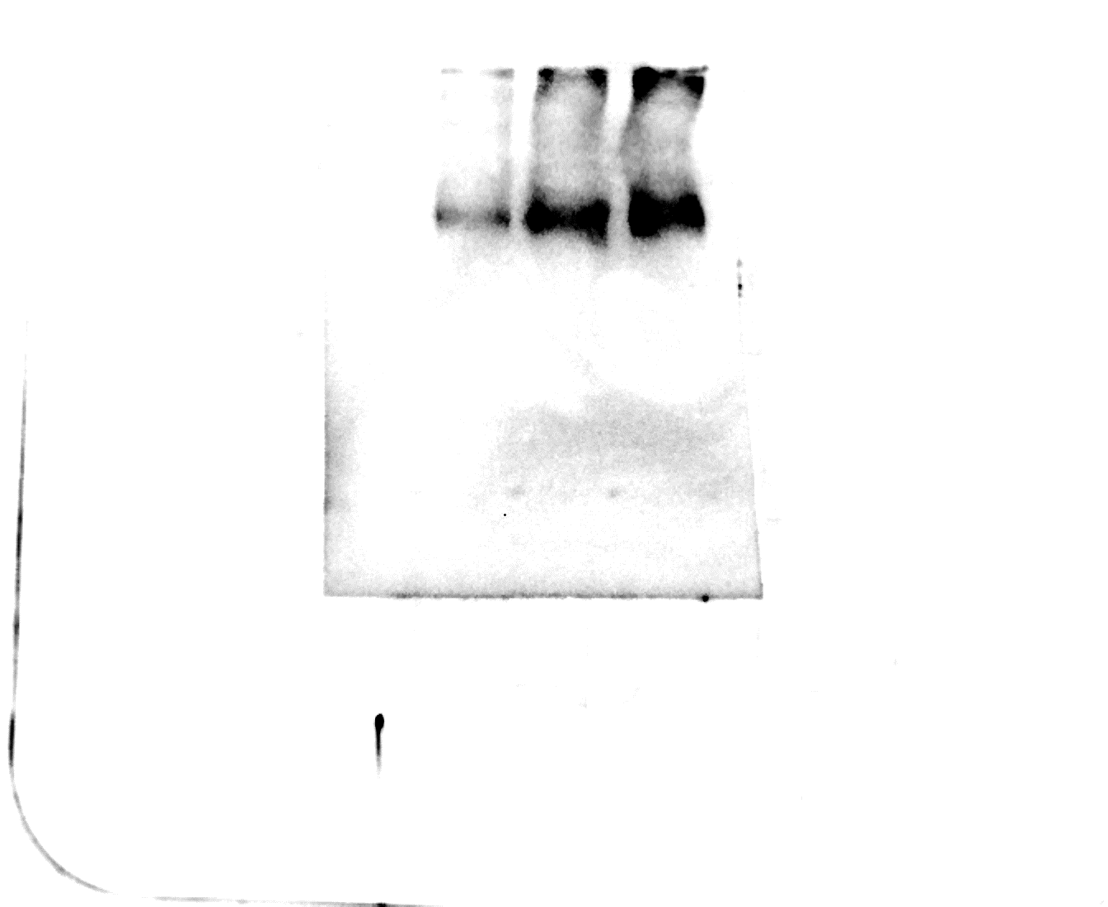
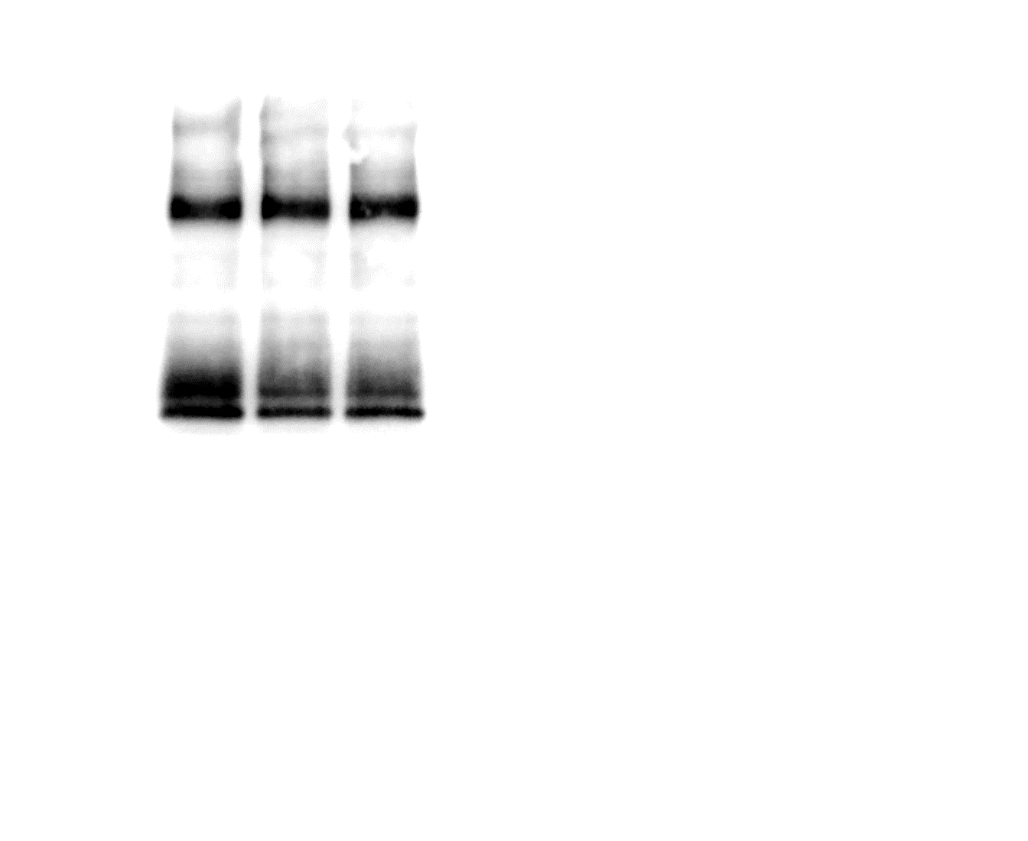
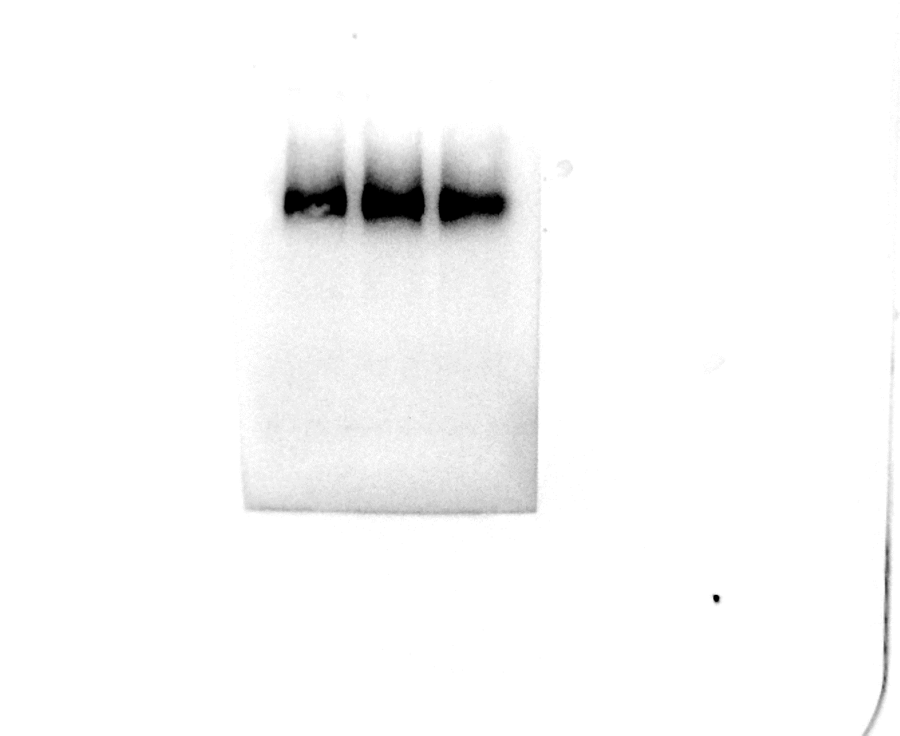
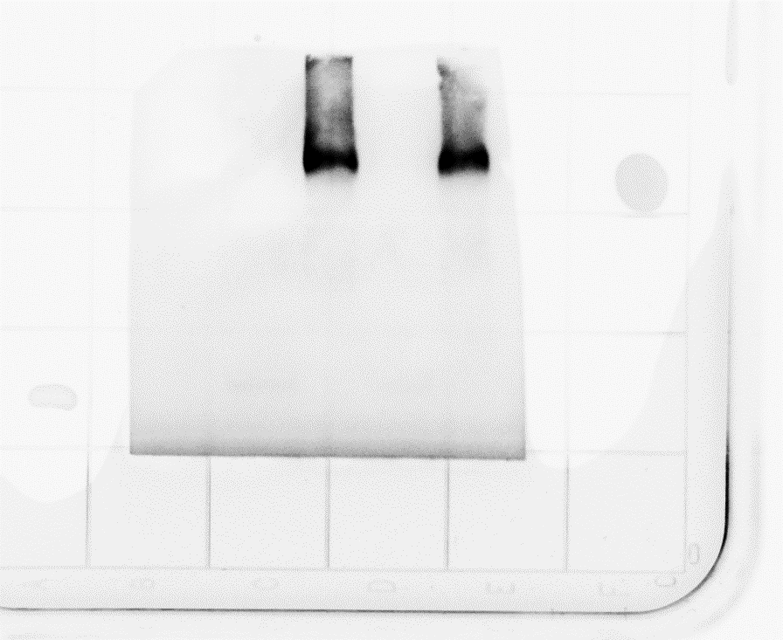
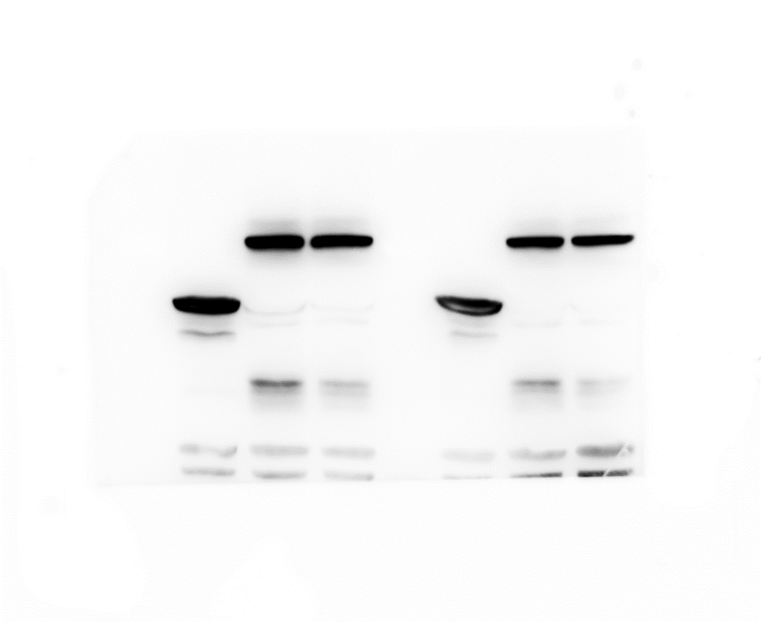
Figure 1e
Figure 3h
Anti-SLR1
100
100
70
70
CoIP/IB:Myc
55
40
Anti-GRF4
70
100
55
IP/IB:GFP
70
40
55
35
40
25
Anti-Actin
100
55
70
55
INPUT/IB:Myc
40
40
35
25
Figure 3i
CoIP/IB:Myc
IP/IB:GFP
INPUT/IB:Myc
100
70
70
55
100
40
70
35
25
Figure 3k
CoIP/IB:Myc
IP/IB:GFP
180
INPUT/IB:Myc
100
130
100
70
100
70
70
55
55
40
40
35
35
25
25

Slide 2
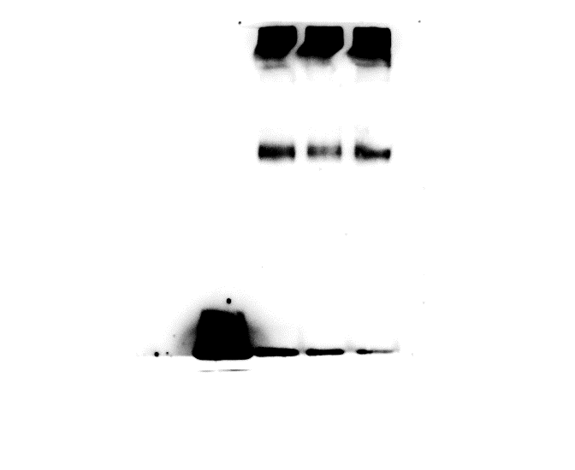
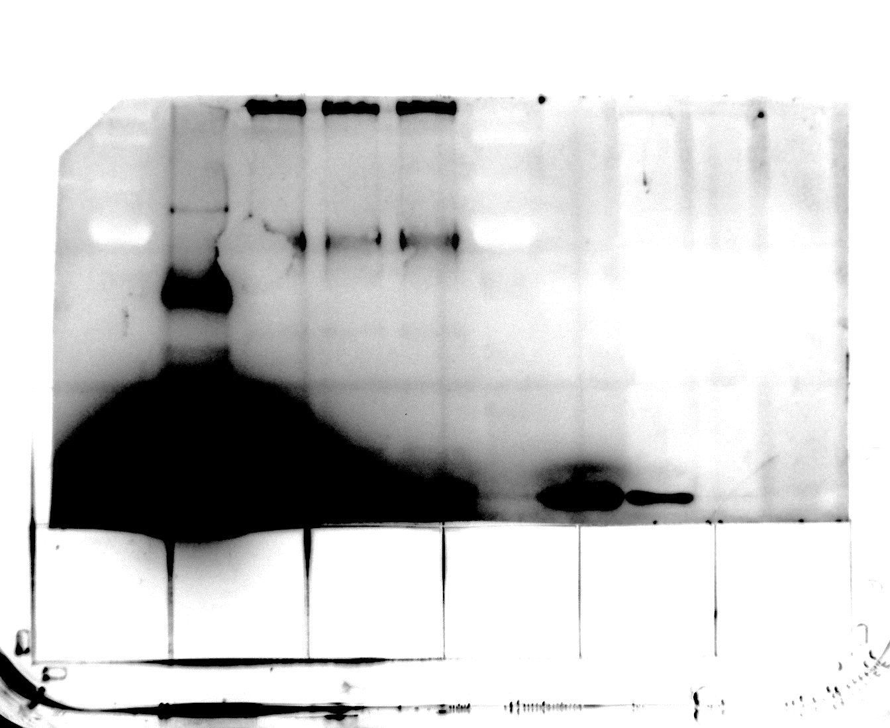
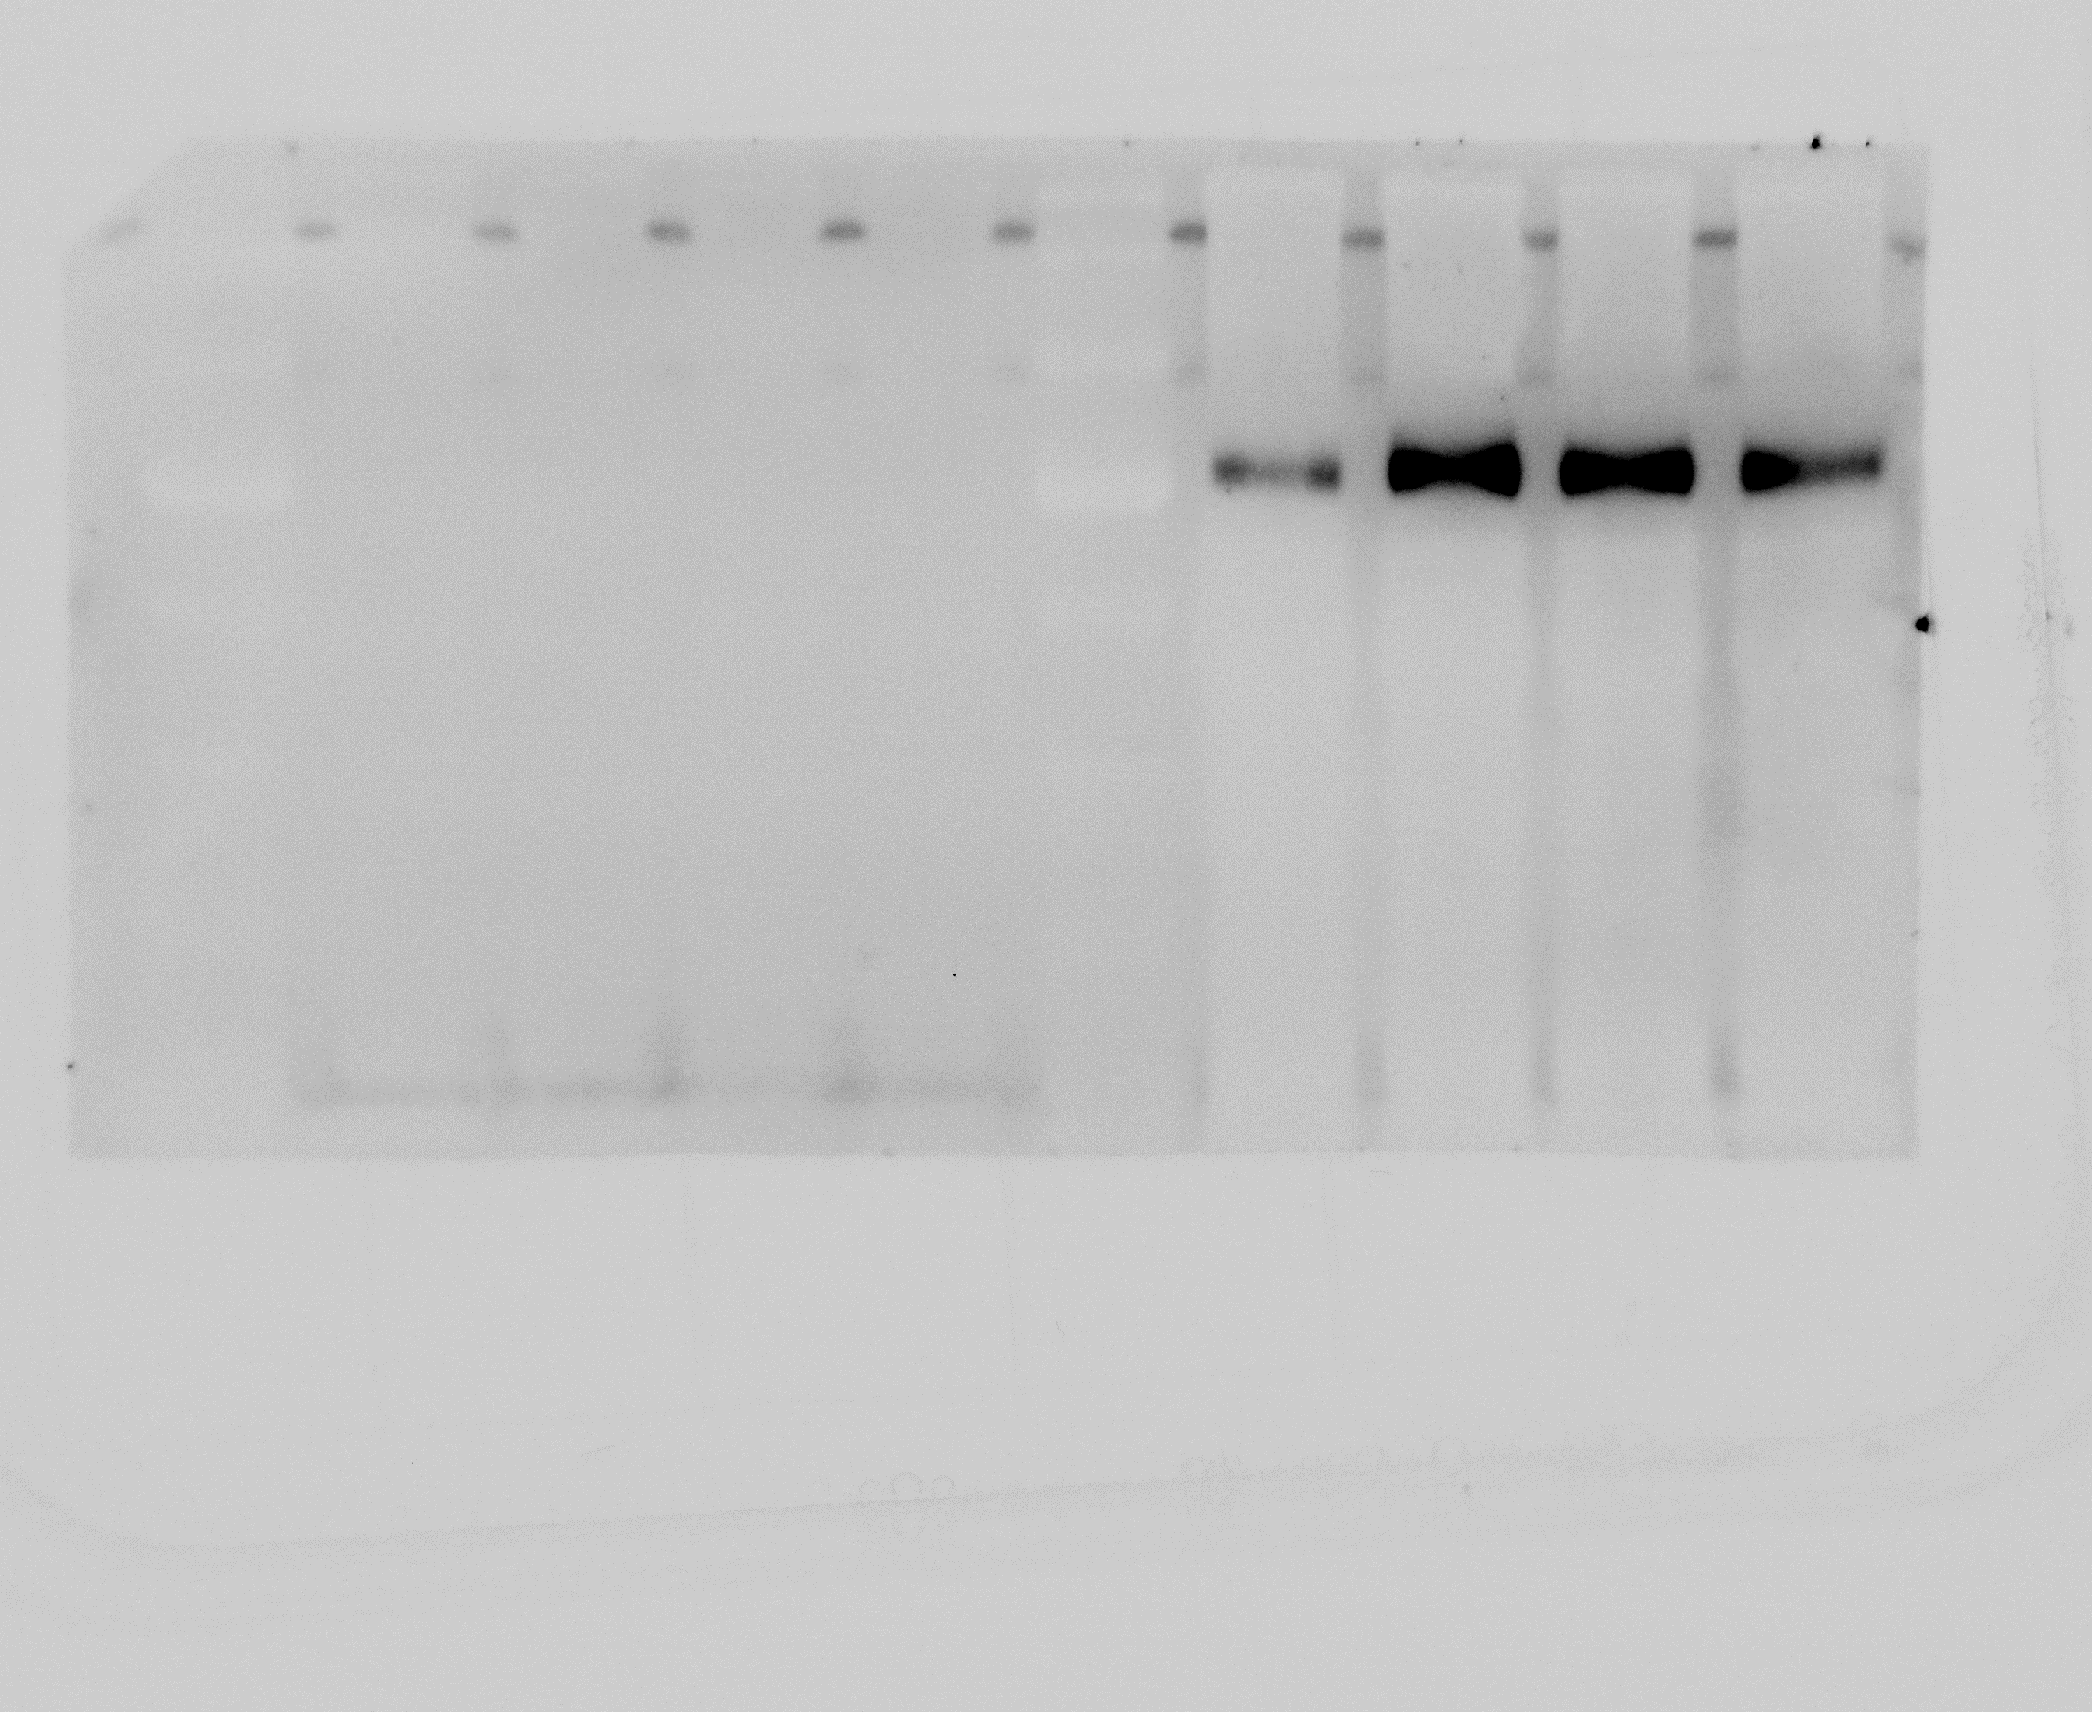
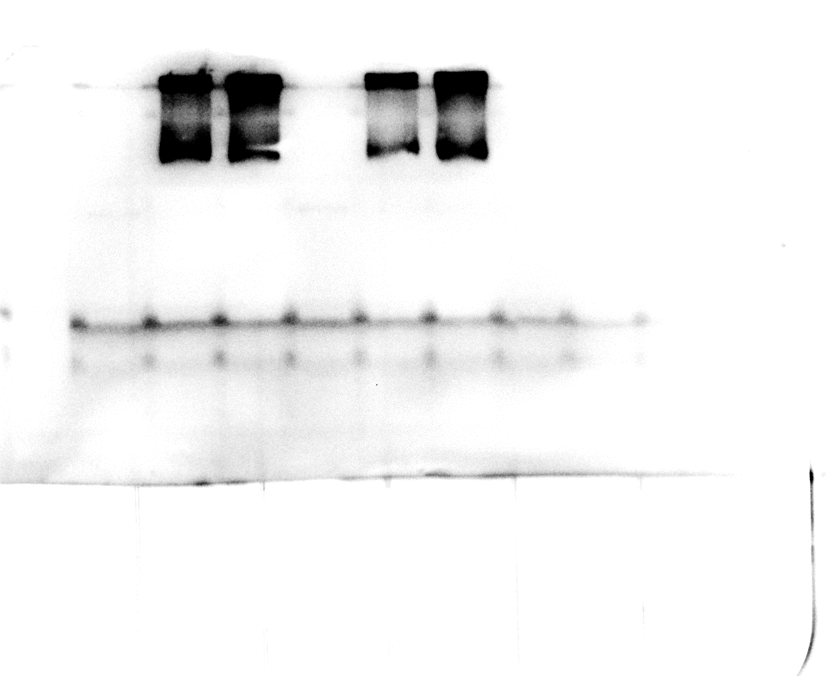
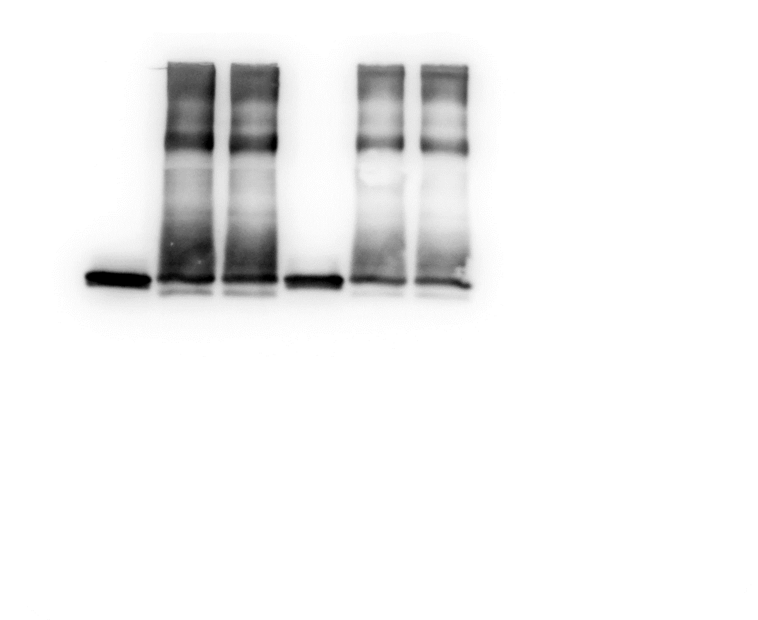
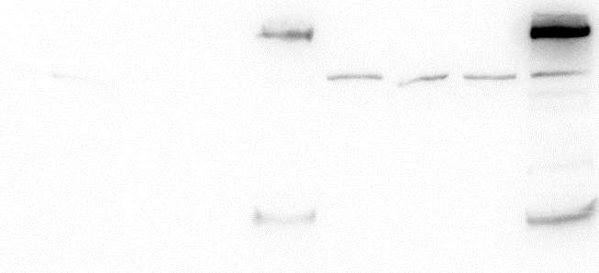
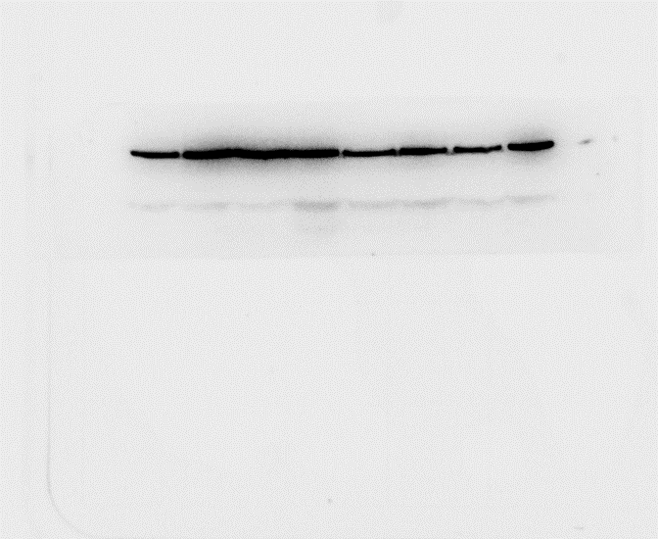
Figure. 3l
CoIP/IB:Myc
IP/IB:GFP
130
INPUT/IB:Myc
130
180
100
130
70
100
100
70
70
Figure. 3m
CoIP/IB:Myc
IP/IB:GFP
100
70
70
55
40
35
25
180
INPUT/IB:Flag
INPUT/IB:Myc
130
100
100
70
70
55
55
40
40
35
35
25
Figure 4a
Figure 4b
Anti-BKI1
70
35
55
Anti-GFP
40
25
35
25
100
Anti-Myc
Anti-Actin
70
55
40
55
35
40
25
55
Anti-Actin
40

Slide 3
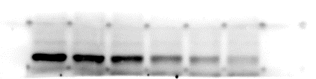
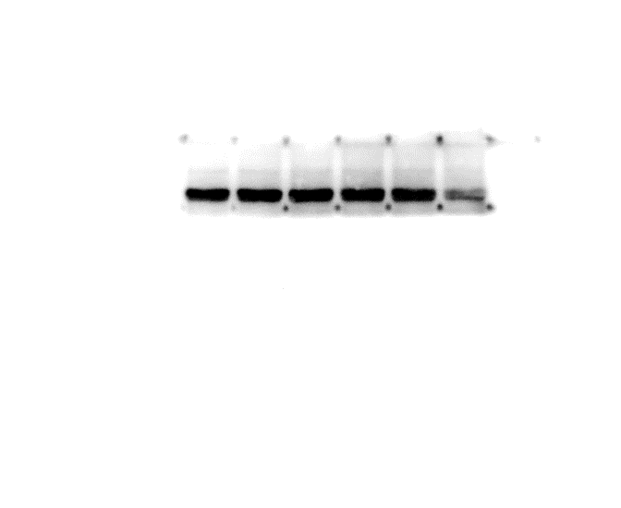
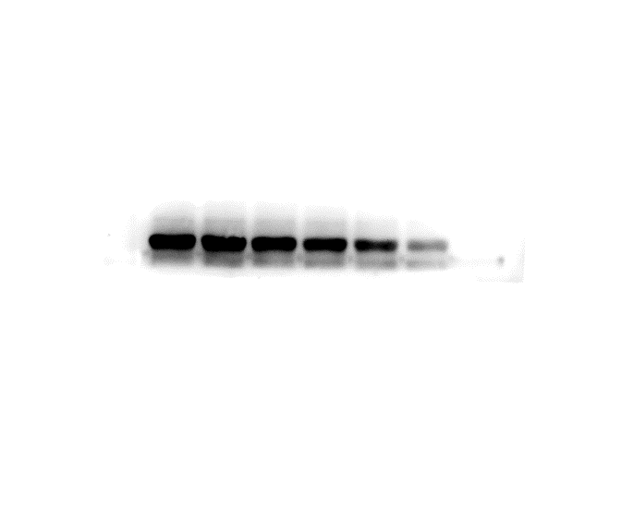
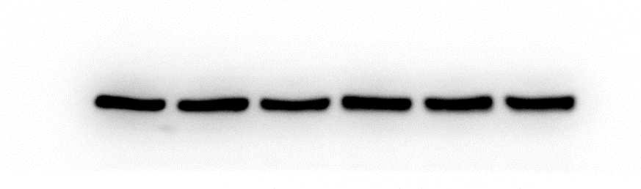
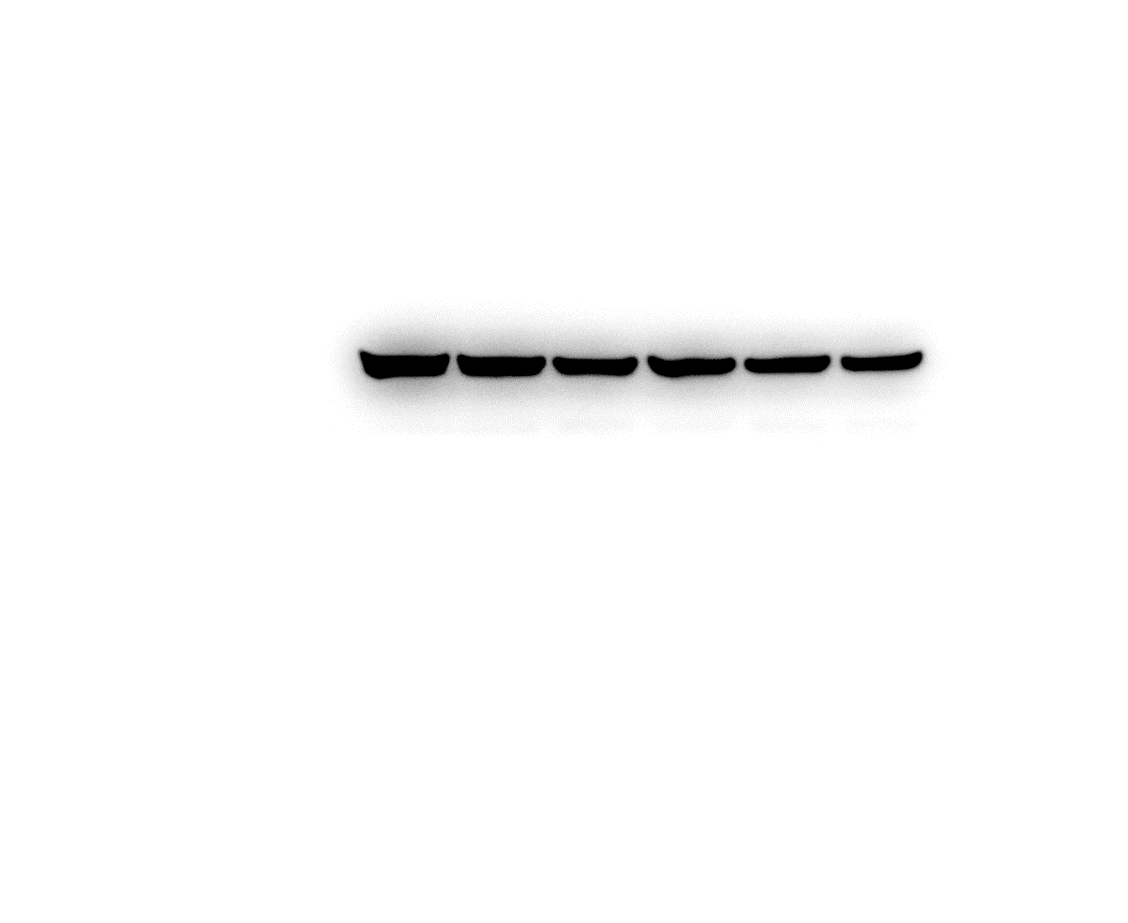
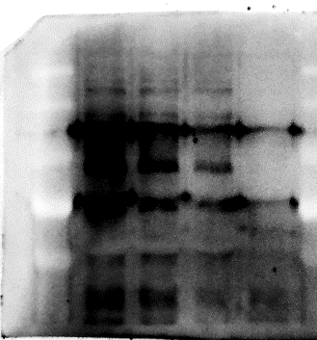
Figure 4c
Fielder
znf-aabbdd
100
100
Anti-His
70
70
55
- MG132
40
55
Anti-Actin
40
100
100
Anti-His
70
70
+ MG132
55
55
Anti-Actin
40
40
Figure 4d
IB:Flag
180
130
100
70
55
Figure 4e
IP: GFP
IP: GFP
Anti-Flag
Anti-GFP
180
INPUT
130
180
Anti-Myc
100
130
130
100
100
70
70
70
55
55
55

Slide 4
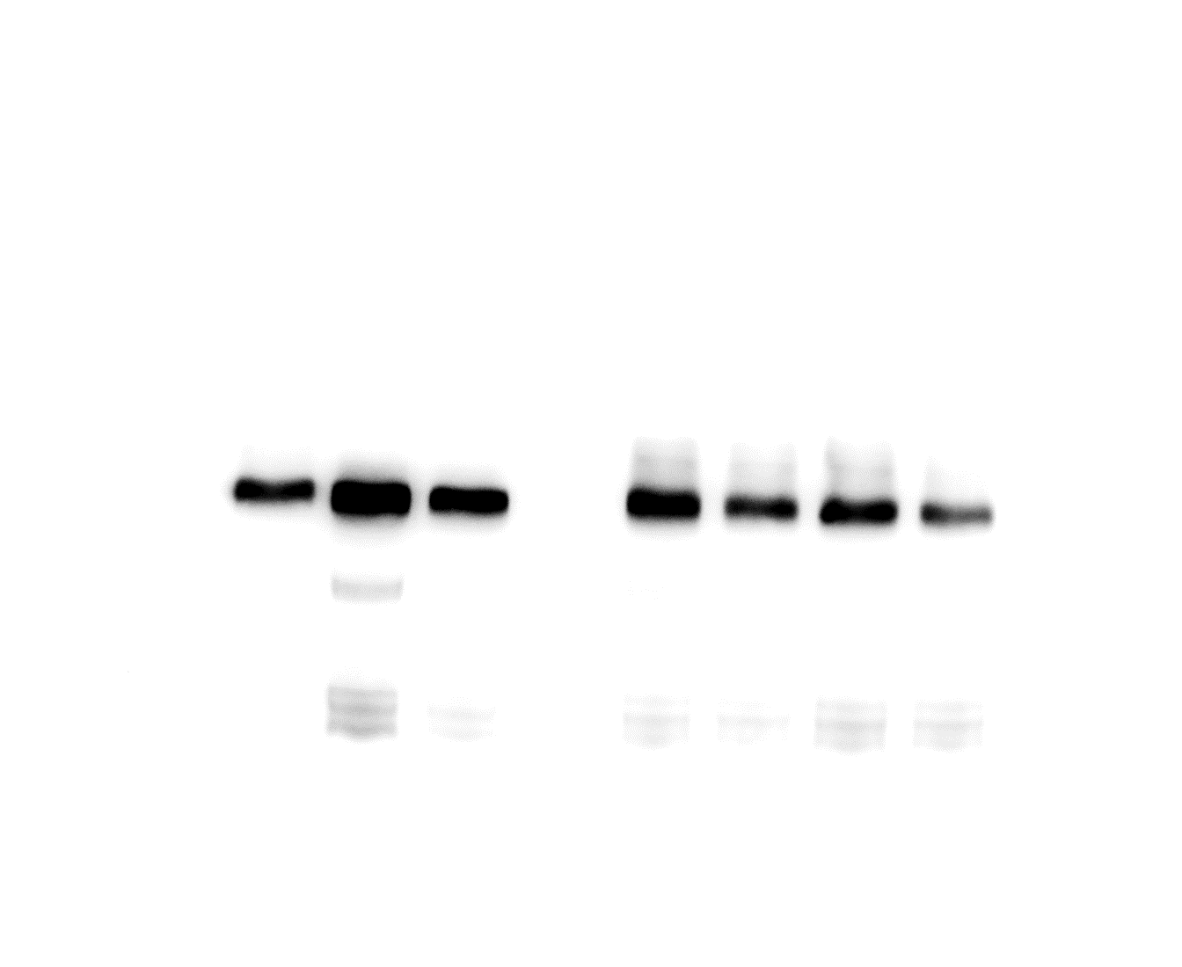
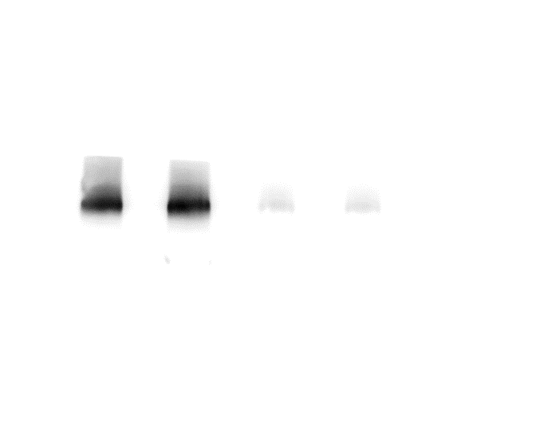
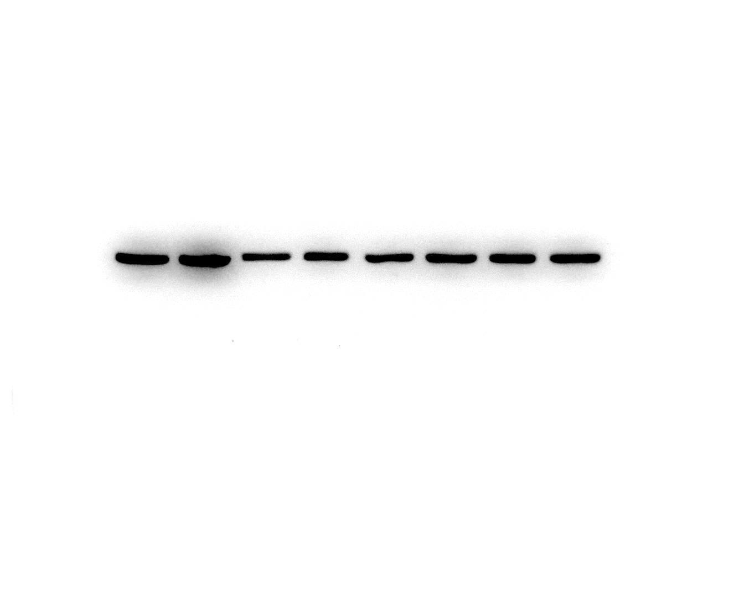
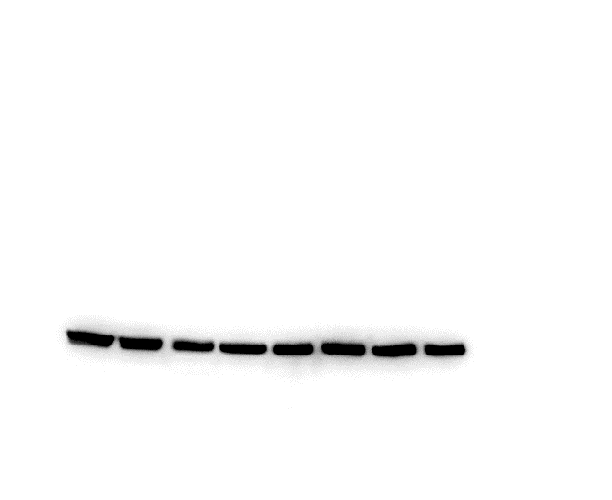
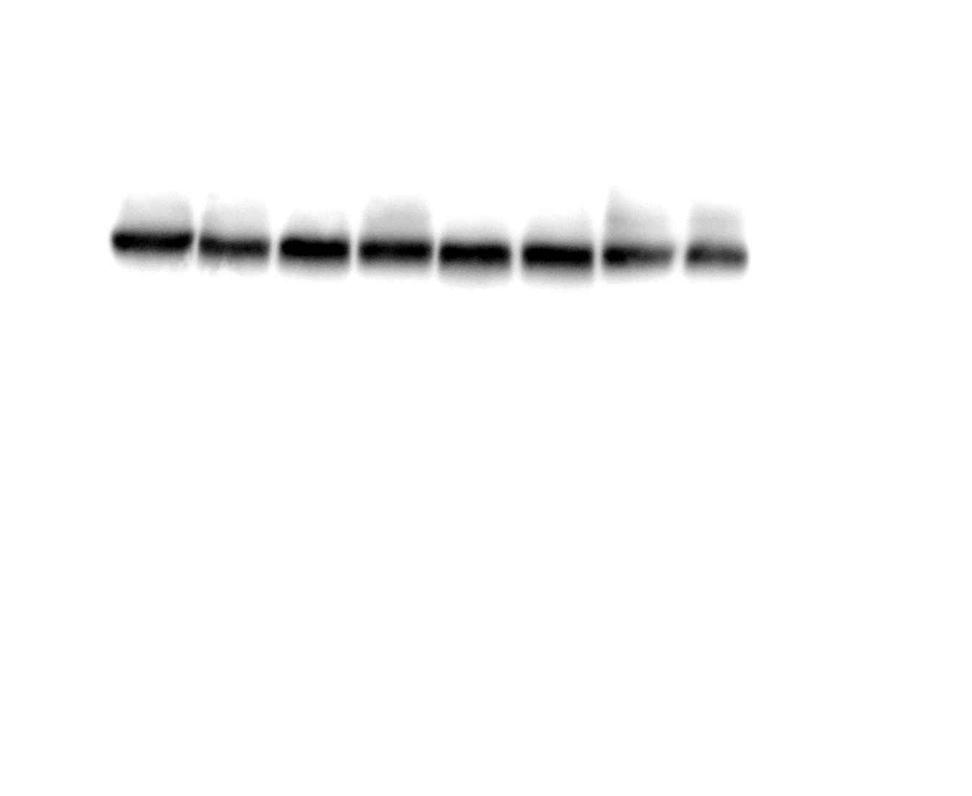
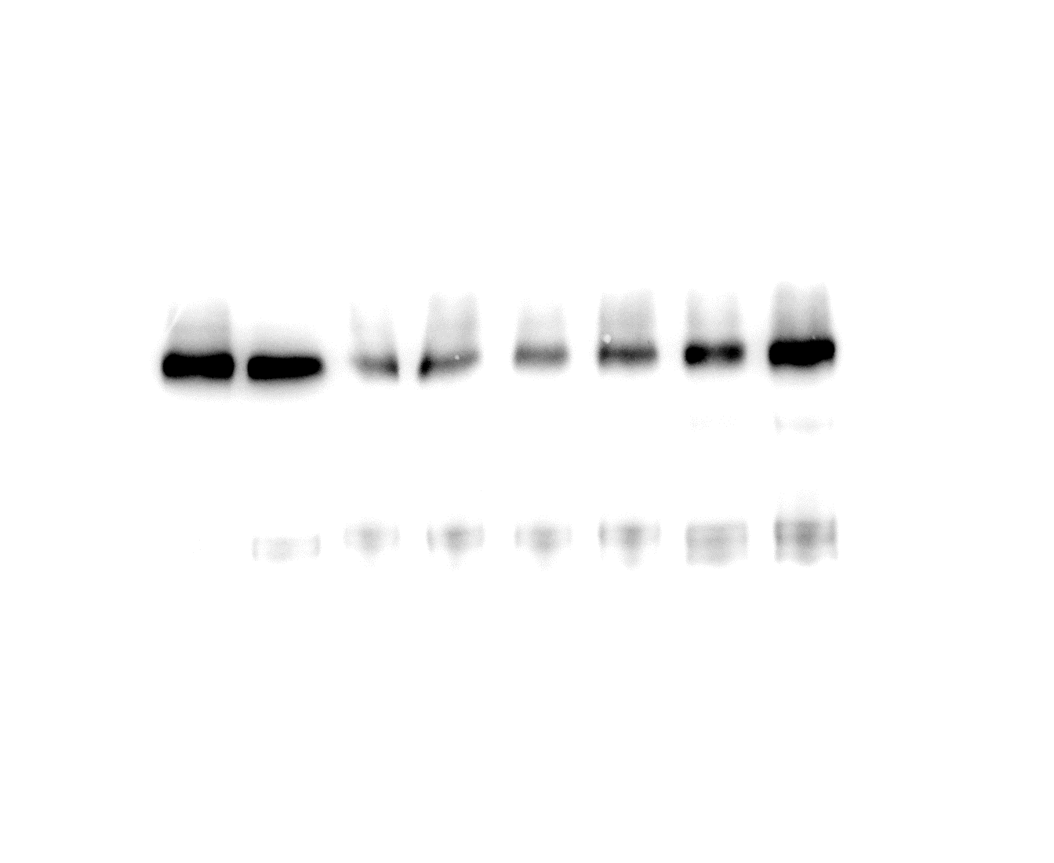
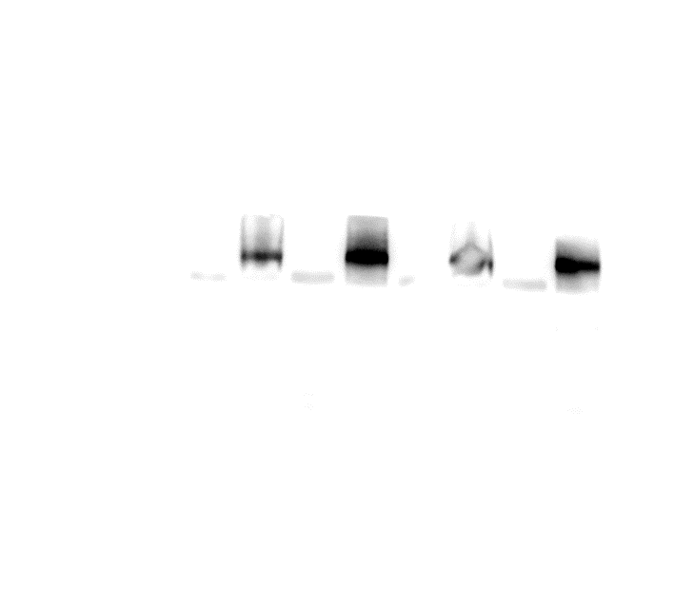

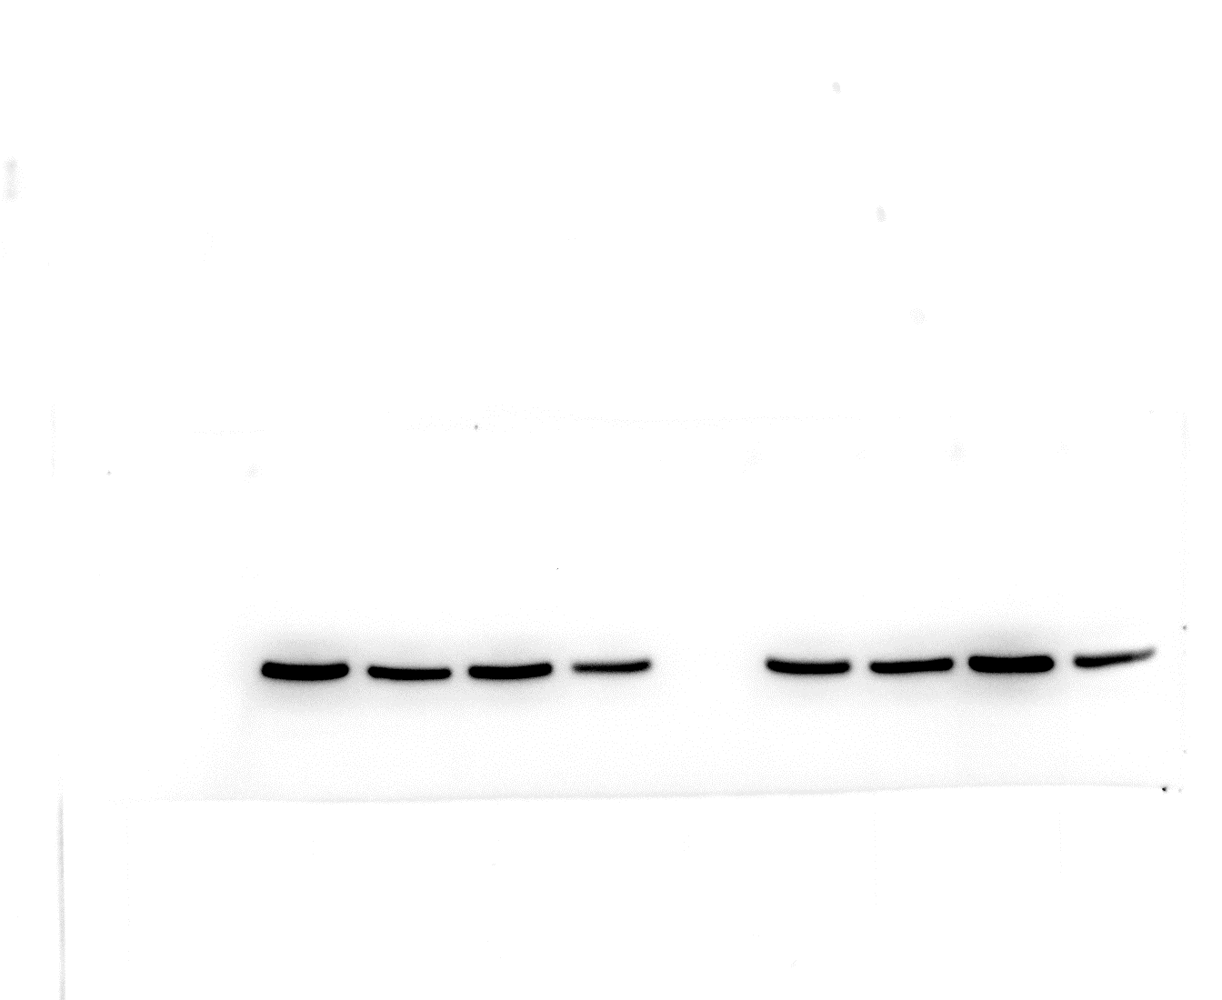
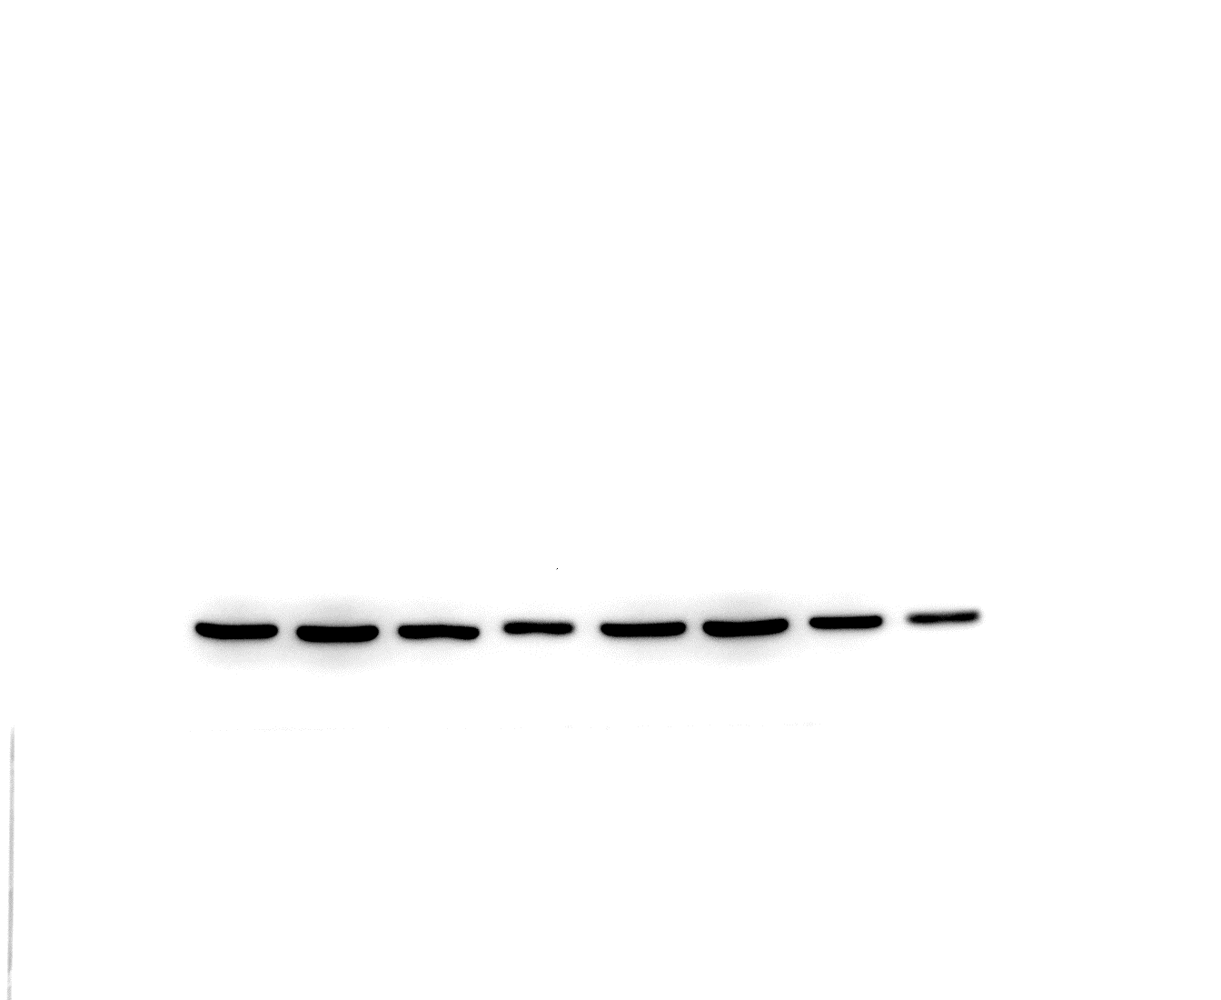
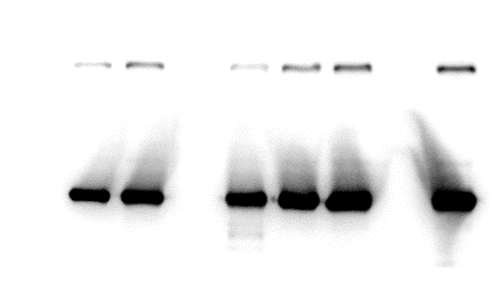
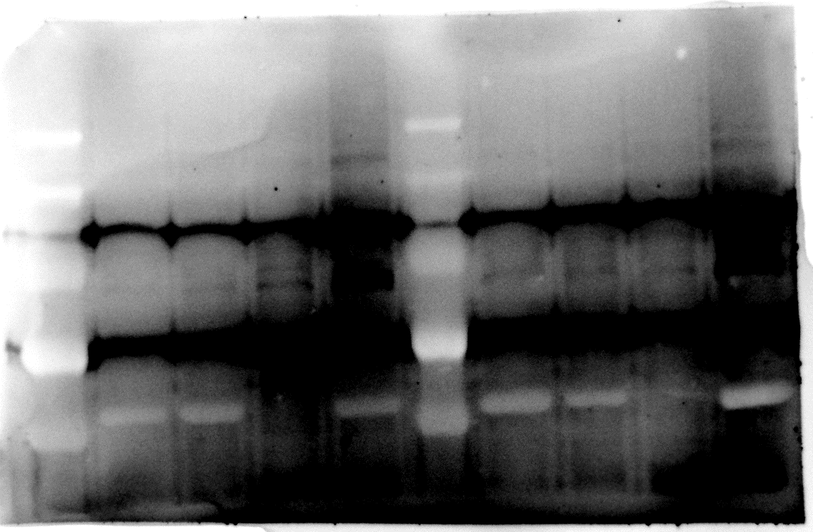
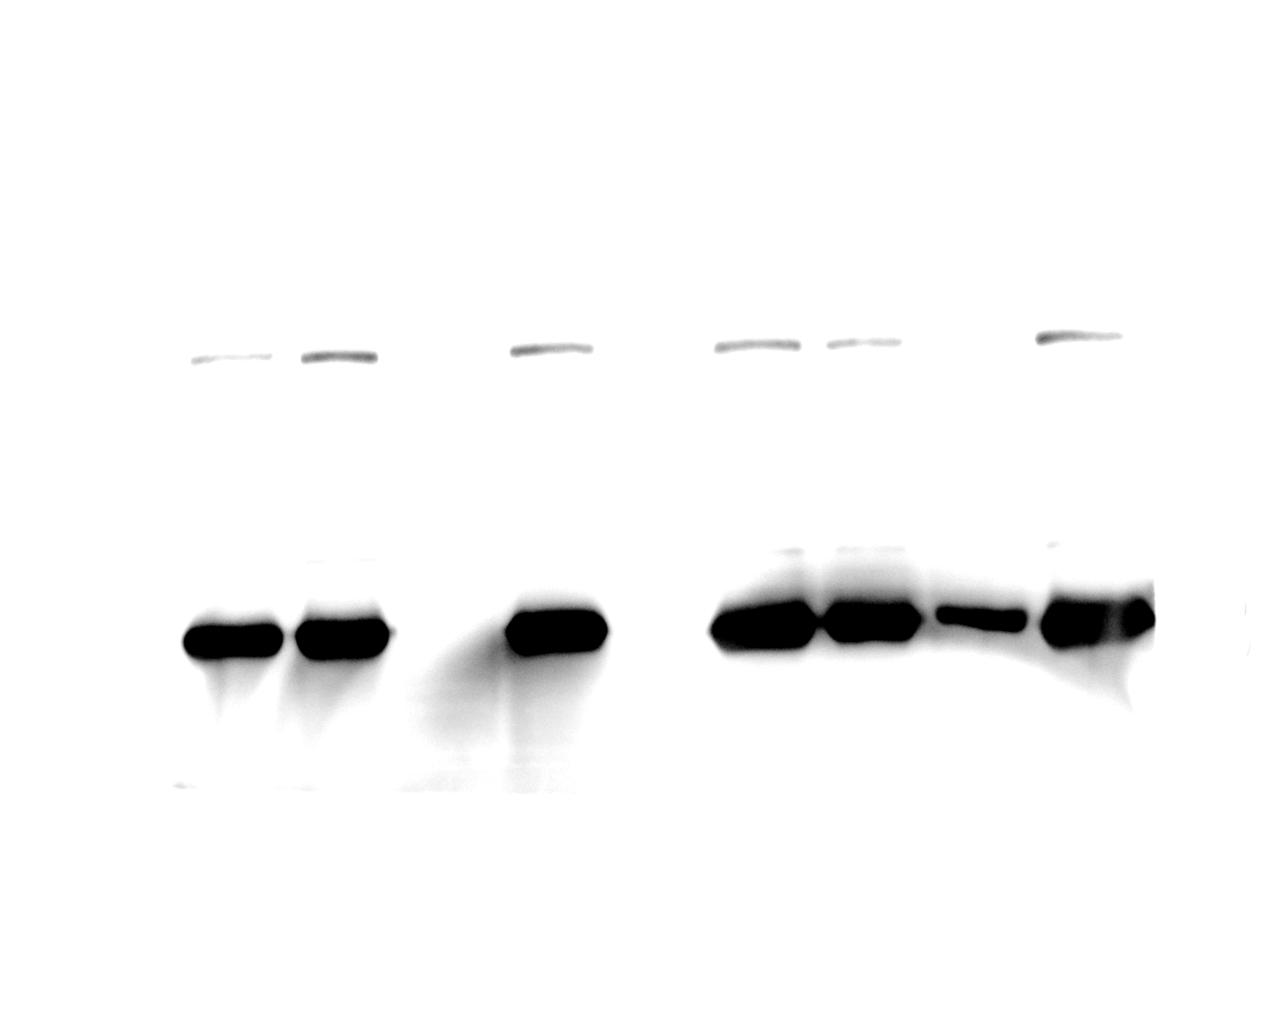
Figure 4h
TaBKI1^{S208/212A}-GFP
TaBKI1^{Y153D}-GFP
70
Anti-GFP
70
Anti-GFP
55
55
100
Anti-Myc
100
Anti-Myc
70
Anti-Actin
70
55
Anti-Actin
40
55
40
TaBKI1^{Y153F}-GFP
TaBKI1^{FAA}-GFP
Anti-GFP
70
70
55
α-ACTIN
Anti-GFP
55
100
Anti-Myc
70
Anti-Myc
100
70
55
Anti-Actin
55
40
40
Anti-Actin
Extended Data Fig. 9c
Anti-BRI1
Anti-Actin
180
100
130
70
100
55
70
40
35
Extended Data Fig. 9g
Anti-MBP
Anti-Flag
-180
-130
-100
-70
-70
-55
-55
Extended Data Fig. 9h
Anti-Flag
Anti-MBP
180
130
70
100
55
70
55

