Slide 1
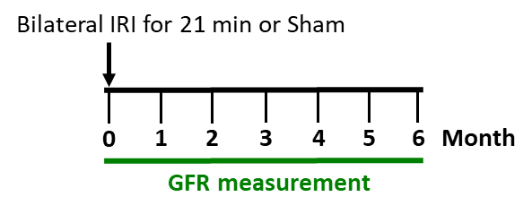
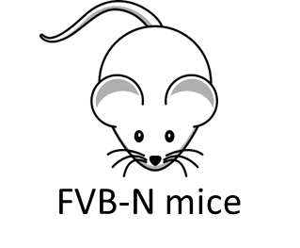
Supplemental Figure 1: AKI-to-CKD model: (A) Experimental Scheme, (B) serum BUN and (C) serum creatinine, (D) GFR.
A
Experimental Scheme
B
Serum BUN: AKI Day 0-180
C
Serum creatinine:
AKI Day 0-6 months
D
GFR: AKI 1-6months

Slide 2
Supplemental Figure 2: Injected fluorescently-labelled murine etanercept is detectable in (A) AKI kidneys (unilateral IRI) and contralateral uninjured kidneys, but not in kidneys of sham mice, (B) Etanercept fluorescence only partially overlaps with CD31 expression (endothelial cell marker), indicating partial localization of etanercept outside of vessels in the kidney interstitium.
A
B

Slide 3
Supplemental Table 1: GO term analysis for all downregulated cytokines stratified by treatment condition: TNF inhibition (ET), EGFR inhibition (ER), or combination treatment (COMB).

Slide 4
Supplemental Table 2: GO term analysis for downregulated cytokines common between all treatment conditions.

Slide 5
Supplemental Table 3: Summary of enrichment analysis of regulatory transcription factors for all cytokines downregulated by TNF inhibition, EGFR inhibition, or combination treatment.

