Slide 1
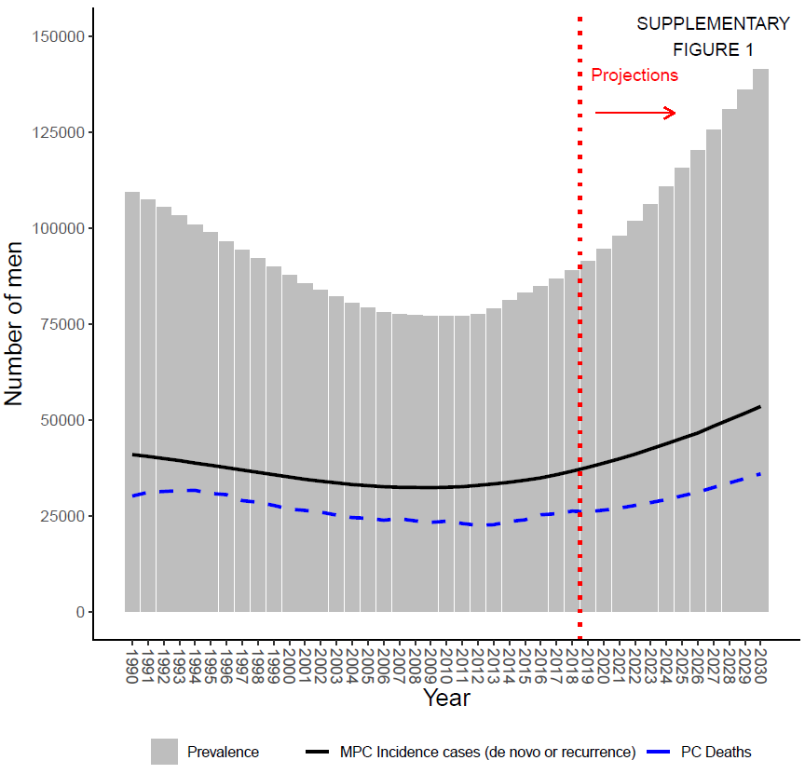
Supplementary Figure S1: Prevalence over time for all races, assuming worse recurrent survival. Solid black line represents estimated number of new metastatic prostate cancer (MPC) cases; dashed blue line represents observed number of prostate cancer (PC) deaths; dotted red line indicates projections after 2018.

