Slide 1
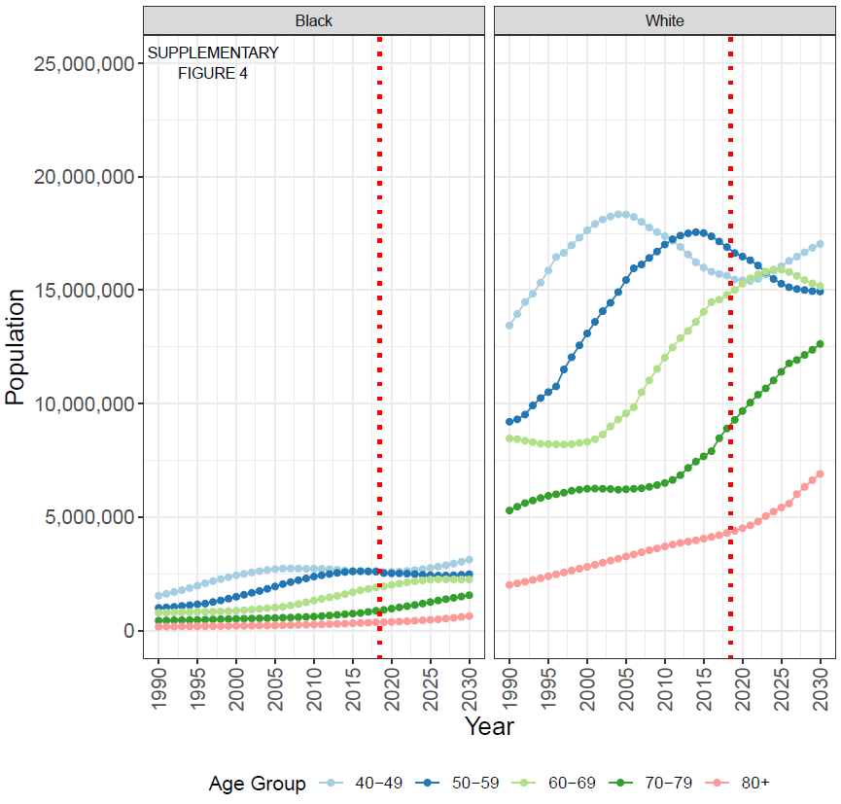
Supplementary Figure S4: Population projections by race and age group (40+) between 1990 and 2030. Projections from 2019 onward are taken from US Census population projections based on the 2010 census.

