Slide 1
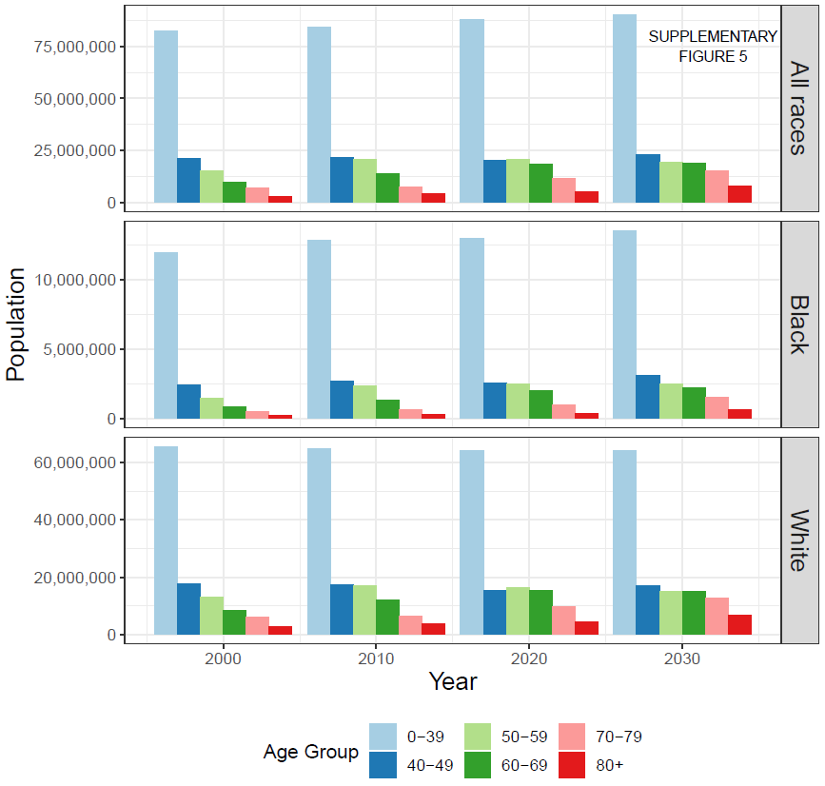
Supplementary Figure S5: Population distributions by race and age group for years 2000, 2010, 2020, and 2030. Projections for 2020 and 2030 are taken from US Census population projections based on the 2010 census.

