Slide 1
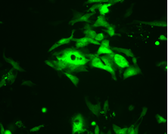
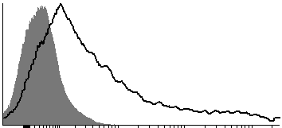
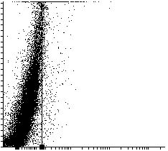
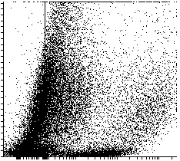
Mock
VSVΔg-SPIKEeGFP
a
b
e
Mock
VSV-SARS-CoV2 spike eGFP
Events
c
8,74%
d
61,59 %
SSC
VSVΔg-SPIKEeGFP
VSVΔg-SPIKEeGFP
Supplementary figure 1: Pseudovirus VSVg-SPIKEeGFP infection in VERO CCL81 cells. The infection of pseudovirus VSVΔg expressing the protein SPIKE and the fluorescent eGFP protein in Vero CCL81 cells were determinated by fluorescent microscopy (a,b) and flow cytometry (c-e). The percentage of positive cells (c,d) and mean fluorescence intensity (MFI) (e) were determined by flow cytometry. Representative histograms are shown. Open histograms: cells infected with the pseudovirus, solid histograms: mock. Bar: 20µm,
Supplementary Figure 1

